Slide 1
Project 2 - Language Modeling & Text Classification
Natural Language Processing
Prof. Rustamov Samir
Eljan Mahammadli 08/02/2023

Slide 2
Corpus
Corpus will mainly consist of books and journals especially scientific and general knowledge books (encyclopedia)
It will be beneficial for language modeling
Potential usage in master thesis experiments
Number of scraped and processed books: 7
I will add more books continuously
Challenge is that each book need custom cleanings

Slide 3
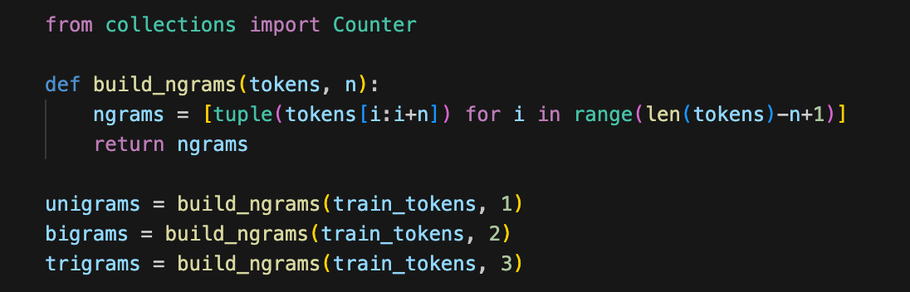
Language Modeling
Unigram, Bigram, Trigram
Evaluation is based on the perplexity score of the test set.
Baseline models use Laplace smoothing to avoid numerical instabilities
I am also using <EOS> as a end of sentence token

Slide 4
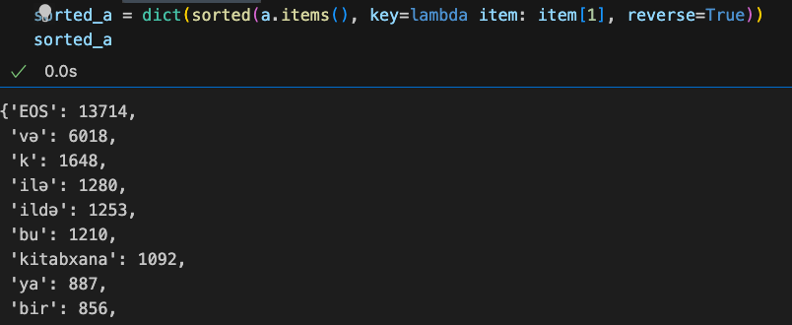
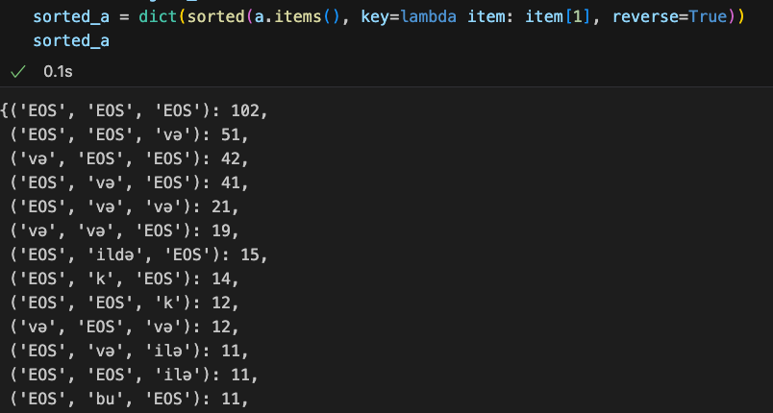
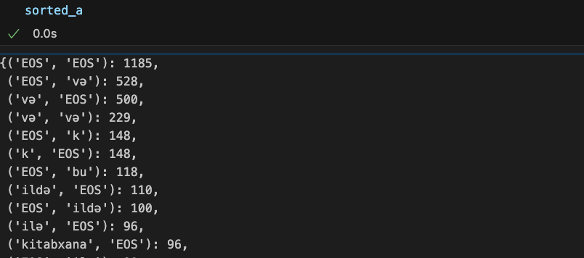
Stats

Slide 5
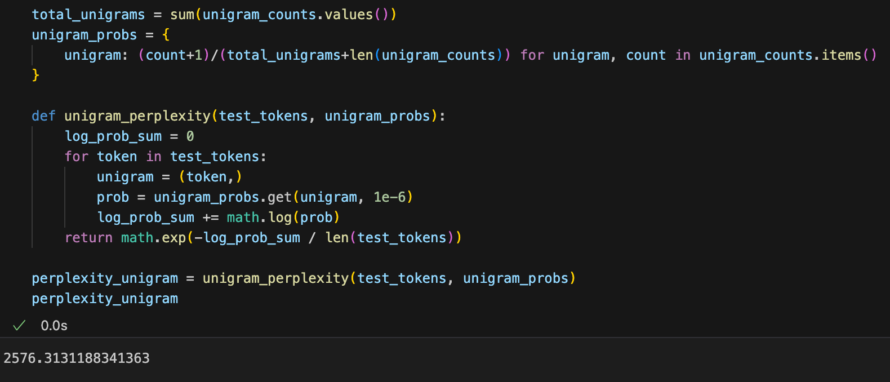
Language Modeling
Example image is for perplexity for the unigram model
Perplexities:
Unigram => 2576
Bigram => 48
Trigram => 1.5

Slide 6
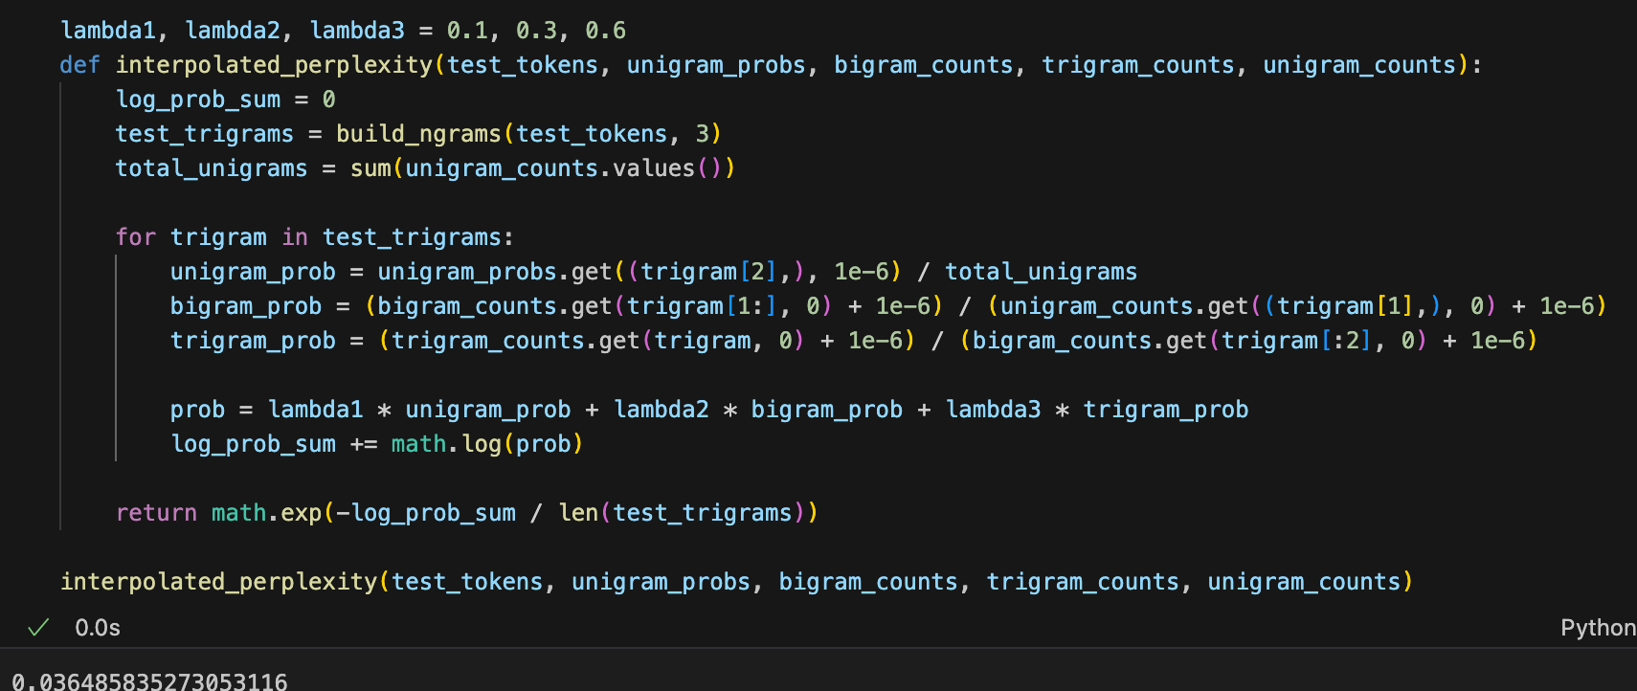
Language Modeling
Using unigram, bigram and trigram probabilities based on lambda weights
Tuned weights and the example best combination is as: 0.1, 0,3 and 0.6 respectively for unigram, bigram and trigram
Perplexity: 0.036

Slide 7
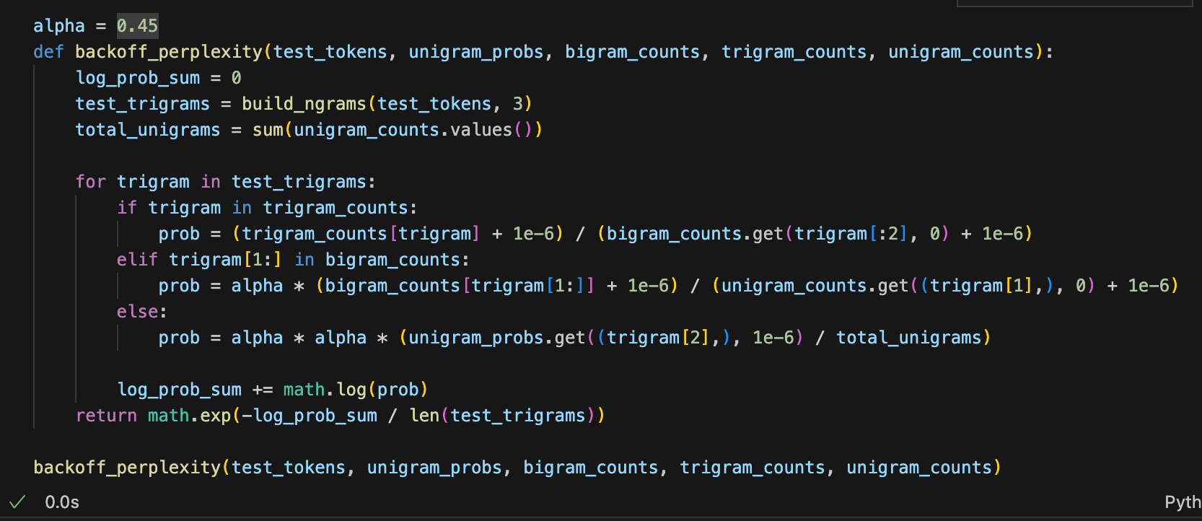
Language Modeling
It uses higher-order n-grams when available and backs off to lower-order n-grams when necessary.
Perplexity score is very high which could be either implementation mistake or it is because of the data. Will resolve…

Slide 8
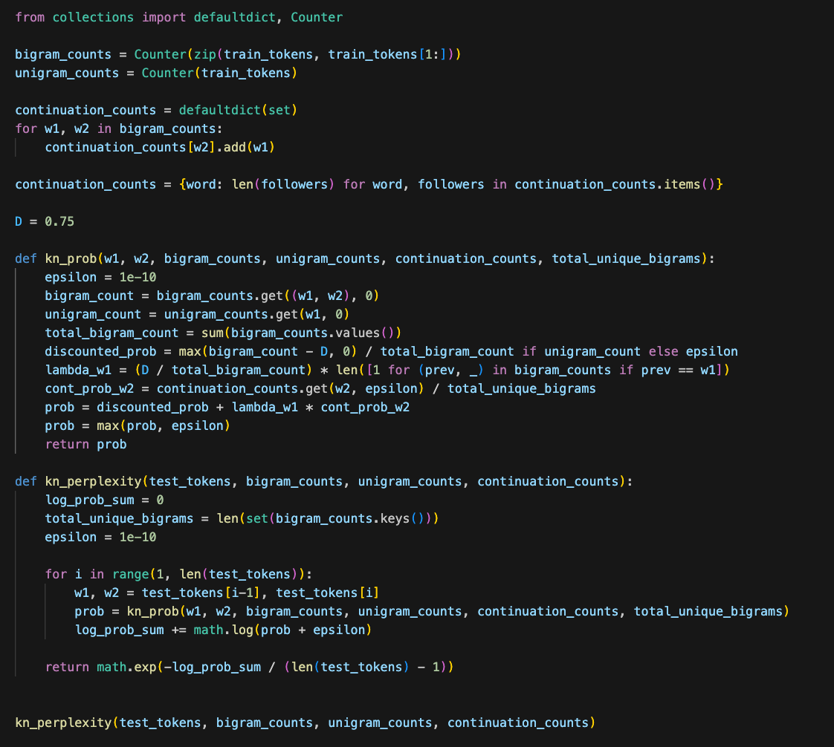
Language Modeling
This is Kneser-Ney Smoothing
It is advanced but complex but it did not work for me as well.

Slide 9
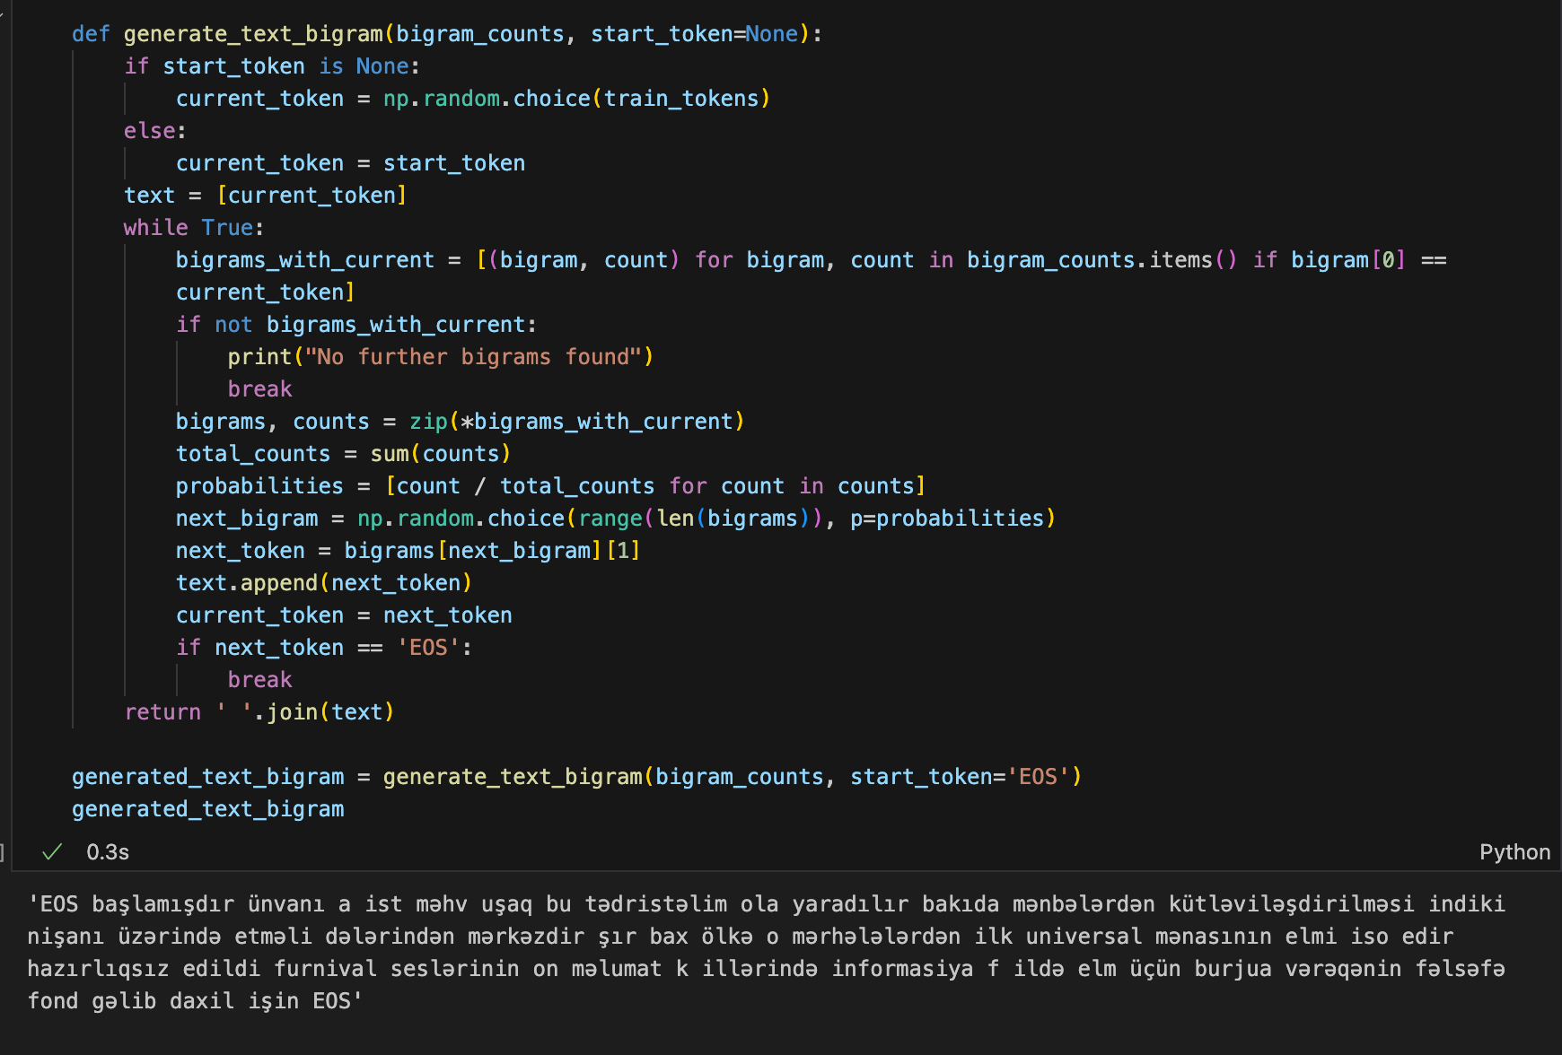
Language Modeling
Text generation example:
Starting with the <EOS> token and sampling based on the probability distribution
Generation code is available for all unigram, bigram and trigram models.

Slide 10
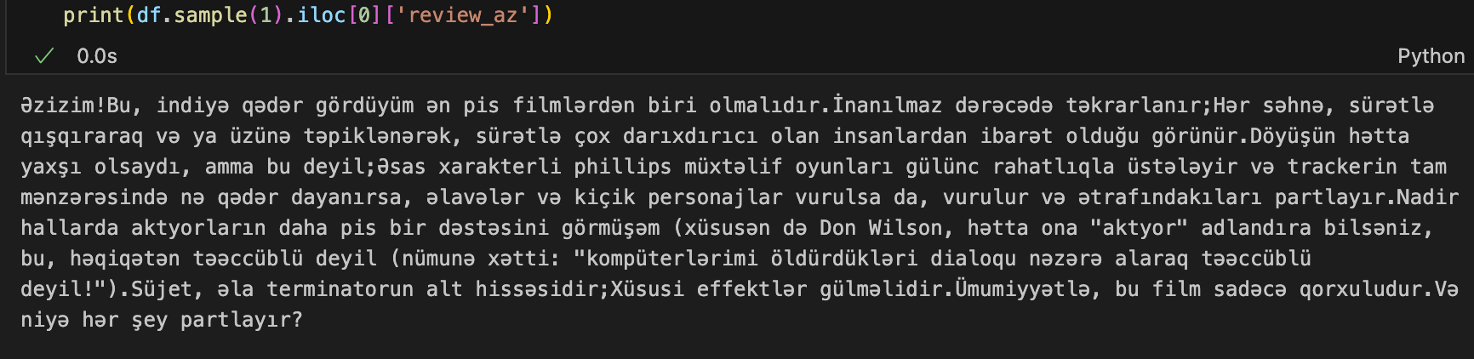
Text Classification
Translated 2K IMDB Movie Rating data to Azerbaijani using Google Translate API.
Example data:

Slide 11
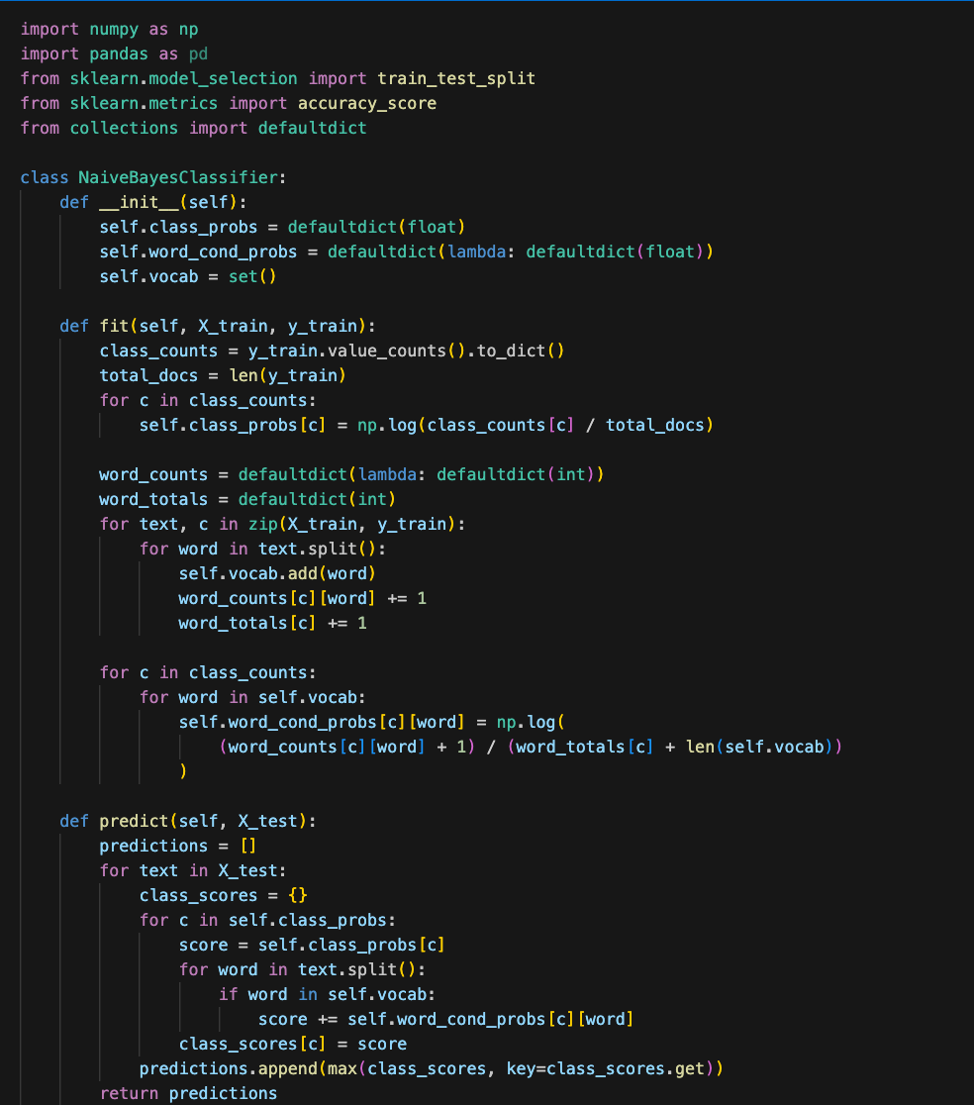
Text Classification
Trained Naive Bayes classifier both from scratch and using Scikit-learn to see if they align

Slide 12
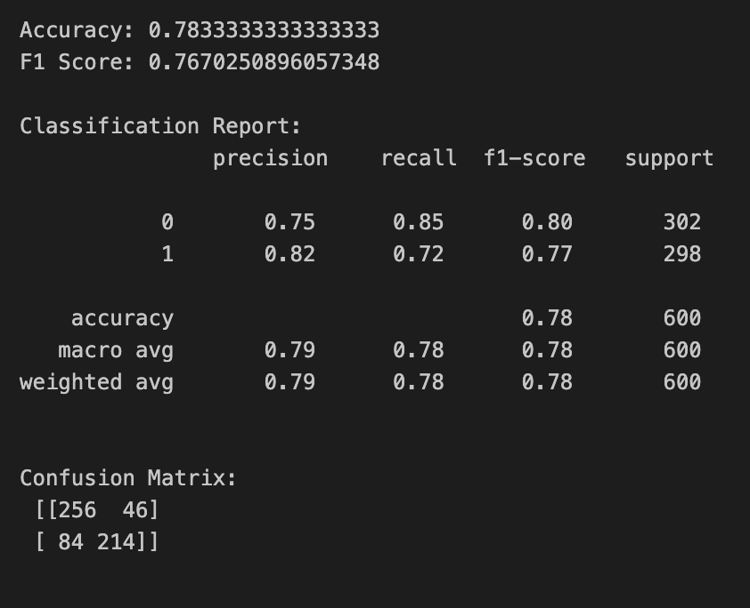
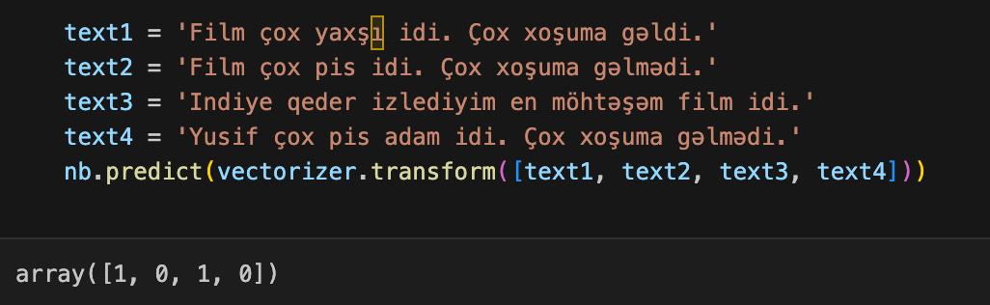
Text Classification
Metrics:
accuracy, recall, classification report, and confusion matrix
And test cases
It seems to work:

Slide 13
Thank you!

