Slide 1
Project 3
Logistic Regression
and Vector Semantics
Natural Language Processing
Prof. Rustamov Samir
Eljan Mahammadli - 28/03/2024

Slide 2
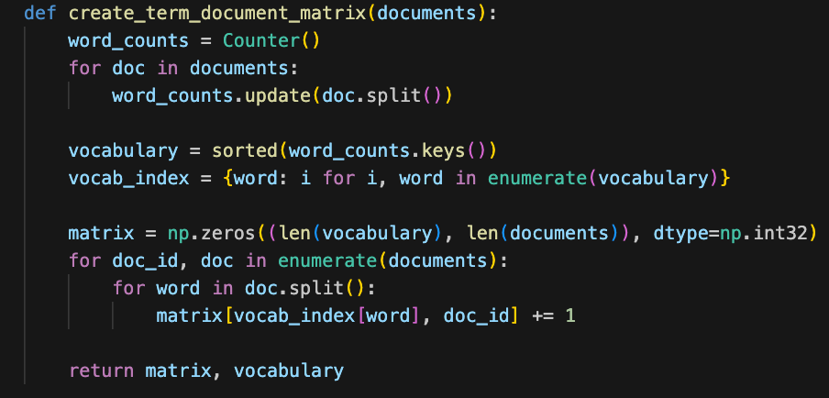
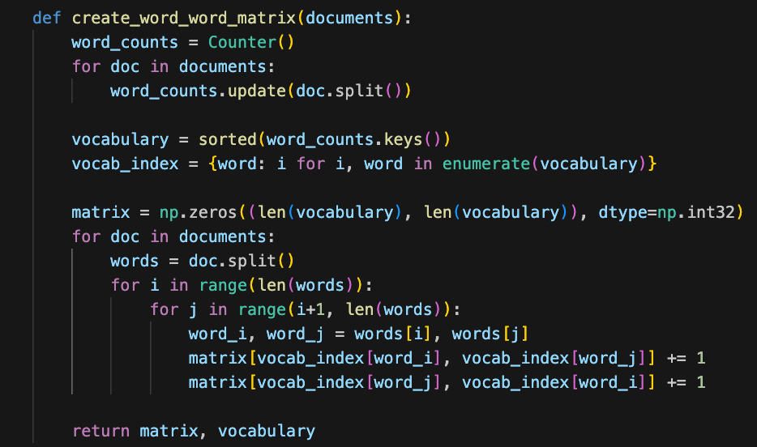
Term-document & word-word matrix

Slide 3
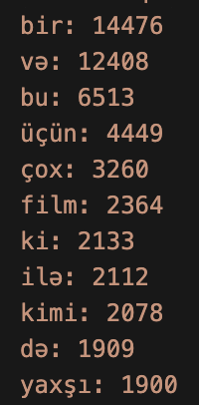
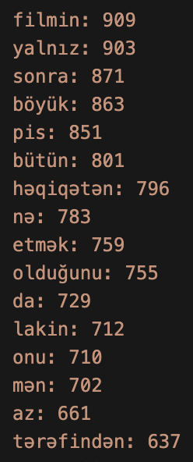
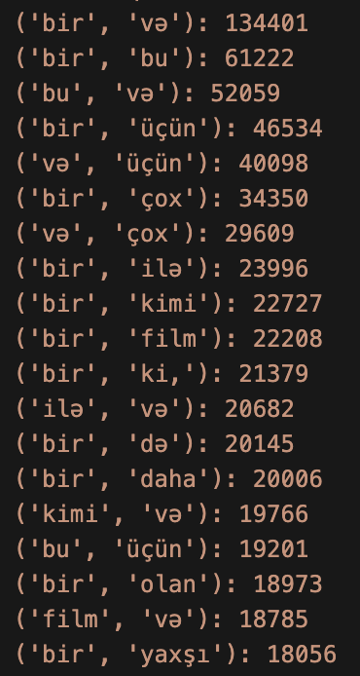
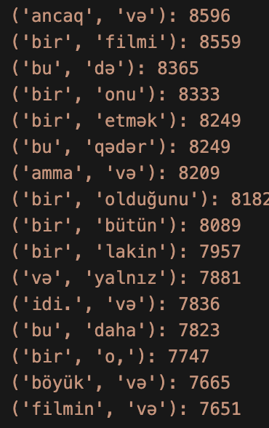
Most frequents items and pairs

Slide 4
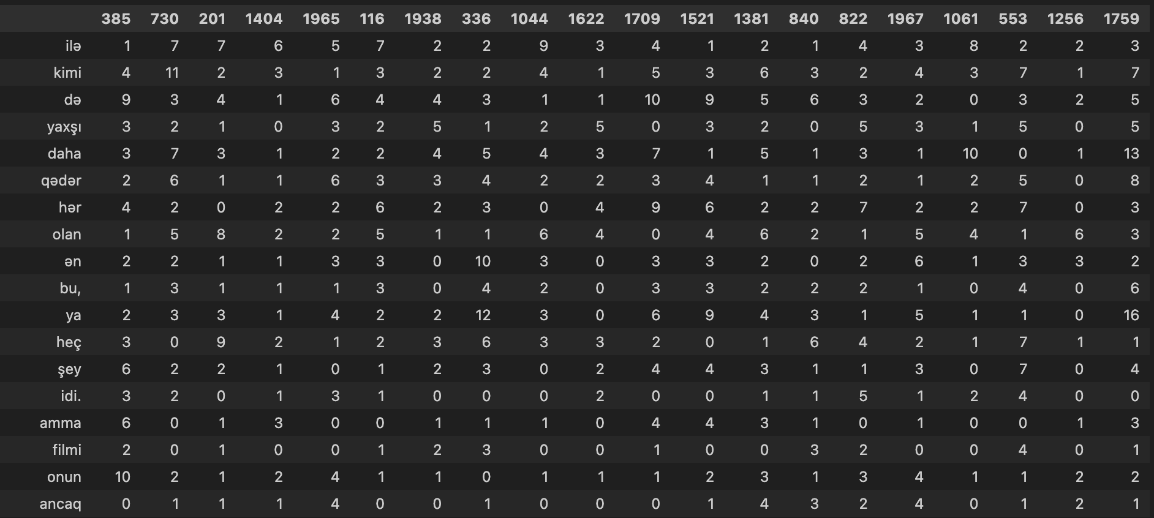
Term Document Matrix

Slide 5
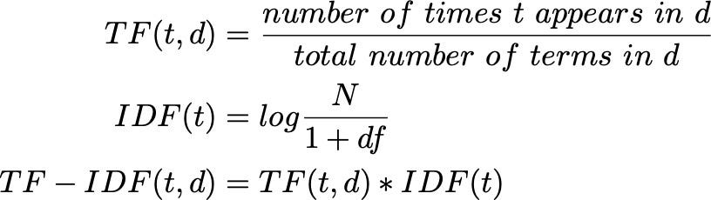
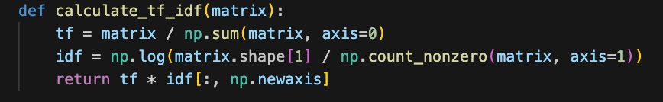
TF-IDF features
TF-IDF calculates a word's importance by multiplying its frequency in a document (TF) with the inverse log proportion of documents containing the word (IDF)
Using `term_doc_matrix`

Slide 6
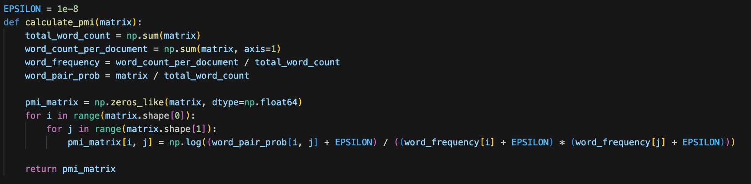
PMI features
PMI measures the association between two words by comparing their joint probability to the product of their individual probabilities, using logarithms.

Slide 7
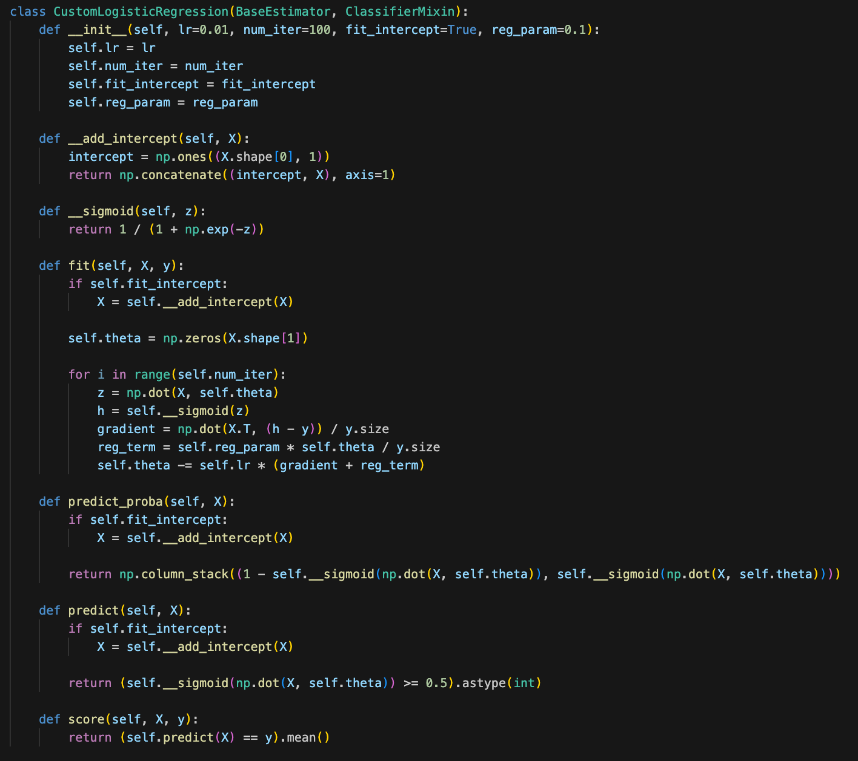
Logistic Regression
Params:
Learning Rate
Number of iterations
L2 Regularization
Intercept

Slide 8
Logistic Regression Evaluation
TF-IDF
PMI
Train Accuracy:
0.936875
Test Accuracy:
0.7525
Train F1 Score:
0.9344581440622972
Test F1 Score:
0.7480916030534351
Test Classification Report:
precision recall f1-score support
0 0.74 0.77 0.76 199
1 0.77 0.73 0.75 201
accuracy 0.75 400
macro avg 0.75 0.75 0.75 400
weighted avg 0.75 0.75 0.75 400
Test Confusion Matrix:
[[154 45]
[ 54 147]]
Train Accuracy:
0.950625
Test Accuracy:
0.7525
Train F1 Score:
0.9501577287066246
Test F1 Score:
0.7681498829039812
Test Classification Report:
precision recall f1-score support
0 0.79 0.69 0.73 199
1 0.73 0.82 0.77 201
accuracy 0.75 400
macro avg 0.76 0.75 0.75 400
weighted avg 0.76 0.75 0.75 400
Test Confusion Matrix:
[[137 62]
[ 37 164]]

Slide 9
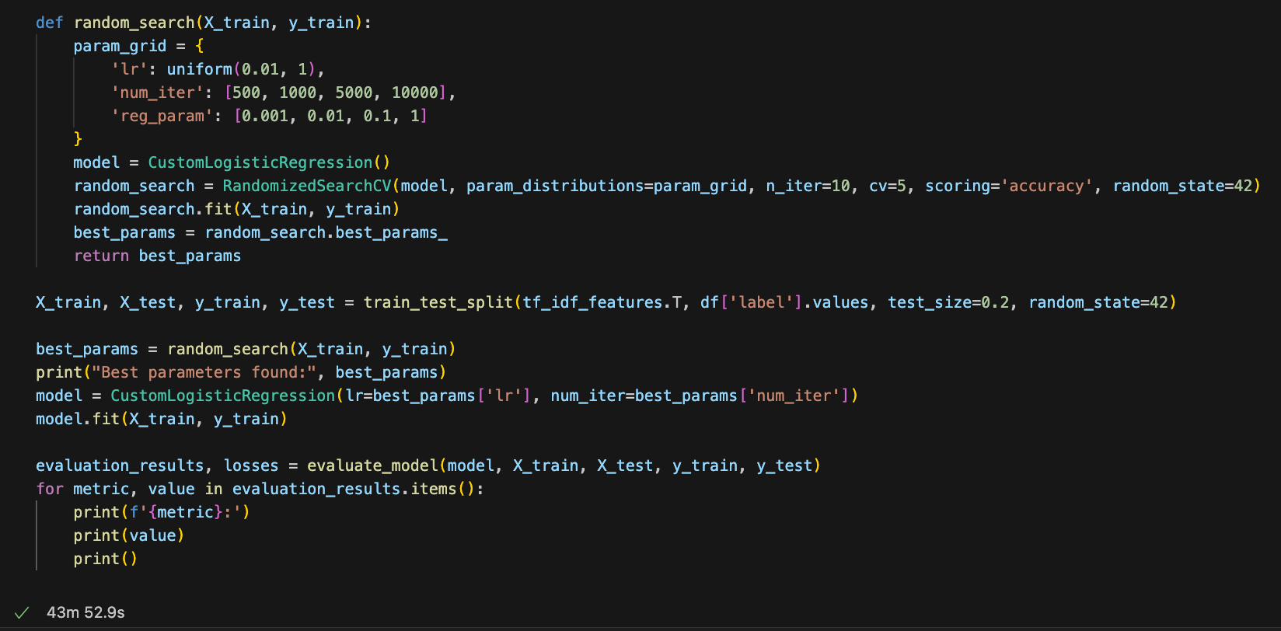
Random Search Tuning
Learning Rate
Number of iterations
Regularization
Accuracy: 0.82
F1 Score: 0.8260869565217391
Confusion Matrix:
[[157 42]
[ 30 171]]
Classification Report:
precision recall f1-score support
0 0.84 0.79 0.81 199
1 0.80 0.85 0.83 201
accuracy 0.82 400
macro avg 0.82 0.82 0.82 400
weighted avg 0.82 0.82 0.82 400

Slide 10
Comparison with Naive Bayes
Naive Bayes
Logistic Regression
Accuracy: 0.78
F1 Score: 0.7582417582417582
Classification Report:
precision recall f1-score support
0 0.73 0.87 0.80 199
1 0.85 0.69 0.76 201
accuracy 0.78 400
macro avg 0.79 0.78 0.78 400
weighted avg 0.79 0.78 0.78 400
Confusion Matrix:
[[174 25]
[ 63 138]]
Accuracy: 0.82
F1 Score: 0.8260869565217391
Classification Report:
precision recall f1-score support
0 0.84 0.79 0.81 199
1 0.80 0.85 0.83 201
accuracy 0.82 400
macro avg 0.82 0.82 0.82 400
weighted avg 0.82 0.82 0.82 400
Confusion Matrix:
[[157 42]
[ 30 171]]

Slide 11
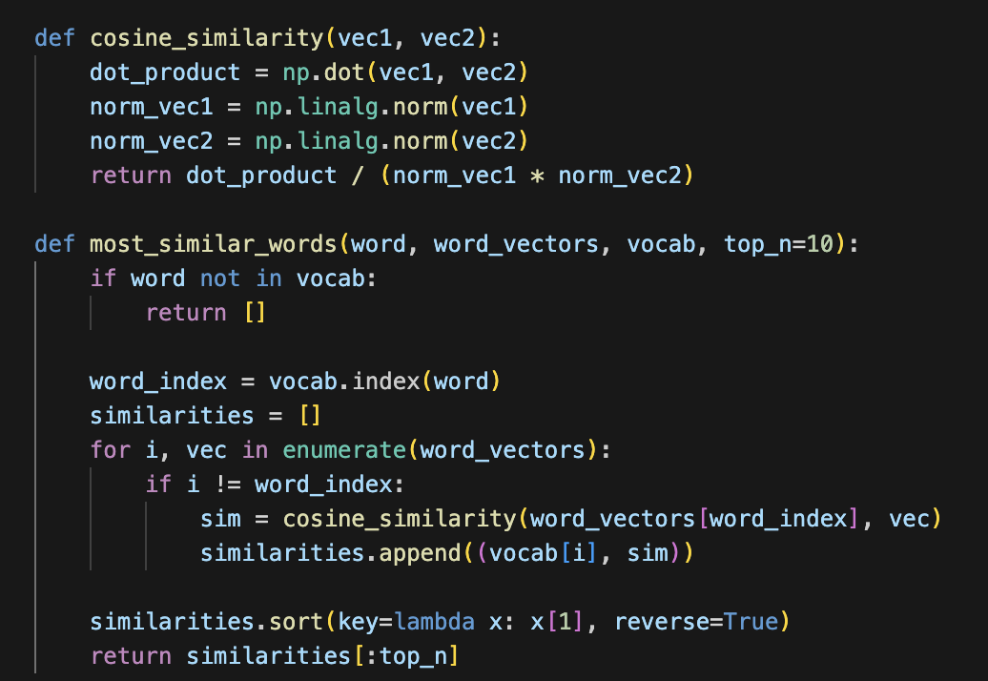
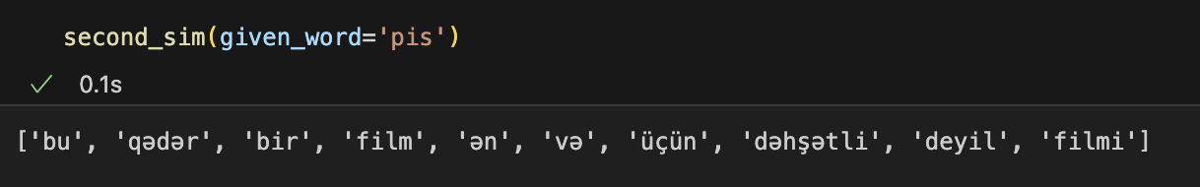
Cosine similarity
Finding most similar words for the given word by using Cosine similarity
Using TF-IDF features
10 most similar words to 'bəyəndim':
samantha: 0.7869332032190166
bravo 0.7869332032190166
olanda.: 0.7869332032190166
stansiya: 0.7845372906768673
ləqəb: 0.7603623560825417
bilməz: 0.7464255628829782
oxumağı: 0.7174692276295543
səhnəyə: 0.6280834834525226

Slide 12
Thank you!

