Slide 1
Network Flow Analysis and DDoS Detection Using CTU-13 Dataset
A Data-Driven Approach to Security Threat Identification
Akash Deepak Sancheti Pengwen Zhu

Slide 2
Introduction
Importance of network security and performance.
Growing Need for intelligent monitoring.

Slide 3
Project Overview
Dataset: CTU (Czech Technical University) network traffic data
Focus: Detection of abnormal network flows and DDoS attacks
Approach: Data-driven analysis of network traffic patterns
Goals:
Detect and classify abnormal network flows
Analyze potential user behaviors
Evaluate Quality of Service (QoS) content

Slide 4
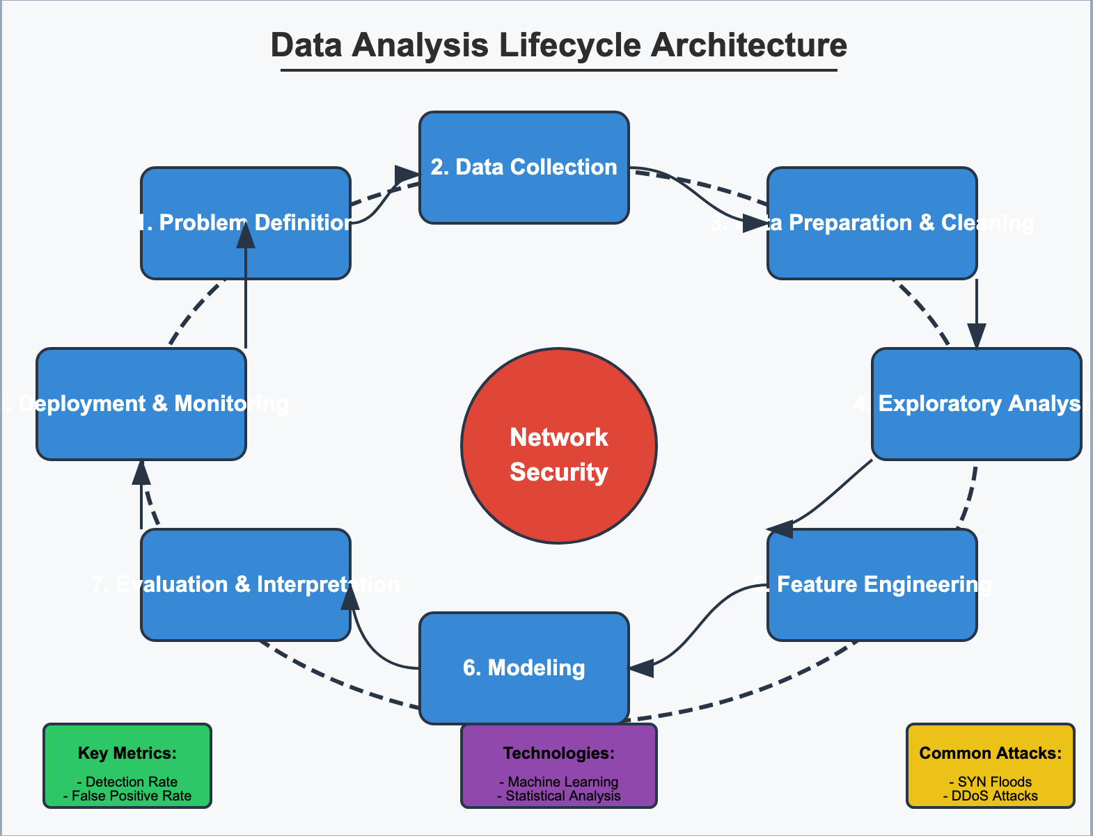
The Data Analysis Lifecycle
Problem Definition
Data Collection
Data Preparation & Cleaning
Exploratory Analysis
Feature Engineering
Modeling
Evaluation & Interpretation
Deployment & Monitoring

Slide 5
Problem Definition
Business Understanding
Network security is critical for organizational infrastructure
Need to detect threats like DDoS attacks in real-time
Understanding normal vs. abnormal traffic patterns
Clear Objectives
Identify abnormal network flows with specific attack patterns (SYN/UDP/ICMP floods)
Classify attack types based on traffic characteristics
Create a reliable detection system for security professionals

Slide 6
Data Collection
CTU Dataset
Real-world network traffic data from Czech Technical University
Contains labeled normal and attack traffic
Rich in features: packet counts, bytes, protocols, durations, etc.
Dataset Characteristics
15,000+ network flow records
Multiple protocols (TCP, UDP, ICMP, etc.)
Features like duration, packet counts, bytes transferred, ports, connection states

Slide 7
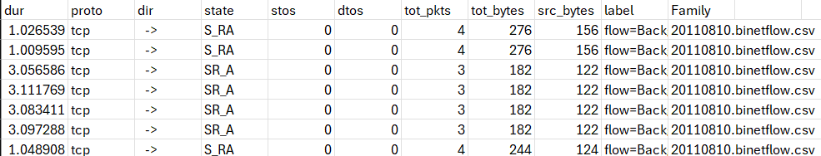
Data Preparation & Cleaning
Initial Inspection:
Handling Missing Values
Data Preprocessing

Slide 8
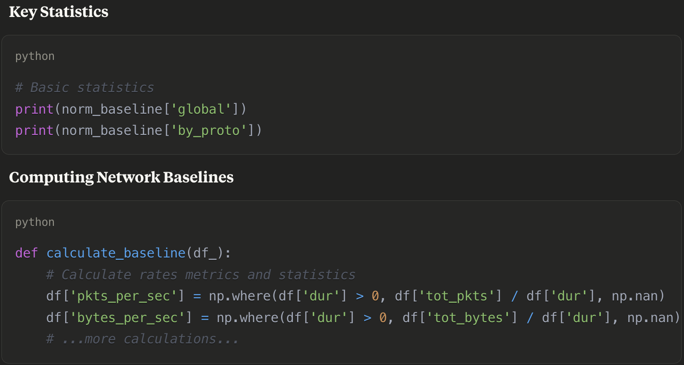
Exploratory Data Analysis
Understanding Network Traffic Patterns
Analyzed traffic by protocol
Examined flow durations, packet counts, and data sizes
Identified baselines for normal traffic

Slide 9
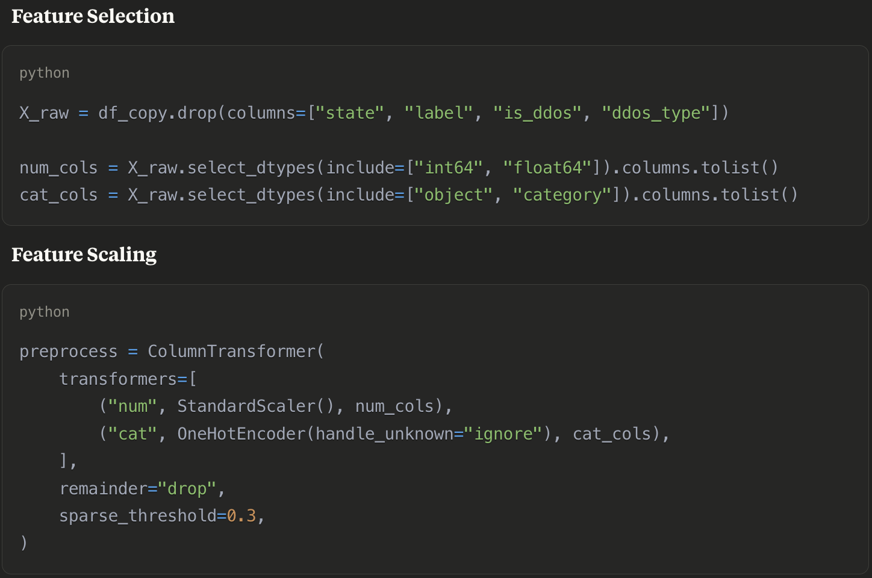
Feature Engineering
Created derived features:
Packets per second
Bytes per second
Source/destination ratios

Slide 10
Modeling: Approach
Unsupervised Learning
K-means Clustering: Grouping similar network flows
DBSCAN: Identifying outliers and anomalies
DDoS Attack Signatures
TCP-based: SYN Flood, ACK Flood, RST Attack
UDP-based: UDP Flood
ICMP-based: ICMP Flood, Ping of Death, Smurf Attack
HTTP-based: Slowloris, RUDY Attack

Slide 11
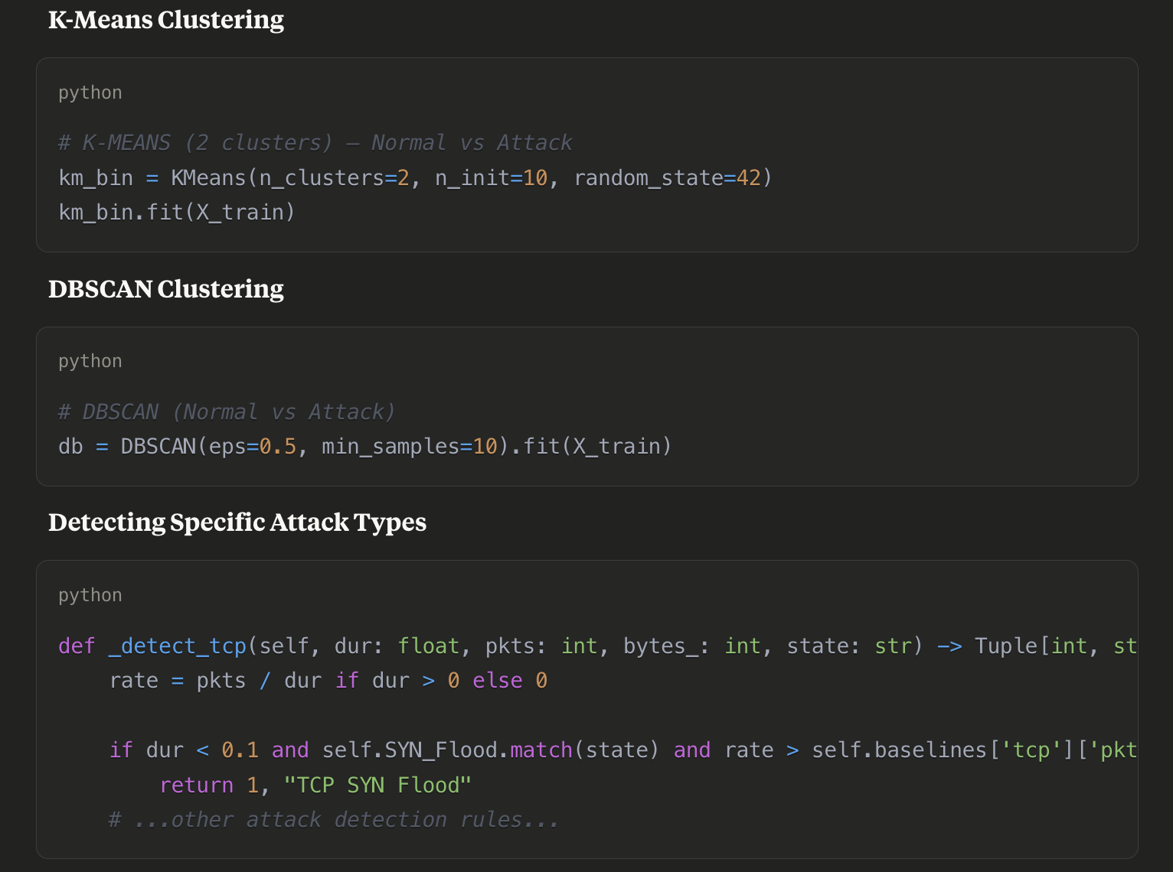
Modeling: Implementation

Slide 12
Evaluation & Interpretation
Clustering Quality
Silhouette score: 0.9925
Adjusted Rand Index: 0.0786
Attack Detection Results
Successfully identified multiple attack types:
TCP SYN/ACK/RST Flood
UDP Flood
ICMP Flood
Media flow Flood
Visualizing Results
PCA for visualizing cluster separation
SHAP values for understanding feature importance

Slide 13

Visualization: Cluster Separation
Visualization of clustering results showing:
Clear separation between normal and attack traffic
PCA reduction shows distinct clusters in 2D space
Some overlap in boundary areas

Slide 14
Feature Importance with SHAP
SHAP Values Visualization showing:
Duration (dur) is highly indicative of attacks
Packet counts and connection states are strong signals
Protocol type has moderate importance

Slide 15
Attack Detection Patterns
SYN Flood Detection
Very short duration (< 0.1 sec)
State matches pattern: ^(S|S_[ASR]|S_RA|S_SA)$
High packet rate compared to baseline
UDP Flood Detection
Massive UDP small packets
Duration < 0.1 sec
Low ratio of source bytes to total bytes (< 0.1)

Slide 16
Key Findings
Abnormal Network Flows
Successfully identified multiple DDoS attack types
Created precise detection rules for each attack pattern
Achieved high detection accuracy with low false positives
User Behavior Analysis
Identified distinct patterns in normal traffic
Clustered usage patterns by protocol and time characteristics
Established baselines for normal protocol usage
QoS Evaluation
Detected performance degradation during attacks
Identified key metrics for monitoring network health
Created statistical baselines for performance monitoring

Slide 17
Conclusions & Recommendations
Conclusions
Unsupervised learning effectively detects network anomalies
Statistical baselines provide reliable detection thresholds
Different attacks show distinct traffic patterns
Recommendations
Implement real-time monitoring based on established baselines
Deploy clustering models for anomaly detection
Set up alerts for deviations from normal traffic patterns
Regularly update baselines as network patterns evolve

Slide 18
Future Work
Incorporate time-series analysis for temporal patterns
Develop more sophisticated sequence analysis for attack progression
Extend to encrypted traffic analysis
Integrate with log and endpoint data for comprehensive monitoring
Explore deep learning approaches for more complex attack patterns

Slide 19
“Thank you.”

