Slide 1

HEALTH COMMUNICATION SYSTEM
SYSTEM USER GUIDE

Slide 2
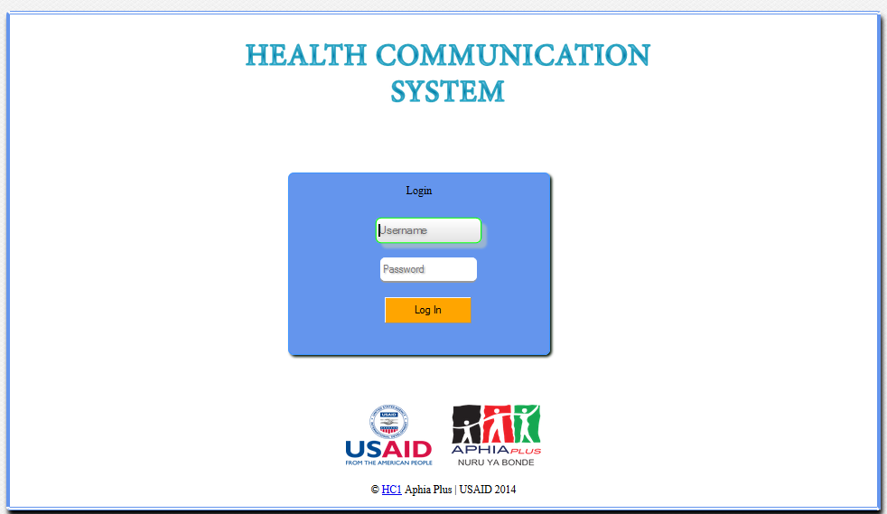
HC1 HOME PAGE

Slide 3
SYSTEM USERS
HC1 system Has three Types of users:
Clerks/System User.
Administrators.
Guests.

Slide 4
SYSTEM USERS
A clerk has the following capabilities in the System.
1)Perform Data Entry
2)Perform data backup
3)Edit personal details
4)Edit data receiver details(M&E Officer)
5)Edit groups, participants and attendance
6)View Reports

Slide 5
SYSTEM USERS- ADMINISTRATORS
An Administrator has the following capabilities in the System.
1)Perform Data Entry
2)Perform data backup
3) Merge Data into the system
4)Edit personal details
5)Edit data receiver details(senior Data Manager)
6)Edit groups, participants and attendance including ability to delete a participant.
7)View Reports
8) Add users to the system

Slide 6
SYSTEM USERS - GUESTS
An guest has the following capabilities in the System.
1)View Reports

Slide 7
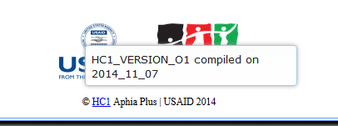
SYSTEM VERSION
To know the system version, over your mouse on the word HC1 at the home page of the system and get to know whether the system is updated.

Slide 8
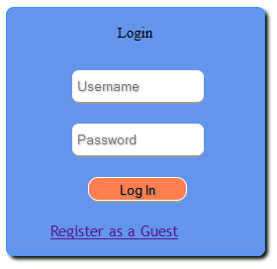
LOGIN PAGE
This is the first page of the system. Provide your username and password to access the System.
Click Here to log in.

Slide 9
HC1-SYSTEM GUIDE
The System users will be directed to the page with the menu shown in the next page. Data clerk will be required to do activities in this order:
i. Add Groups
ii. Add facilitators
iii. Add participants
iv. Mark Attendance.
This is simplified by the HC Form Entry navigation Module.

Slide 10
SYSTEM USER menu.
Click Here to add groups, facilitators, participants and mark the attendance
Click here to view reports available in the system
Click here to edit personal details as registered in the system
Click Here to edit groups, facilitators and participants .
Click here to do data backup, merging and editing data receiver email address
Click here to edit attendance for each group.

Slide 11
HC FORM ENTRY
Has got 7 steps.
Enables a user to Add/select a group
Add facilitators
Add Participants
Mark attendance
Preview the marked details.

Slide 12
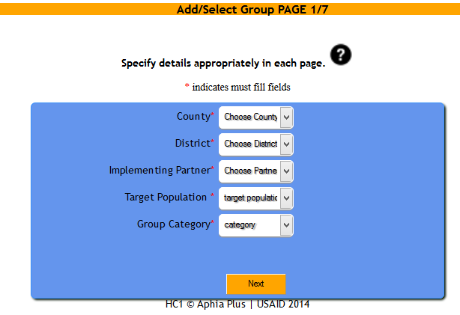
PAGE 1/7

Slide 13
PAGE 1/7 (Group Category)
one can choose a group category as either new or existing.
New Group - Means that the group name has not been entered into the system and thus one is adding it the first time.
Existing group – The group name is already added into the system. One should select the group name from the select box that is displayed.

Slide 14
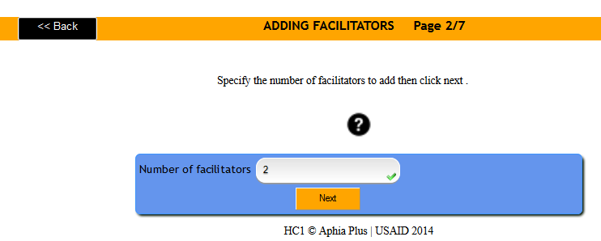
PAGE 2/7 (No. Of Facilitators)
Specify the number of facilitators To add in the input field shown below.

Slide 15
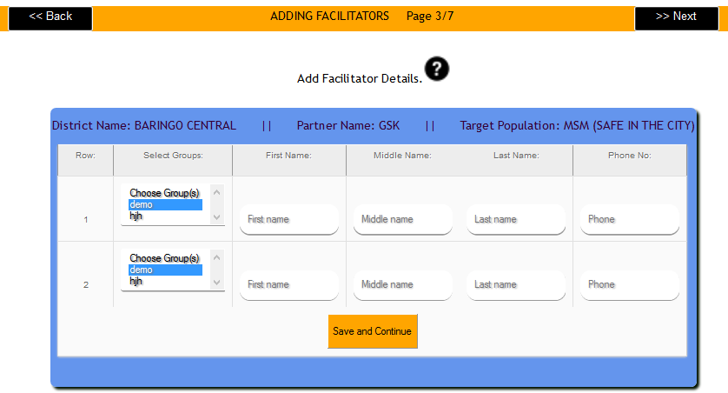
PAGE 3/7 (Facilitator details)
Add the Group Name (pre-selected), Firstname , Middlename (Optional), Last name and phone number (optional) of each participants.

Slide 16
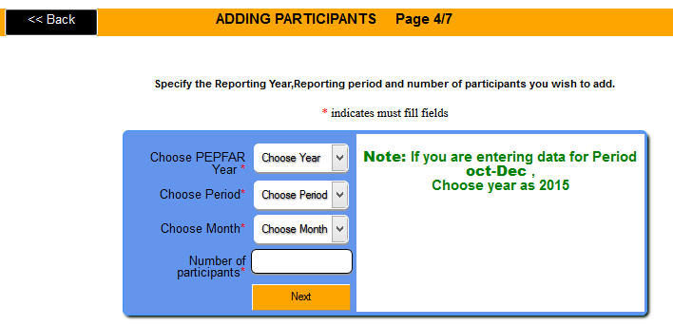
PAGE 4/7 (Adding Participants)
Choose the PEPFAR Year which the Data you are belongs to, the period, Month and the Number of months

Slide 17
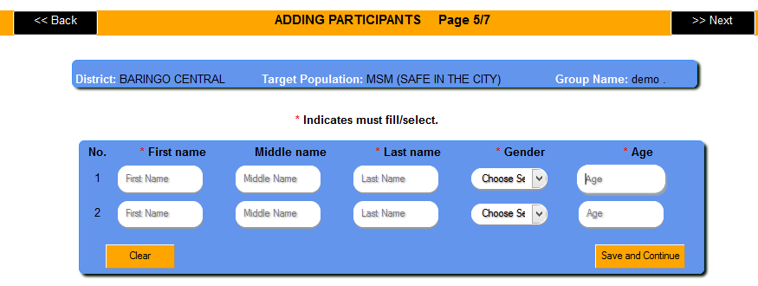
PAGE 5/7 (Adding Participants)
Enter all the fields whose table header is marked with a red asterik (*)

Slide 18
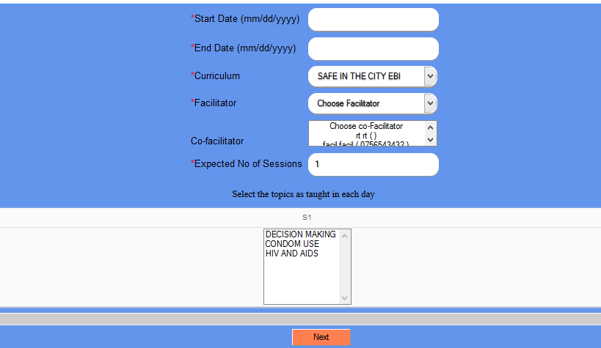
PAGE 6/7 (Registering Topics)
Enter all the fields whose table header is marked with a red asterik (*)

Slide 19
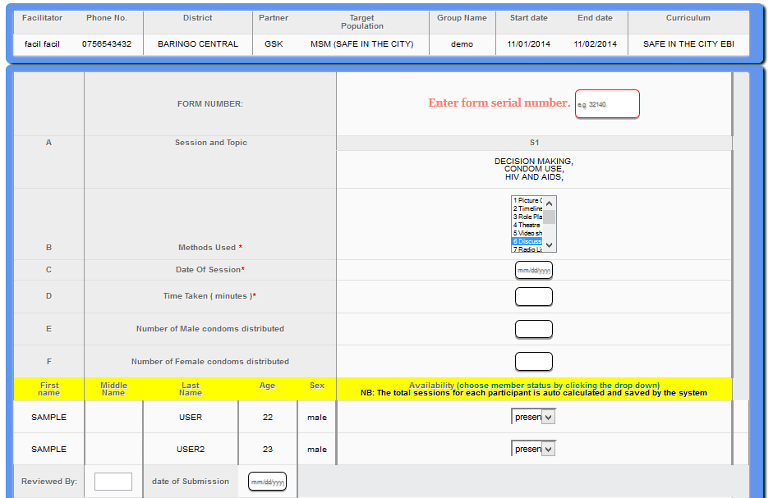
PAGE 7/7 (Marking Attendance)
Enter all the fields whose table header is marked with a red asterik (*)
Note: adding more than one forms serial number has now been disabled for accuracy in data analysis reasons and validations

Slide 20
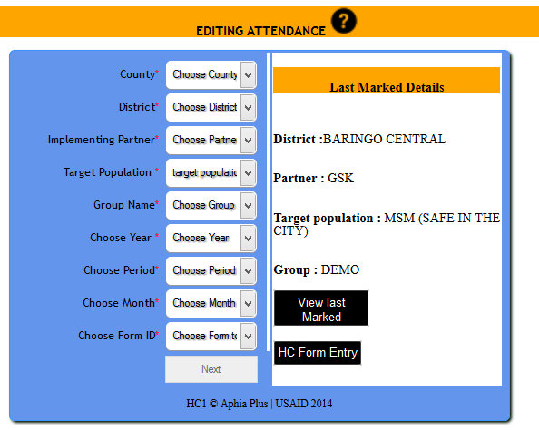
Editing Attendance

Slide 21
Editing Attendance
After Marking Attendance of one form , a page showing the last marked details will be shown.
This helps one to make decision on whether to preview last marked page or to begin marking a new form.

Slide 22
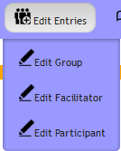
EDIT ENTRIES.
When a mouse is moved over the group entries button the following sub menu appears.
Click here to edit group’s details.
Click Here to edit facilitators details.
Click Here to edit participant’s details.

Slide 23
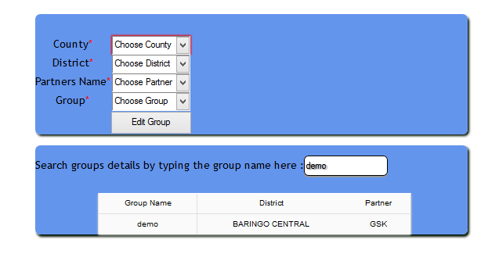
EDIT GROUPS.
Select the details as entered during registration for the group which you want to edit its details.
If one doesn’t know the district or partner in which a group belongs, they can search those details by typing its name in the search field .

Slide 24
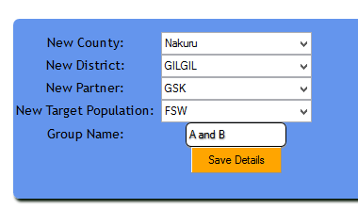
EDIT GROUPS.
Edit groups.
On this page, Enter the right new data (County, District, Partner, Target Population and Group Name) then click on save button.
Enter all the right group name and then save the details.

Slide 25
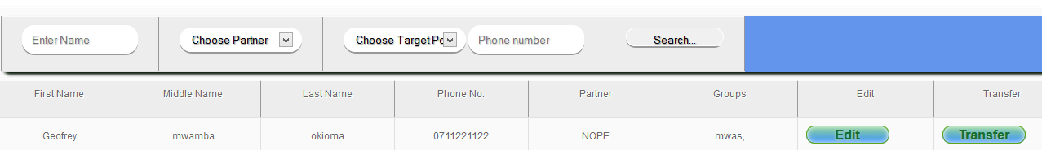
Edit facilitators.
Within this the user can be able to search the facilitator. Enter the details shown and then click Here
Click Here to transfer a facilitator from one groups to to others.
Click Here to edit facilitators details.

Slide 26
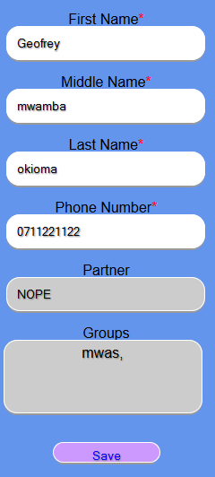
EDIT FACILITATOR DETAILS.
Here the user can be able to edit the facilitators basic details entered during registration.
Edit any of these details as preferred.
These details can not be edited. If you need to change them then select transfer in the previous page
Click here to save the details

Slide 27
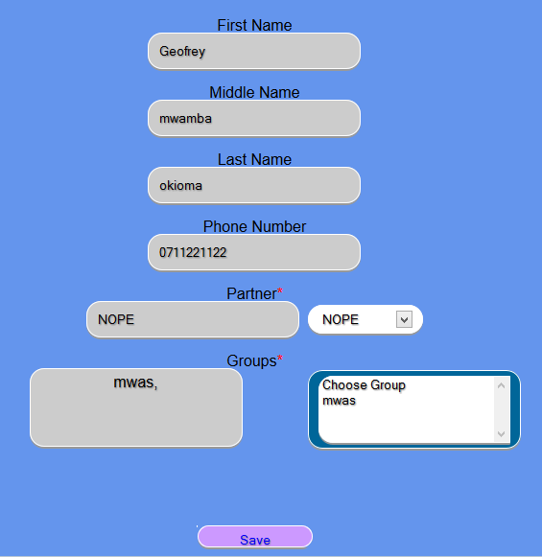
TRANSFER FACILITATOR.
Within this page the system user can be able to associate the facilitator with one or more the groups.
Associate facilitator to more groups here
Previously selected groups.

Slide 28
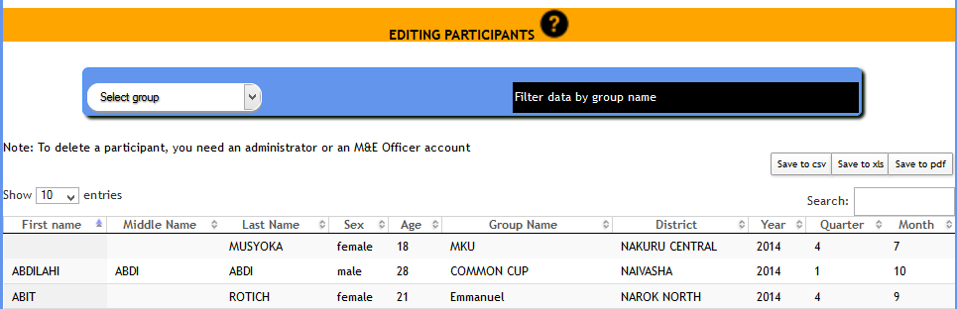
Edit Participants.
A dynamic search field
Double click on any field to edit the details
Use the group select box above to load data for a specific group.
NB: opening this page will by default open the last entered 1000 particiapnts.

Slide 29
Edit Participants (exporting Participants)
Export the selected data into any of the formats shown.

Slide 30
Edit Attendance.
This page will be divided into two sections for explanation purposes.
The upper part is for editing the sessions details and the lower part is for editing individual attendance.

Slide 31
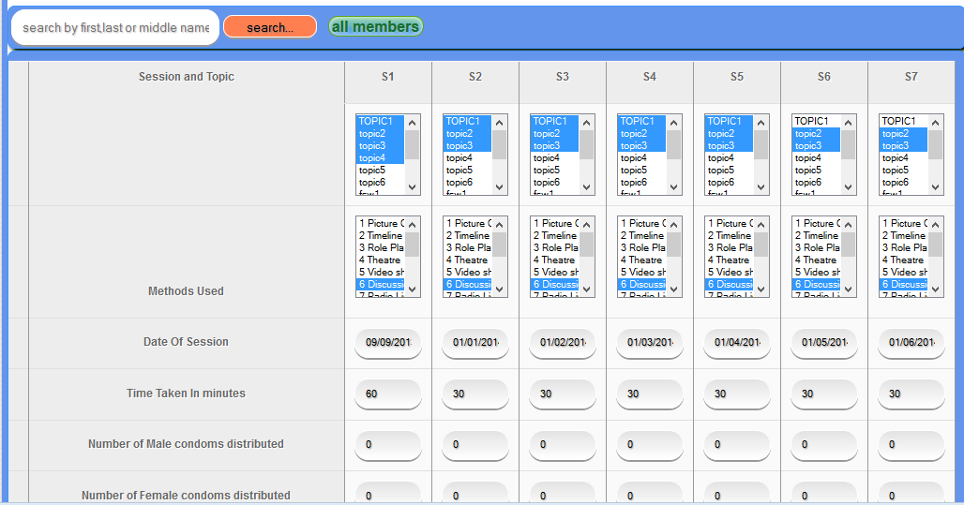
Edit sessions details.
Within this the user can be able to search for a participant using the first, middle or last name.
Edit all the session details as preferred.

Slide 32
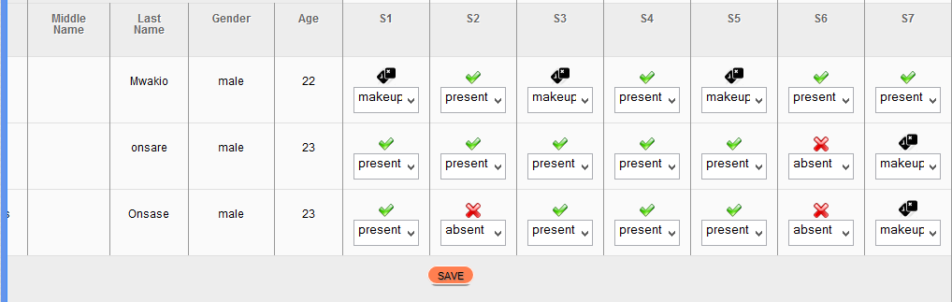
Edit sessions details.
This page enables the user to edit participant’s attendance as needed. What appears on each select box is the current attendance status.
Click Here to choose the right selection if the participant was not present. Present is the current selection .
After choose all the right details, click here to save the details.

Slide 33
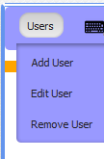
ADDING USERS
Within this the administrator can be able to add clerks and also edit their details.
Click here to add a new user
Click here to edit existing user details.

Slide 34
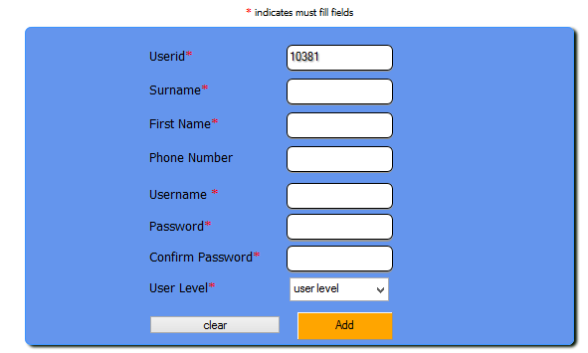
ADDING USERS
This is the clerk registration page. Enter all the required details appropriately. Click Add to save.
The passwords must match

Slide 35
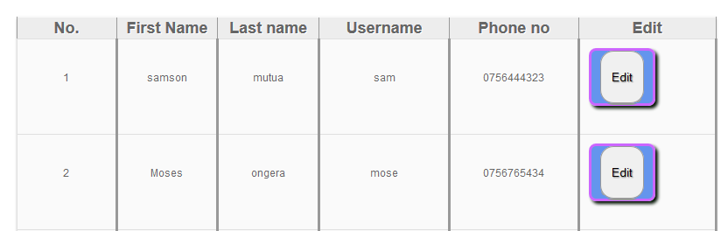
EDIT USERS.
This page lists all the details for all the clerks. Click on the edit button to edit the clerk’s details.
Click here to edit the user details.

Slide 36
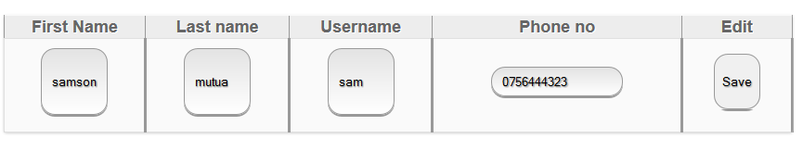
EDIT CLERKS.
Within tis page the user is required to enter all the correct details and then press the save button.
After entering all the right details, press here

Slide 37
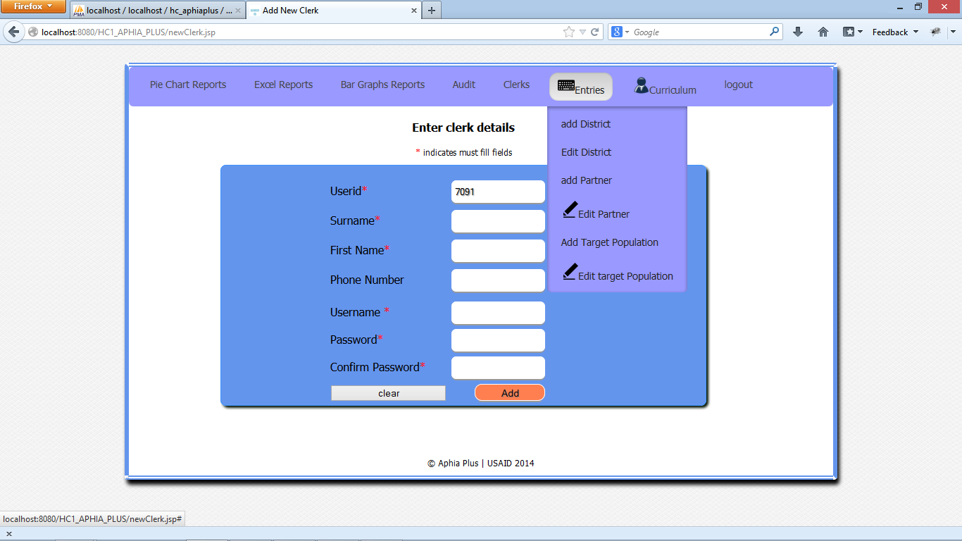
ENTRIES.
Within tis page the user is required to enter all the correct details and then press the save button.
Add new districts
Edit the existing district details
Add new partners
Edit the existing partner details
Add new target population
Edit the existing target population

Slide 38
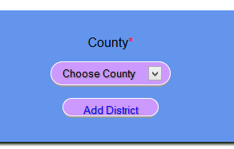
Add Districts.
Choose a county where you want to add district(s) to and then click on Add District button.

Slide 39
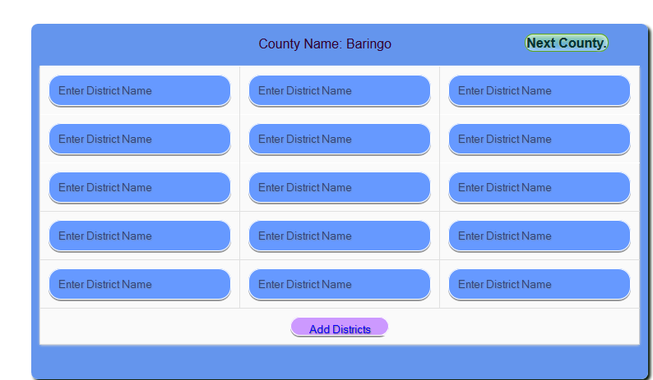
Add Districts.
Within this page the user can register at least 1 district and at most 15 districts per page.
Click here to save the details

Slide 40
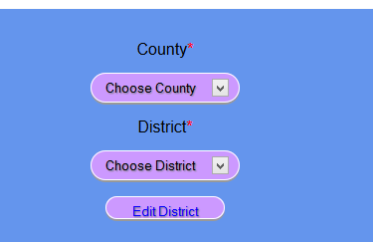
Edit Districts.
Choose the district that you want to edit its details. Click on the edit district button.

Slide 41
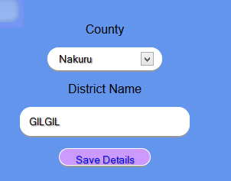
Edit Districts.
Enter the right district name and then save the details. If this district belongs to a different county than the one shown then choose the right county and then save details.
Choose the right county.
Enter the right district name.

Slide 42
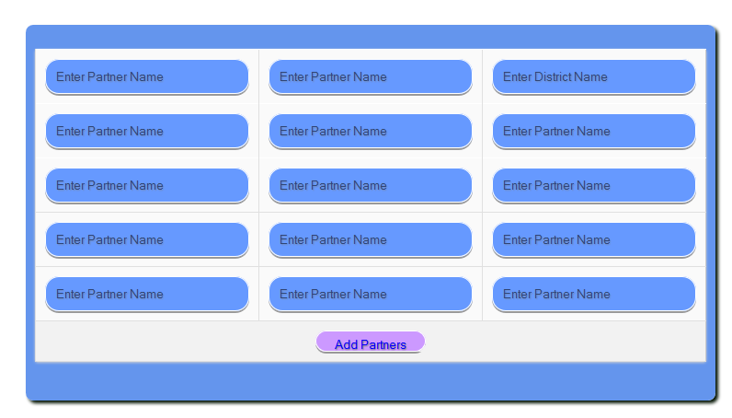
Add Partner.
Within this page the user is able to add at least 1 and at most 15 partners.

Slide 43
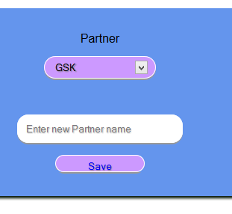
edit Partner.
The clerk is also able to edit the partner name as shown below.
Select the partner to edit its details
Enter the new partner name.
Click here to save the details.

Slide 44
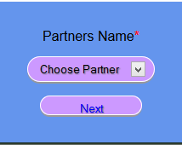
ADD TARGET POPULATIONS.
Choose a partner under whom you want to add the target populations. The target populations to be added will belong to this partner. After selecting the target population click on the Next button.

Slide 45
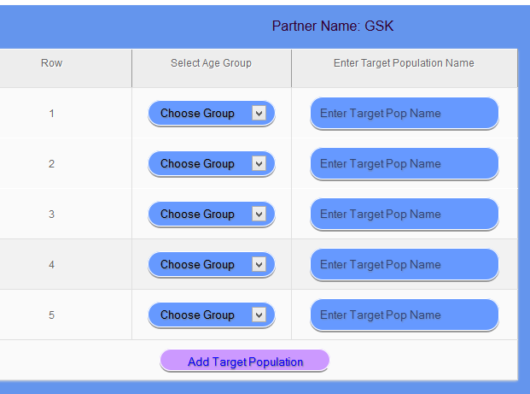
ADD TARGET POPULATIONS.
Within this page the user can register at least 1 and at most 5 target populations.
The partner you selected from the previous page.
Choose the age group here.
Enter target population name
Click here to add all the entered details

Slide 46
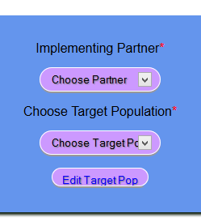
edit TARGET POPULATIONS.
Choose the partner and the target population that you want to edit its details. Click the Edit Target Population button to move to the edit page.

Slide 47
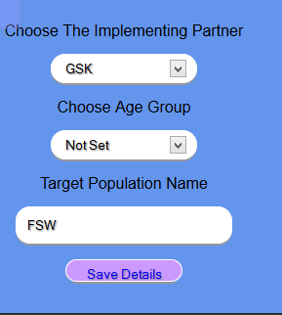
edit TARGET POPULATIONS.
Edit all the details as needed and then save them.
NOTE : If the age group is not set, then your details wont be saved.
Choose the correct partner here.
Choose the age group here.
Enter the correct target population name here.

Slide 48
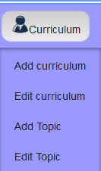
CURRICULUM.
Within this the administrator can be able to add and edit curriculum. She/he can also be able to add or edit topics within a given curriculum.
Click here to Add Curriculum to the system
Click here to edit the curriculum
Click here to add topics to a given curriculum.
Click here to edit the topic details per curriculum.

Slide 49
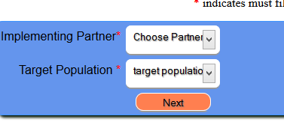
ADD CURRICULUM.
Choose the right target population to which you want to add curriculum.

Slide 50
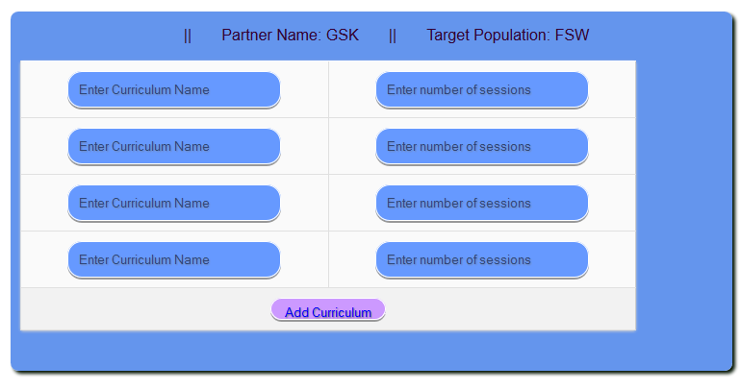
ADD CURRICULUM.
Within this page, a user can register a maximum of 4 and a minimum of 1 curriculum. Each curriculum has the associated number of sessions which also must be entered.

Slide 51
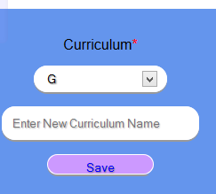
Edit CURRICULUM.
This is the curriculum edit page. Within this the user can be able to change the curriculum name.
Choose the curriculum you need to edit here.
Enter the new curriculum name.

Slide 52
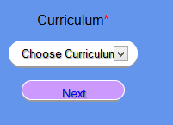
Add Topics.
Here the user needs to choose the curriculum where she/he needs to add topics. After choosing the curriculum the user can click on the next button.

Slide 53
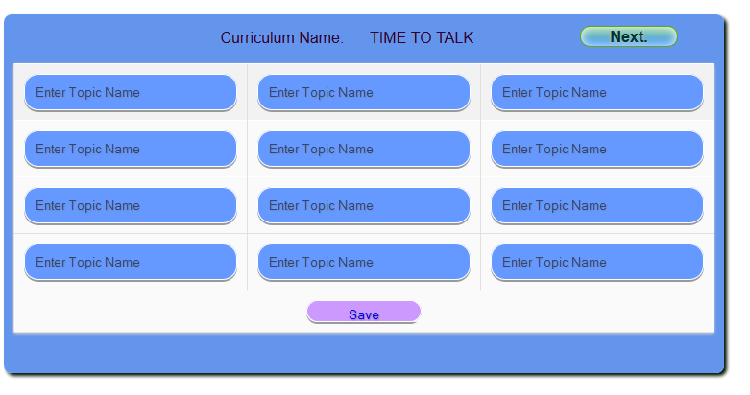
Add Topics.
Here the user can be able to register at most 12 and at least 1 topic per this page. Enter all the topic names you need to register under the selected curriculum and then save the details.

Slide 54
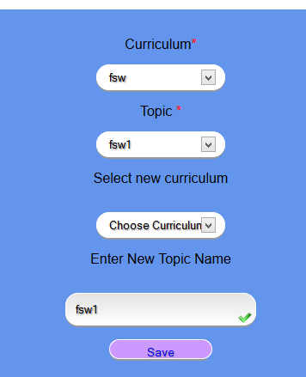
edit Topics.
Edit and then save the details.
Select curriculum and the topic you need to edit its details
Choose the new curriculum and enter the correct topic name.

Slide 55
REPORTS
As the administrator , you can generate all the reports shown with more additional reports to come.
HC System is able to generate the following reports :
County completion rate(pie chart)
Partner completion rate(pie chart)
Groups completion rate (excel)
Target population attendance (bar chart)
Kepms Report ( Age based report and Partner based report per month ).

Slide 56
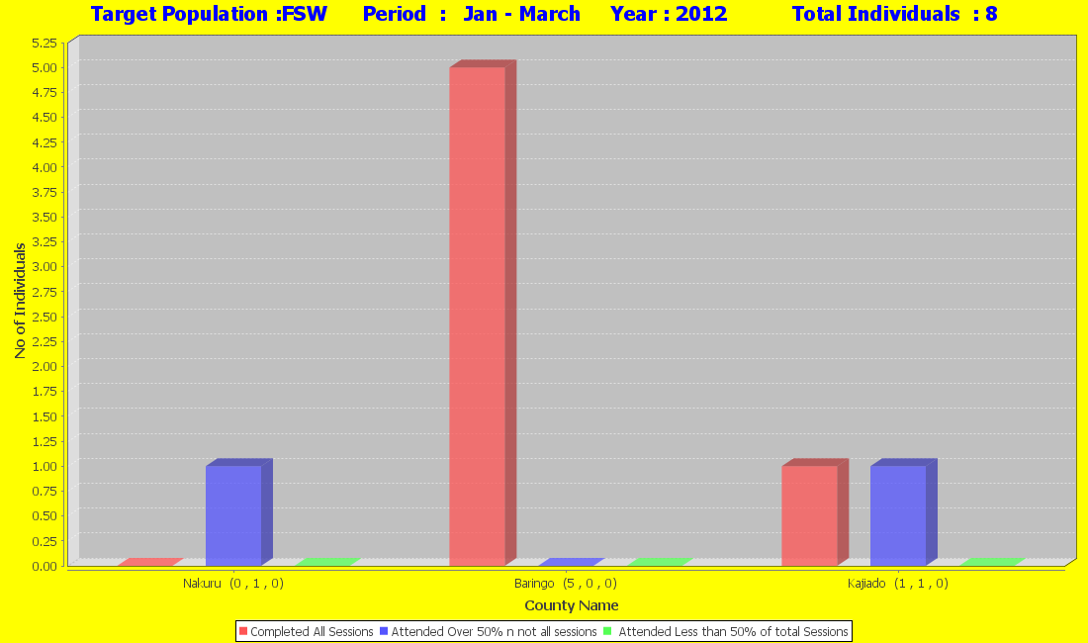
REPORTS-Target completion rate per county

Slide 57
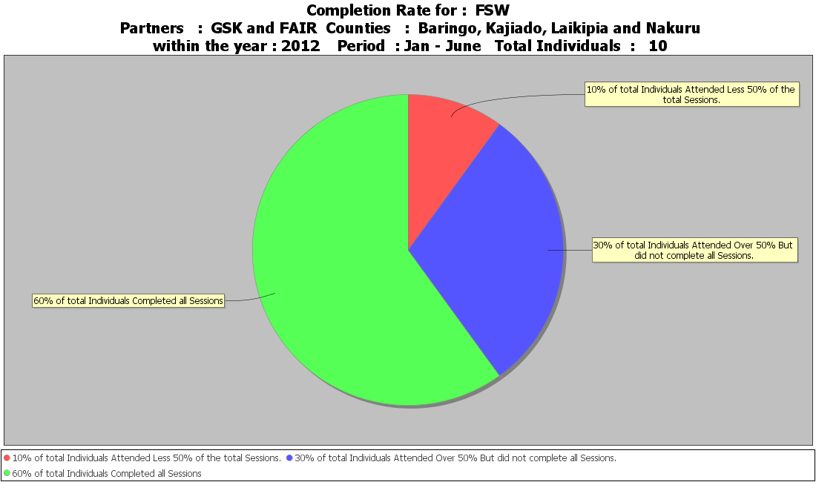
REPORTS-Target population completion rate

Slide 58
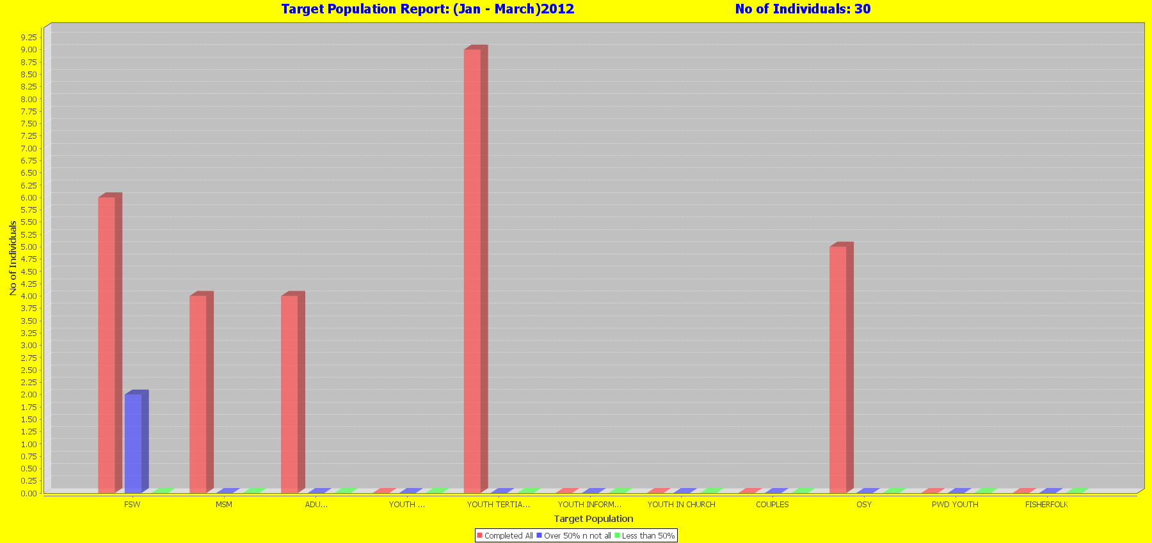
REPORTS-target population attendance

Slide 59
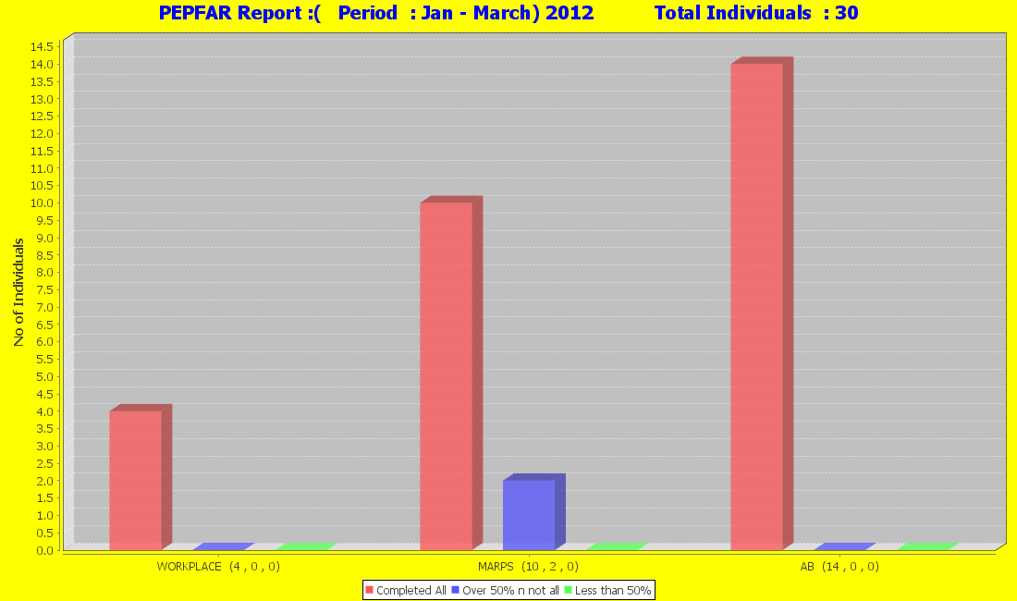
REPORTS-PEPFAR Attendance.

Slide 60
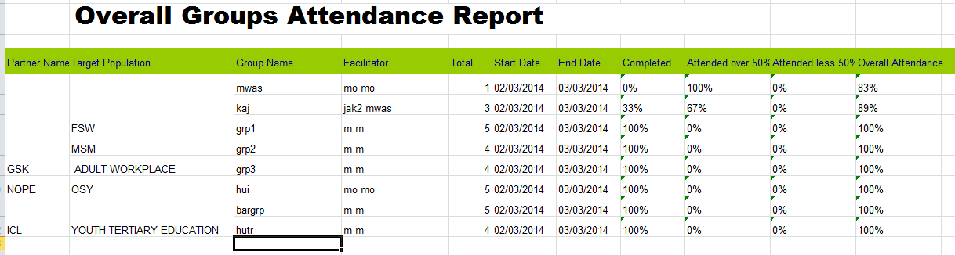
REPORTS-groups attendance
This reports shows attendance of various groups

Slide 61
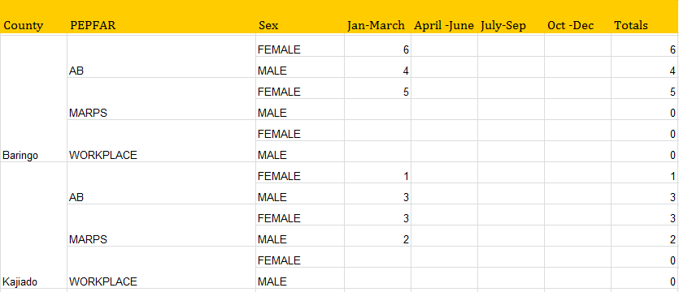
REPORTS-PEPFAR report
This report shows the completion rate for all the counties with the given PEPFAR. It shows only those who have completed.

Slide 62
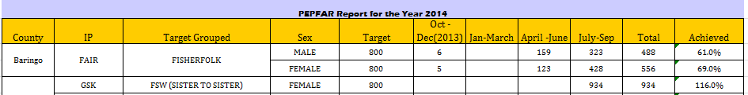
REPORTS-PEPFAR report
This report shows the completion rate for all the counties with the given target populations . It shows only those who have completed.
Note that Targets and Achieved column has been added .

Slide 63
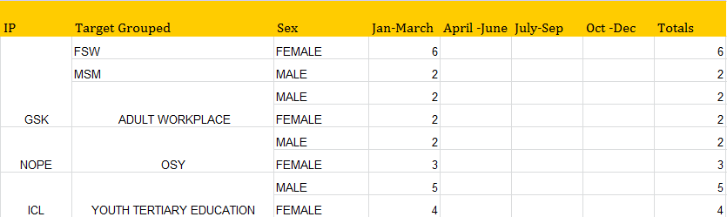
REPORTS-PEPFAR report
This report shows the completion rate for all the Partners with the given target populations . It shows only those who have completed.

Slide 64

REPORTS – KEPMS BY AGE GROUP
This report shows the number of people who completed all sessions report by month, Year and age bracket.
NB: Always enable macros when viewing this report.

Slide 65

REPORTS – KEPMS BY PARTNER
This report shows the number of people who completed all sessions report by month, Year , population and gender.
NB: Always enable macros when viewing this report.

Slide 66
GUEST.
The system support a guest user whose main role will be to generating and viewing the system reports.
This is only through the APHIAplus Systems Kiosk Reports module.

Slide 67

GUEST MENU.
This is the menu that will be shown to a guest user.
Hovering your

Slide 68
DQA
You can now use a Data Quality Analysis Module to know on data that is not meeting the expected standards/format.
As of HC1_VERSION_01 (2014_11_07), there are three sections of the DQA.
(1) Invalid date DQA
(2)Duplicates DQA
(3)Incomplete records

Slide 69


Invalid date- DQA
After double clicking on the date cell
Start-date should be of format dd-mm-yyyy
End date should be of format dd-mm-yyyy
This section shows you date that is in wrong format. You can edit each of this fields by double clicking on the field and selecting the correct date from a calendar.

Slide 70

Duplicates-DQA
Each of the simultaneous columns shown are duplicates mode
To delete one of each instance of a duplicate, You should be a system administrator or an M&E officer.
NB: You can always export the shown duplicates into either csv, xls or pdf format using the buttons shown in each page.
Read the Help tips in each DQA to understand more about how to use the module.

Slide 71

Incomplete Records DQA
This section shows data that was not completely marked up to the last step (7/7) of the HC form entry.
All the records that appear to have 0 sessions attended means that data for that individual was not completely marked.
To Clean up this records, master the county , partner , target population , group name , year , month , quarter and form number if applicable.

