Slide 1
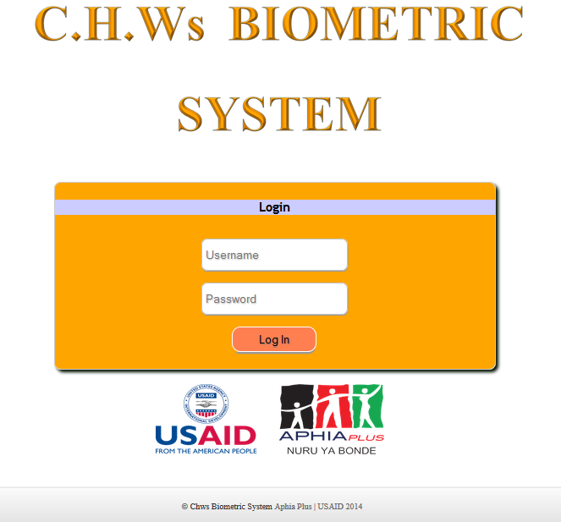
CHWs-BIOMETRIC SYSTEM USER GUIDE.

Slide 2
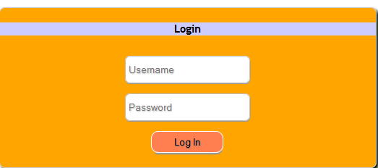
FIRST PAGE/INDEX PAGE
Enter Username and Password to access system resources.
Enter Your User Name Here
Enter Your Password Here.
Click Here to Log In.

Slide 3
User Menu.
Whenever you put a mouse on any item in the menu, a sub-menu appears from which you can select an item.
Put Mouse Here to add New CHWs Or Edit Exist CHWs Details
Click Here to edit your profile
Click Here to generate and send a payment file
Put Your Mouse Here to mark the attendance of CHWs.
Click Here to Log Out

Slide 4
Order Of Use.
Following is the order of using the system:
Add a CHW if he/she does not exist.
If the CHW exist edit any of his/her details.
If the CHW exist and all his/her details are captured well including the finger print, mark the attendance of the CHW.
After marking the attendance of all CHWs for that days meetings, Generate the payment file.

Slide 5
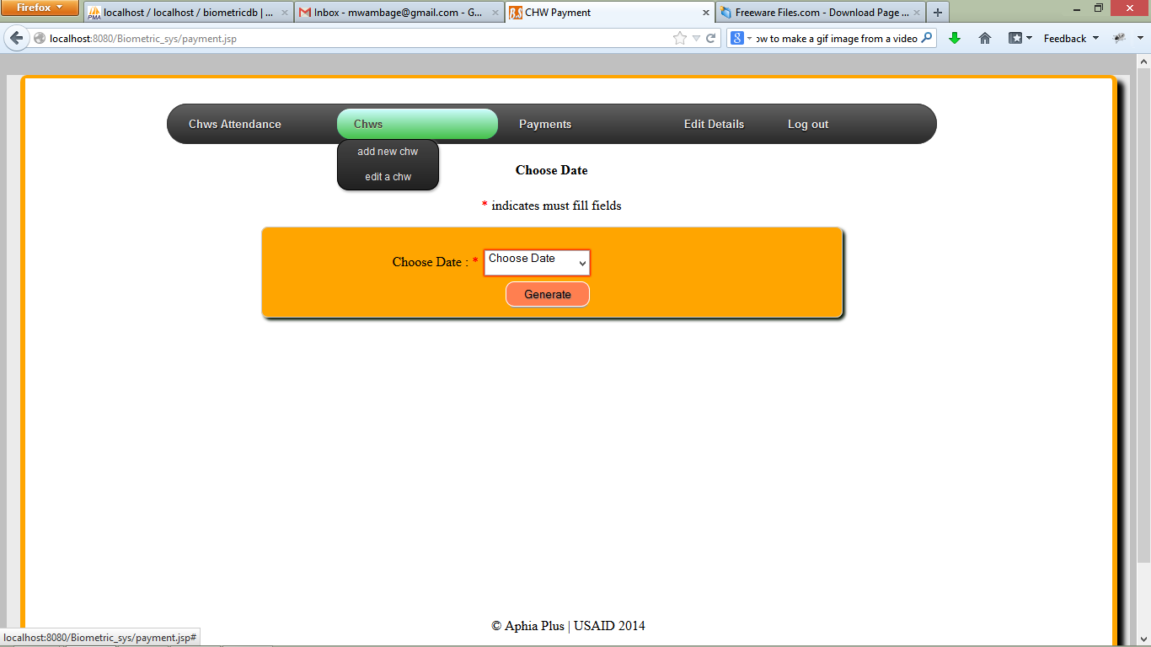
Add New CHWs.
If the CHW Does not exist in the system, click on the button shown below to add him/her to the system.
Click Here.

Slide 6
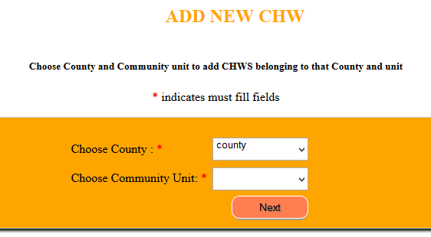
Add New CHWs.
Select the county and the Community Unit to which you want to add the CHWs. Then Click Next.

Slide 7
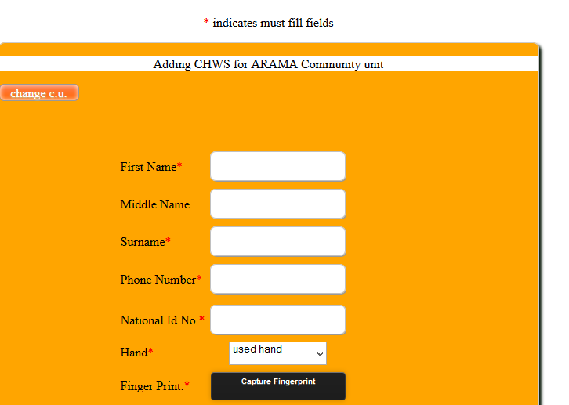
Add New CHWs.
Connect the Scanner to the laptop and then Enter all details as shown . Those marked with a red star must be filled whereas others are optional. Then Choose the hand from which the finger will be captured. Click on capture finger Print

Slide 8
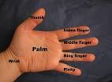
Add New CHWs.
Index Finger
All through, this is the finger we will be using. If the CHW does not have this finger, the index finger will be an option
Middle Man

Slide 9
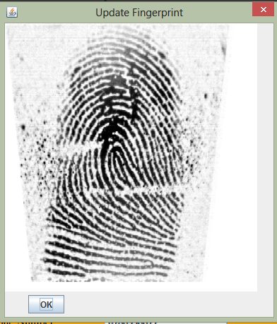
Add New CHWs.
Put the finger on the scanner and then press gently. If an image appears As shown here, it means the image has been captured. Press OK to save details.

Slide 10
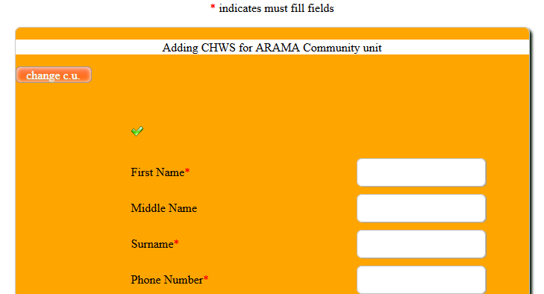
Add New CHWs.
Do this for all the members whom you want to register who belong to the earlier selected community group. After registering all, press.
Click Here to start registering for another community unit.

Slide 11
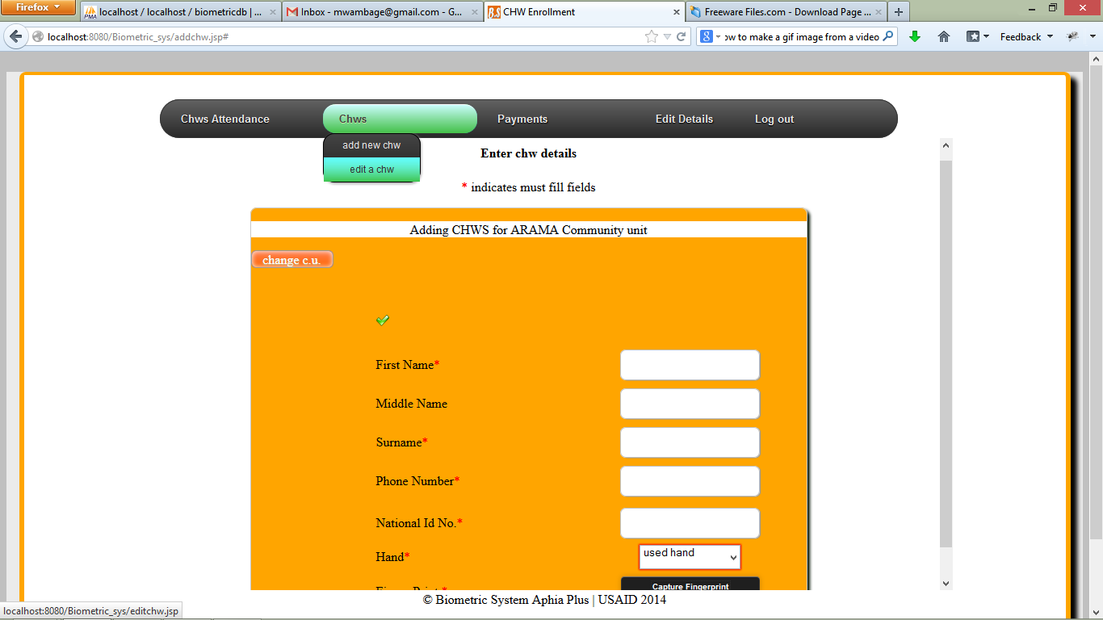
Edit CHWs Details.
Incase the details for a CHW exist but some more details need to be added e.g. finger print, click on the button shown.
Click Here

Slide 12
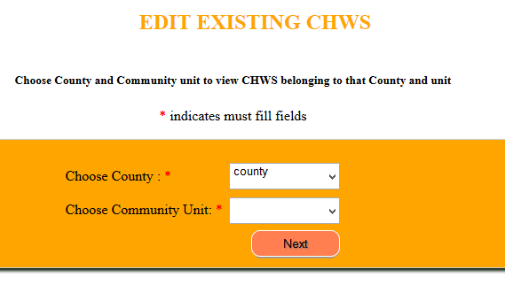
Edit CHWs Details.
Select the county and the Community unit where you want to edit CHWs details. Click on next button.

Slide 13
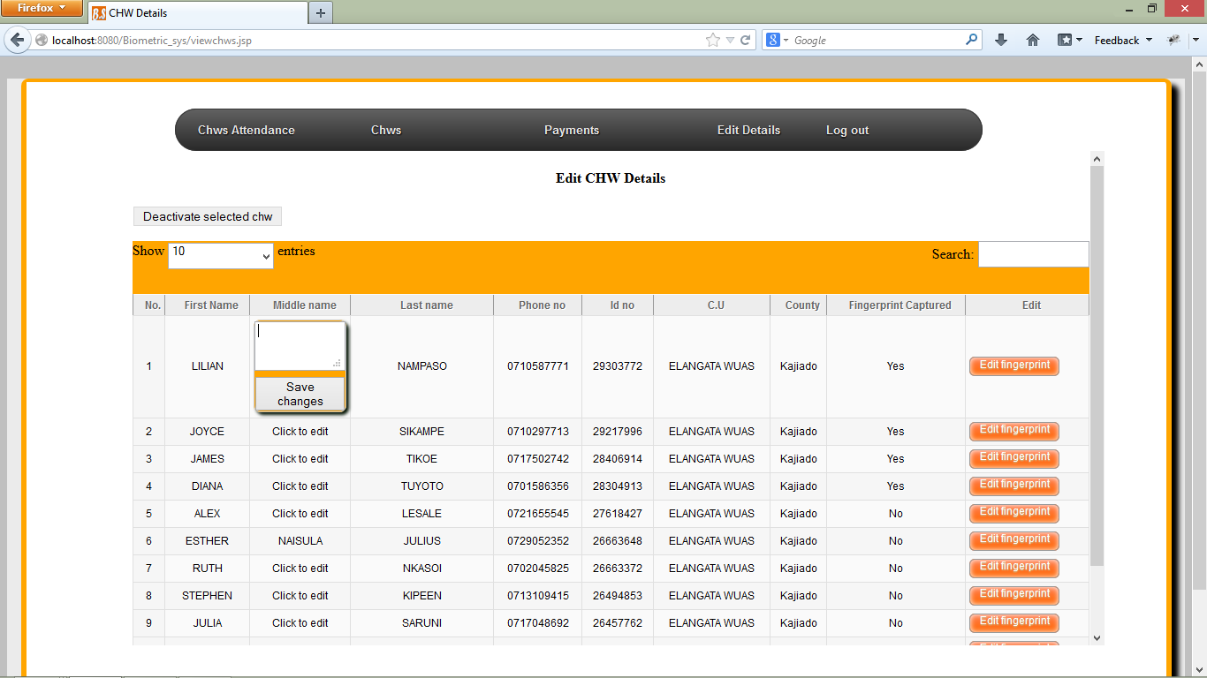
Edit CHWs Details.
Within the page , the user can edit CHWs Details
1
4
5
3
6
2

Slide 14
Edit CHWs Details.
This is the key of the outlined field in the previous slide:
Deactivate the selected CHW-First you select a CHW by clicking on a given row and then click on this button.
By default the page displays a maximum of 10 CHWs, by clicking here you can select to view 10,25,50 or 100 CHWs.
The user can click on any of the field and edit CHWs details, e.g. name, id no, phone no. you click on the field you want to edit and a box will appear as the one shown.
This shows that the finger print has not been captured.
This is a search box, enter any details to search for a CHW.
Click This to capture a new fingerprint or to update the existing fingerprint.

Slide 15
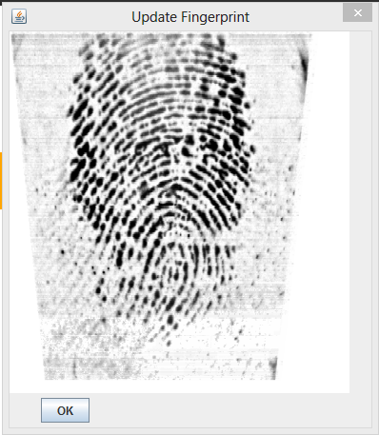
Edit CHWs Finger Print.
After Clicking on the edit fingerprint button, a pop up comes out. The user is required to click on the pop up and then ask the CHWs to put their fingers on the scanner and then gently press until a fingerprint image appears as shown above. Click OK to save the fingerprint.

Slide 16
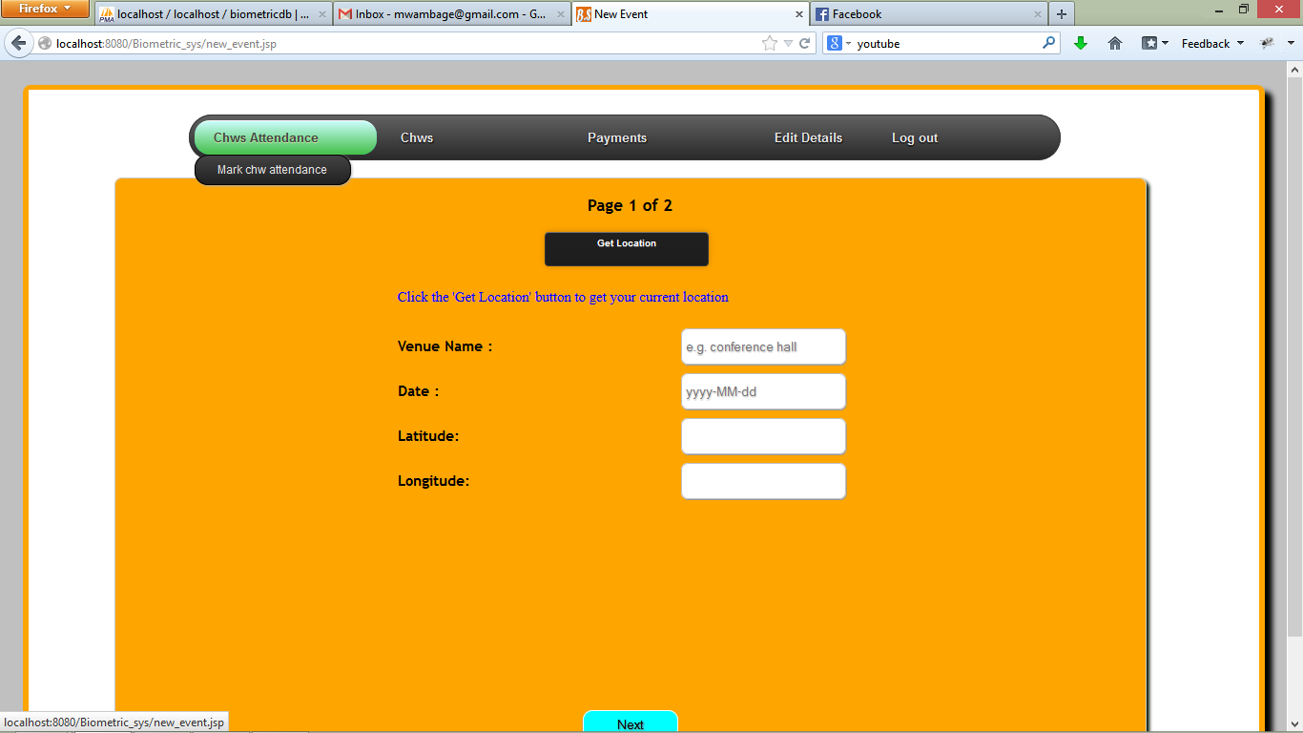
Mark CHWs Attendance.
Click in any of the two items and you will be directed to a page where you can register new CHWs. Ensure that there is internet connection before clicking on this button.

Slide 17
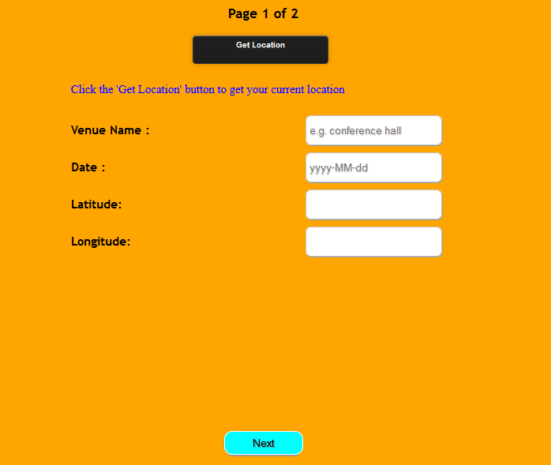
Mark CHWs Attendance.
Click Here if the longitudes and latitudes are empty.
Enter Venue Name for the meeting
Click to select meeting date
These are generated by the system
Click Here to move to the marking page

Slide 18
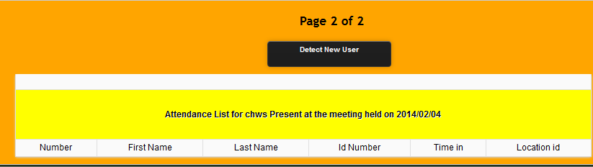
Mark CHWs Attendance.
To Start marking the attendance of CHWs, Connect the Scanner wait until it is detected full and then Click on Detect New User Button. On clicking , a window shown in the next page will appear.
After clicking on where the arrow points, a screen will appear which is described in the next slide.

Slide 19
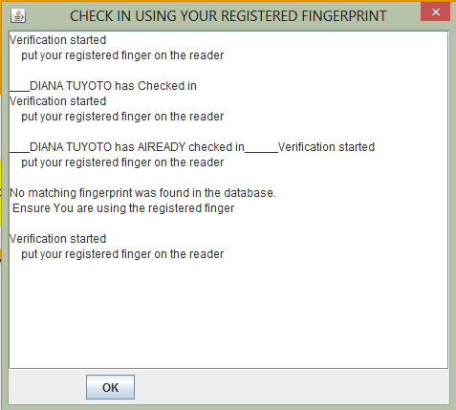
Mark CHWs Attendance.
Click On this screen and wait as the users put their finger in the correctly.
This shows that the finger the CHW is using is not recognized. He /she should use the correct finger or put his/her finger properly or he/she is not registered.
This Shows that the user has successfully checked in.
This shows that the user has already checked . He/she is attempting to check in more than once.
After Checking in all the users, click here to view them.

Slide 20
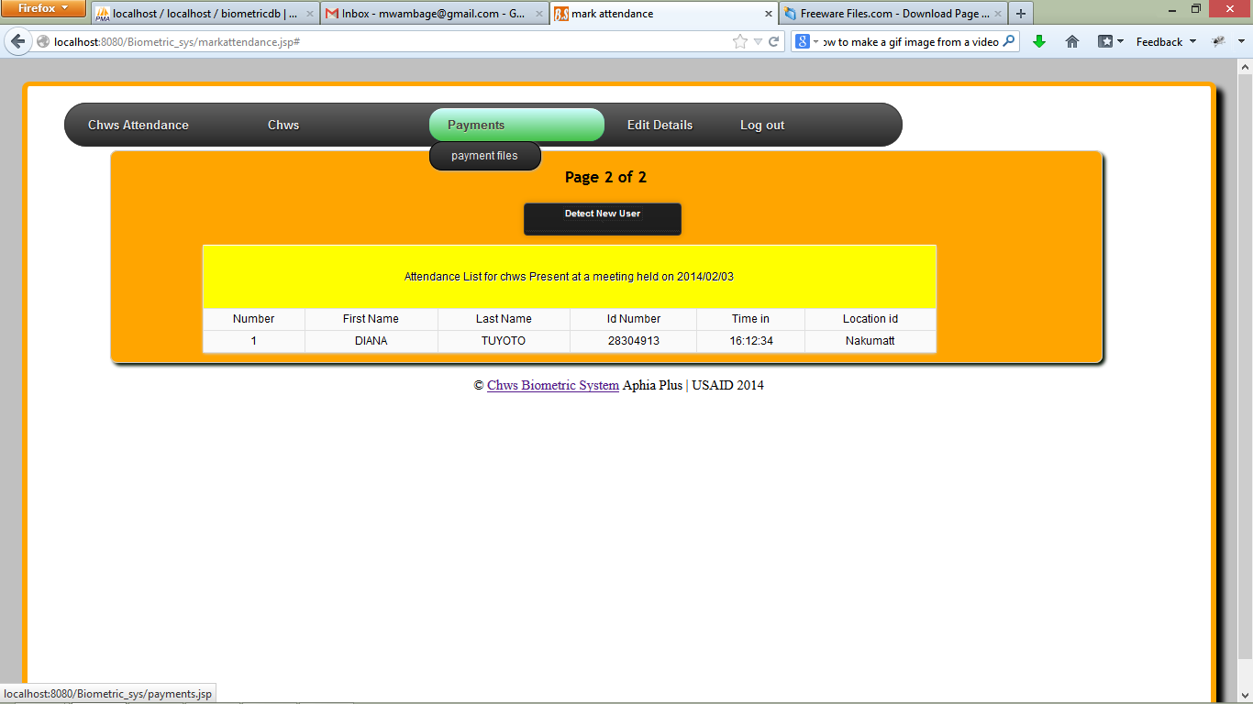
Make Payment File.
Click Here to select date for which the meeting was Held. The payment file generated will only contain all the names of CHWs who attended a meeting on the selected date.

Slide 21
Make Payment File.
NOTE:
The payment file is created if the attendance of all the expected CHWs has been marked. The file is generated only once per session date.
You must confirm that there is Internet Connection before you generate the payment file.
The payment file generated is for you to view don’t sent it to anybody.

Slide 22
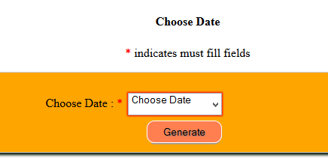
Make Payment File.
Choose the Meeting Date and then Click on the generate button.

Slide 23
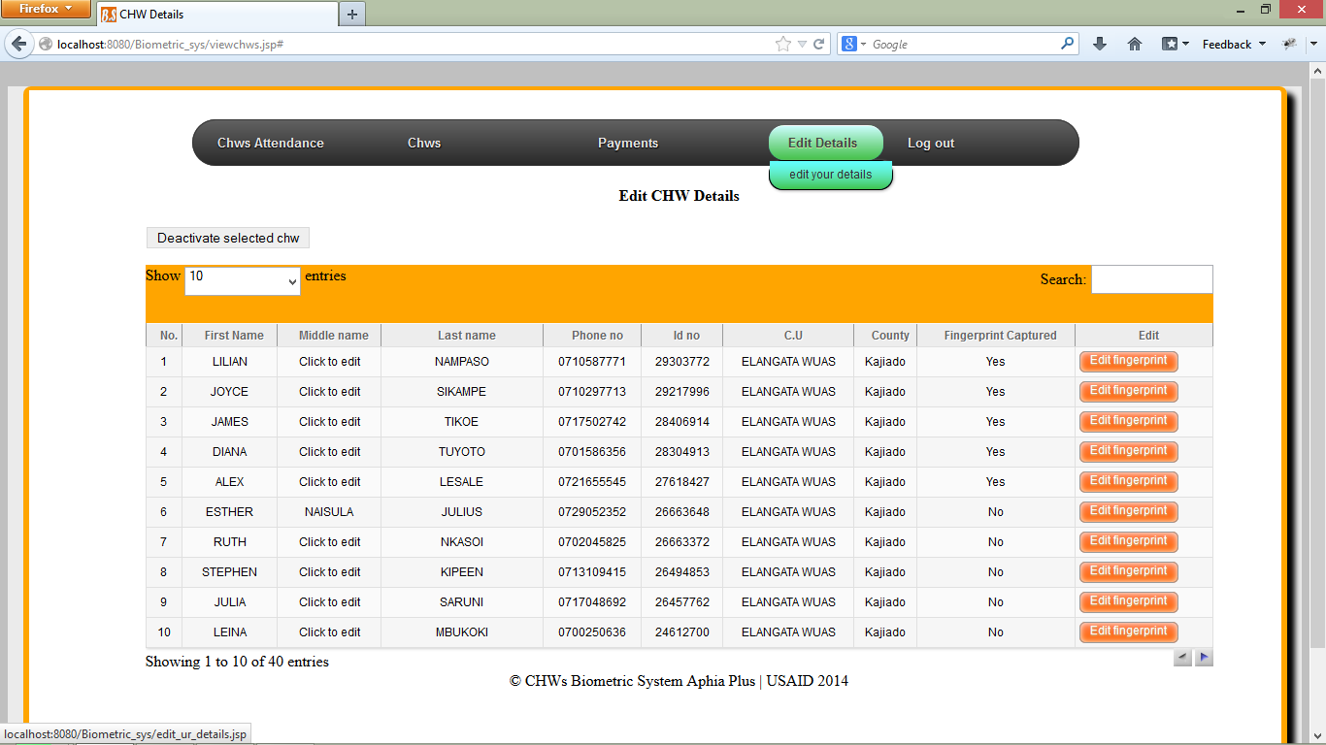
Edit Your Profile.
The User is able to edit his/her details.
Click on the link shown below.

Slide 24
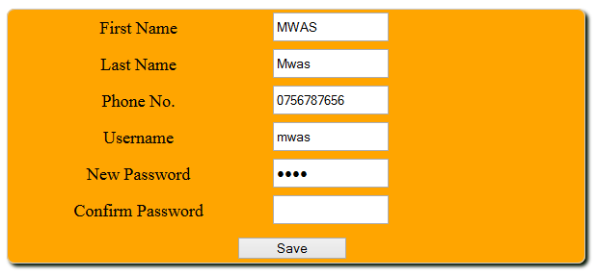
Edit Your Profile.
Edit any of the above details and then click on the save button.

Slide 25
CHWs Biometric System.
END

