Slide 1
Form 1A Data Upload Module
USER GUIDE

Slide 2
Overview
This module will help IMIS system users to download a blank Form 1a excel template with populated organizational unit and period details for monthly data filling, validation and submission.
Below are the details that will be pre-populated.
Period
Year
Month
Organizational unit
County
Subcounty
Facility Name
Mfl Code

Slide 3
Downloading Form 1a Template
Click the link http://hsdsacluster2.fhi360.org:8080/InternalSystem/gettemplate.jsp
From the window that opens, select Year, Month , County ,Subcounty and facility then Click Download button.
Year, Month and county are must select.
Subcounty and facility name are optional
To download F1a templates for all active facilities within an entire county, choose the county and leave blank the subcounty and facility .
To download F1a templates for all active facilities within one or more sub-counties, choose the county, sub-counties and leave blank the facility
Downloading a F1a template for more than 1 facility generates a zipped folder with excel files.
Downloading a F1a template for one facility generates an non-zipped excel output.

Slide 4
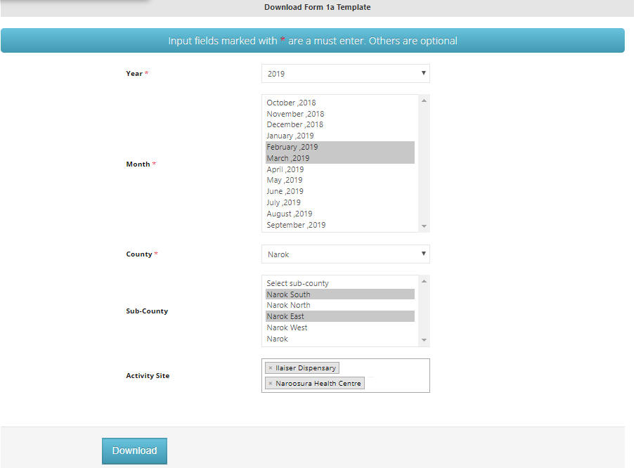
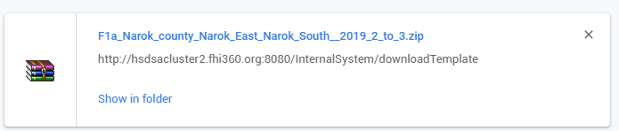
Downloading Blank Form 1a Template for multiple sites
A zipped output

Slide 5
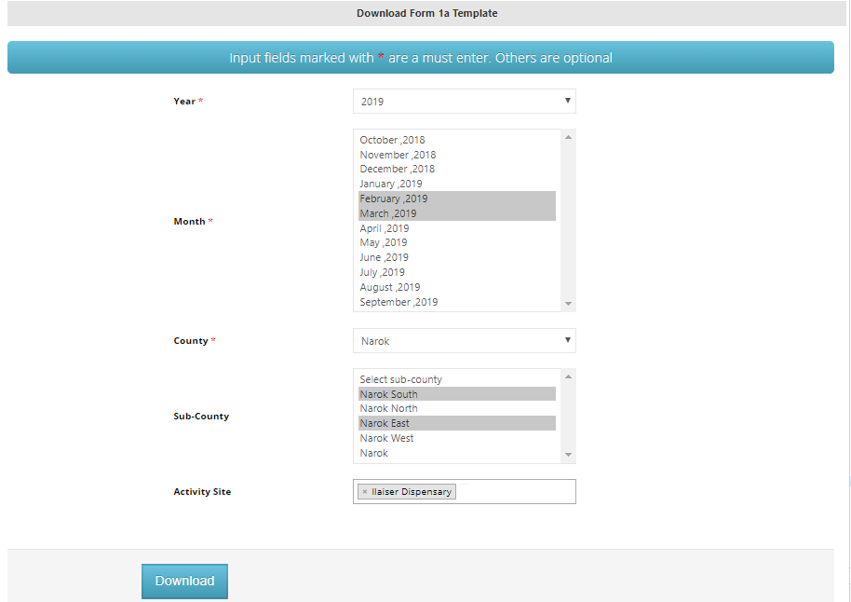
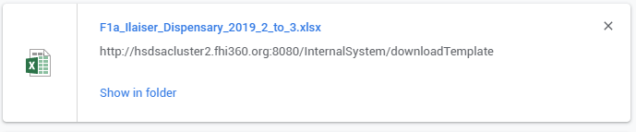
Downloading Blank Form 1a Template for 1 site
A single site excel output

Slide 6
Filling Form 1a Template
If your download was zipped ,ensure you first extract it into a normal folder
From the extracted folder, open each of the excel sheets and fill data appropriately. Each sheet has data for a specific month
Ensure you have filled data on all the sections in the form based on facility’s program area support.eg HTC, PMTCT, ART , SGBV
Incases of corrections, always ensure data is filled in all the Form sections , even if the area of correction is only one.
After filling all the sections, check the Warning and Errors section for any flagged errors per age for your action.
As you correct the errors and warnings, the errors and warning notifications reduce/disappear.
Flagged Errors must be addressed before uploading the filled excel template. Otherwise, data will not be sent to the server.

Slide 7
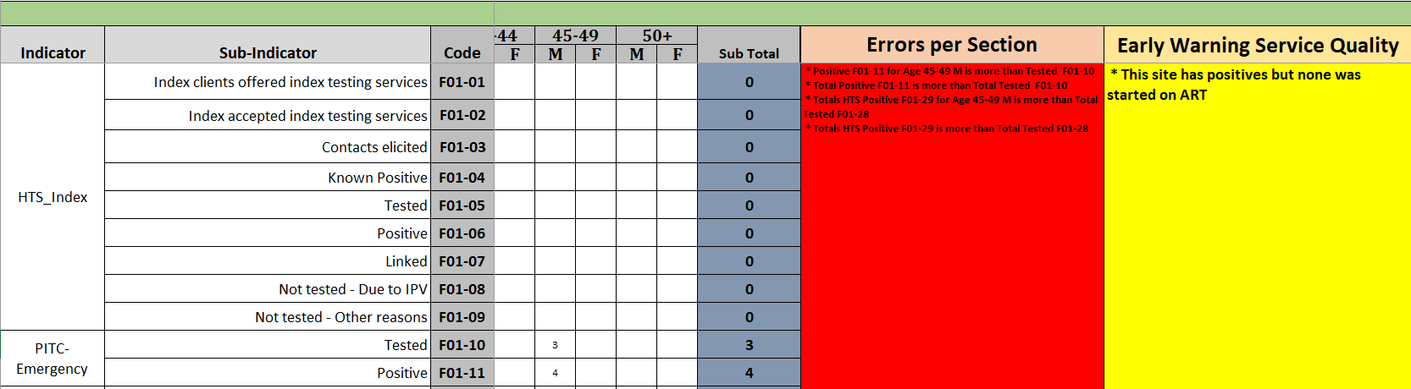
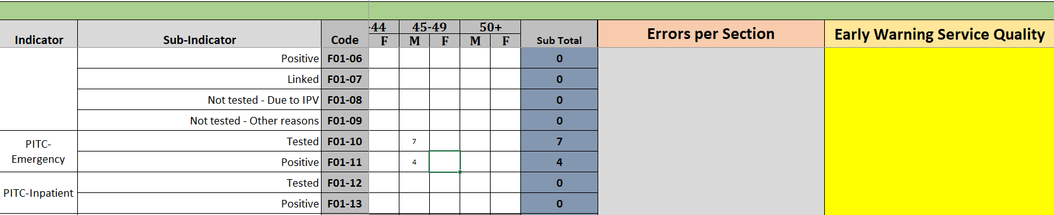
Filling Form 1a Template
Before Correcting the PITC-Emergency Testing vs positive data for age 45-45 F
After correcting the PITC-Emergency Testing vs positive data for age 45-45 F, errors disappear

Slide 8
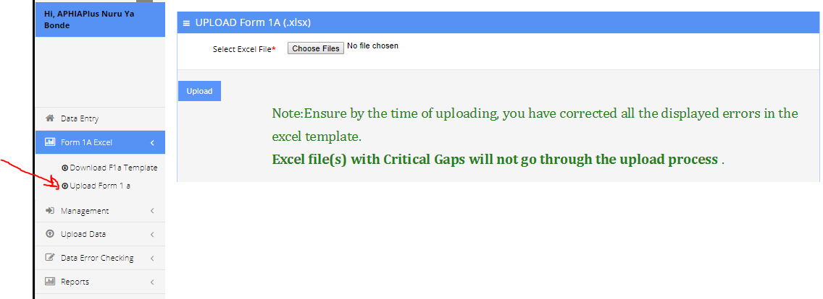
Uploading Form 1a Template
To upload filled F1a data template, ensure you have logged into IMIS
After login , click the Form 1A Excel menu then Upload F1a

Slide 9
Uploading Form 1a Template
You can upload data for one or more facilities for one or more months at once.
To do that, put all the excel files to be uploaded in the same folder.
Click the Choose files button to browse and select the files to upload.
Use the control button in the keyboard to select multiple excel files.
Click the Upload Button and wait for a upload feedback
If the upload is successful without errors and warnings, you will see an output in the web saying that data upload was successful
If the upload has errors , you will see an output in excel file named Data_quality Errors.
If the upload has warnings only, you will see an output embedded in excel

Slide 10
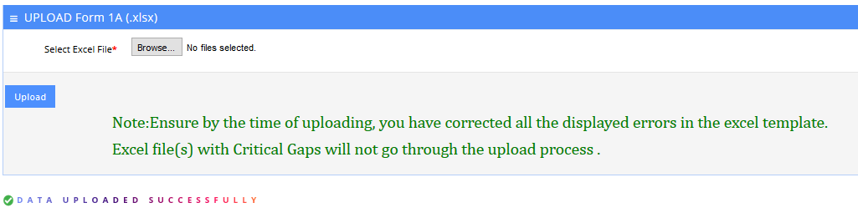
Successful Form 1a Template Upload
If the upload is successful without errors and warnings, you will see an output in the web saying that data upload was successful
Upload feedback

Slide 11
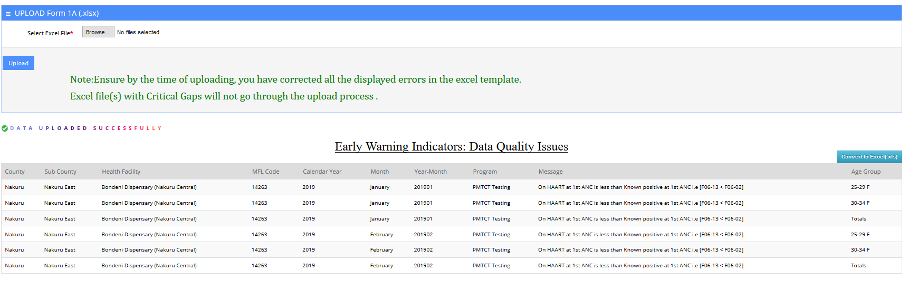
Successful Form 1a Template Upload with Warnings
If the upload is successful without errors but with warnings, you will see an output in the web saying that data upload was successful and a list of warnings to be worked on
Click here to download excel output

Slide 12
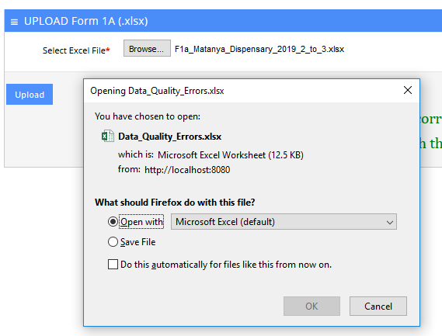
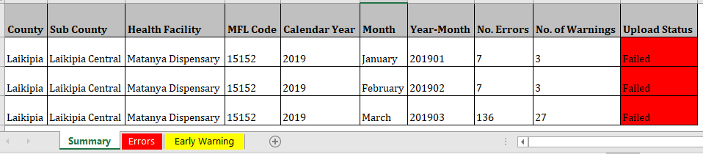
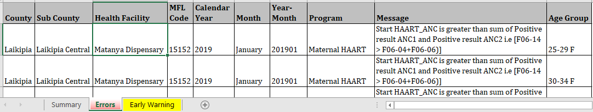
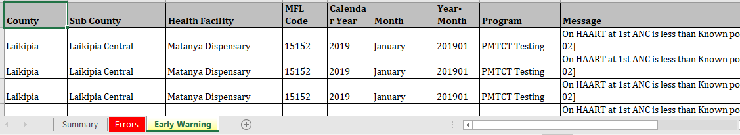
Unsuccessful Form 1a Template Upload
If the upload has errors ,the excel sheet with error will not be uploaded, and instead, you will see a feedback in excel file named Data_quality Errors.
Open the excel file and check the summary sheet for upload status of each of the months per facility
If in one excel file, some sheets have errors while others don’t have, The ones with errors will be skipped while the ones without errors will be uploaded
Pay attention to the upload status to know the months that failed validation check.
Summary sheet
On the errors sheet, read the message column to understand the gap that has failed validation for correction on the F1a upload template
Upload Feedback
Errors sheet
Early warning sheet

Slide 13
Correcting Failed Form 1a Template Upload
If the Form 1a template upload has failed, please go through the upload feedback output file and update all the errors flagged.
Corrections should be done on the original excel file.
After corrections, reupload the file(s) again then check the feedback to ensure you get the message Data uploaded successfully

Slide 14
Note Carefully
Do not Cut and paste data in the F1a excel template. This will interfere with the validation formulas.
Uploading data through the excel module replaces all the earlier entered data for that facility, year and month . Therefore, by the time of upload, ensure that the data is accurate and complete.

Slide 15
Good Luck as you upload

