Slide 1
INTEGRATED MNCH SYSTEM
Version 1.0 Userguide

Slide 2
MNHC OVERVIEW
An Integrated System For Enrolling , Monitoring and Evaluating Pregnant Mothers.
Made to support The Koibatek Study of Pregnant Mothers.
Consists of two main applications, One for Enrolling mothers, and the core one which manages all enrolled mothers details .
The two above applications are web based
The Enrollment application can be run in a computer browser(chrome, Firefox) or In an Android phone browser or using Androids ODK(open data kit) Collect application .
The management system is made to update the mothers data from conception to postnatal status using the Mother baby book, ANC Register, Maternity register and Postnatal register.
Notes:
Elaborate More on Koibatek Study of Pregnant Mothers.
The enrollment application uses formhub to collect and store the data from the field and for aggregation and exporting into the core System for more precise editing.
ODK Collect needs a formhub username and password, from where one can access the mothers enrollment form, fill all the details, save , edit and upload the details through the internet to a server.

Slide 3
MNHC MODULES
Running application for the first time.
Mobile application.
Computer Based application.
Managing Community Health workers (add, edit)
Enrolling Mothers
Importing Enrolled Mothers data
Mother Baby Book data entry
Registers Data entry(ANC, Maternity, Postnatal registers)
SMS Module (creating and editing and sending general and targeted sms ).
Reports

Slide 4
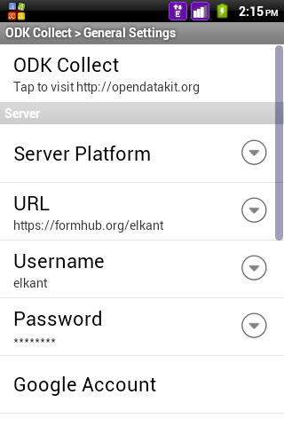
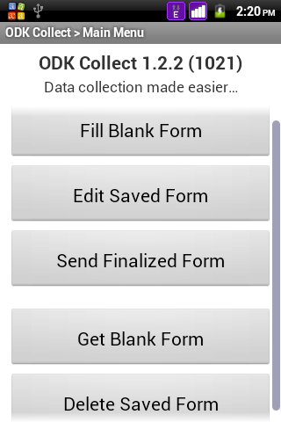
Configuring ODK Collect
Options> general settings
Click to fill mothers enrollment form
Edit saved form
Send all filled forms
Get all forms from formhub server
1. Connecting to formhub server
2. ODK Collect main menu

Slide 5
Running MNHC The First Time
Configuring Mobile application ( ODK Collect.)
Download the ODK Collect Android application from http://play.google.com store or from http://opendatakit.org .
(For admin) Create a formhub account and upload the koibatek data entry form.
After installing odk collect in your phone, click to open it.
Click on the options , general settings.
Click on URL dropdown , then enter formhub url.
Click on Username to enter the formhub username.
Click on password and enter the formhub password
You are now ready to proceed and fill your first form.
Notes:
This part is done when the user is running the application the first time.
If your username is john, the formhub url will be of the form https//formhub.org/john.
At this point, the formhub account is already created and thus an admin does not have to bother much on creating anything more.

Slide 6
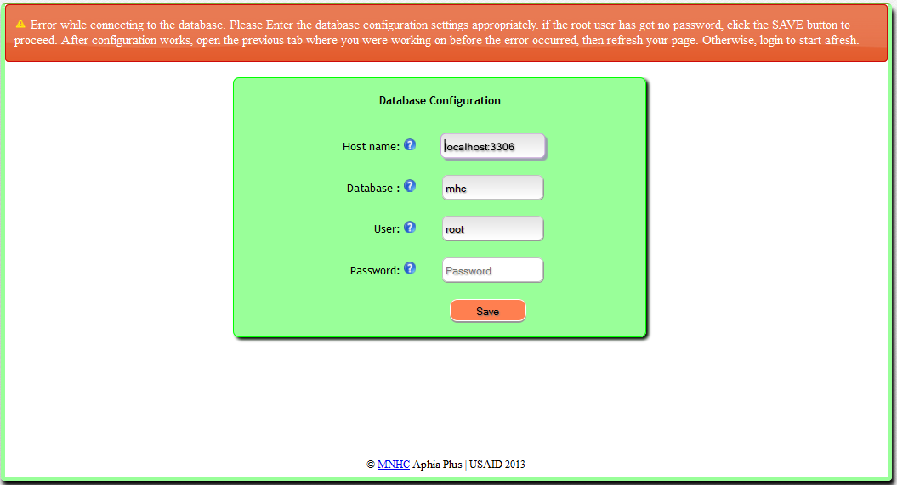
Running MNHC The First Time Configuring the database
Unless otherwise advised, leave the password field unfilled and click the save button. If This should direct you to the login page if the configuration went succesful.
Notes:
One can edit the host name , username and the password depending on the settings of your MYSQL database.However, this requires someone with a technical background of MYSQL installation.

Slide 7
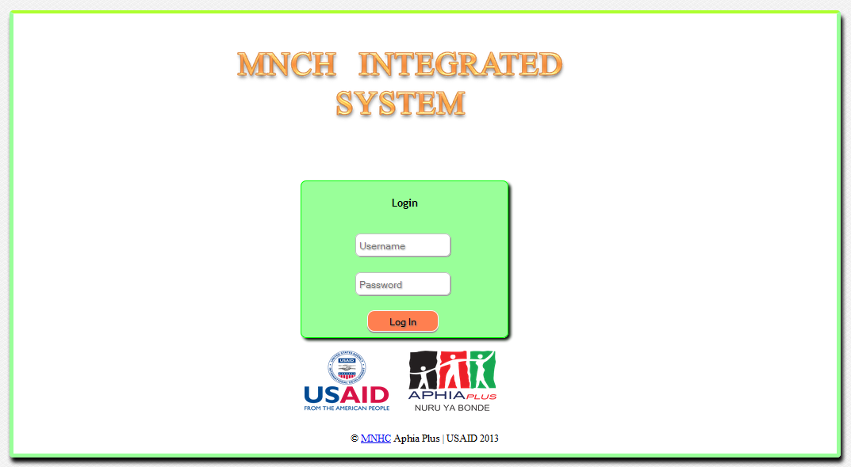
Running MNHC The First Time
The home page of the MNHC System

Slide 8
Running The application The First Time
Running the MNHC web based System.
Open your firefox or chrome browser.
Type url http://localhost:8080/MHC/index.jsp
Notes:
This set up assumes that one has already installed the application using the setup files and that the host machine has got a tomcat server running .

Slide 9
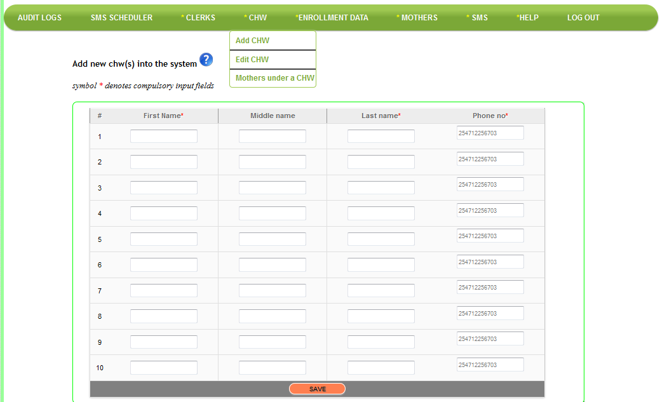
Managing Community Health workers ADDING A CHW

Slide 10
Managing Community Health workers
ADDING A CHW
Log in as an administrator. (login credentials to be provided ).
Over your mouse on the CHW menu, then choose add chw
Enter chws first name, middle name(optional) , last name and phone number
Currently, you can add atmost 10 chws at a go.
Use any row of interest to enter the chw details.
Click the save button to save the entries to the system
Notes:
The CHWS should be existing into the system prior to registration of any mothers.

Slide 11
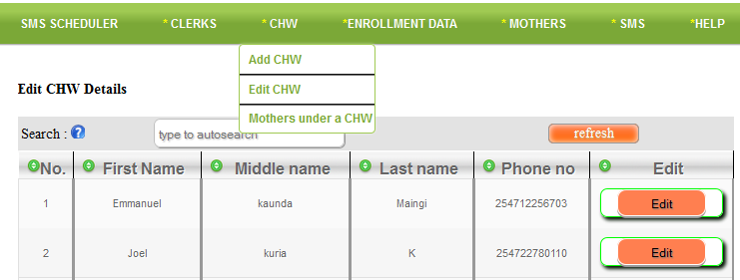

Managing Community Health workers EDITING A CHW
Clicking edit opens the lower form allowing one to edit

Slide 12
Managing Community Health workers
EDITING A CHW
To edit a chw, over your mouse on the chw menu, select edit chw.
A list of all the chws appears.
To edit a certain chw:
Click on the edit button at the last column of each row.
Another screen appears allowing you to edit any field of interest.
Click save to commit the edits.
NB: You can only edit one chw at a time and not more than one.
Notes:
One should be an admin to edit a chw.
You can search a chw by typing their first, last , middle name or phone number

Slide 13
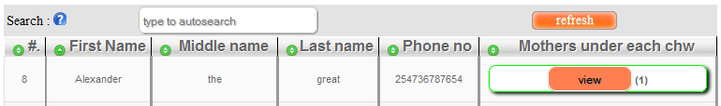
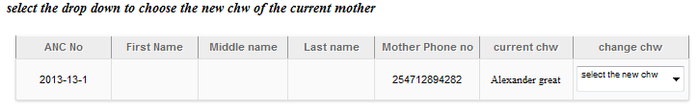
Managing Community Health workers
Mothers under a chw
Notes:
One can change the chw of the mother by just . NB At this point one must have mothers already added.

Slide 14
Managing Community Health workers
MOTHERS UNDER A CHW
Helps one to see the number of mothers managed by each chw.
Over your mouse on the chw menu.
Click the ‘mothers under chw menu’
A list of all the chws appears with a count of the total mothers shown in brackets.
Select the view button for each chw to open a new form with a list of all mothers under that chw.

Slide 15
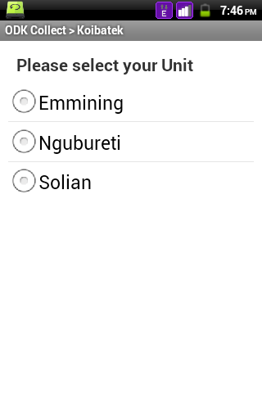
ENROLLING MOTHERS ODK Mobile Phone Application.
Notes:
This is just the first page of the mobile application. Every question / note in the application is usually left in its page.

Slide 16
ENROLLING MOTHERS
ODK Mobile Phone Application.
Open your ODK Collect application
Click ‘Fill Blank Form’
Choose KOIBATEK FORM
Start Entering data for all the fields as appropriate
Once editing is done, save the form for submission or further editing.
Notes:
This part assumes that one has already completed step one of running the application the first time on ODK Collect.

Slide 17
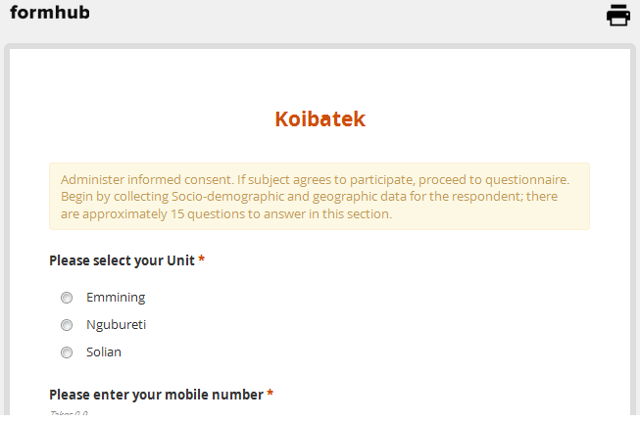
ENROLLING MOTHERS Computer based web Application
This is the computer web based application first page that is used to enroll new mothers
Notes:
Enrolling mothers form.

Slide 18
ENROLLING MOTHERS
Computer BASED WEB Application
Over Your Mouse on ‘Home ’ menu.
Click the Enroll mothers menu.
Fill all the necessary fields about the mother you are enrolling.
Click save to upload their details once you are through.
If You have no internet connection, the details that you have added are kept in a queue until you have a working connection when they are uploaded.

Slide 19
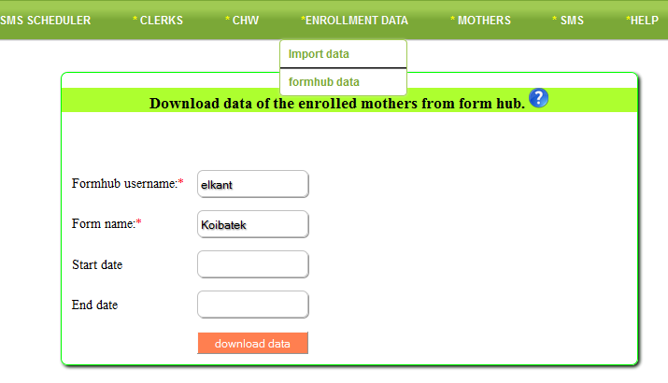
IMPORTING DATA
DOWNLOADING DATA IN .XLS FORMAT
Notes:
You can enter the start and end date to specify the range of data to download.

Slide 20
IMPORTING DATA
DOWNLOADING DATA IN .XLS FORMAT
All the enrolled mothers details are saved in formhub.
One must import the data into the MNHC System.
To do this:
Over your mouse on ‘Enrollment data’
Click on ‘formhub data’
A form appears requiring you to enter your formhub username , form name, start date and end date.
Start date and end date are optional and leaving them blank means one will be downloading all time data.
Click the Download Data button.
You have have your download ready in .xls format.
Save the excel file in the folder Root folder/MHC_UPLOADS/ ready for uploading. E.g C:/MHC_UPLOADS

Slide 21
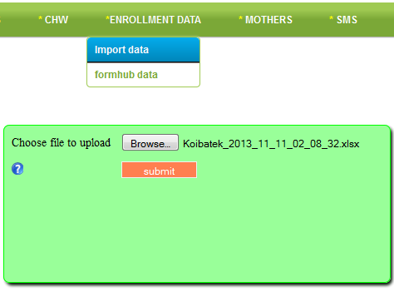
IMPORTING DATA UPLOADING DATA

Slide 22
IMPORTING DATA
UPLOADING DATA
Over your mouse on ‘Enrollment data’
Click on ‘import data’
A form appears enabling one to select the file containing the data for upload.
As of Version MNHC 1.0, data is importable in .xls.
Navigate to Root drive of your application, e.g C, then MHC_UPLOADS where you can select your .xls file.
This guide assumes that you have already downloaded the excel file into the folder Root drive/MHC_UPLOADS

Slide 23
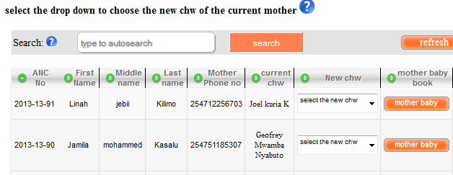
Data Entry Mother Baby Book- view mothers page

Slide 24
Data Entry Mother Baby Book
Log in as a data clerk.
Click at the Home menu
Click at the View all mothers menu.
Search the mother you would wish to edit their details by typing their anc number, first, middle or last name or their phone number.
Click the mother baby link.
This leads you to the maternal profile page.
Notes:
See the next page which is the maternal profile page

Slide 25
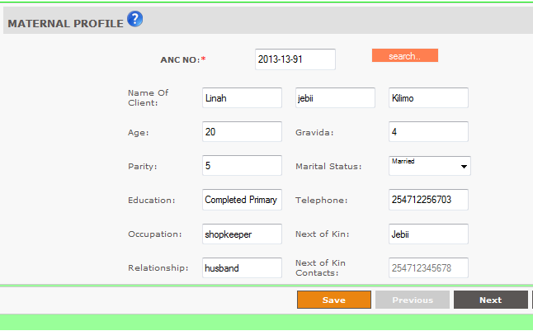
Data Entry Mother Baby Book- maternal profile
Click next to move to the next page
Notes:
C

Slide 26
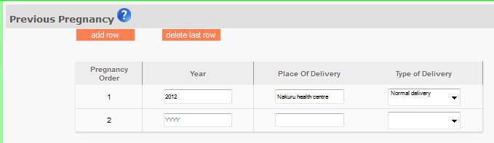
Data Entry Mother Baby Book-Previous pregnancy

Slide 27
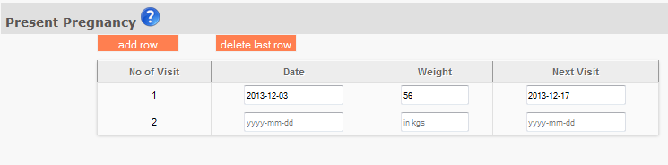
Data Entry Mother Baby Book-Present pregnancy
Notes:
One can add a row

Slide 28
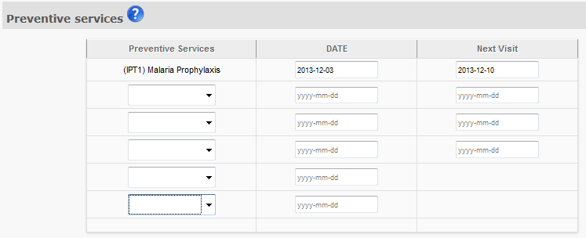
Data Entry Mother Baby Book-Preventive Services

Slide 29
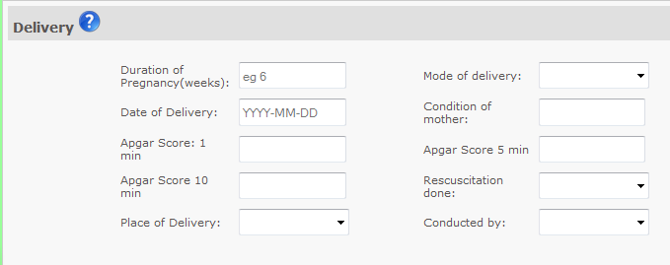
Data Entry Mother Baby Book-Delivery

Slide 30
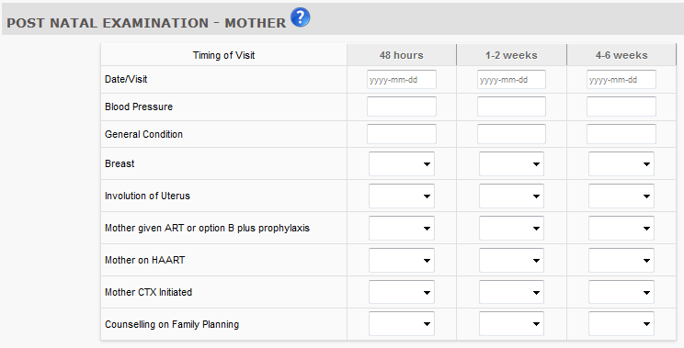
Data Entry Mother Baby Book-Post natal mother

Slide 31
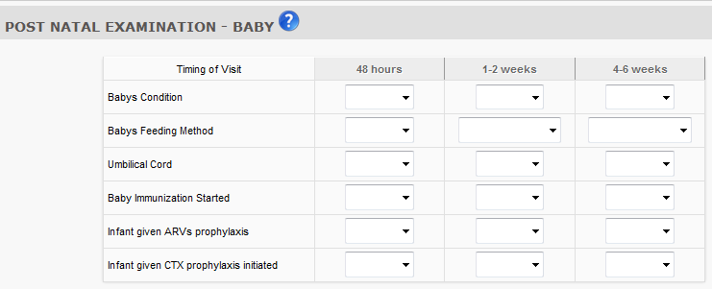
Data Entry Mother Baby Book-Post natal baby

Slide 32
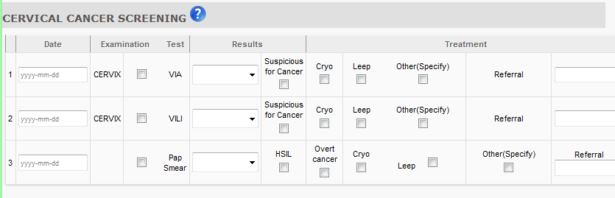
Data Entry Mother Baby Book-Cancer Screening

Slide 33
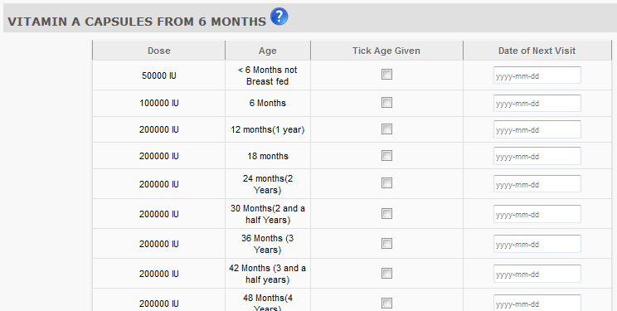
Data Entry Mother Baby Book-Vitamin A

Slide 34
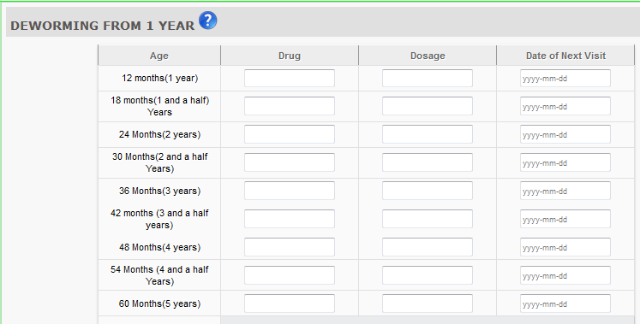
Data Entry Mother Baby Book-Deworming

Slide 35
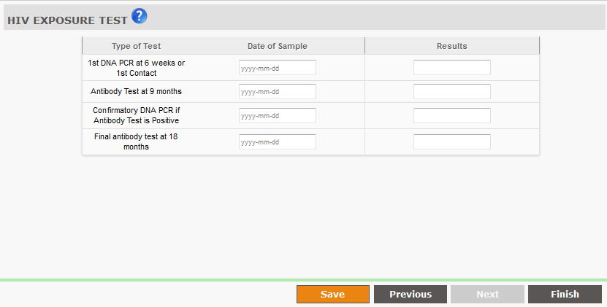
Data Entry Mother Baby Book-HIV EXPOSURE
Notes:
Click on Finish to save the data entry form.

Slide 36
Data Entry ANC REGISTER
This register holds information about mothers Anti natal clinic visits.
The register is filled at healthcentres.
Each mother is identified by a unique ANC NO. for each pregnancy.
NB: One should have their mother baby book details already filled in the system before proceeding to search a mother in the ANC Register.

Slide 37
Data Entry ANC REGISTER
To fill the ANC Register for a mother;
Over your mouse on the HOME menu
Click on view mothers menu
A list of all mothers with mother baby book ,anc and maternity register links appear.
Search a mother by typing their ANC number, first , middle , last name or phone number.
Click on the anc register button
The first section of the anc register, (a to h) appears.

Slide 38
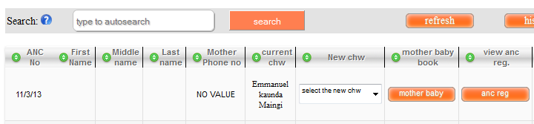
Data Entry ANC REGISTER
Open view all mother page
Click on anc reg link.

Slide 39
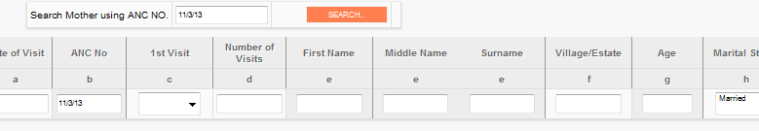
Data Entry ANC REGISTER – a to h
Notes:
This section contains details from columns a to h of the ANC register.
NB: as of this version of MNHC, one is not allowed to enter the ANC Number manually.

Slide 40
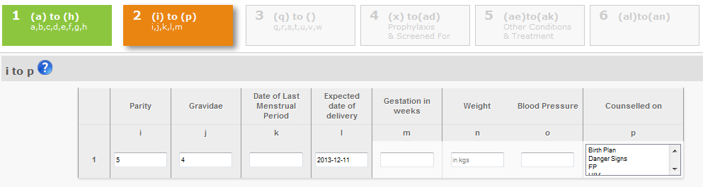

Data Entry ANC REGISTER – i to p
For more detailed guide on each section, click the blue help icon.
The orange tab( 2 I to p) shows the current open tab.
The green tab shows the already visited tabs and the light-grey ones show the pages to be visited yet.
Move to the next tab by clicking Next button, back by pressing the previous button and finish by clicking the Finish button.

Slide 41
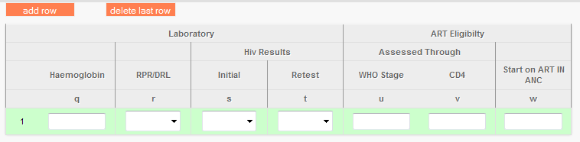
Data Entry ANC REGISTER – q to w
Unlike some other sections of the ANC Register, section q to w requires one to input all the values by typing them and thus there are no values being captured from the Mother Baby book , hence no already prefilled input fields.
Notes:
Section Q to W

Slide 42
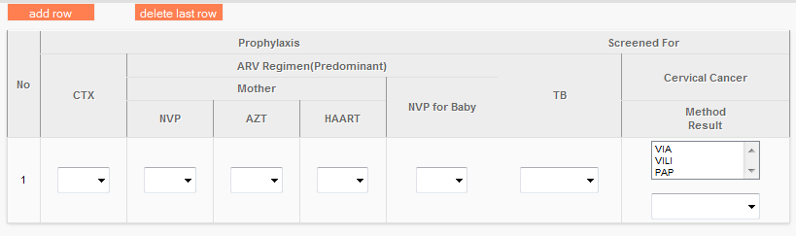
Data Entry ANC REGISTER – x to ad
Unlike some other sections of the ANC Register, section x to ad requires one to input all the values by typing them and thus there are no values being captured from the Mother Baby book , hence no already prefilled input fields.

Slide 43
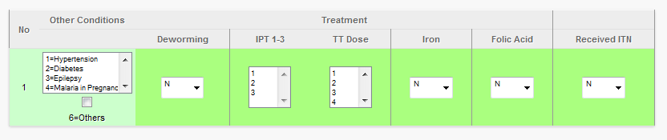
Data Entry ANC REGISTER – ae to ak
Fill this column
Already prefilled
One should only enter contents in the ‘other conditions’ column only, since the other columns are getting their data from the Mother baby book.

Slide 44
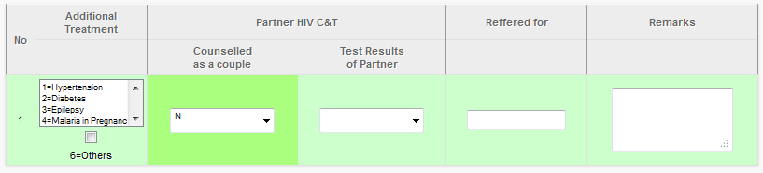
Data Entry ANC REGISTER – al to an
Skip this column
Fill the rest of the fields

Slide 45
Data Entry MATERNITY REGISTER
Manages mothers details after delivery.
Is a model of Kenya’s Ministry of Health maternity register and picks all the data from that book.
NB: The maternity register is different from other registers in that it differentiates mothers using their Admission number rather than the ANC number.
To open thematernity register :
Click view all mothers menu
Search any mother of interest
Click the Maternity Register
Type the mothers admission number to see the mother details

Slide 46
Data Entry MATERNITY REGISTER (a) to (h)

Slide 47
Data Entry MATERNITY REGISTER (i) to (p)

Slide 48
Data Entry MATERNITY REGISTER (q) to (u)

Slide 49
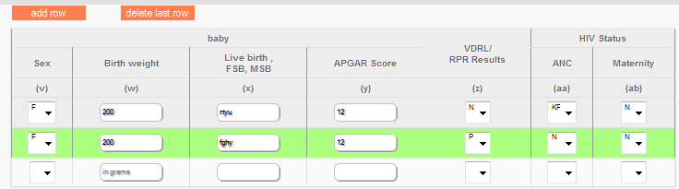
Data Entry MATERNITY REGISTER (v) to (ab)

Slide 50
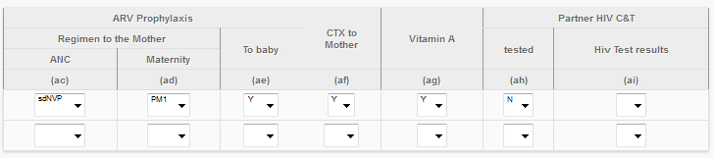
Data Entry MATERNITY REGISTER (ac) to (ai)

Slide 51
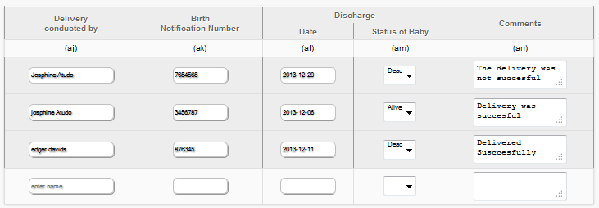
Data Entry MATERNITY REGISTER (aj) to (an)

Slide 52
Data Entry ANC VISITS DAIRY
This dairy is used to track mothers antenatal care clinic attendance.
Each mother who is expected to attend a clinic should be marked somewhere . The mothers who fail to attend should be notified through an sms.

Slide 53
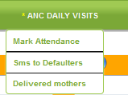
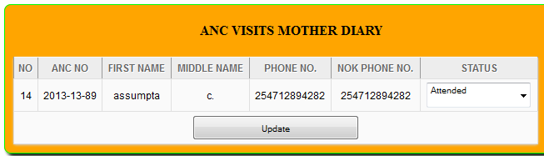
Data Entry Marking ANC visits dairy

Slide 54
Data Entry Marking ANC visits dairy
To mark the mothers who attended clinic for that day;
Over your mouse on Anc daily visits menu
Select the Mark Attendance submenu
A list of the mothers who should be visiting the Clinic on that day appears.
Update the status of the mother as attended if they availed themselves or as Not attended if they never turned up for the visit.
Click on Update to commit the results.

Slide 55
SMS
Mnhc uses Sms to send mothers targeted ,general and reminder messages .
Sms must be created, and disbursed by a user(admin).
Targeted messages are send at scheduled time while general sms are send by users at any logical time of interest.
One SMS consists of 160 characters , including space.
Notes:
A page here means the maximum number of characters allowed in a single SMS. If the sms is greater than 160, then the number will be greater than that.

Slide 56
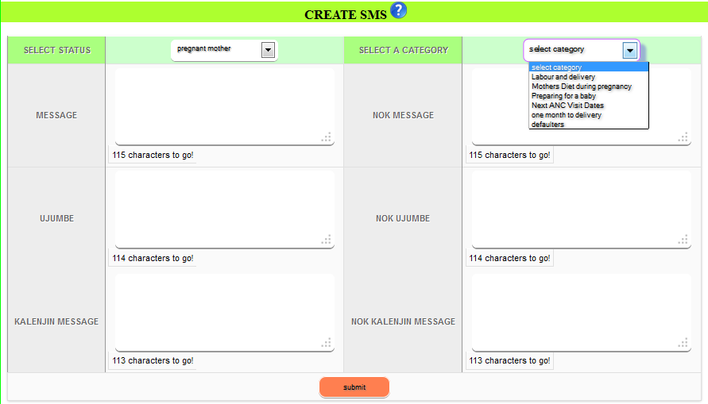
SMS creating an SMS

Slide 57
SMS creating an SMS
To Create an SMS
Over your mouse on SMS menu
Click on Create SMS link
A window appears prompting you to select status of the targeted receivers.
Select the category of the sms amongst the available options in the drop down.
Create an English message for both first person and third person
Create a swahili message ‘Ujumbe’ for both first and third Person.
Create a Kalenjin message, for both First and third person.
Click submit
All the messages should have the same meaning, and the difference should be the language and the person to whom it is being send to.
NB: Names and salutations are already catered for, thus one should not include salutation and someone’s name.

Slide 58
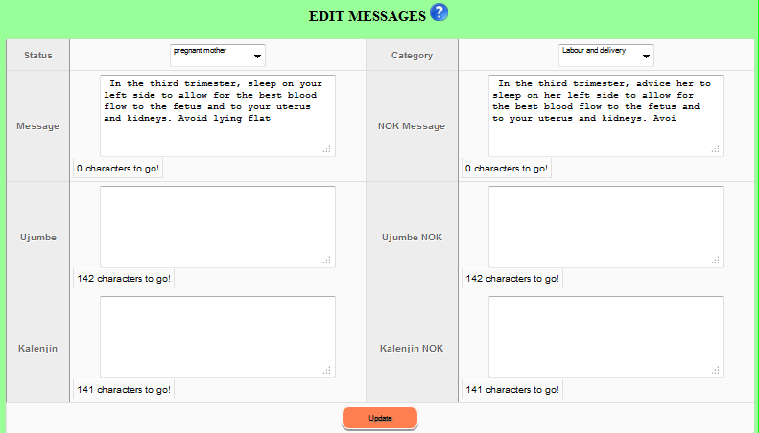
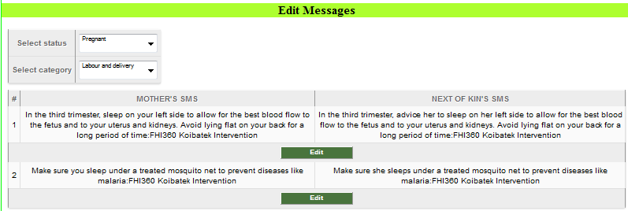
SMS editing an SMS

Slide 59
SMS editing an SMS
To edit an SMS
Over your mouse on SMS menu
Click on Edit SMS link
A window appears prompting you to select status of the SMS and the Category.
A list of all the messages appears under the selected category and status.
Click on edit under any of the messages to view all the messages (swahili, English and Kalenjin) in both first and third person.
Edit the message of intrest
Click the Update button to commit the edits.

Slide 60
SMS interacting through an SMS
One can send three types of SMS to mothers.
General SMS
Targeted SMS
Defaulters SMS.
General SMS includes messages to mothers at either of the status pregnant or post natal.
Targeted SMS includes messages to mothers who their anc visits or expected delivery days are due on a certain predefined date.
Defaulters SMS is a messaging system used to track and remind mothers who fail to attend ANC visits that they never did so.
MNHC is also used as interaction channel through which mothers assigned to a certain CHW can ask them questions and the chw responds back through the system.
The interaction should be free of charge .

Slide 61
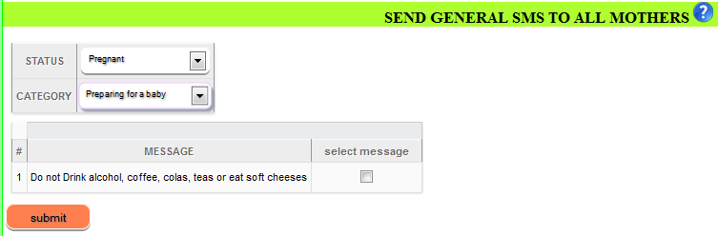
SMS sending General SMS

Slide 62
SMS sending General SMS
To send a general sms,
Over your mouse on SMS menu
Select ‘Send General SMS’ submenu
Select The status of the receivers(pregnant or postnatal)
Select the category of the sms amongst the following categories:
Labour and delivery
Mothers diet during pregnancy
Preparing for a baby
A list of sms under the specified status and category appears.
Check the sms you’d wish to broadcast.
Click submit and wait for the sms to be send.

Slide 63
SMS sending Targeted SMS
A user interface accessible to an administrator is available for them to make changes on the hours of the day in which the ANC visits and EDD modules that sends targeted sms are executed.
Eg. The EDD module for sending SMS can set to be executed daily at 8:30am and not any other time .
The targeted sms are send by a code in the background .
The system sends the sms to mothers whose anc visit dates are one month and one week due or their expected delivery date is one month due .
Notes:
To avoid sending duplicate SMS , a monitoring table exists that indicates whether ANC SMS/ EDD SMS for that day have been send and thus no SMSs can resend again to the intended receivers .
If the ANC and EDD execution time comes when there is a problem in internet connection ( important when sending SMSS) on the host machine of the system, then a postponement of the scheduler is done to a later time in a recurring manner until internet connection is back during that day, where the execution is done and SMS send

Slide 64
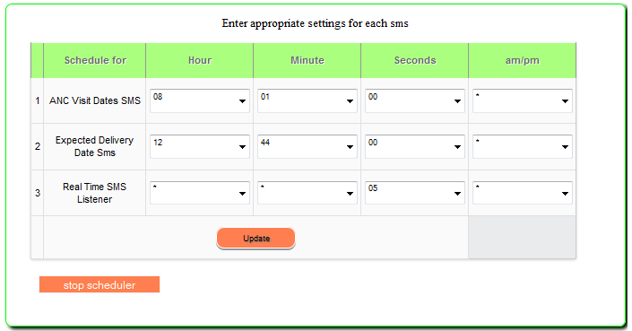
SMS Setting up SMS Scheduler
Click the Update button, then stop the scheduler and restart it for the changes made to be effective.

Slide 65
SMS Setting up SMS Scheduler
To set the scheduler time :
Login as an admin
Click on sms scheduler menu.
On the window that appears:
Enter the hour, minute, seconds and am/pm values for each of ANC and EDD scheduler time.
If any of the columns does not apply, select an asteric ‘*’.
For the Real-time listener, specify the seconds column only. This is the number of seconds taken before the system checks for new incoming sms.
5 seconds is the advised value.

Slide 66
SMS Sending SMS to defaulters
To send sms to mothers who never attended the clinic;
Ensure you fully mark the anc visits attendance of mothers for that current day.
All mothers who have not attended the ANC visit will be qualified to receive a defaulter sms.
Check the mothers by ticking the check box under column send sms.
Click the Send SMS to defaulters button to disburse the smss.
NB: You should sent sms to mothers at the very day they defaulted .

Slide 67

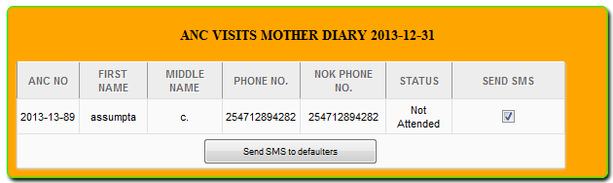
SMS Sending SMS to defaulters

Slide 68
SMS Mother To CHW Interaction
A registered mother can send any SMS to their assigned chw through the MNHC System.
A mother should send the sms using their phone number or the next of kin’s phone number
The mother should sent the sms to the provided MNHC sms disbursement number.
As of version 1.0 of the MNHC system, the number is not static but in later versions, the number will be communicated.
The send sms will be redirected to the right chw by the system.
NB: Read the notes below
Notes:
A mother can send an sms to their chw using the registered next of kin’s phone number.
A mother can also send an SMS to their chw using another unregistered number to their CHW. To do this, The mother should send an SMS beginning with their registered ten digit number, a space , then the message to the chw.

Slide 69
SMS CHW To Mother Interaction
The message that is sent to a chw comes with a mother id.
The mother id is usually written in brackets.
To respond back to the mother, send a message to the MNHC sms Disbursement number in this format:
@motherid @ Message
e.g. To respond to an sms from a mother whose id is 2, type the following:
@2@ ‘your response message’

Slide 70
End

