Slide 1
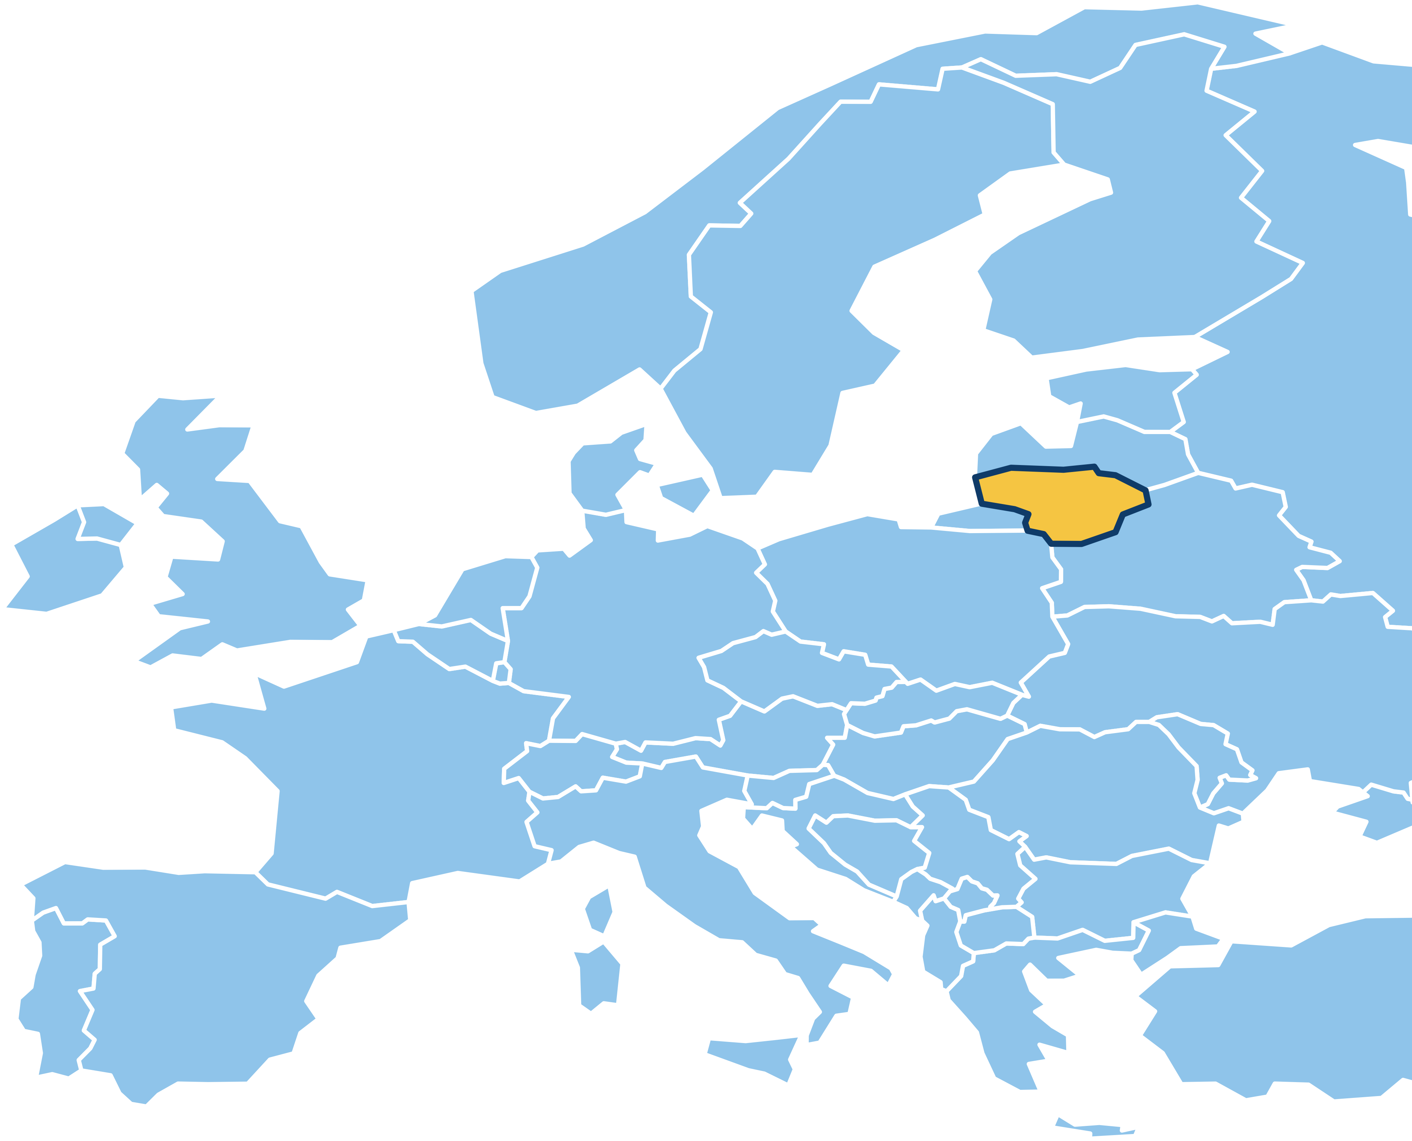


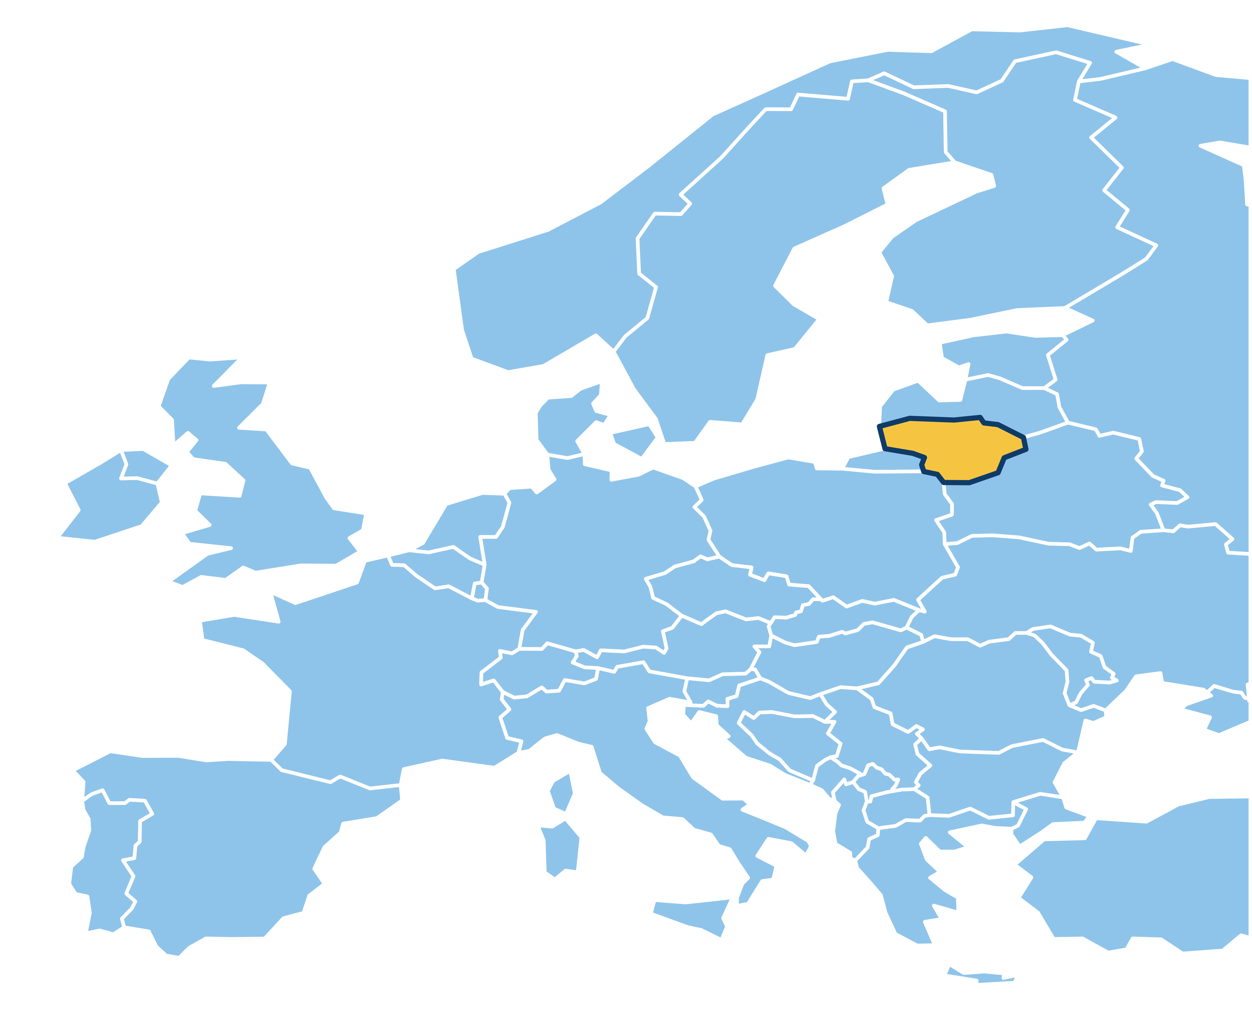





PEP / EUROPEAN PARLIAMENT POLICY POSTER
ECONOMY & FINANCE
COMPARE THE PRICE.
WHY NOT THE QUALITY?
LOGISTICS SERVICE QUALITY & CUSTOMER SATISFACTION
IN LITHUANIAN E-COMMERCE
Chaymae Elkasri / International Business Administration / Lithuania
THE CHALLENGE
WHAT QUALITY INCLUDES
Delivery prices are easy to compare.
Service quality should be too.
Reliable, on-time delivery
Parcels in good condition
Clear tracking and complaint handling
THE POLICY OPPORTUNITY
EU parcel-delivery rules already support tariff transparency. Build on price information by
testing clear, comparable measures of service quality.
CALL TO ACTION
MAKE DELIVERY QUALITY COMPARABLE.
Develop and test shared measures of reliability, on-time delivery, parcel condition and complaint
handling.
WHAT COULD CHANGE?
TODAY
POSSIBLE FUTURE
Price + estimated
delivery time
Price + comparable
service quality
Policy concept: shared indicators need clear definitions, fair verification and EU-wide testing.
LITHUANIA TO EUROPE
Local research to inform a wider European conversation about delivery quality.
FROM EVIDENCE TO ACTION
LISTEN
Understand what shoppers value
MEASURE
Define fair, reliable indicators
COMPARE
Test comparable quality information
KEY RESEARCH FINDINGS
71 submissions / 60 eligible responses / Return handling: n = 41
4.58 / 5
r = .586
78.3%
HIGHEST QUALITY RATING
STRONGEST LINK, n = 60
TOP THREE PRIORITIES
Order accuracy
Communication
Speed, reliability, condition
THE SURVEY EVIDENCE
QUALITY RATING
LINK TO SATISFACTION
Mean score / five-point scale
Pearson correlation / r
Order accuracy
4.58
Return handling*
0.597
Product condition
4.38
Communication
0.586
Communication
4.36
Product condition
0.513
Reliability
4.24
Reliability
0.499
Delivery speed
3.90
Delivery speed
0.492
Return handling*
0
3.06
Order accuracy
0.469
5
0
1
WHAT SHOPPERS PRIORITISE
Share selecting each dimension as their top priority / n = 60
Delivery speed
31.7%
Reliability
26.7%
Product condition
20.0%
Order accuracy
10.0%
Communication
10.0%
Return handling
0%
40%
1.7%
* Return handling: 41 complete paired responses; all other dimensions: 60. Correlation indicates association, not causation.
POTENTIAL BENEFITS
BETTER
INFORMATION
COMPETITION
ON QUALITY
CLEARER
STANDARDS
CROSS-BORDER
COMPARABILITY
METHOD
Cross-sectional online survey using convenience sampling. Participants had received an online-purchase
delivery in Lithuania in the previous six months. Six quality dimensions used paired five-point items;
satisfaction used four items. Analysis: descriptive statistics and Pearson correlations.
READ WITH CAUTION
Small, non-random sample (n = 60), below the planned 100–200. Findings are not
representative of Lithuania or the EU and cannot establish causation.
EU POLICY
CONTEXT
Regulation (EU) 2018/644 addresses cross-border parcel delivery, including tariff
transparency. Quality indicators remain a proposal for testing.
HAVE A QUESTION?
REFERENCES
WHATSAPP
WhatsApp: +370 628 05 196 • Celkasr22@lcc.lt
Sources: Elkasri survey (2026); Regulation (EU) 2018/644.
Full references via QR. Design contact: Chaymae Elkasri / Celkasr22@lcc.lt.

