Slide 1
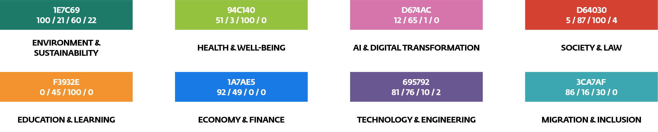
Please be sure to fill this out:
Authors + QR-Link: Chaymae Elkasri | References: https://docs.google.com/document/d/1LrENoEXVlNTbItlunBo2xR9weEgIFos6/edit
Name / email address for design or technical queries: Chaymae Elkasri / Celkasr22@lcc.lt
Font specifications :
Please use the "Nunito Sans" font for the text! Free download at: https://fonts.google.com/specimen/Nunito+Sans?query=Nunito+Sans
Please submit all other fonts by name or, preferably, as font files (to ensure correct rendering in print).
Design/Layout:
In general, the poster design is up to you—the specified font sizes are recommendations. However, please ensure that the font sizes are not significantly smaller.
Cluster colors:
QR-Code on Poster (if needed for Literature):
They can be generated free of charge at https://www.qrcode-monkey.com/. We recommend a minimum size of 2 x 2 cm.
Images/Graphics/Elements:
Please also submit the raw data (e.g., Excel files for your graphs). Thank you very much.
Submission of data:
Please be sure to submit both the PPT and a print-ready PDF, along with the elements described above.
Final poster size:
With: 420 x Height 1360 mm.
Typographic proposal :
Headline Font size: 72
Secondary headline Font size: 40
Introduction Suspendisse sem lorem, ornare non, vestibulum ut, tempor porttitor, est. Quisque convallis aliquet eros. Nunc nec nulla eget urna convallis eleifend. Nulla feugiat eros at augue. Integer feugiat nisi vitae velit. Font size: 24
Running text Suspendisse sem lorem, ornare non, vestibulum ut, tempor porttitor, est. Quisque convallis aliquet eros. Nunc nec nulla eget urna convallis eleifend. Nulla feugiat eros at augue. Integer feugiat nisi vitae velit. Font size: 18
Subheading
Running text Suspendisse sem lorem, ornare non, vestibulum ut, tempor porttitor, est. Quisque imperdiet, quam a gravida pulvinar, est sem faucibus felis, sit amet consequat pede turpis id ante. In facilisis sodales arcu. Mauris tincidunt. Font size: 18
Running text Suspendisse sem lorem, ornare non, vestibulum ut, tempor porttitor, est. Quisque imperdiet, quam a gravida pulvinar, est sem faucibus felis, sit amet consequat pede turpis id ante. In facilisis sodales arcu. Mauris tincidunt. Font size: 18
Running text Suspendisse sem lorem, ornare non, vestibulum ut, tempor porttitor, est. Quisque imperdiet, quam a gravida pulvinar, est sem faucibus felis, sit amet consequat pede turpis id ante. In facilisis sodales arcu. Mauris tincidunt. Font size: 18
Running text Suspendisse sem lorem, ornare non, vestibulum ut, tempor porttitor, est. Quisque imperdiet, gravida pulvinar, est sem faucibus felis, sit amet consequat pede turpis id ante. In facilisis sodales arcu. quam a gravida pulvinar, est sem gravida pulvinar, est sem faucibus felis, sit amet consequat pede turpis id ante. In facilisis sodales arcu. faucibus felis, sit amet consequat pede turpis id ante. In facilisis sodales arcu. Mauris tincidunt. Font size: 18
Captions Suspendisse sem lorem. Font size: 10
Literature : Müller, M./Schulze, M. (2020): Literaturangaben richtig machen. In: Meyers großes Werk Font size: 9

