Slide 1

HAGIAZO HAIR
Be set apart
BUSINESS PACK · VENTURE I OF HAGIAZO
Premium braids, locs & wigs · Harlow, Essex

Slide 2
THE BIGGER PICTURE
Hagiazo — a house
set apart
HAGIAZO
Hagiazo Hair is the first of many. Hagiazo means to set apart — a philosophy bigger than hair, carried into every venture. One house, one ethos: set apart, and then its world.
Hagiazo Hair
LIVE
Hagiazo Homes
NEXT
Hagiazo Beauty
Led by Ruvimbo & Elkelvin.
Hagiazo Wellness · …

Slide 3
THE ROADMAP
The house we're building
A lifestyle house united by one thread — set apart — not by a single trade.
Hagiazo Hair
Hagiazo Homes
Hagiazo Beauty
Braids, locs & wigs
Home & living
Beauty
LIVE
NEXT
ENVISIONED
Hagiazo Wellness
Hagiazo Homeware
Hagiazo Studios
Wellness
Home & gifting
Studios / creative
ENVISIONED
ENVISIONED
ENVISIONED
Plus Hagiazo Holdings — the group entity to come. · Prove the first, then build the house.

Slide 4
VENTURE I — THE PACK
Inside Hagiazo Hair
01
The promise
02
Meet Ruvimbo
Why clients leave transformed
Founder, therapist-trained, ~15 years
03
Services & pricing
04
Brand at a glance
Six signature categories
The look, feel & voice
05
The essentials
06
Money & direction
Compliance, privacy & admin
A simple rhythm & the focus

Slide 5
THE PROMISE
More than hair —
a renewing
THE MOAT
Most braiders compete on price and speed.
Hagiazo means to set apart. Clients don't just leave looking different — they leave feeling renewed. Therapist-trained care meets master craft, so the transformation is never only physical.
Hagiazo competes on how the chair feels — a calm, restorative experience few can copy.
“You don't just leave looking different — you leave set apart.”

Slide 6
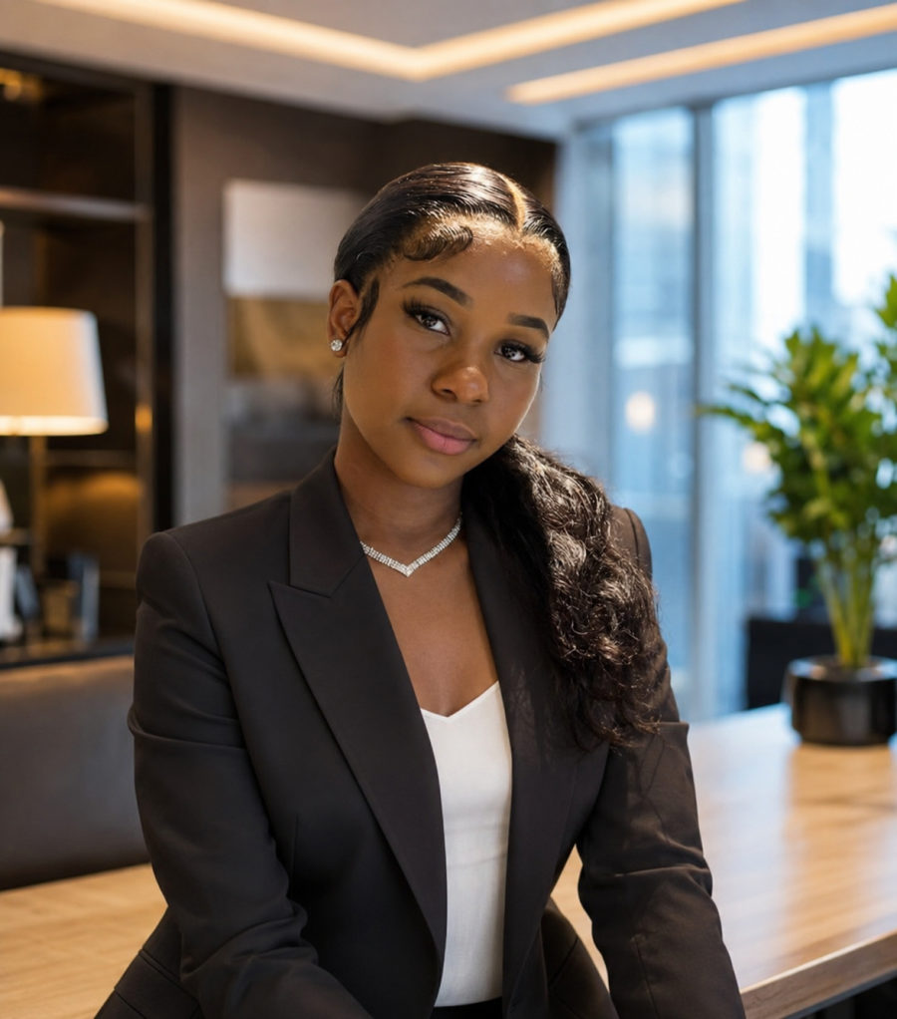
THE FOUNDER
Meet Ruvimbo
Founder and heart of Hagiazo Hair. Before the styling chair, there was the therapist's chair — and that same instinct, to care for the whole person, shapes every appointment.
15+
1
6
Years of craft
Therapist-trained
Signature services

Slide 7
SERVICES
Signature services & pricing
Braiding hair is included. Size refers to the partings — the finer the braids, the more work and the higher the price.
Boho Bob Braids
Cornrow & Fulani Braids
French Curls
£110 – £140
£85 – £140
£120 – £180
Knotless Braids
Knotless Boho Braids
Custom Wigs
£100 – £185
£130 – £170
from £75

Slide 8
BRAND
Brand at a glance
PALETTE
TYPOGRAPHY
Fraunces
Headings — serif, editorial
Near-black
Charcoal
Gold
Stone
Cream
#0D0A07
#2A2420
#A98A66
#ECEBE7
#FAFAF8
Inter — clean sans for body text
A GROUP IDENTITY
Monogram, palette and voice are shared across every Hagiazo venture — set apart, then tailored.

Slide 9
GET IT RIGHT
The essentials
The basics that protect the business — documented in full in the pack.
✓
Register with HMRC
✓
Insurance
Self-employment & Self Assessment
Public & treatment liability
✓
ICO / UK GDPR
✓
Health & safety
Pay the data fee; privacy policy live
A simple written risk assessment
✓
Local licensing
✓
Protect the brand
Confirm with Harlow Council
Trademark “Hagiazo”; secure domains & handles

Slide 10
DIRECTION
Money & the 90-day focus
A SIMPLE RHYTHM
THIS QUARTER
Log what you take, every time
Keep every receipt (they lower your tax)
Move 20–30% of profit to a tax pot monthly
Spend your time on the work that pays best
1
Convert
Real photos + a working booking link
2
Compliance
Insurance + ICO / GDPR
3
Be found
Google Business Profile + reviews
Grow the second engine: custom wigs earn about twice the braiding hourly rate.

Slide 11
FOR YOUR CLIENTS
Client-ready tools
Consultation & Intake Form
Aftercare Cards
A professional form clients complete before their appointment — style, hair, allergies, photo consent and deposit.
Take-home cards for braids, locs and wigs so every style lasts and hair stays healthy.
Booking & Cancellation
Privacy Policy
A ready deposit, reschedule and no-show policy — set your amounts and publish.
Website-ready, UK GDPR-compliant, with photo consent built in.

Slide 12
Be set apart
HAGIAZO · a house being built, one venture at a time
hagiazohair.co.uk · @hagiazohair
elkelvinwilliams.github.io/harlow-hair-beauty · Harlow, Essex

