Slide 1

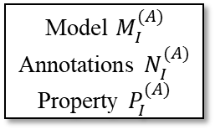






SysML
AADL
Explanation Model $E_{s}$
Model $M_{s}$
Property $P_{s}$
Explanation Model $E_{A}$
Model $M_{A}$
Property $P_{A}$
IML
Explanation Model $E_{I}^{(S)}$
Model $M_{I}^{(S)}$
Annotations $N_{I}^{(S)}$
Property $P_{I}^{(S)}$
Model $M_{I}^{(A)}$
Annotations $N_{I}^{(A)}$
Property $P_{I}^{(A)}$
Explanation Model $E_{I}^{(A)}$
Meta-reasoner
Meta-reasoning planner
Reasoning Graph
Query Analysis and Dispatch
Translators
SRL
Lustre/…
L
Investigator
SMT Solvers
Model Checkers
Other Solvers
This page does not contain any export controlled technical data

Slide 2







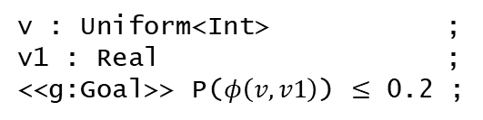


v : Uniform<Int> ;
v1 : Real ;
<<g:Goal>> P($φ\left(v,v1\right)$) $≤$ 0.2 ;
Meta-reasoning planner
$$φ(v,v_{1})$$
0.$2$
$$φ[v←c]$$
Y / N / U
Substitute
$$KB$$
Estimator
$$≥$$
$$KB⊨G$$
1000
$$c$$
$$false$$
$$G$$
Done
Sampler
This page does not contain any export controlled technical data

Slide 3






















$$S_{1}$$
$$S_{2}$$
$$S_{4}$$
$$S_{5}$$
$$S_{3}$$
Meta-reasoning planner
$$A_{1}⇒A_{2}$$
$$A_{2}⇒A_{3}$$
$$KB$$
$$KB$$
$$true$$
$$KB⊨G$$
$$true$$
$$KB⊨G$$
$$G$$
$$G$$
$$∧$$
$$∧$$
$$A_{3}∧G_{3}⇒A_{4}$$
Done
$$A_{2}∧G_{2}⇒A_{5}$$
$$KB$$
$$KB$$
$$∧$$
$$true$$
$$KB⊨G$$
$$true$$
$$KB⊨G$$
$$G$$
$$G$$
$$G_{5}⇒G_{1}$$
$$G_{4}⇒G_{2}$$
$$KB$$
$$KB$$
$$true$$
$$KB⊨G$$
$$true$$
$$KB⊨G$$
$$G$$
$$G$$
This page does not contain any export controlled technical data

Slide 4

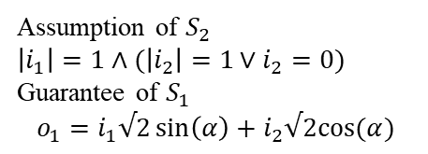


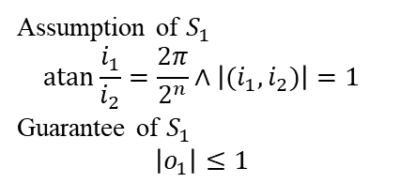
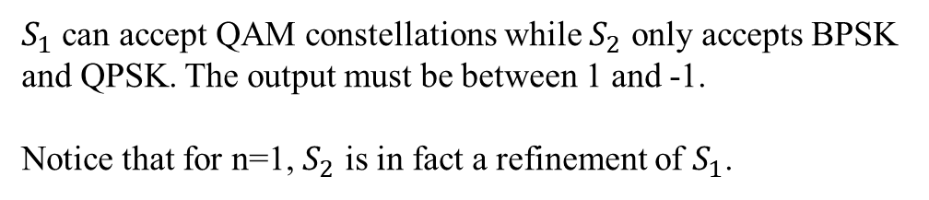



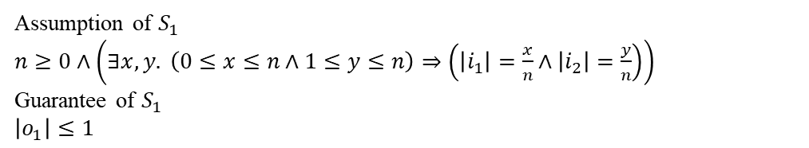




$$S_{1}$$
$$S_{2}$$
Assumption of $S_{1}$
$n≥0∧\left(∃x, y. \left(0≤x≤n∧1≤y≤n\right)⇒\left(\left|i_{1}\right|=\frac{x}{n}∧\left|i_{2}\right|=\frac{y}{n}\right)\right)$
Guarantee of $S_{1}$
$\left|o_{1}\right|≤1$
$$i_{1}$$
$$i_{1}$$
$$o_{1}$$
$$o_{1}$$
$$i_{2}$$
$$i_{2}$$
$$α$$
Simple spec for QAM modulation
$$n$$
Assumption of $S_{2}$
$\left|i_{1}\right|=1∧(\left|i_{2}\right|=1∨i_{2}=0)$
Guarantee of $S_{1}$
$$o_{1}=i_{1}√2\sin\left(α\right)+i_{2}√2cos⁡(α)$$
Simple spec for BPSK or QPSK modulation
Assumption of $S_{1}$
$$\operatorname{atan}{\frac{i_{1}}{i_{2}}}=\frac{2π}{2^{n}}∧\left|{(i}_{1},i_{2})\right|=1$$
Guarantee of $S_{1}$
$$\left|o_{1}\right|≤1$$
$S_{1}$ can accept QAM constellations while $S_{2}$ only accepts BPSK and QPSK. The output must be between 1 and -1.
Notice that for n=1, $S_{2}$ is in fact a refinement of $S_{1}$.
This page does not contain any export controlled technical data

Slide 5
package utrc::test1
public
with Base_Types;
system S1
features
i1: in data port Base_Types::Float;
i2: in data port Base_Types::Float;
o1: out data port Base_Types::Float;
n : in data port Base_Types::Integer ;
annex iml {**
a1 <<a:Assume>> : Bool := exists x:Int, y:Int { (y >= 0 && y <= n && x>=1 && x <= 0) => ( (i1 = x/n || i1 = -1 * x/n) && ( i2 = y/n || i2 = -1 *y/n)) } ;
g1 <<g:Guarantee>>: Bool := o1 <=1 && o1 >=-1;
**};
end S1;
system S2
features
i1: in data port Base_Types::Float;
i2: in data port Base_Types::Float;
o1: out data port Base_Types::Float;
alpha : in data port Base_Types::Float;
annex iml {**
a1 <<a:Assume>> : Bool := (i1 =1 || i1=-1) && (i2=0 || i2 =1 || i2 = -1) ;
g1 <<g:Guarantee>>: Bool := o1 = i1 * sqrt(2) * sin(alpha) + i2 * sqrt(2) * cos(alpha);
**};
end S2;
system implementation S1.Impl
subcomponents
S2_sub : system S2 ;
connections
i1_TO_A : port i1 -> S2_sub.i1;
i2_TO_A : port i2 -> S2_sub.i2;
S2_TO_o1 : port S2_sub.o1 -> o1 ;
end S1.Impl;
end utrc::test1;
AADL MODEL
This page does not contain any export controlled technical data

Slide 6
AADL package
package utrc.test1 ;
import iml.lang.*;
import hermes.iml.aadl.* ;
import hermes.iml.contracts.* ;
type <<s:system>> S1 {
i1 <<i:in,p:port>>: Float;
i2 <<i:in,p:port>>: Float ;
o1 <<o:out,p:port>>: Float ;
n <<i:in,p:port>>: Integer;
a1 <<a:Assume>> : Bool := exists x:Int, y:Int { (y >= 0 && y <= n && x>=1 && x <= 0) => ( (i1 = x/n || i1 = -1 * x/n) && ( i2 = y/n || i2 = -1 *y/n)) } ;
g1 <<g:Guarantee>>: Bool := o1 <=1 && o1 >=-1;
}
type <<s:system>> S2 {
i1 <<i:in,p:port>>: Float;
i2 <<i:in,p:port>>: Float ;
o1 <<o:out,p:port>>: Float ;
alpha <<i:in,p:port>>: Float;
a1 <<a:Assume>> : Bool := (i1 =1 || i1=-1) && (i2=0 || i2 =1 || i2 = -1) ;
g1 <<g:Guarantee>>: Bool := o1 = i1 * sqrt(2) * sin(alpha) + i2 * sqrt(2) * cos(alpha);
}
type <<s:system,i:implementation>> S1__impl extends S1 {
S2_sub <<c:subcomponent>>: S2 ;
i1_TO_A : Connection := new Connection {source=i1; target = S2_sub->i1;};
i2_TO_A : Connection := new Connection {source=i2 ; target = S2_sub->i2;};
S2_TO_o1 : Connection := new Connection {source=S2_sub->o1 ; target =o1 ;} ;
//i1_TO_A <<c:connection>>: Bool := i1 = S2_sub->i1;
//i2_TO_A <<c:connection>>: Bool := i2 = S2_sub->i2;
//S2_TO_o1 <<c:connection>>: Bool := S2_sub->o1 = o1 ;
}
package hermes.iml.aadl ;
import iml.lang.* ;
type Integer sameas Int;
type Float sameas Real ;
type Boolean sameas Bool ;
meta type system ;
meta type implementation ;
meta type in ;
meta type out;
meta type port;
meta type connection;
meta type subcomponent;
type Connection<type T> {
source : T ;
target : T;
}
IML model
Contract package
package hermes.iml.contracts;
meta type Assume ;
meta type Guarantee;
Language package
package iml.lang;
type Int ;
type Real ;
type Bool ;
meta type Assert;
meta type Goal;
meta type Modality;
sqrt : Real ~> Real ;
sin : Real ~> Real ;
cos : Real ~> Real ;
This page does not contain any export controlled technical data

Slide 7
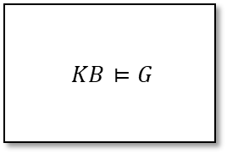

Reasoning graph (written in IML) where inst is a generic instance of S1__iml
(inst->S2_sub->a1 => inst->S2_sub->g1) && inst->a1
$KB⊨G$
inst->g1
$∧$
Done
inst->a1
$KB⊨G$
inst->S2_sub->a1
This page does not contain any export controlled technical data

Slide 8
BACKUP
This page does not contain any export controlled technical data

Slide 9
Demodulator
DeInterleaving
Error correction
Deframer
System, mission, attacks
Attack Tree
ATG
ATO
Done
Algorithm
Algorithm2
This page does not contain any export controlled technical data

