Slide 1
Case Study 08 Chapter 2, Question 10
Matthew Baldree, Ben Brock, Tom Elkins, Austin Kelly

Slide 2

Abstract
Data analysis of the annual Washington D.C. Cherry Blossom Race from 1999 through 2012 reveal there are noticeable differences of age and elapsed race time. In addition, the abrupt change in run times might be due to a race contestant lottery established in 2009.

Slide 3
Background
This case study is based on the case study: “Getting the data into the right format.” [1]
Race results were scraped from www.cherryblossom.org from 2001 through 2012. Results from 1999 through 2001 were not available online and were obtained elsewhere.
Runner-selection moved to a lottery system in 2009. The organization claims the previous first-come-first-served system may have negatively affected registrants who could not get to the website before the race filled up.

Slide 4
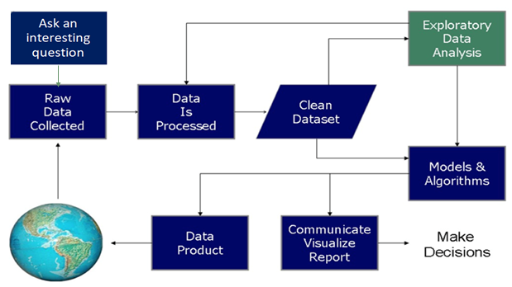
What Do Data Scientists Do?
Notes:
This slide helps blend the Scientific Method with Data Science.

Slide 5
Questions
Did the increase in popularity influence the results of the race?
Did the distribution in the age of the runners change?
Did the change to a lottery-based registration process impact the results?

Slide 6


Data Loading/Prep
Data was loaded from Cherry Blossom and github sites. [2] [3] [4]
R data: 1999 and 2000 from dtkaplan/statisticalModeling site
Web data: 2001 through 2012 from ”…/results/year/…” pages
Data frames created from R and Web sites (see next two slides) were merged into one data frame.
1999-2000
2001…2012

Slide 7
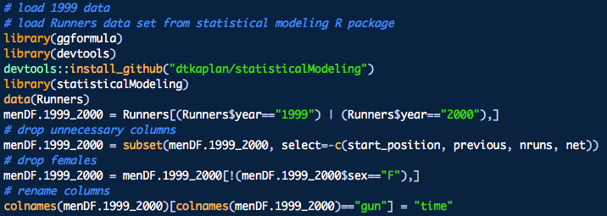
Data loading: years 1999 and 2000
Load devtools in order to load R library from GitHub that contain previous race results.
Load data Runners and filter on the years we need; i.e., 1999 and 2000.
Drop columns and data that we do not need.
Rename column for merging.

Slide 8


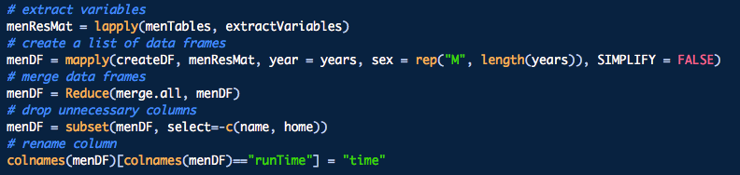
Data Loading: 2001 – 2012 Years
Extract data from web pages into table with year heading.
Extract variables from tables and create data frame per year.
Merge yearly data frame into one data frame.

Slide 9
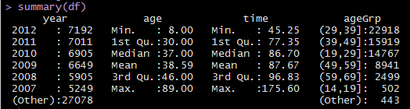
Processing and Cleaning the Data
Determine Important Features
Age
Time
Year
Investigate outliers
Age
Time
Data Wrangling
Age-Group
Dropped people under 8 running a 10K.
Dropped records with a race finish under 20 minutes.
Added USATF standard 10 year age groupings.

Slide 10
How age distributions vary by year

Slide 11
Growth of race by year

Slide 12
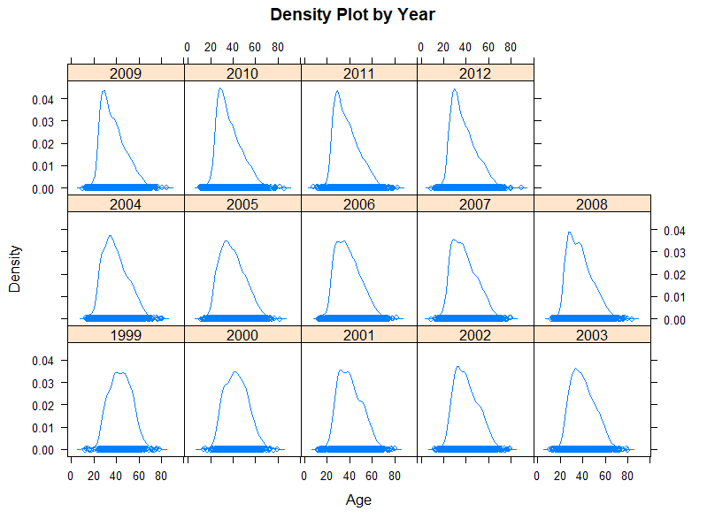
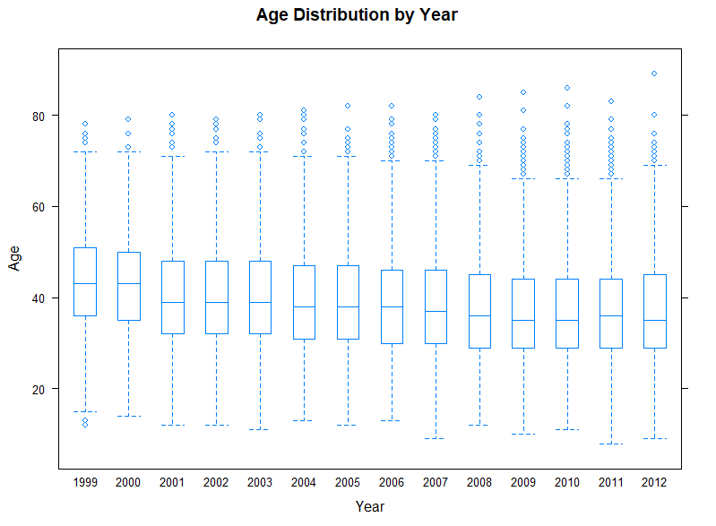
Men’s Runner Results - Age
Boxplot distribution shows the average runner’s age decreases over the years
Density Plots indicate a shift to the left, validating the boxplot pattern. Vertical line is stationed at mean for 1999 and ends to the right of the mean for 2009.

Slide 13
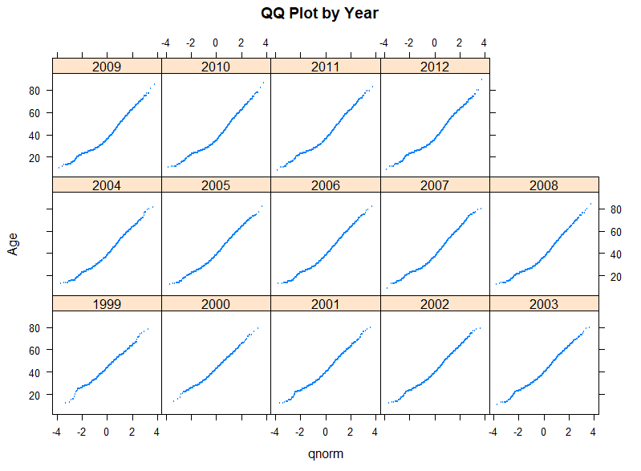
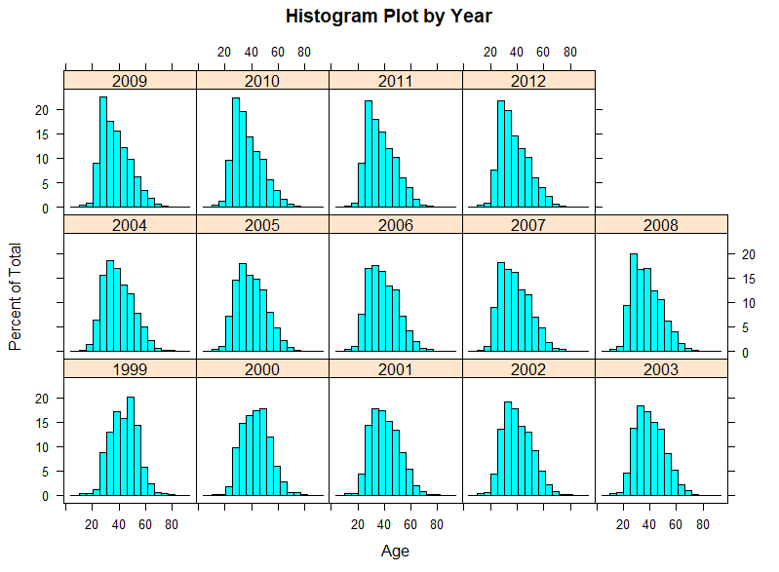
Men’s Runner Results– Age (continued)
The histograms of the ages are relatively normal year over year
QQ plots for each year also show a relatively flat line, indicating no true need for transformation of the data before proceeding. This data is normal!

Slide 14
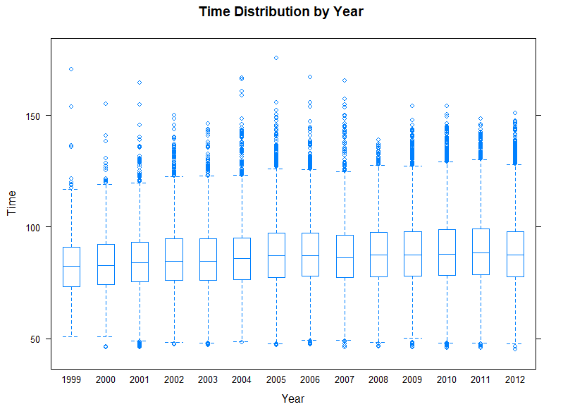
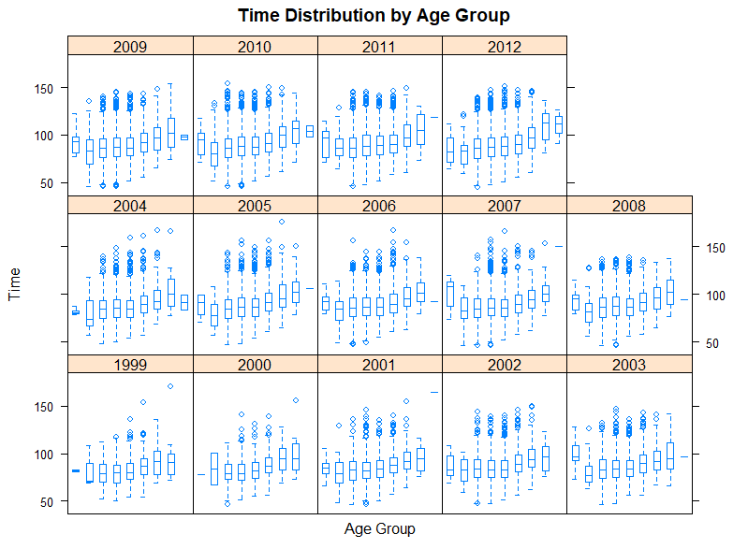
Men’s Runner Results - Time
When compared side by side, the boxplot distribution at the top show an increase in average run times over the course of the 14 years.
The gradual increase in run times paired with the gradual decrease in age for the runners lead us to believe there were more serious, professional runners in 1999 than there were in 2012.

Slide 15
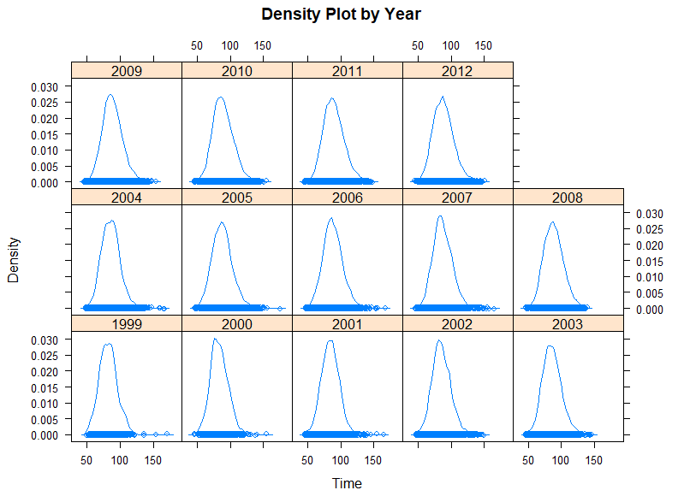
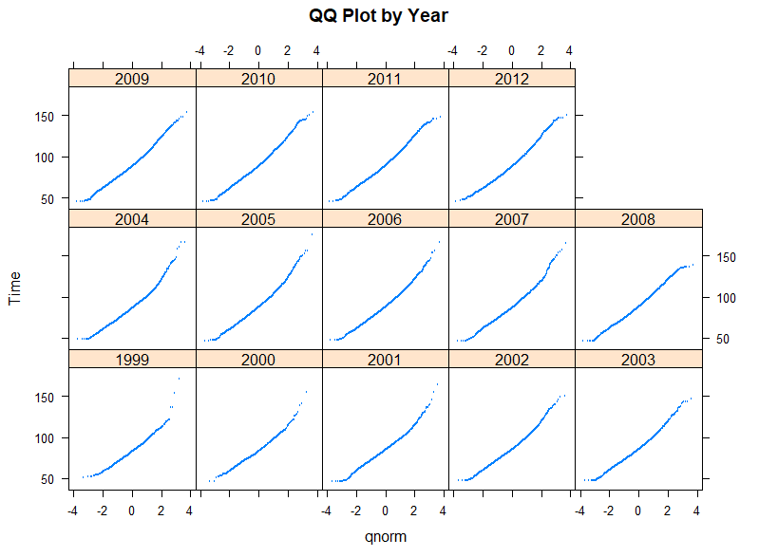
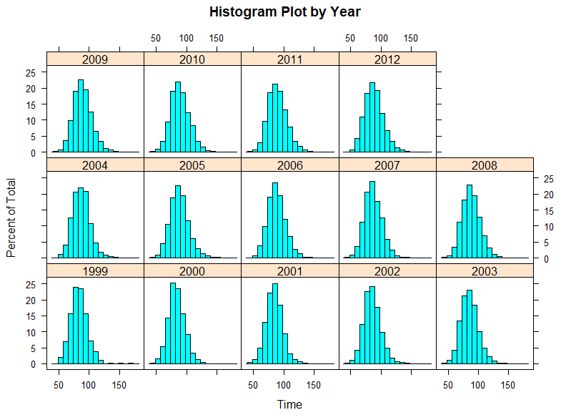
Men’s Runner Results – Time (continued)
Looking at the QQ plots for the average run time year over year, we see this data is relatively normal as well. This can also be seen with the matrix of histograms.

Slide 16
How run times vary by year
With this violin plot, we see the average run time gradually increasing over time.
We can see the gradual change from the initial average relative to the red line.

Slide 17
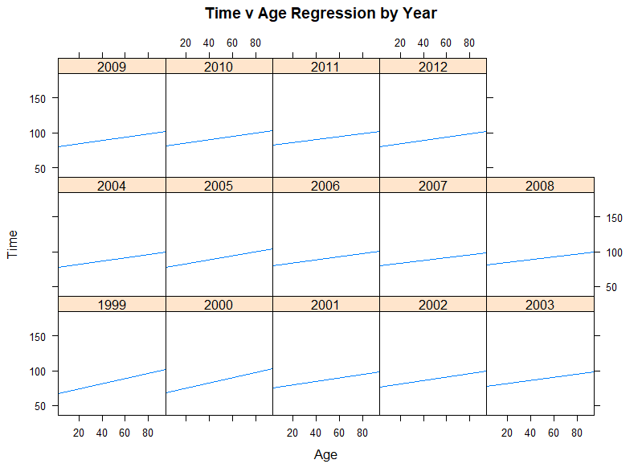
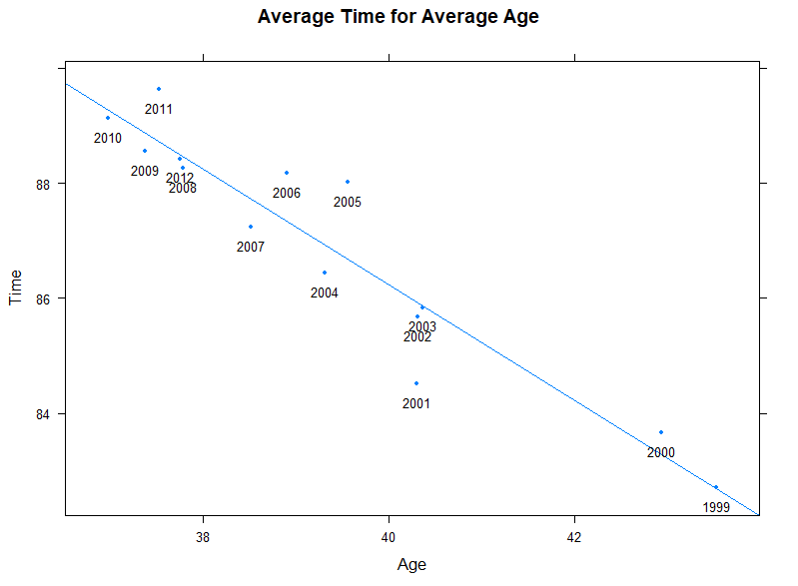
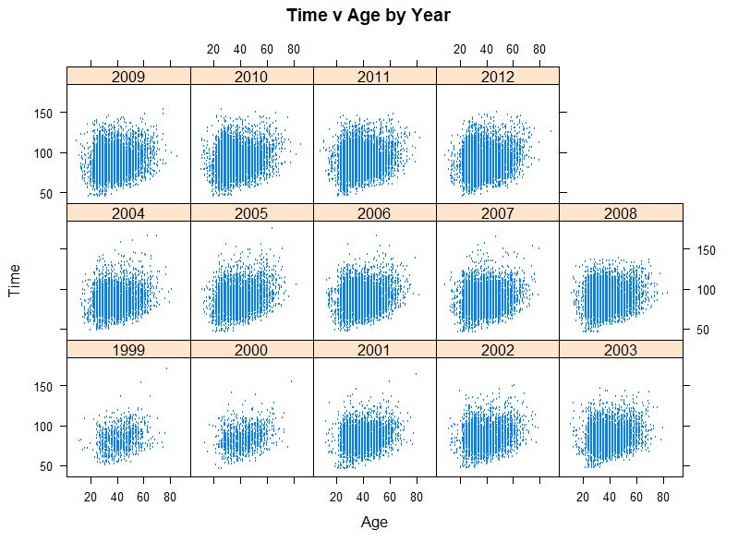
Men’s Runners Results Age versus Time and Age per Year
XY Plot – Time versus Age by Year
XY Plot – Time vs Age Regression by Year
XY Plot – Time vs. Avg Time for Avg Age
XY Plot – Age vs. Avg Age by Year
XY Plot – Time vs. Avg Time by Year

Slide 18
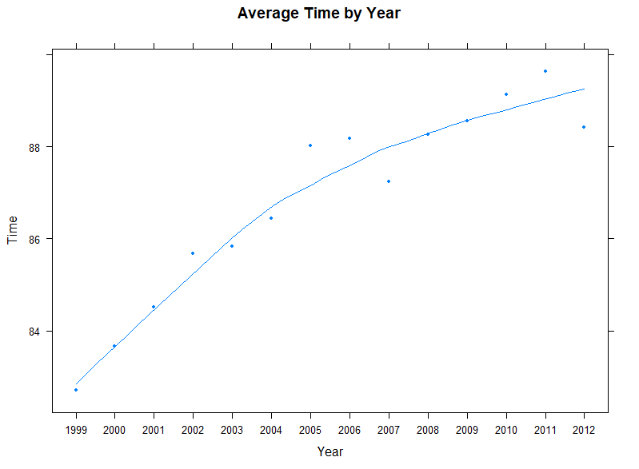
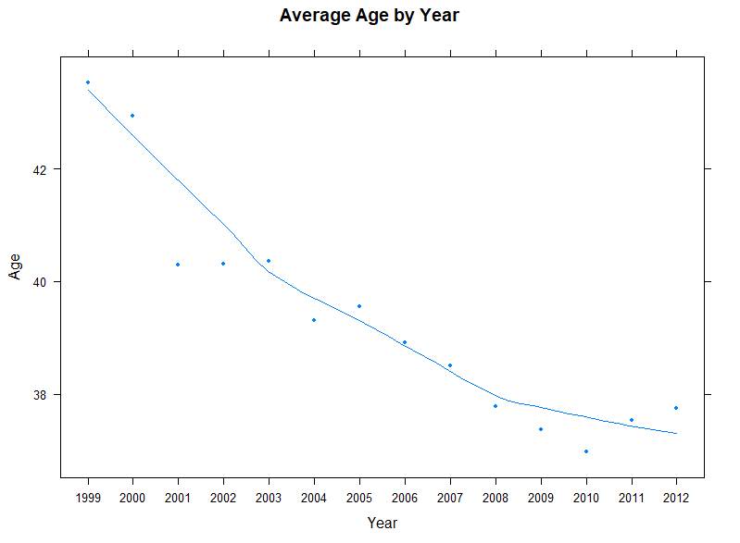
Averages by year
Avg Time
One of our team’s hypotheses claims there was a higher percentage of professional runners in the early years of this data. With an increasing average time and a decreasing average age, we expect a higher number of people who join for the fun and not in preparation for more serious marathons.
Avg Age

Slide 19
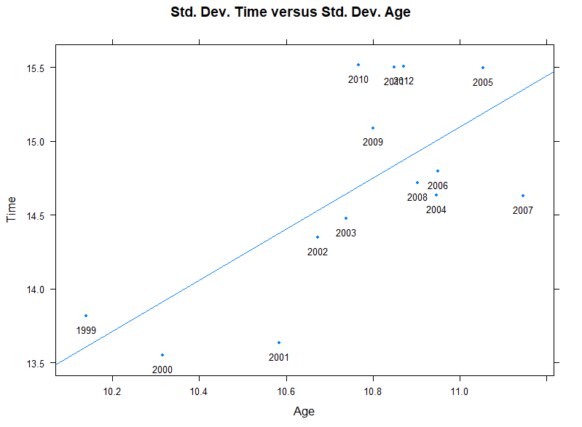
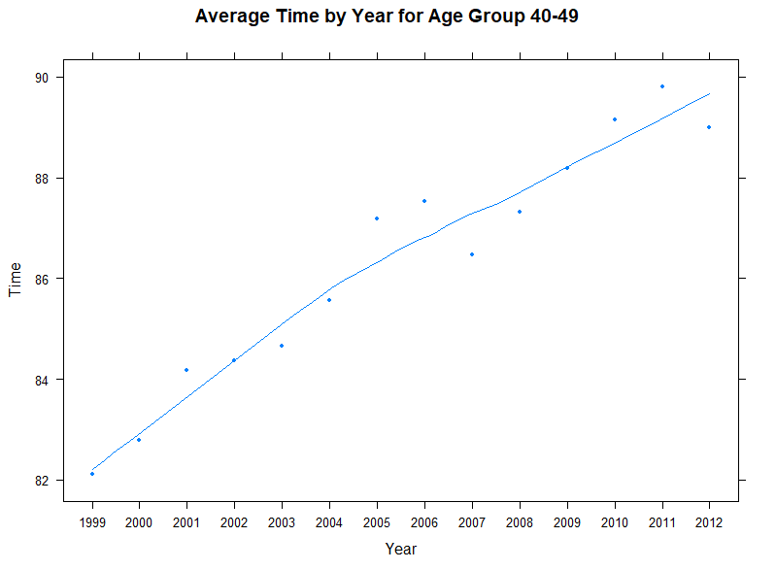
More …..
XY Plot – Time vs. Avg Time by Year for Age Group 40-49
XY Plot – Time vs. Std. Dev Time vs Std Dev Age

Slide 20
Models & Algorithms - used in the R code
MANOVA is a Multivariate extension of ANOVA with the only difference being that in MANOVA there are Multiple Dependent Variables (DV).
ANOVA - 1 DV
MANOVA – 2 or more DVs
Experimental designs in which researchers manipulate or control one or more IVs to determine the effect on one DV (ANOVA) or more DVs (MANOVA)

Slide 21
Models & Algorithms - used in Excel
T-Test: (parametric) Used to compare two groups means
Can only be used for two Age groups (not multiple)
Assume the data to have a normal distribution (bell-shaped curve)
Similar standard deviation
Data must be measured values
Chi-Square Test: (non-parametric)
Sample size must be more than 20
Only be used to compare an experimental result w/a theoretical outcome
Aims to test the null hypothesis of NO DIFFERENCE between data sets

Slide 22
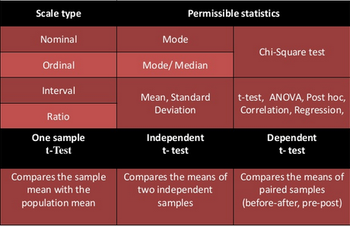
Models & Algorithms - used in Excel
Models used
T-Test
2009 compared to 2010 age group means
Chi-Square
Compared two or more groups variances

Slide 23

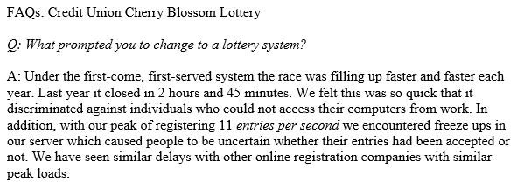



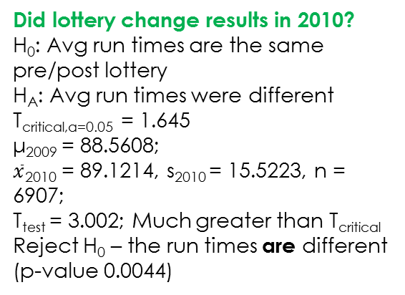
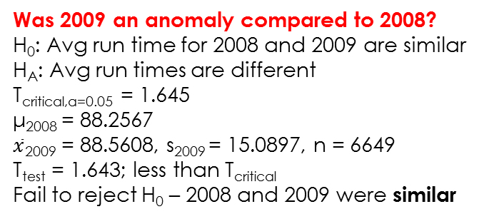
Testing a claim of bias [6]
Was 2009 an anomaly compared to 2008?
H₀: Avg run time for 2008 and 2009 are similar
H_{A}: Avg run times are different
T_{critical,α=0.05} = 1.645
μ₂₀₀₈ = 88.2567
$\overline{x}$₂₀₀₉ = 88.5608, s₂₀₀₉ = 15.0897, n = 6649
T_{test} = 1.643; less than T_{critical}
Fail to reject H₀ – 2008 and 2009 were similar
from Lottery FAQ
START
Was it time/distance-related?
Was it age-related?
Location | 2009 | 2010 | Row total
East Coast | 6423 6414.96 | 6657 6665.04 | 13080
Central | 131 136.83 | 148 142.17 | 279
Mountain | 22 21.58 | 22 22.42 | 44
Pacific | 50 51.50 | 55 53.50 | 105
Europe/ Africa | 18 19.13 | 21 19.87 | 39
Col totals | 6644 | 6903 | 13547
Did lottery change results in 2010?
H₀: Avg run times are the same pre/post lottery
H_{A}: Avg run times were different
T_{critical,α=0.05} = 1.645
μ₂₀₀₉ = 88.5608;
$\overline{x}$₂₀₁₀ = 89.1214, s₂₀₁₀ = 15.5223, n = 6907;
T_{test} = 3.002; Much greater than T_{critical}
Reject H₀ – the run times are different (p-value 0.0044)
Findings:
The introduction of the lottery system had an impact on the registration process, which had an impact on the average run times compared to 2008/2009; however, it may not have been as surmised by the organizers: composition of geographically separated registrants did not change, but distribution in age group did.
Age Group | 2009 | 2010 | Row total
<20 | 73 86.53 | 111 97.46 | 184
<40 | 3944 3993.43 | 4547 4497.57 | 8491
<60 | 1912 1859.62 | 2042 2094.38 | 3954
<80 | 202 191.42 | 205 215.58 | 407
Col totals | 6131 | 6905 | 13036
H₀: Geographically separated registrants were not affected
H_{A}: One or more groups were affected
χ²_{critical,α=0.05} = 9.488
χ²_{test} = 0.7395: MUCH less than χ²_{critical}
Fail to reject H₀ – not affected by time/distance
H₀: Age groups were not affected
H_{A}: One or more age groups were affected
χ²_{critical,α=0.05} = 7.815
χ²_{test} = 9.043: Greater than χ²_{critical}
Reject H₀ – age groups were affected
Notes:
Should we put the findings section on another slide?

Slide 24
Conclusion/Discussions
Did the increase in popularity influence the results of the race?
Our analysis showed the dramatic increase in race participation, and, as the popularity increased, the mean race time increased (became slower).
Did the distribution in the age of the runners change?
Our analysis showed a steady shift to the left (younger) in age distribution.
Did the change to a lottery-based registration process impact the results?
T-tests showed that the introduction of the lottery-based registration did have an impact in the mean race time.
Chi-squared analyses showed that the change was most noticeable in the distribution in age groups and not with geographically-dispersed groups.

Slide 25
Conclusion/Discussions
Over the course of 14 years, it is evident the general makeup of the participants of the Cherry Blossom Race in Washington D.C. shifted from a group of older, dedicated runners to a group of younger, less serious runners.
The implementation of a lottery system in 2009 influenced both the run times and age group distributions.
Runner geographic distribution was not influenced as claimed by the hosts of the race.

Slide 26
REFERENCES
Nolan, Deborah; Lang, Duncan Temple; Data Science in R: A Case Studies Approach to Computational Reasoning and Problem Solving; 2015.
Cherry Blossom Race; http://www.cherryblossom.org/.
R Code to explore and analyze data; MSDS7333-Case08-Master.R
R Code to load data and create data frame; MSDS7333-Case08-DataLoad.R
R Code with supporting functions; MSDS7333-Case08-fx.
Excel Code for bias testing of race lottery.

