Slide 1
Title

Slide 2
Abstract
Austin

Slide 3
Background
Austin

Slide 4
Data Loading/Prep
Matt

Slide 5
Data Prep
Matt

Slide 6
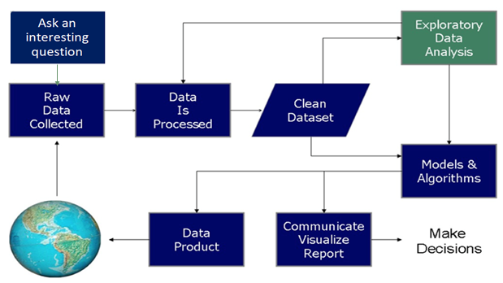
What Do Data Scientists Do?

Slide 7
Processing and Cleaning the Data
Determine Important Features
Age
Time
Year
Investigate outliers
Age
Time
Data Wrangling
Age-Group

Slide 8
Exploratory
Ben/Austin

Slide 9
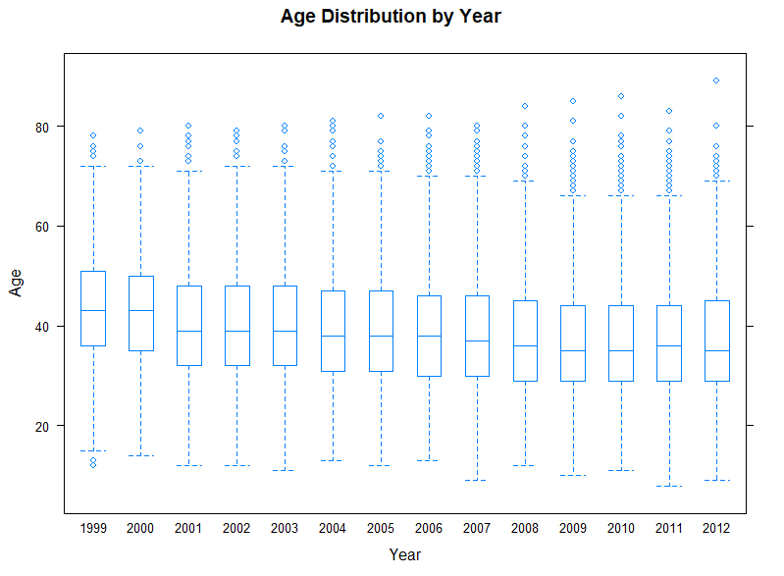
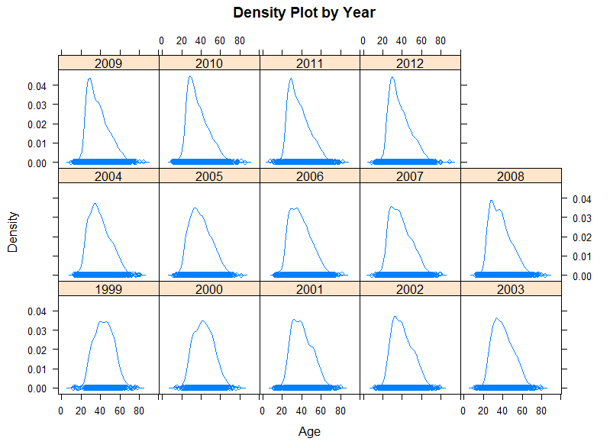
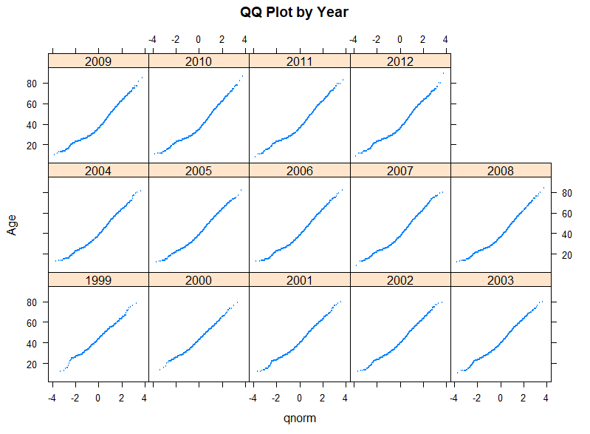
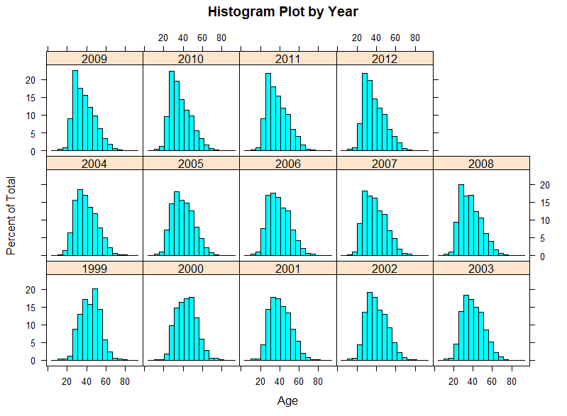
Men’s Runner Results - Age
Boxplots
Histograms
Density Plot
QQ Plot

Slide 10
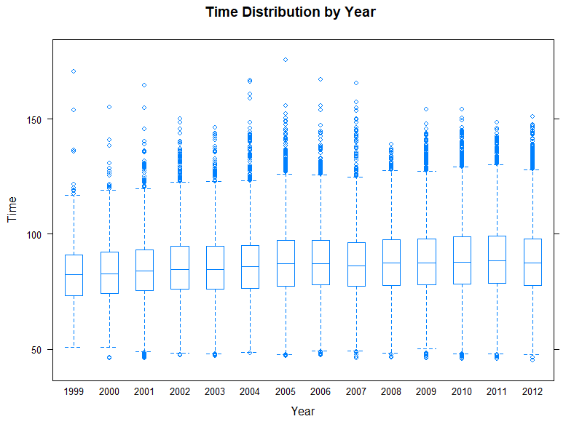
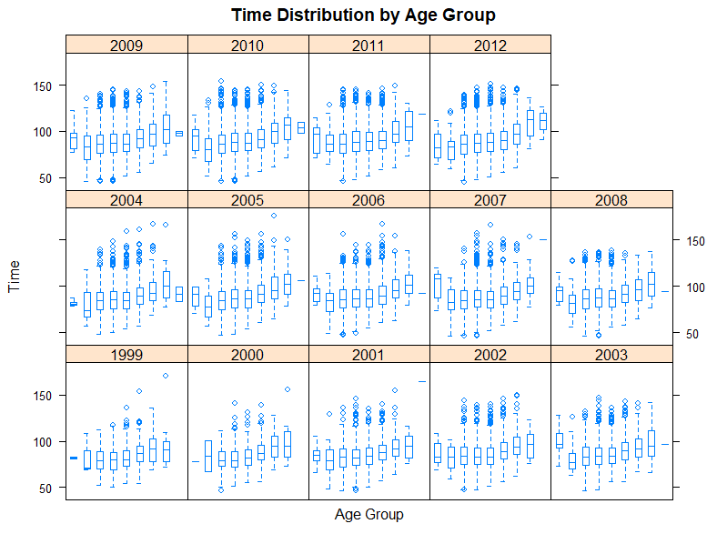
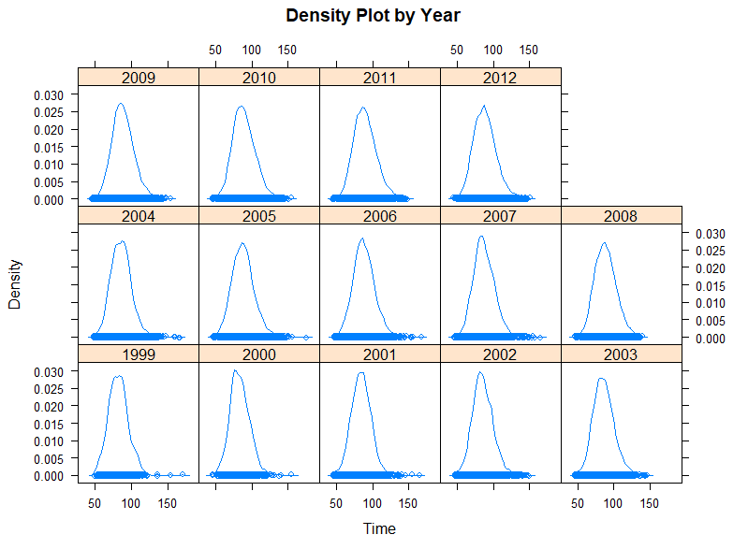
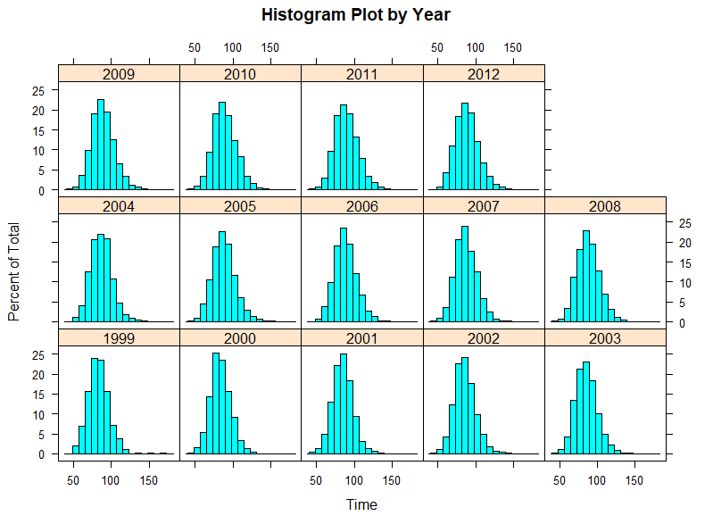
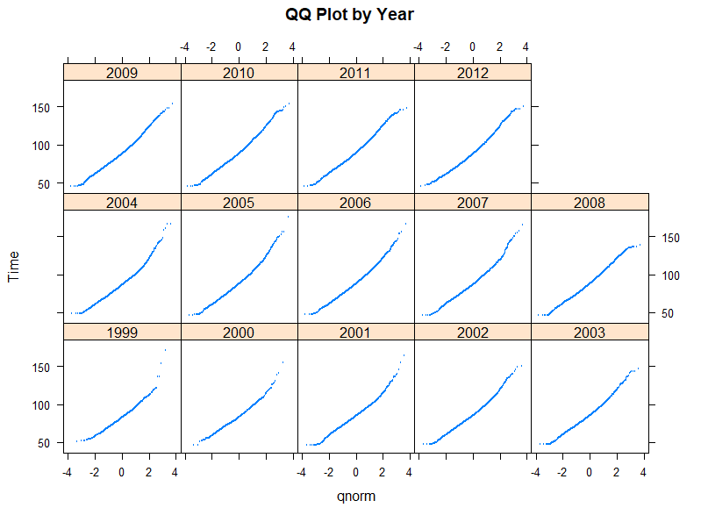
Men’s Runner Results - Time
Boxplot by Year
Boxplot by Age/Year
Histogram
Density plot
QQ plot

Slide 11
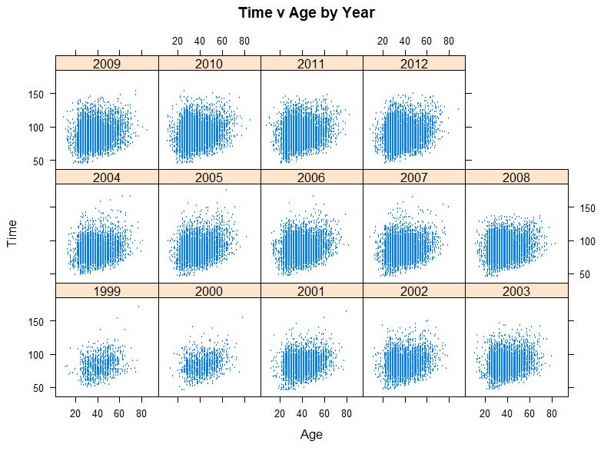
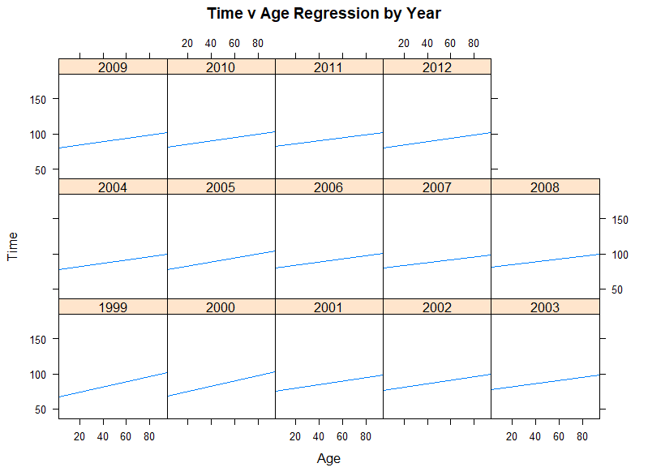
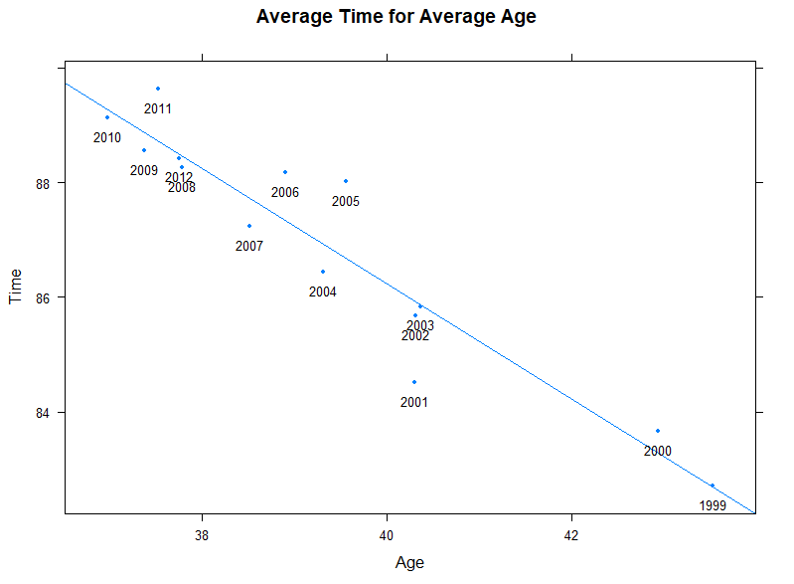
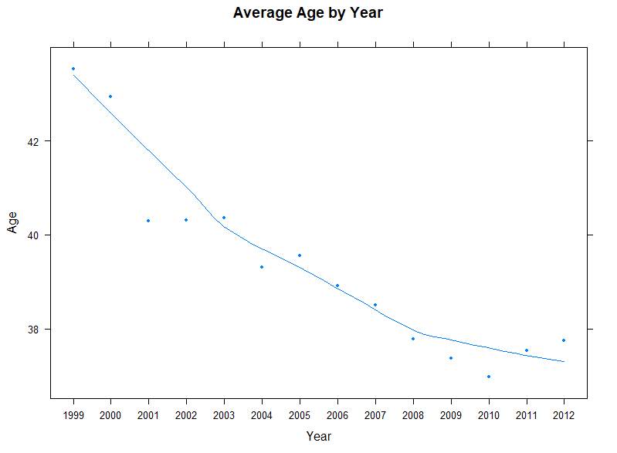
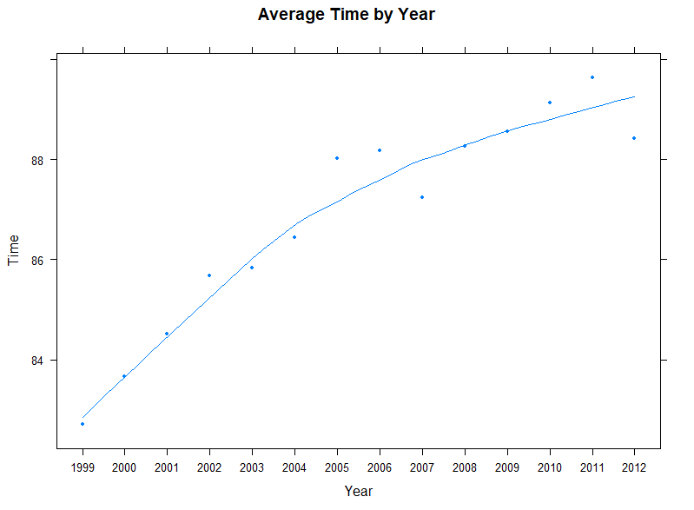
Men’s Runners Results Age versus Time and Age per Year
XY Plot – Time versus Age by Year
XY Plot – Time vs Age Regression by Year
XY Plot – Time vs. Avg Time for Avg Age
XY Plot – Age vs. Avg Age by Year
XY Plot – Time vs. Avg Time by Year

Slide 12
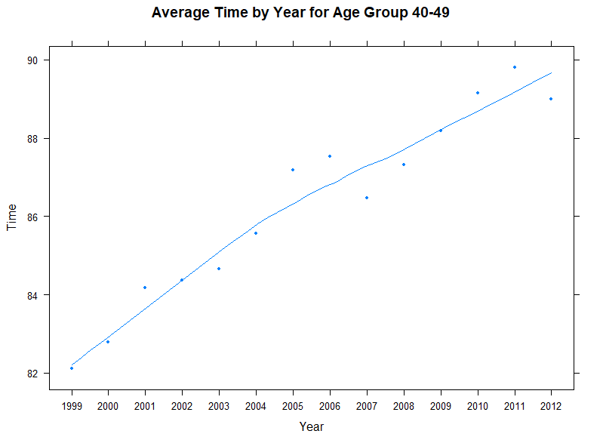
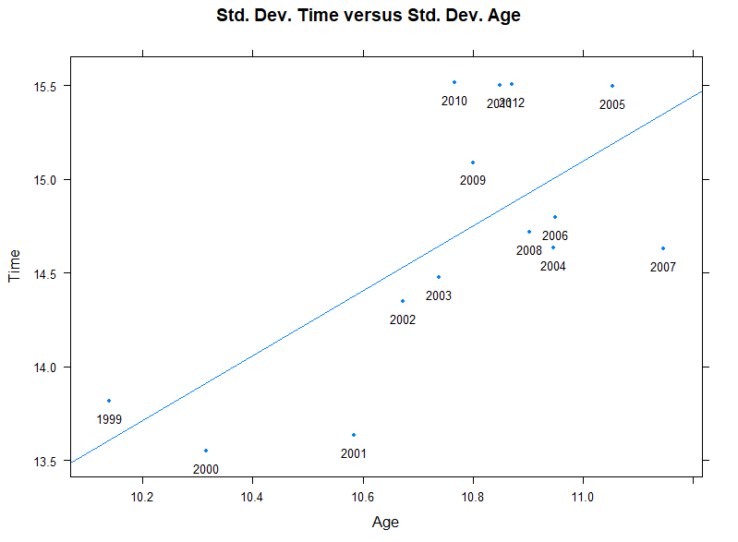
More …..
XY Plot – Time vs. Avg Time by Year for Age Group 40-49
XY Plot – Time vs. Std. Dev Time vs Std Dev Age

Slide 13
Models & Algorithms - used in the R code
MANOVA is a Multivariate extension of ANOVA with the only difference being that in MANOVA there are Multiple Dependent Variable.
ANOVA - 1 DV
MANOVA – 2 or more DVs
Experimental designs in which researchers manipulate or control one or more IVs to determine the effect on one DV (ANOVA) or more DVs (MANOVA)

Slide 14
Models & Algorithms - used in Excel
T-Test: (parametric) Used to compare two groups means
Can only be used for two Age groups (not multiple)
Assume the data to have a normal distribution (bell-shaped curve)
Similar standard deviation
Data must be measured values
Chi-Square Test: (non-parametric)
Sample size must be more than 20
Only be used to compare an experimental result w/a theoretical outcome
Aims to test the null hypothesis of NO DIFFERENCE between data sets

Slide 15
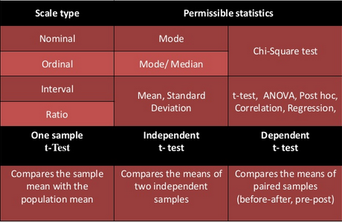
Models & Algorithms - used in Excel
Models used
T-Test
2009 compared to 2010 age group means
Chi-Square
Compared two or more groups variances

Slide 16

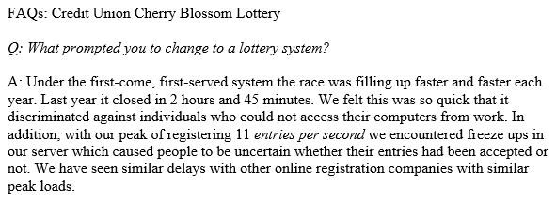



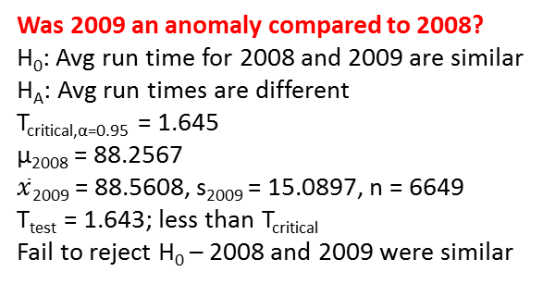
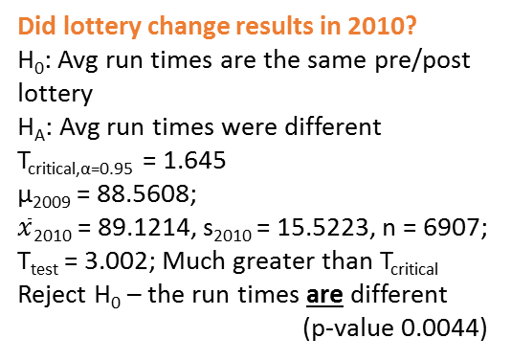
Testing a claim of bias
from Lottery FAQ
Was 2009 an anomaly compared to 2008?
H₀: Avg run time for 2008 and 2009 are similar
H_{A}: Avg run times are different
T_{critical,α=0.95} = 1.645
μ₂₀₀₈ = 88.2567
$\overline{x}$₂₀₀₉ = 88.5608, s₂₀₀₉ = 15.0897, n = 6649
T_{test} = 1.643; less than T_{critical}
Fail to reject H₀ – 2008 and 2009 were similar
START
Was it time/distance-related?
Location | 2009 | 2010 | Row total
East Coast | 6423 6414.96 | 6657 6665.04 | 13080
Central | 131 136.83 | 148 142.17 | 279
Mountain | 22 21.58 | 22 22.42 | 44
Pacific | 50 51.50 | 55 53.50 | 105
Europe/ Africa | 18 19.13 | 21 19.87 | 39
Col totals | 6644 | 6903 | 13547
Did lottery change results in 2010?
H₀: Avg run times are the same pre/post lottery
H_{A}: Avg run times were different
T_{critical,α=0.95} = 1.645
μ₂₀₀₉ = 88.5608;
$\overline{x}$₂₀₁₀ = 89.1214, s₂₀₁₀ = 15.5223, n = 6907;
T_{test} = 3.002; Much greater than T_{critical}
Reject H₀ – the run times are different
(p-value 0.0044)
Was it age-related?
Age Group | 2009 | 2010 | Row total
<20 | 73 86.53 | 111 97.46 | 184
<40 | 3944 3993.43 | 4547 4497.57 | 8491
<60 | 1912 1859.62 | 2042 2094.38 | 3954
<80 | 202 191.42 | 205 215.58 | 407
Col totals | 6131 | 6905 | 13036
Findings:
The introduction of the lottery system had an impact on the registration process, which had an impact on the average run times compared to 2008/2009; however, it may not have been as surmised by the organizers: composition of geographically separated registrants did not change, but distribution in age group did.
H₀: Geographically separated registrants were not affected
H_{A}: One or more groups were affected
χ²_{critical,α=0.95} = 9.488
χ²_{test} = 0.7395: MUCH less than χ²_{critical}
Fail to reject H₀ – not affected by time/distance
H₀: Age groups were not affected
H_{A}: One or more age groups were affected
χ²_{critical,α=0.95} = 7.815
χ²_{test} = 9.043: Greater than χ²_{critical}
Reject H₀ – age groups were affected

Slide 17
Conclusion/Discussions
All

