Slide 1

Azure Cloud Infrastructure Deployment and Management Project

Slide 2
Team Members:
Haytham Mohamed
Ismail Sabry Attwa
Abdel-Azizi Fouad
Ahmed Ibrahim saad
Mohamed Sarhan
Essam Abdo Hassan

Slide 3
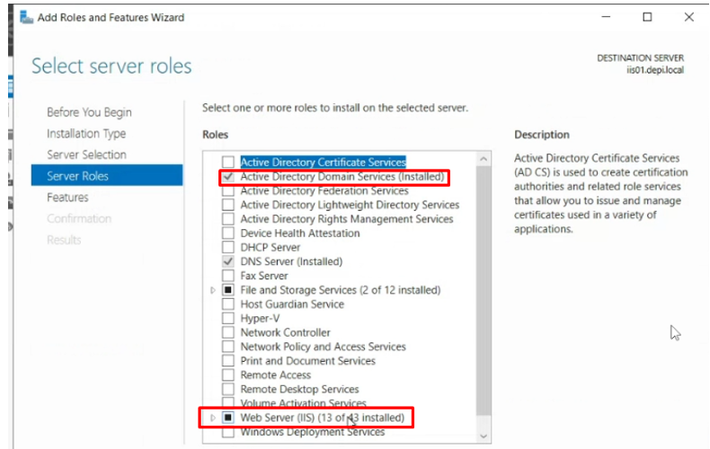
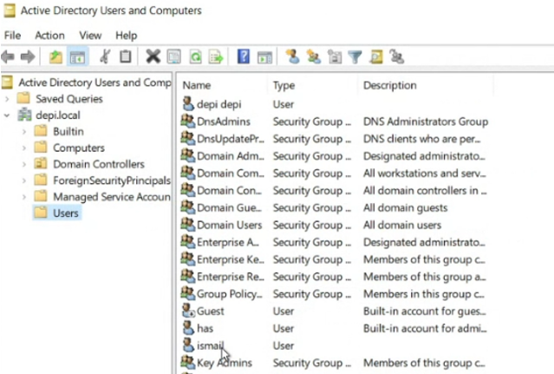
Azure AD setup
Within Resource group named we manage to deploy 2 virtual machines (VMs) at the same VNET
Both using windows server 2022OS and IIS feature installed
The IIS01 server promoted to be Domain controller with domain name ( depi.local ) then IIS02 joined that domain
Using AD we created some users like ( dpi, Ismail,..)

Slide 4
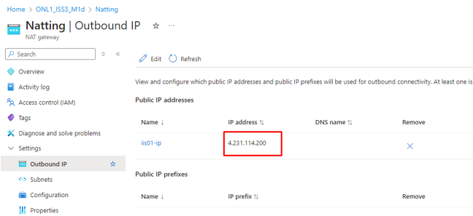
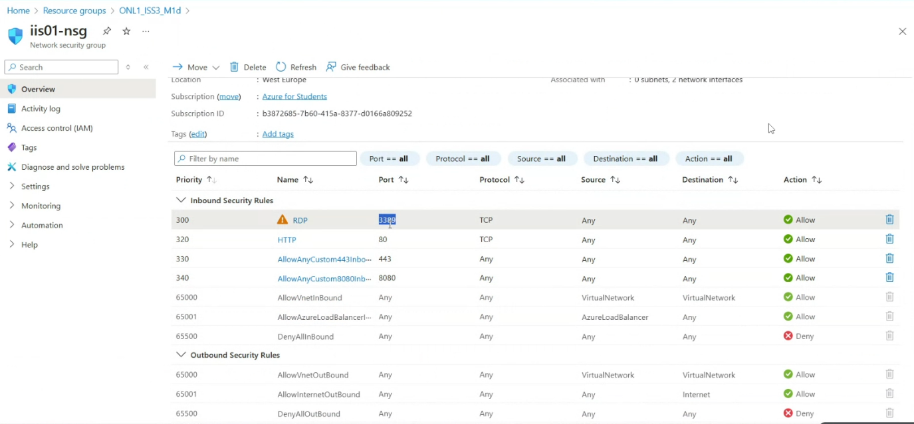
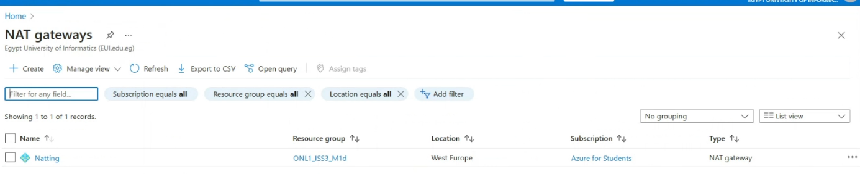
Network Configurations
All of our recourses are at the same VNET named IIS01-vnet using west Europe Region .
to save number or public IPs we created NAT gateway which allow the internet for VM01 and VM02 .
the public IP of NAT gateway as shown.
NSG named iis-01 created and configured with inbound / outbound rules as needed then attached the 2 VM’s to it.

Slide 5
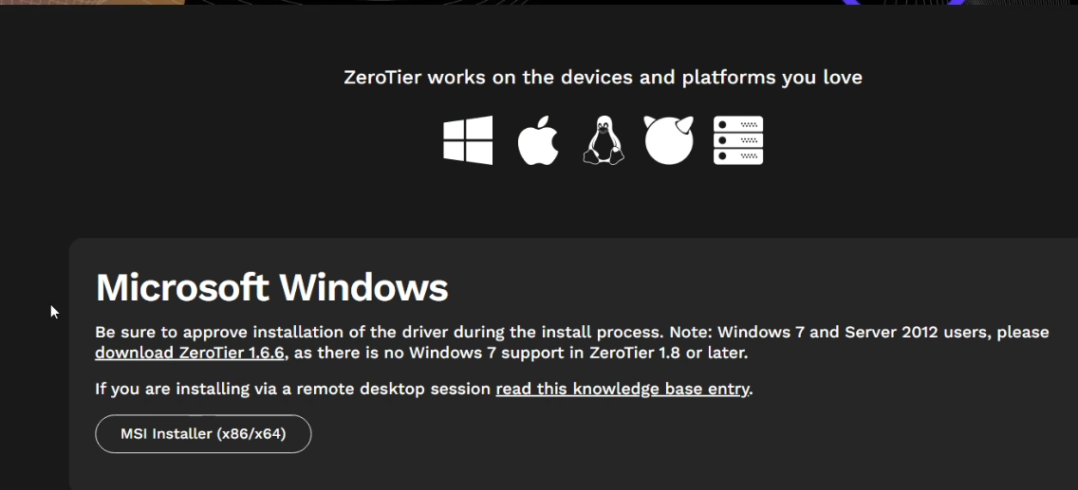
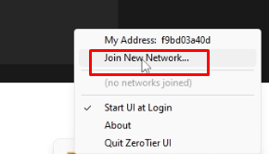
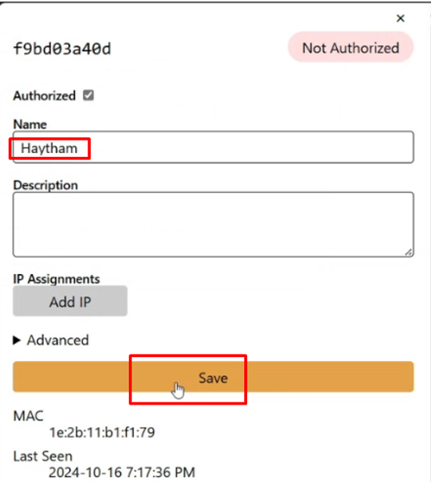
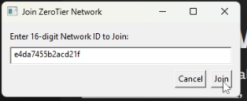
To login to the VM we used before the bastion host, but we found that it is expensive, so we used another app name Zero tier
After installation , open the app then join with the ID.
The admin should allow which IP should connect to VM01 and VM02

Slide 6
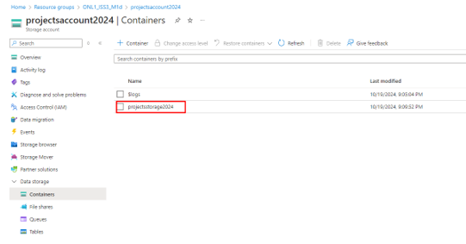
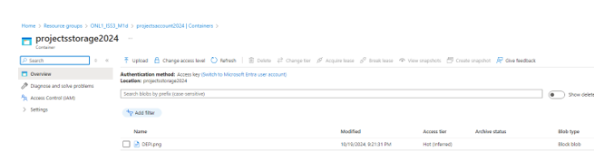
Storage Solutions
Storage account named Projectsaccount2024 created then contained with same name
PNG file uploaded to that container as Block BLOB
SAS URLS created as well to be accessed from internet and Hot Access tier was selected

Slide 7
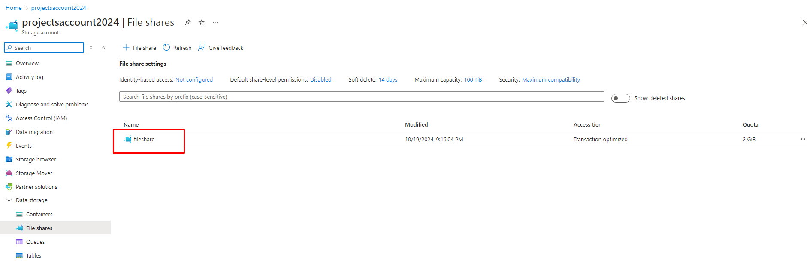
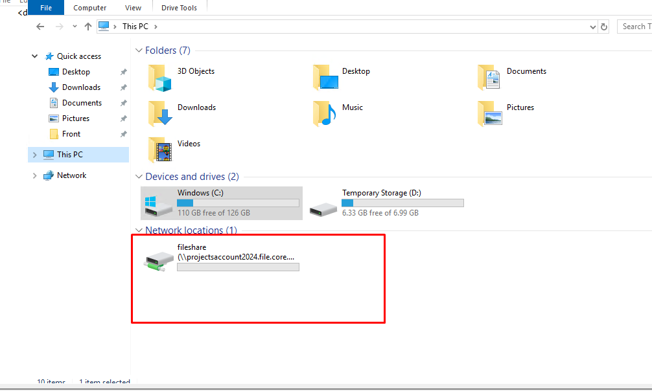
Creating NW fileshare & Backup
Using the same storage account a Fileshare created and mapped to both VM’s
Text file created and accessed by VM’s
We enabled daily backup on both VM’s as well

Slide 8

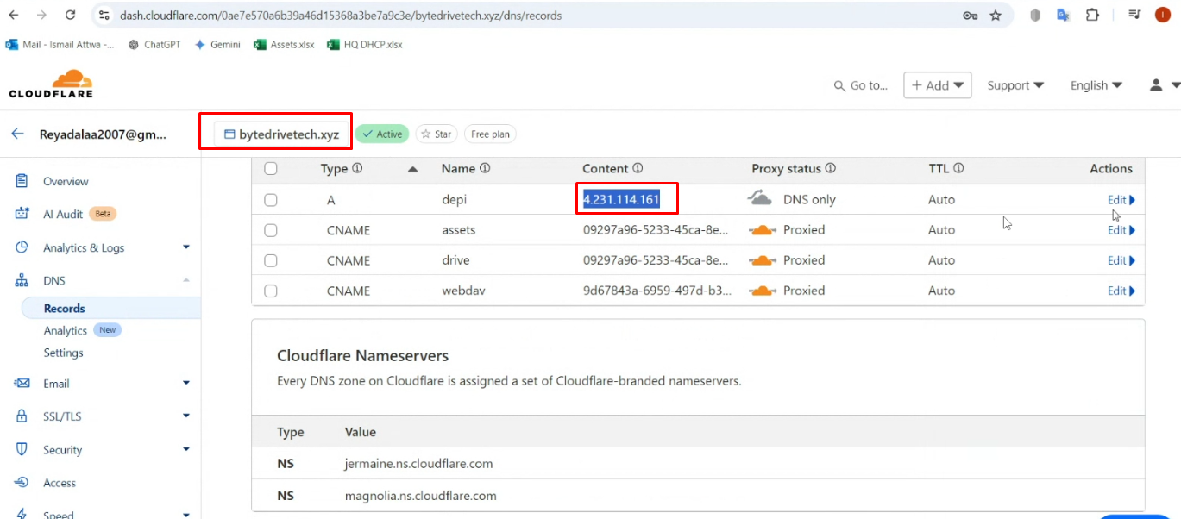
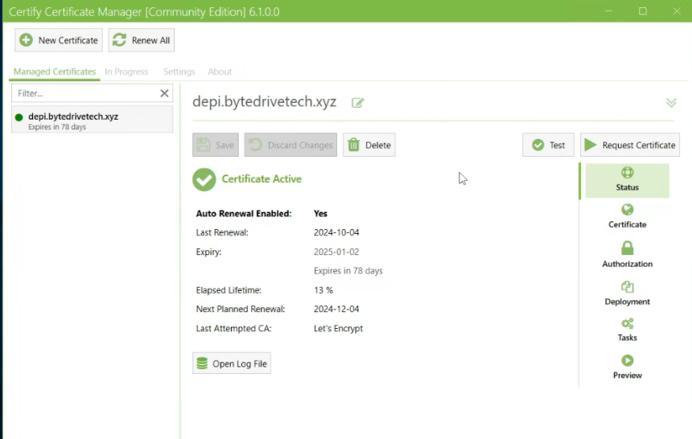
Final Integration
Our app is 3-tier ( Front – Back – DB )
Some dependencies installed to launch the wep app like (node.js … )
To make it secured we installed Certify app will give
us a free cert for 90 days.

Slide 9
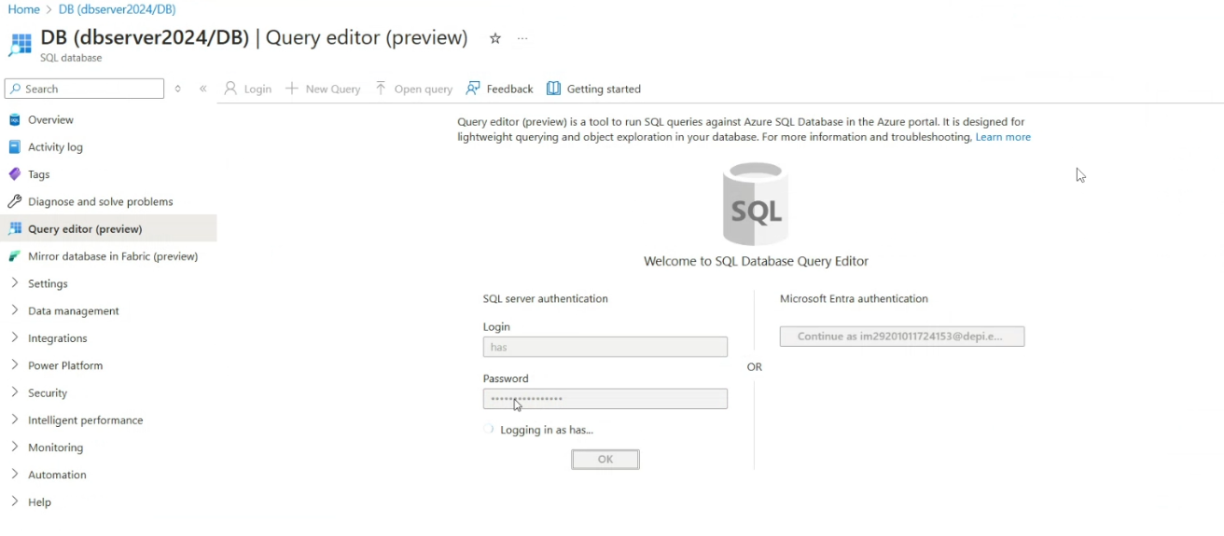
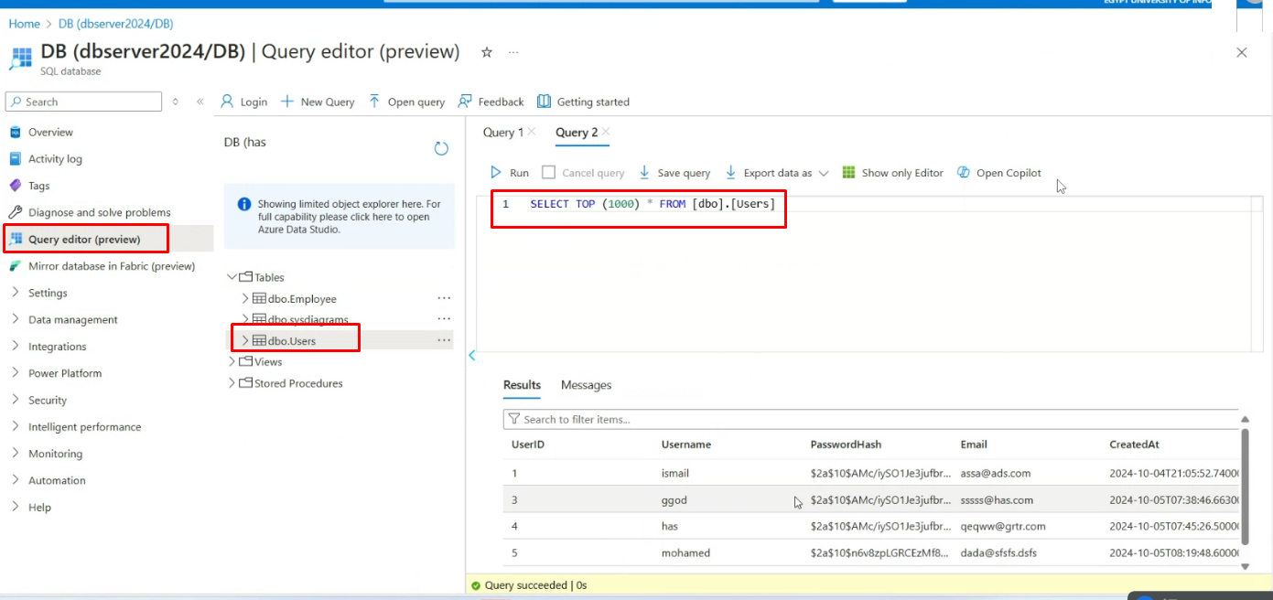
We created DB server and DB instance.
We crated a table named Users to store users' info after registration.

Slide 10
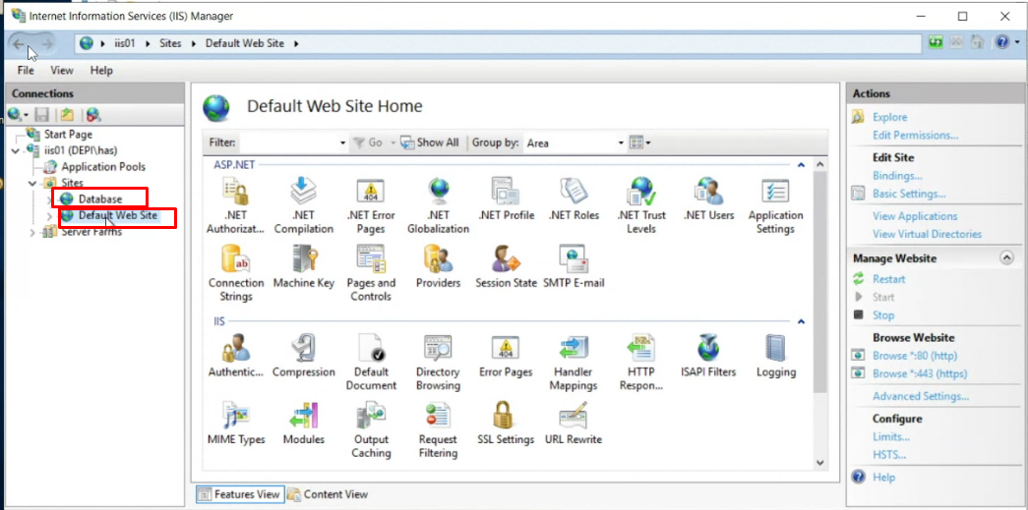
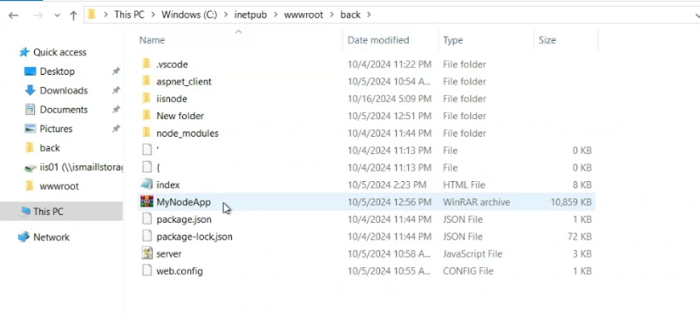
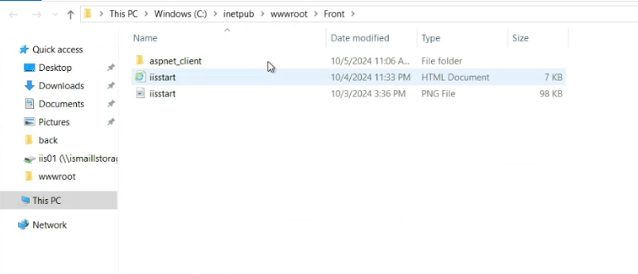
On IIS01 server, we created two sites one for web and one for DB.
the document root for the web site shown below.
the backend server the one that has node.js app

Slide 11
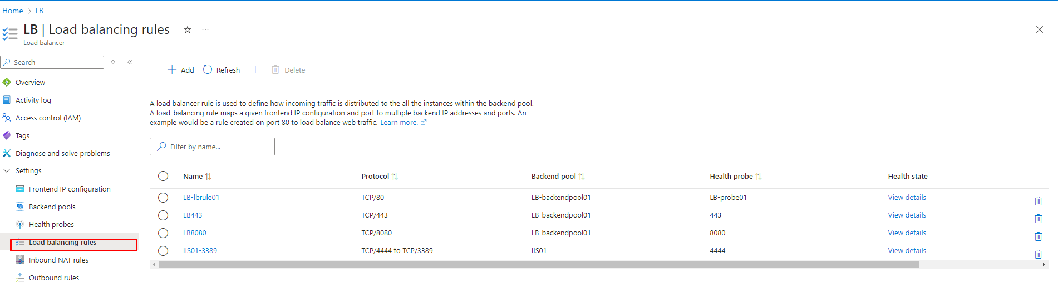
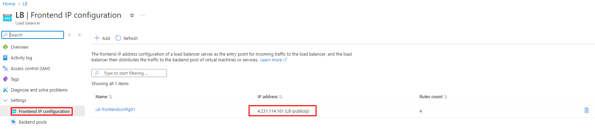
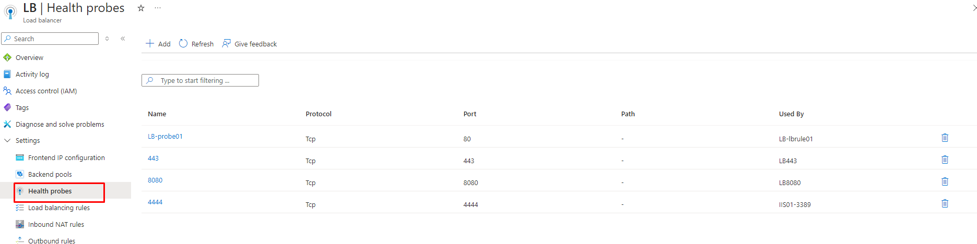
We crated Load balancer
Front-end IP configured
Back-end pool configured
We added some health check probes

Slide 12
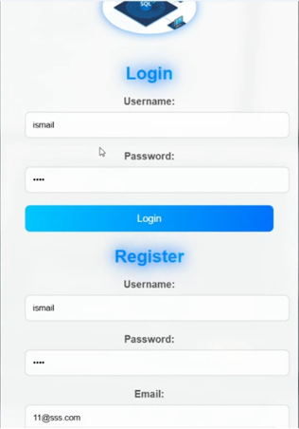
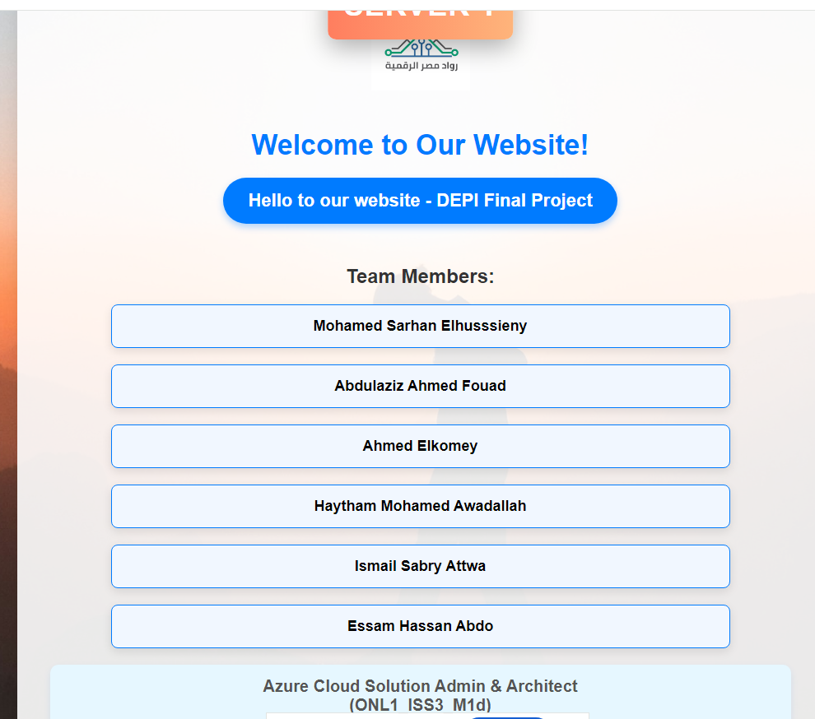
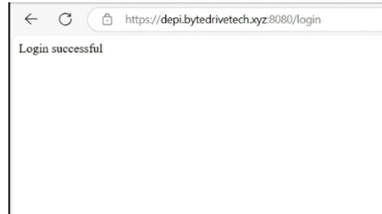
Using the DNS record from cloud flare ,Users can login to the following domain to access the webapp https://depi.bytedrivetech.xyz:8080
and once login shows below:

Slide 13
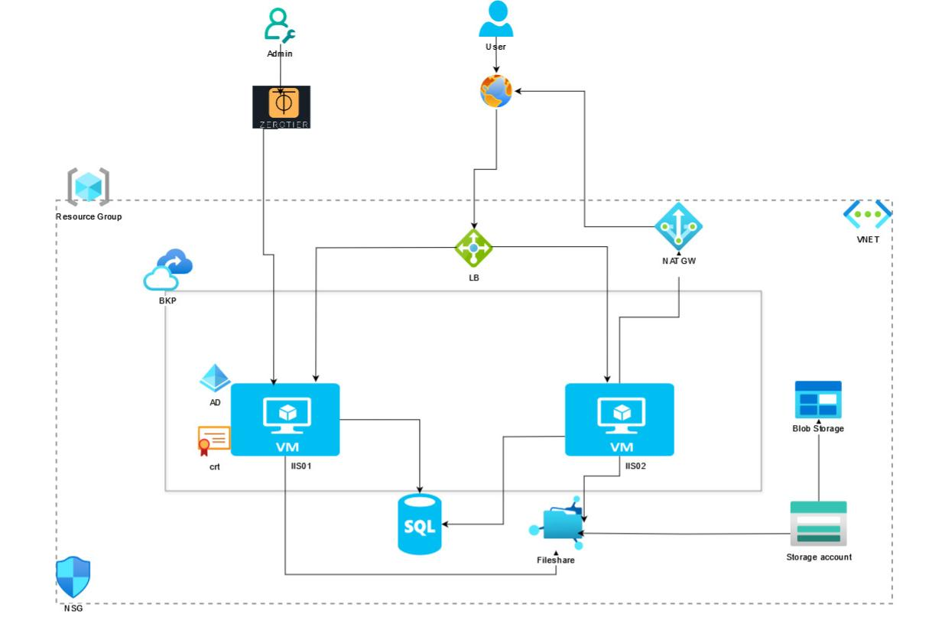
The Full Diagram of the project

Slide 14

Thank You

