Slide 1
Homework Assignment #4
-- due: Dec 7, 10:00am
Visit “Digital Art Festival Taipei (台北數位藝術節)”
  http://digitalarts-festival.taipei/
  Opening Hour: 2018.11.22-12.01 10:00-18:00（Free Entry）
  Attend the guide tour (11/25) or visit by yourself
Write a report of your visit to Digital Art Festival Taipei
  give at least 300 words of your suggestions or comments for your experiencing
  Take a photo of your favorite exhibition

Slide 2
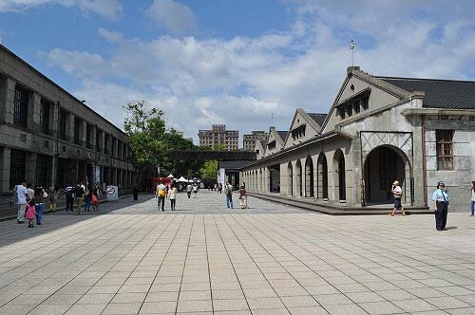
Guide tour in 11/25 13:00
Gathering time: 12:50
Gathering location: Songshan Cultural and Creative Park (松山文創園區)
  Front door of Warehouse No. 5
5號倉庫

Slide 3
Submission
Please submit a “Report.pdf” file to ceiba
Late submission:
  within 24 hours after its due will incur 20% penalty,
  after 24 hours and within seven days of its due will incur 50% penalty, and
  after seven days of its due will not be graded.
  Note: One minute late is the same as 23 hours late.
DO NOT COPY OTHER’S HOMEWORK!!

