Slide 1
Card 01 - Propanol
Molecular Formula
Lewis Structure
C H
H
H
H
3
8
H
C
C
C
H
H
H
H
Condensed Structural Formula
Bond-Line Structure
CH CH OH
3
2

Slide 2

Card 02 - Ethanol
Molecular Formula
Lewis Structure
C H O
H
H
H
2
6
..
H
C
C
C
O
H
..
H
H
H
Condensed Structural Formula
Bond-Line Structure
CH COCH
3
3

Slide 3

Card 03 - acetone
Molecular Formula
Lewis Structure
H
O
H
C H O
..
..
3
6
H
C
C
C
H
H
H
Condensed Structural Formula
Bond-Line Structure
C HCOCH
2
3

Slide 4

Card 04 - acetic acid
Molecular Formula
Lewis Structure
H
O
..
..
C H O
..
2
4
2
H
C
C
O
H
..
H
Condensed Structural Formula
Bond-Line Structure
C COOH
2

Slide 5

Card 05 - ETHYL ACETATE
Molecular Formula
Lewis Structure
C H O
H
O
H
H
..
..
4
8
2
..
H
C
C
O
C
C
H
..
H
H
H
Condensed Structural Formula
Bond-Line Structure
CH COOCH CH
3
2
3

Slide 6

Card 06 - CYCLOHEXANE
Molecular Formula
Lewis Structure
C H
H
H
H
C
H
6
12
H
C
C
H
H
C
C
H
H
C
H
H
H
Condensed Structural Formula
Bond-Line Structure
(
)
CH
2
6

Slide 7

Card 07 - CYCLOHEXANONE
Molecular Formula
Lewis Structure
O
..
..
C H O
H
C
H
6
10
H
C
C
H
H
C
H
H
C
H
C
H
H
Condensed Structural Formula
Bond-Line Structure
(
)
CH
CO
2
5

Slide 8
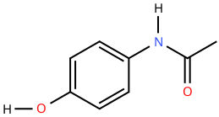
Card 08 - ACETAMINOPHEN
Molecular Formula
Lewis Structure
H
C H NO
H
H
H
C
8
9
2
C
C
N
C
C
H
..
..
..
H
..
C
C
O
H
O
C
H
..
H
Condensed Structural Formula
Bond-Line Structure
HOC H NHCOCH
6
4
3

Slide 9
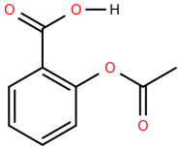
Card 09 - ASPIRIN
Molecular Formula
Lewis Structure
..
..
C H O
O
C
O
H
..
..
H
4
H
C
..
9
8
C
C
O
C
C
H
..
..
..
H
C
C
O
H
C
H
H
Condensed Structural Formula
Bond-Line Structure
CH COOC H COOH
3
6
4

Slide 10
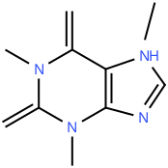
Card 10 - CAFFEINE
Molecular Formula
Lewis Structure
H
..
O
..
H
..
C
H
C H N O
..
C
N
H
C
N
C
H
8
10
4
2
C
H
H
C
..
C
..
..
O
N
N
..
H
C
H
H
Condensed Structural Formula
Bond-Line Structure
CH N(C=O)N(CH )
C(=O)C=CN(CH )C=N
3
3
3

