Slide 1
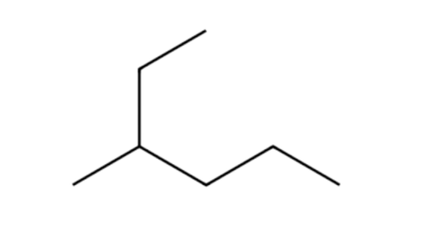
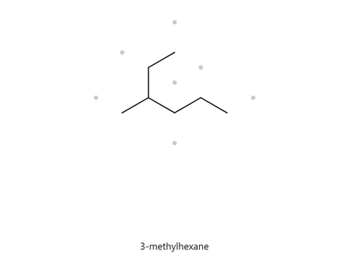
Card A02 - C H
7
16
Numbered Parent
Naming Trial
1
2
Parent: longest chain = 6C, so hexane
Numbering: up to right
(nearest to substituents)
Substituent: methyl on C3, so 3-methyl
3
4
5
6
My Name
The Alkane Check
3-methylhexane
✓ longest chain confirmed ✓ lowest locants ✓ alphabetical order ✓ punctuation ✓ formula counted

Slide 2
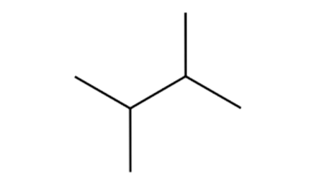
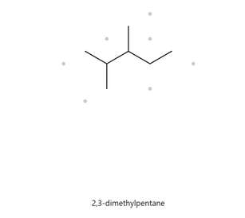
Card A03 - C H
7
16
Numbered Parent
Naming Trial
Parent: longest chain = 4C, so pentane
Numbering: right to left
Substituent: methyl on C2, C3;
so, 2-3 dimethyl
4
2
3
1
My Name
The Alkane Check
2,3-dimethylpentane
✓ longest chain confirmed ✓ lowest locants ✓ alphabetical order ✓ punctuation ✓ formula counted

Slide 3
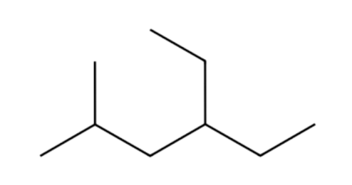
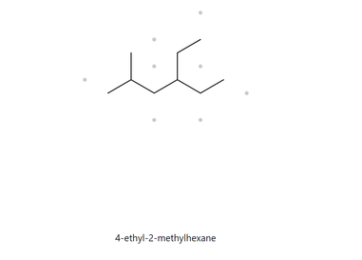
Card A04 - C H
9
20
Numbered Parent
Naming Trial
Parent: longest chain = 6C, so hexane
Numbering: left to right
Substituent: methyl on C2, ethyl on C4, so 4-ethyl-2-methyl
2
3
4
5
1
My Name
The Alkane Check
4-ethyl-2-methylhexane
✓ longest chain confirmed ✓ lowest locants ✓ alphabetical order ✓ punctuation ✓ formula counted

Slide 4
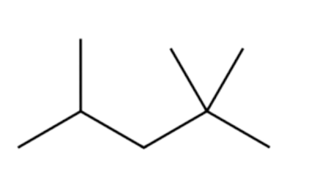
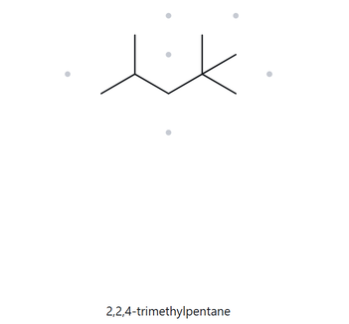
Card A05 - C H
8
18
Numbered Parent
Naming Trial
Parent: longest chain = 5C, so pentane
Numbering: right to left
Substituent: 2 methyl on C2, methyl on C4, so 2,2,4-trimethyl
4
3
2
1
My Name
The Alkane Check
2,2,4-trimethylpentane
✓ longest chain confirmed ✓ lowest locants ✓ alphabetical order ✓ punctuation ✓ formula counted

Slide 5
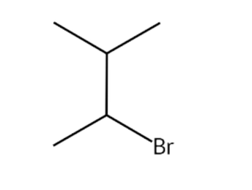
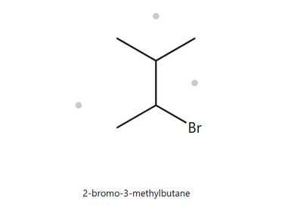
r
Card A06 - C H B
5
11
Numbered Parent
Naming Trial
4
Parent: longest chain = 4C, so butane
Numbering: lower right to upper left (alphabetically)
Substituent: Bromo on C2, methyl on C3, so 2-Bromo-3-methyl
3
2
1
My Name
The Alkane Check
2-bromo-3-methylbutane
✓ longest chain confirmed ✓ lowest locants ✓ alphabetical order ✓ punctuation ✓ formula counted

Slide 6
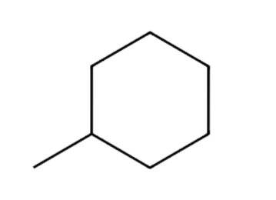
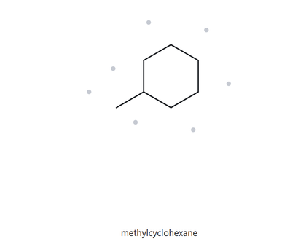
Card A07 - C H
7
14
Numbered Parent
Naming Trial
3
2
4
Parent: ring = 6C, so cyclohexane
Numbering: from connected methyl to the end of the ring
Substituent: methyl on C1, so methyl
1
5
6
My Name
The Alkane Check
methylcyclohexane
✓ longest chain confirmed ✓ lowest locants ✓ alphabetical order ✓ punctuation ✓ formula counted

Slide 7
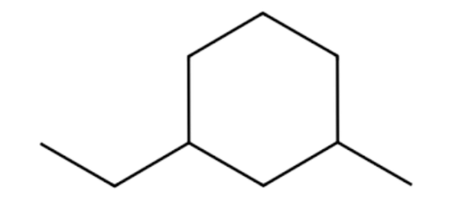
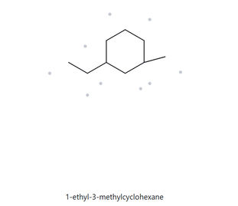
Card A08 - C H
9
18
Numbered Parent
Naming Trial
5
Parent: ring = 6C, so cyclohexane
Numbering: from chain connected to ethyl to the nearest carbon connected to methyl to the end of the ring (alphabetical)
Substituent: ethyl on C1, methyl on C3, so 1-ethyl-3-methyl
6
4
1
3
2
My Name
The Alkane Check
1-ethyl-3-methylcyclohexane
✓ longest chain confirmed ✓ lowest locants ✓ alphabetical order ✓ punctuation ✓ formula counted

Slide 8
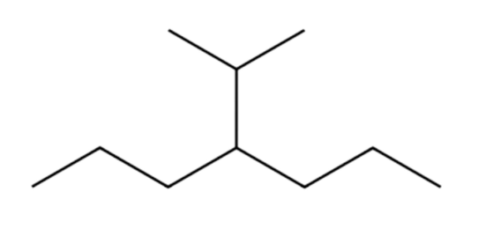
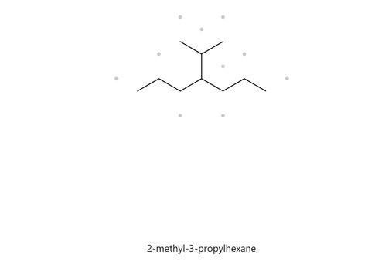
Card A09 - C H
10
22
Numbered Parent
Naming Trial
Parent: longest chain = 6C, so hexane
Numbering: either left to right to start, for the functional group is in the center
Substituent: methyl on C2, propyl on c3, so 2-methyl-3-propyl
2
3
4
5
6
1
My Name
The Alkane Check
2-methyl-3-propylhexane
✓ longest chain confirmed ✓ lowest locants ✓ alphabetical order ✓ punctuation ✓ formula counted

Slide 9
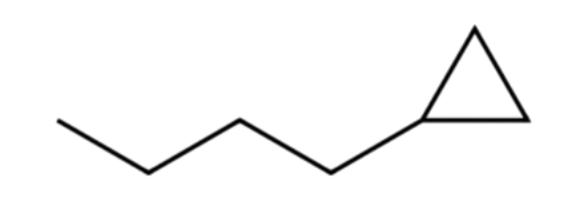
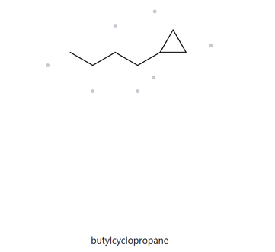
Card A10 - C H
7
14
Numbered Parent
Naming Trial
Parent: Longest chain = 5C, so pentane.
Numbering: Start from right to left because the cyclopropyl substituent must receive the lowest possible number (C1)
Substituent: Cyclopropyl on C1
5
1
4
3
2
My Name
The Alkane Check
butylcyclopropane
✓ longest chain confirmed ✓ lowest locants ✓ alphabetical order ✓ punctuation ✓ formula counted

