Slide 1
Assignment 2:
Predicting GitHub User Activity
Ella Tso · Student ID 113700058
Big Data Analytics Techniques
and Applications
Fall 2026
Code: github.com/ellatso/NYCU-BigData-Assignment2
Notes:
Title. Ella Tso, student ID 113700058. All code, results and figures are in the public GitHub repository shown on the slide.

Slide 2
Overview
LightGBM on time-aware relational features built from rows visible at prediction time
Task for each of 4,465 test users, predict whether they open_pr, open_issue, issue_comment, pr_review, pr_review_comment, push during 11/22–11/29 (Taiwan).
Data GH Archive hourly files → official preprocess.py → 8 relational tables (9,000-user cohort, anonymized).
Method weekly as-of samples → temporal + relational (FK-join) features → 6 LightGBM heads → per-activity thresholds; a temporal GNN is the learned-graph comparison.
Evaluation Score = (macro-F1 + micro-F1) / 2 on later weeks; train / calibration / development split by time; 11 ablations vs. copy-last-week.
Code github.com/ellatso/NYCU-BigData-Assignment2
1,608
hourly GH Archive files
09/01–11/07 UTC
11
matched ablations with
bootstrap 95% CIs
+1.6 pt
best temporal variants
vs. copy-last-week
(CI excludes 0)
Identical
CSV after an independent
rebuild + refit
Notes:
Overview of the task, data, method and evaluation. Key numbers: 1,608 hourly files; 11 ablations; best temporal variants beat copy-last-week by about 1.6 points with confidence intervals excluding zero; the submission is reproducible byte for byte.

Slide 3
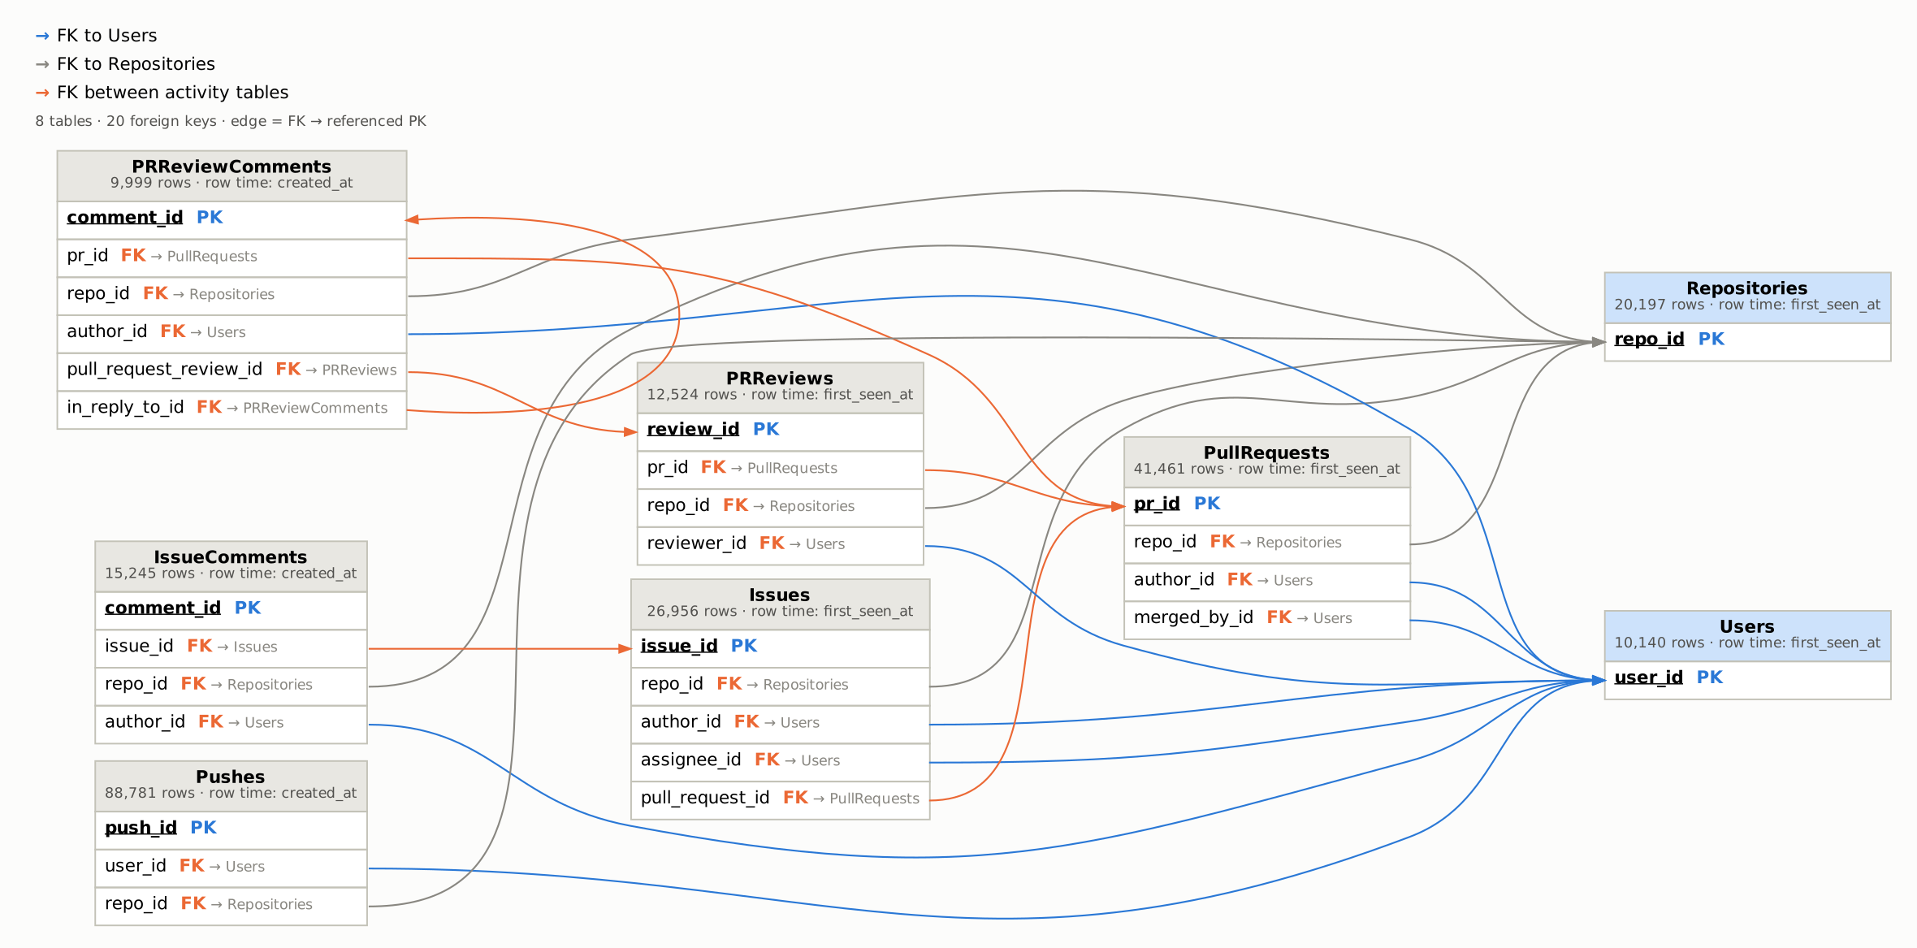
(1%) Question 1 Schema graph
8 tables as nodes and 20 foreign keys as edges (FK → referenced PK)
Notes:
Question 1, schema graph. Eight tables as nodes, twenty foreign keys as edges pointing from the FK column to the referenced primary key. PK is the row number; an FK stores the referenced row number. Eight FKs point to Users, six to Repositories and six connect activity tables, including the self-reference in_reply_to_id. Each node shows its row count and the row-time column that decides when a row becomes visible, which we use for as-of filtering in Q3.

Slide 4
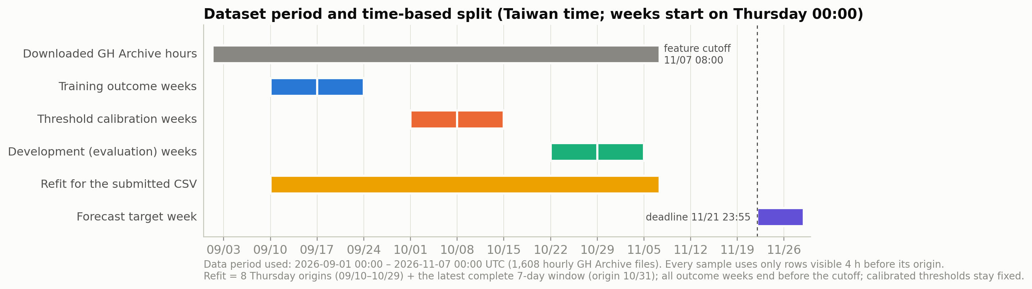
(1%) Question 1 Dataset time period
Data period used: 2026-09-01 00:00 – 2026-11-07 00:00 UTC (1,608 hourly GH Archive files)
1,608 h
all hourly files downloaded
& gzip-verified (28.7 GB)
8 tables
official preprocess.py;
PK/FK checks pass
9 origins
final refit 09/10–10/31
(Taiwan, outcome ≤ cutoff)
352 h
lead from the feature
cutoff to the target week
Notes:
Question 1, time period. We used GH Archive from September 1 to November 7 UTC. Training, calibration and development weeks are separated in time, and the final model is refit on all complete weeks before the cutoff.

Slide 5
(3%) Question 2 Relational features from FK joins
Time-windowed FK aggregations turn the 8-table graph into user-level signals
Family | FK path | What is computed | #
Repository activity | user → events → Repositories ← events ← other users | Others' activity per type in repos the user touched (90 d); 7-day mean / max; own events removed | 12
Reviewed-repo PRs | user → PRReviews → Repositories ← PullRequests | PRs opened by others in the last 3 d in repos the user reviewed (90 d) | 1
Received interactions | user ← PR / Issue.author ← IssueComments, PRReviews, PRReviewComments | Replies received on the user's own PRs / issues in 3 and 7 d, and distinct partners (self excluded) | 12
Collaborators | user ↔ co-actor on the same PR / issue (cohort only) | Collaborators' 7-day activity per type; number of collaborators (90 d) | 7
Static baseline | user → Repositories ← all users (all history) | Degree, concentration, neighbours' activity, all-time replies received | 18
Design choices short windows (3 / 7 d) capture current collaboration; 'others' always excludes the user; collaborator activity uses cohort users only, because non-cohort users' activity is incomplete by construction. Submitted model: 7 user + 36 temporal + 32 dynamic relational = 75 inputs.
Notes:
Question 2, how relations are modeled. We follow foreign keys from the user to repositories, PRs and issues, and aggregate what other users did there in short windows. All joins respect visibility time.

Slide 6
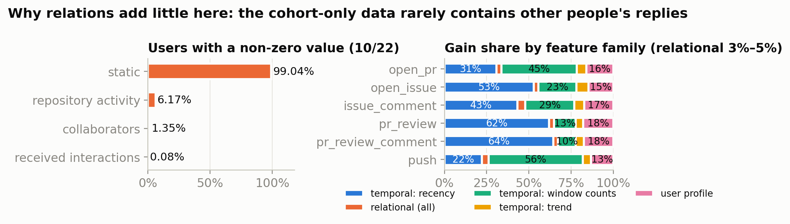
(3%) Question 2 What the relational signal looks like
The tables keep only cohort users’ own events, so replies from others are rarely observed
40 / 10,524
comments on cohort-authored
threads written by someone else
0.08%
of users have any non-zero
received-interaction feature
3–5%
of the submitted model’s gain
comes from relational features
Notes:
Question 2, analysis. Received-interaction features are almost always zero because the preprocessing keeps only events performed by cohort users. Only 40 of 10,524 comments on cohort threads are by others. Relational features get 3 to 5 percent of the gain.

Slide 7
(3%) Question 2 Relational ablation + GNN
Neither FK aggregates nor a temporal GNN beat temporal features on development weeks
Variant (dev. weeks 10/22 + 10/29) | Dev Score | Δ vs temporal LightGBM (95% CI)
Temporal only, LightGBM (7/14/30 d) | 35.73% | —
+ static relations | 35.02% | −0.71 pt (−1.36, −0.05)
+ received interactions | 35.73% | 0.00 (features all zero)
+ dynamic relations (submitted) | 35.12% | −0.60 pt (−1.17, −0.06)
dynamic relations − collaborators | 35.30% | −0.43 pt (−0.97, +0.15)
Static relations only (no temporal) | 33.45% | −2.27 pt (−3.41, −1.13)
MLP on temporal inputs (no graph) | 34.92% | −0.80 pt (−1.75, +0.12)
Temporal GNN: user → repo → user | 35.06% | −0.66 pt (−1.61, +0.47)
Temporal GNN (learned relations)
2-hop message passing user → repo → user; edges carry 7/30/90-day counts and recency (time encoding).
vs the same MLP without the graph: +0.14 pt on development weeks (CI −0.80, +0.97), +1.5 pt on the TA reference week (54.55% vs 53.06%).
Why the LightGBM relational model is submitted
Fixed in the config before any real-data run; < 1 pt from temporal-only; deterministic and fully reproducible.
Paired user-level bootstrap, 1,000 resamples within each week (10,334 user-weeks). GNN and MLP: mean of 3 seeds, same inputs, same threshold procedure.
Notes:
Question 2, ablation. Neither hand-built relational features nor a learned temporal GNN beat temporal features on the development weeks. Message passing helps on the higher-activity reference week, consistent with the cohort-closure finding. The submitted model was fixed in advance.

Slide 8
(5%) Question 3 As-of sampling prevents leakage
Every training row is rebuilt exactly as the archive looked at prediction time t
t − 4 h (feature cutoff)
t (origin, Thu 00:00 TW)
t + 7 d
features: rows visible before t − 4 h
label: activity in [t, t + 7 d), visible by t + 7 d
Row time, not creation time
A row enters only after its row time (first_seen_at / created_at); PRs, issues and reviews can appear weeks after created_at.
Visible endpoints
The event must occur before the cutoff and its user and repository rows must already be visible.
No later-known columns
merged_at, merged_by_id, closed_at, state_reason and dismissed_at are never used.
Time-ordered splits
Weekly origins; train 09/10–09/17, calibration 10/01–10/08, development 10/22–10/29; each split’s labels end before the next split’s cutoff.
Notes:
Question 3, leakage control. Features only use rows visible four hours before the origin; labels count activity in the following seven days. Later-known columns are dropped and splits are strictly by time.

Slide 9
(5%) Question 3 Temporal features
Multi-window counts, recency and trend for each activity; recency carries most of the signal
Group | Definition (per user, at cutoff t − 4 h) | #
Window counts | log(1 + count) of each activity in the last 7 / 14 / 30 d | 18
Activity span | active days and distinct repositories in 7 / 14 / 30 d | 6
Recency | days since the last occurrence of each activity (cap 400) | 6
Trend | (count₇ + 1) / (count₃₀ / 4 + 1) for each activity | 6
User profile | days since first seen; log lifetime count of each activity | 7
62–64%
of LightGBM gain from recency for
pr_review and pr_review_comment
56%
of gain from window counts for push
(45% for open_pr)
Top 5 inputs
recency of pr_review, account age,
recency of pr_review_comment,
open_issue, issue_comment
Counts are log-scaled; windows stop at the cutoff, so a 30-day window at an early origin only sees collected days (warm-up limits are logged in coverage.csv).
Notes:
Question 3, temporal features. Multi-window counts, recency and trend per activity, plus user profile. Recency dominates for reviews; window counts dominate for push.

Slide 10
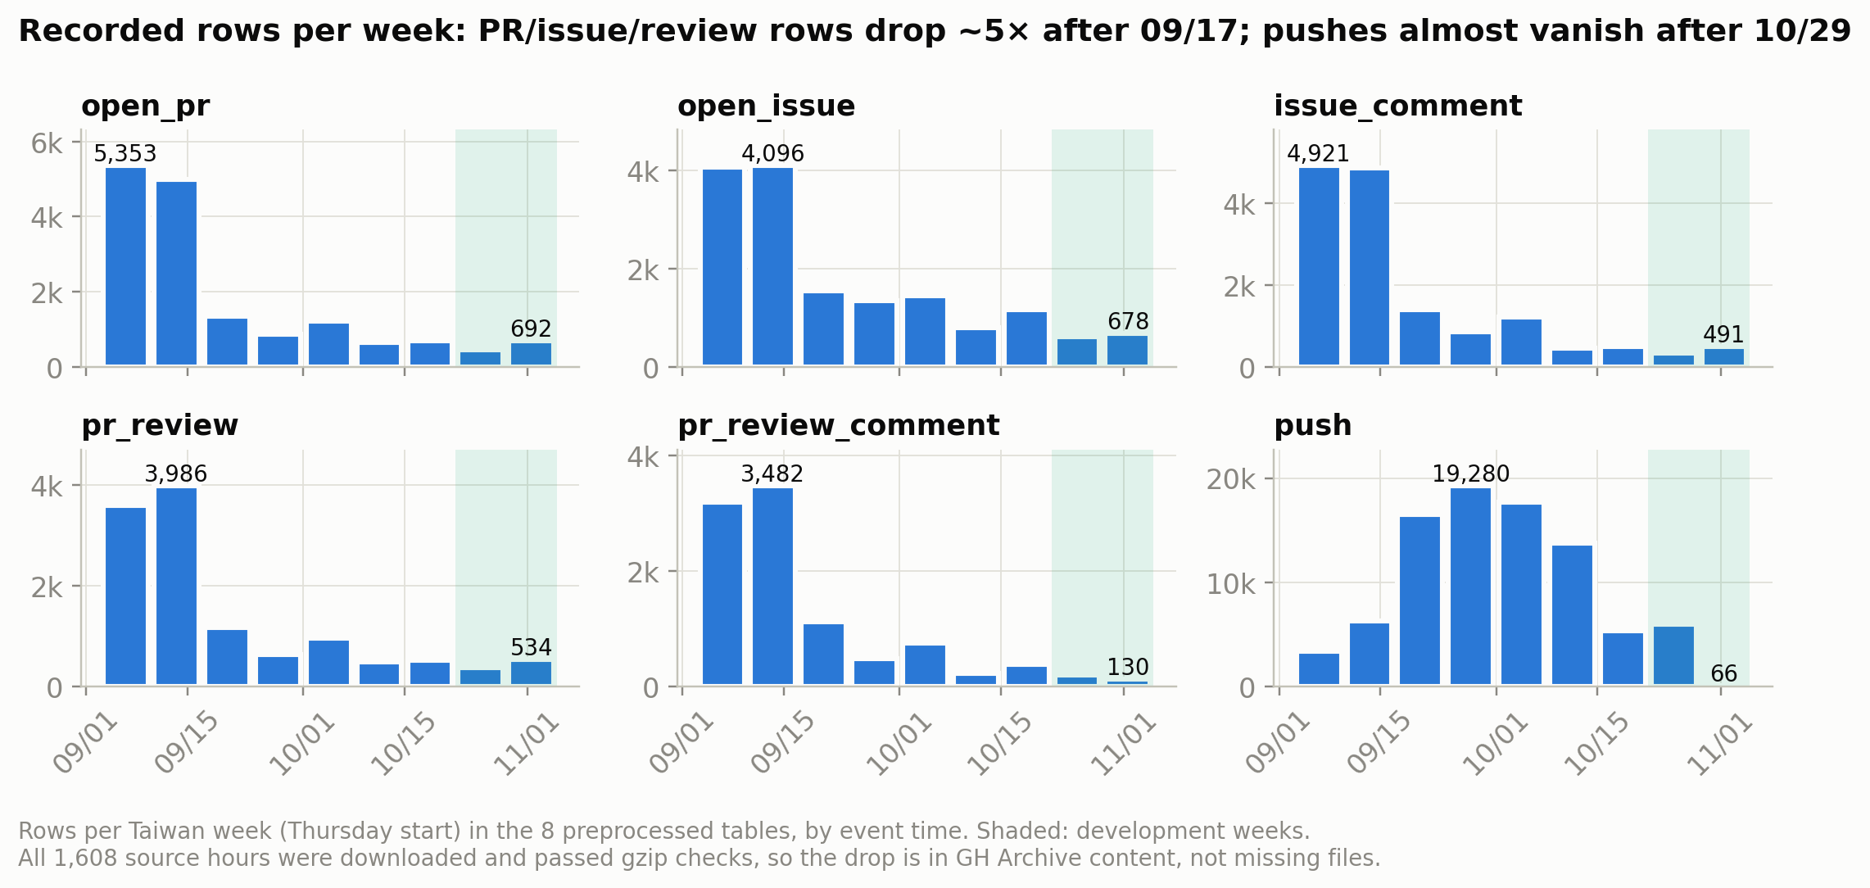
(5%) Question 3 The data are not stationary
Recorded rows fall ~5× after 09/17 and pushes nearly vanish after 10/29
Notes:
Question 3, analysis. Weekly volumes drop sharply: pull requests, issues, comments and reviews fall about five times after mid-September and pushes almost vanish at the end of October. This is in the archive content itself, matching the course note about missing raw information.

Slide 11
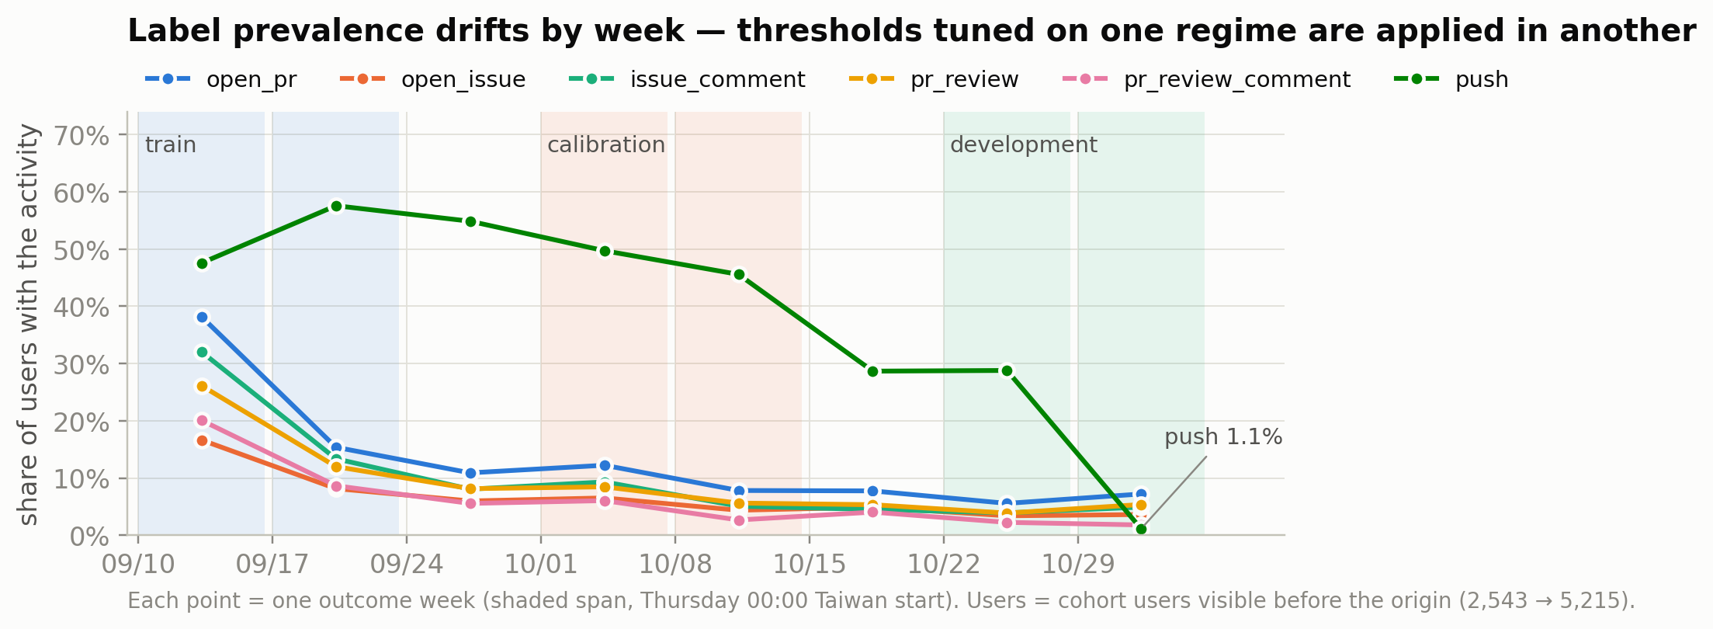
(5%) Question 3 Label drift and threshold calibration
Positive rates shift by week, so thresholds are tuned per activity on separate calibration weeks
Regime shift
Calibration Score ≈ 52%, development ≈ 35%.
open_pr prevalence 38.1% → 5.6% (09/10 → 10/22).
Push 28.8% → 1.1% in the last week: the six-activity Score falls from 41–45% to 21–24% for every variant; without push it stays at 31–36%.
Development weeks are never used for tuning, so this gap is reported, not hidden.
Frozen threshold | PR | Issue | Comment | Review | Line cmt | Push
value | .300 | .275 | .375 | .175 | .225 | .425
Each threshold maximises the mean weekly Score over the two calibration weeks (coordinate search, 3 passes), then stays fixed for development and the final prediction.
Notes:
Question 3, drift. Label prevalence drifts strongly, so we tune one threshold per activity on calibration weeks that are separate from training and development. The collapse of push explains most of the drop in the last week.

Slide 12
(5%) Question 3 Visibility time: the availability clock
Issues often enter the archive long after they were opened; counting by visibility time helps
Table | Rows | Visible > 24 h after event time
Issues (open_issue) | 19,379 | 30.4%
PullRequests (open_pr) | 16,694 | 2.8%
PRReviews (pr_review) | 12,524 | 0.4%
IssueComments, PRReviewComments, Pushes | 114,025 | 0%
36.41%
development Score with the
availability clock (best temporal
variants: 36.4–36.5%)
+1.59 pt
vs copy-last-week;
95% CI +0.62 to +2.62 pt
Occurrence clock
windows ask “what happened in the last k days?” — an old issue that only just became visible is counted in its original week.
Availability clock
windows ask “what newly became visible in the last k days?” — the view the archive actually offers at prediction time.
Notes:
Question 3, availability. About 30 percent of issues appear more than a day after they were opened. Counting windows by visibility time gives a development score of 36.4 percent, 1.6 points above copy-last-week, with a confidence interval above zero.

Slide 13
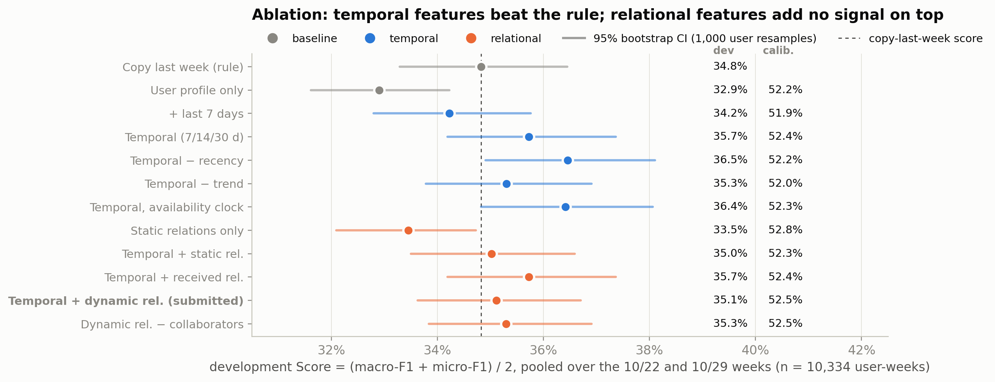
(5%) Question 3 Ablation with bootstrap CIs
Temporal information is what beats copy-last-week; all variants share dates, users, labels, tuning
Δ vs copy-last-week: user profile only −1.89 pt (CI excludes 0) · + 7/14/30-day windows, recency, trend +0.91 pt (P(better) = 0.97) · removing recency +1.64 pt and availability clock +1.59 pt (both CIs exclude 0). Dev. weeks 10/22 + 10/29, 10,334 user-weeks, 1,000 paired user resamples.
Notes:
Question 3, ablation. Each dot is a variant with a 95 percent bootstrap interval. Temporal windows beat the rule; removing recency or switching to the availability clock helps most under the shift.

Slide 14
(5%) Question 4 Framework
From GH Archive hours to a checked, reproducible submission file
1 · Data
2 · As-of sampling
3 · Features
4 · Model
5 · Output
GH Archive
1,608 hourly files
09/01–11/07 UTC
event stream:
event time +
row-visibility time
temporal (Q3): counts
in 7/14/30 d, recency,
trend, active days
6 LightGBM
classifiers (seed 42,
deterministic)
refit on 9 origins
(09/10–10/31)
official preprocess.py
(9,000-user cohort,
anonymization)
origin t (weekly,
Thu 00:00 TW): rows
visible before t − 4 h
relational (Q2): FK
joins — repo activity,
replies, collaborators
per-activity
thresholds on
calibration weeks
output_113700058.csv
4,465 × 6 (155 unseen
→ calibration prior)
8 relational tables
(Parquet)
label: activity in
[t, t + 7 d), visible
by t + 7 d
user profile: age,
lifetime counts
11 ablations +
copy-last-week on
development weeks
evaluate.py check +
rebuild & refit:
identical CSV
Blue = temporal (Q3), orange = relational (Q2). The same as-of sampler produces training, calibration, development and test rows, so prediction-time features are computed exactly as in training.
Notes:
Question 4, framework. Data, as-of sampling, features, model and output. The same sampler is used for every split and for the final prediction.

Slide 15
(5%) Question 4 Pipeline steps and evaluation
Six steps, each with a check; our labels reproduce the TA’s copy-last-week reference
1
Download 1,608 hourly files; SHA-256 recorded; gzip verified; resumable.
Reference week 09/27–10/04 | TA README | Ours
Copy last week | 49.61% | 50.39%
GNN with time encoding | 54.82% | —
Temporal (7/14/30 d) | — | 53.79%
Temporal + dynamic rel. (submitted) | — | 53.95%
Temporal GNN (ours) | — | 54.55%
2
Build tables unchanged official preprocess.py → 8 tables; PK/FK checks.
3
Sample weekly origins (Thu 00:00 TW); as-of features + 7-day labels.
4
Train 6 LightGBM heads: 160 trees, lr 0.045, 23 leaves, seed 42, deterministic.
Our copy-last-week score is within 0.8 pt of the README value, so our label construction is consistent with the TA’s.
Our model rows are optimistic: this week overlaps the calibration window.
5
Calibrate + evaluate thresholds on 10/01 + 10/08; 11 ablations on 10/22 + 10/29.
6
Refit + predict 9 origins 09/10–10/31; 4,465 users; 155 unseen → calibration prior.
Notes:
Question 4, pipeline. Six steps from download to prediction, each with a check. On the TA reference week our copy-last-week rule scores 50.4 percent versus 49.6 in the README, which validates our labels.

Slide 16
(5%) Question 4 Output and conclusions
The submitted CSV can be regenerated byte for byte from GH Archive with the code on GitHub
4,465 × 6
rows in input order; official
evaluate.py format check passes
Conclusions
Time is the main signal: multi-window counts and recency beat copy-last-week; visibility-aware counting helps most under drift.
Relations add little on development weeks — hand-built or learned by a temporal GNN — because cohort-only tables rarely contain other users’ replies (40 of 10,524 comments).
Strong distribution shift (volume −5×, push → 1%) dominates the scores; per-activity thresholds on separate weeks limit the damage.
Limitations and next steps
Two development weeks: most differences are within ±1.5 pt and CIs overlap.
Next: train the GNN on a longer history (collection starts 09/01) and add drift-aware threshold updates.
Code and results: github.com/ellatso/NYCU-BigData-Assignment2
Identical CSV
after rebuilding all 8 tables
and refitting (SHA-256 f5be6efe…)
Identical model
checkpoint re-trained on a
second machine
Notes:
Question 4, output and conclusions. The CSV is reproducible byte for byte. Time is the main signal, relations add little in cohort-only data, and the distribution shift dominates. Next steps: a temporal GNN and drift-aware thresholds.

