Slide 1
MERN Image Repository
Shopify Challenge
by Ellee Chen

Slide 2
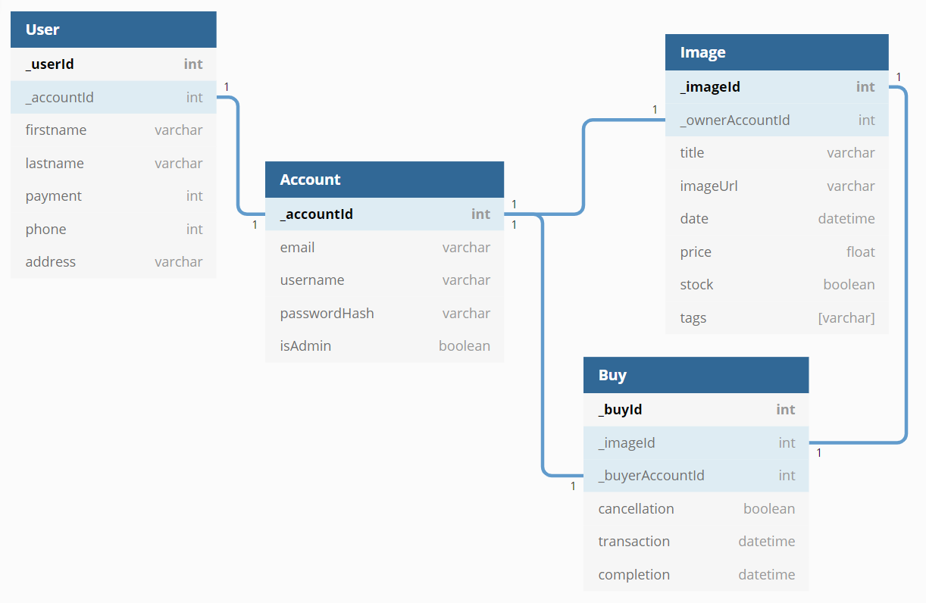
ER Model

Slide 3
Permission Hierarchy
Can login/logout, read all accounts, read/update/delete any account,
read all users, create own user info, read/update any user info,
read all images, create own image, read/update/delete any image,
search images by owner/title/date/price/stock,
read all buys, create own buy, read/update any buy
admin
Can login/logout, read/update own account,
create/read/update own user info,
read all or any images, create/update own image,
search images by owner/title/date/price/stock,
create/read/update own buy
general user
all
Can register, read all images*
* Limited frontend. Not reveal detail info of the image.

Slide 4
 |  | register | read all | read one | update | delete | login/logout
Account | admin | O | O | O | O | O | O
 | general user | O | X | △ (own) | △ (own) | X | O
 | all | O | X | X | X | X | X
 |  | create | read all | read one | update
User | admin | △ (own) | O | O | O
 | general user | △ (own) | X | △ (own) | △ (own)
 | all | X | X | X | X
 |  | create | read all | read one | update | delete | search
Image | admin | △ (own) | O | O | O | O | O
 | general user | △ (own) | O | O | △ (own) | X | O
 | all | X | △ | X | X | X | X
 |  | create | read all | read one | update
Buy | admin | △ (own) | O | O | O
 | general user | △ (own) | X | △ (own) | △ (own)
 | all | X | X | X | X

Slide 5
Setups – Backend
Create backend folder: mkdir PROJECT_NAME-backend
Initialize: npm init
Install packages: npm install express mongoose dotenv bcrypt jsonwebtoken cookie-parser mongoose-type-url cors
Setup MongoDB Atlas & get connection string
Code server, models, routers
Start: nodemon server

Slide 6
Backend – Routes
Account
Register – POST: http://localhost:8000/register
Request body = { email, username, password, passwordVerify, isAdmin }
Login – POST: http://localhost:8000/login
Request body = { username, password }
Logout – GET: http://localhost:8000/logout
Auth – GET: http://localhost:8000/auth

Slide 7
Backend – Routes
Account
Read all – GET: http://localhost:8000/account
Read one – GET: http://localhost:8000/account/:accountId
Update – PUT: http://localhost:8000/account/:accountId
Request body = { newEmail, newUsername, newPassword, newPasswordVerify, newIsAdmin }
Delete – DELETE: http://localhost:8000/account/:accountId

Slide 8
Testcase – Account
Register { email, username, password, passwordVerify, isAdmin }
Email needs to be unique, at least 8 characters, and meets Regex.
Username needs to be unique, at least 3 characters, and meets Regex.
Password needs to be at least 6 characters, and equals to PasswordVerify.
IsAdmin default false if not putting anything.
Read all / Delete
Only admin can access.
Read one / Update
Can only do own if not admin.
Updating data should meet register rules, except IsAdmin.
Only admin can update IsAdmin.

Slide 9
Backend – Routes
User
Create – POST: http://localhost:8000/user
Request body = { firstname, lastname, payment, phone, address }
Read all – GET: http://localhost:8000/user
Read one – GET: http://localhost:8000/user/:accountId
Update – PUT: http://localhost:8000/user/:accountId
Request body = { newFirstname, newLastname, newPayment, newPhone, newAddress }

Slide 10
Testcase – User
Create { firstname, lastname, payment, phone, address }
One account can only have one user and vice versa.
Can only create own user info.
Payment default 0 if not putting anything.
Read all
Only admin can access.
Read one / Update
Can only do own if not admin.
Updating data should meet create user rules.

Slide 11
Backend – Routes
Image
Create – POST: http://localhost:8000/image
Request body = { title, imageUrl, date, price }
Read all – GET: http://localhost:8000/image
Read all by owner – GET: http://localhost:8000/image/owner/:accountId
Read one – GET: http://localhost:8000/image/:imageId
Update – PUT: http://localhost:8000/image/:imageId
Request body = { newTitle, newImageUrl, newDate, newPrice, newStock }
Delete – DELETE: http://localhost:8000/image/:imageId
Search – GET: http://localhost:8000/image/search/q?<field>=<value>

Slide 12
Testcase – Image
Create { title, image, date, price, (stock) }
Can only create own image.
Date default now if not putting anything.
Read all / Read one / Search
No blockers.
Update / Delete
Can only do own if not admin.
Updating data should meet create image rules.

Slide 13
Backend – Routes
Buy
Create – POST: http://localhost:8000/buy
Request body = { _imageId }
Read all – GET: http://localhost:8000/buy
Read all by buyer – GET: http://localhost:8000/buy/buyer/:accountId
Read one – GET: http://localhost:8000/buy/:buyId
Read one by imageId – GET: http://localhost:8000/buy/image/:imageId
Update – PUT: http://localhost:8000/buy/:buyId
Request body = { cancellation, completion }

Slide 14
Testcase – Buy
Create { _imageId, _buyerAccountId, (cancellation), transaction, (completion) }
Can only create own buy.
Buyer default self, transaction default now.
Read all
Only admin can access.
Read one / Update
Only admin, image owner, or buyer can do it.
Can only update { cancellation, completion }.

Slide 15
Setups – Frontend
Create frontend folder: mkdir PROJECT_NAME-frontend
Create app: npx create-react-app .
Install packages: npm install react-router-dom axios react-bootstrap bootstrap@4.6.0 moment
Code components…
Start: npm start

Slide 16
Frontend – Order
_id: buy._id,
_imageId: buy._imageId,
_buyerAccountId: buy._buyerAccountId,
_ownerAccountId: image._ownerAccountId,
title: image.title,
imageUrl: image.imageUrl,
price: image.price,
transaction: buy.transaction,
cancellation: buy.cancellation,
completion: buy.completion

