Slide 1
Block Management System

Slide 2









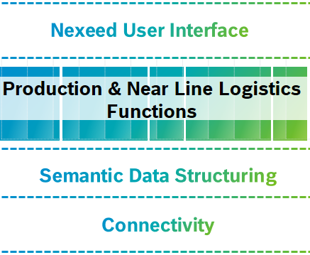



Block Management System Brief
Nexeed Industrial Application System – Vision
Software
MES
Manufacturing Execution System Connectivity to machine and ERP, execution, traceability, quality data, ….
PPM
Production Performance Manager Process and condition monitoring
Nexeed IAS
NTK
Nexeed Transparency Kit Transparency for the shopfloor, e.g. bottleneck detection
Refactoring & Integration
IES
Intralogistics Execution System Logistics solution for transport management and supermarkets
DTS
Digital Twin System Structuring of production data
Auto-mation
Nexeed Automation Engineering and run time for machine control
Services
Services
Application, Operations, Training, Consulting
Notes:
As the future #1 provider of industrial digitalization solutions, we bring our customers in manufacturing industry to the leading edge of production excellence by providing smart software and professional services to continuously improve production and logistics processes.
We and our partners relentlessly support our customers and users worldwide by providing solutions meeting the needs of shopfloor employees and management alike.
We combine our proven manufacturing process and IT expertise to provide reliable and highly beneficial solutions.
作为未来第一大工业数字化解决方案提供商，我们通过提供智能软件和专业服务不断改进生产和物流流程，将制造业客户带到卓越生产的前沿。 我们和我们的合作伙伴通过提供满足车间员工和管理层等需求的解决方案，不懈地支持我们的全球客户和用户。 我们结合成熟的制造工艺和 IT 专业知识，提供可靠且非常有益的解决方案。

Slide 3
Nexeed IAS Vision
Block Management System Brief
Significant added values
Flexible deployment models (on-premise & cloud)
Operated IT system
Transition and migration path for existing installations
Nexeed IAS
Common user interface / experience (Bosch Design Guide compliant)
Single sign on
Refactoring & Integration
Interoperable, scalable and managed application portfolio
Possibility for flexible combination of modules
Include applications from other GBs and partners
Provides raw data as structured information for all functions (i.e. master data)
Re-useable standardized non-functional services/features
Engineered on guiding principles that are valid across all appl. and their providers
Uni- & bidirectional hardware connectivity (shopfloor)
3rd party software integration through open APIs and integration points
Once integrated usable for the entire portfolio
Notes:
Ralf

Slide 4
Step Wise IAS Migration
Block Management System Brief
3
Legal Compliance
2
Relevant topics (not a closed list)
Legal requirements from target markets
BCI and BOSCH norms and standards
Security PEP (e. g. Security Concept)
Data Protection
1
IAS Market Readiness
IAS Architecture Readiness
IAS SaaS Readiness
Common (Web-) UI Concept
Common Authorization/ Authentication
Legal/Compliance
3rd party integration (module level)
Improved testing maturity
Linux Docker Deployment
Common Master Data (MDM)
Health endpoint for basic monitoring / IAS Logging
Module-spanning Security Concept / Found. Security SDK
New module design (w/o func. overlap)
Multi Database Support
Multi Tenancy
Common UX Concept
Support of Integration Events
Support of automated system testing
Notes:
Thomas
80% of module scope should be ready 03/23 with step 1-3

Slide 5
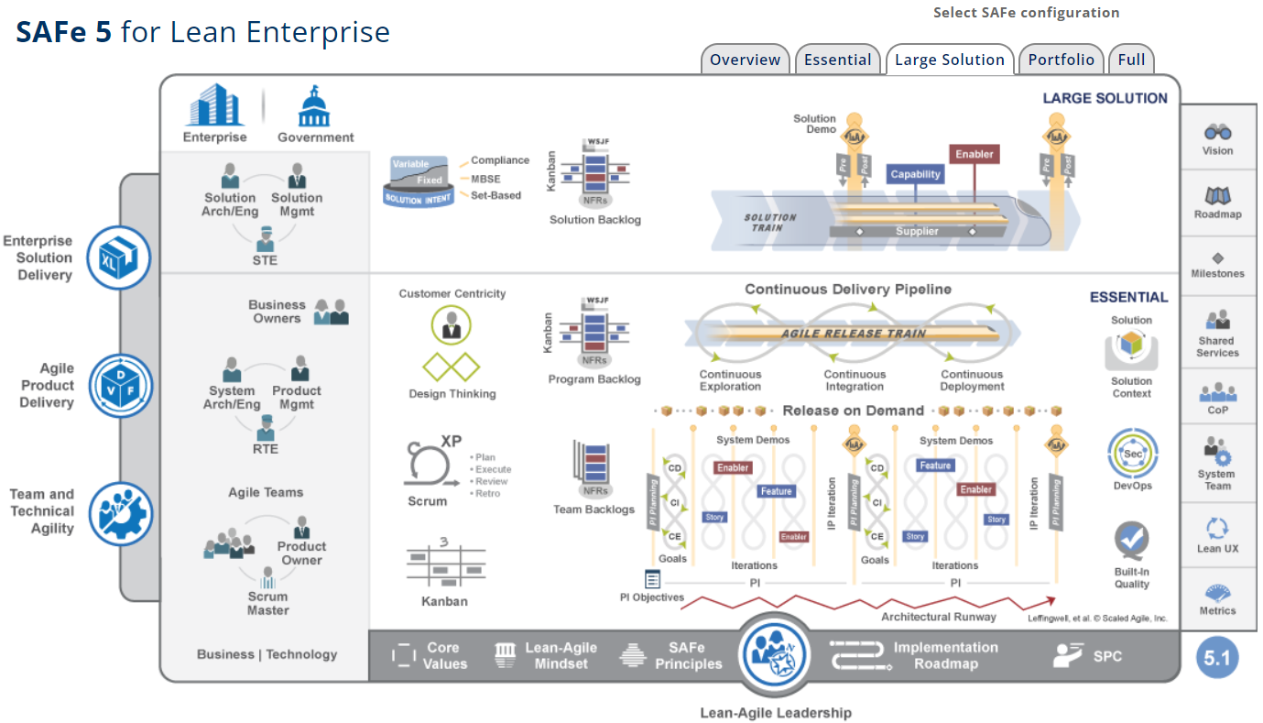
BCI Portfolio & Agile Organization
SAFe @ BCI
In the context of SAFe we define our portfolio with regards to dedicated development value streams at BCI. Thus, consulting and change trainings are currently out of scope, but nevertheless part of the BCI portfolio overall.
Portfolio
Nexeed IAS, Nexeed Automation, Bosch Semantic Stack (RBS)
Solution
Nexeed IAS*
Program
ART 1
Operating Base
ART 2
Execution
ART 3
Shopfloor Management / Intralogistics
ART 4
Machine & Equipment / Product & Quality
ART 5
Nexeed Automation*
ART42
Bosch Semantic Stack*
(by 2023)
Team
7 Teams
- A-Team
- Code Transformers
- Codeulhu
- Force Push
- MDM
- Portalisten
- BeConnected
7 Teams
- Byte Club
- Game of Threads
- _happy Coding
- MAOAM
- Power Booster
- Star Scrum
- The Expendables
7 Teams
- Backend Wizards
- Frontend Artists
- Stock Management
- KPI Busters
- tmpVar
- Transport Management
- Tatooine
8 Teams
- Codebusters
- IT Crowd
- Traceability
- Fighting Spirit
- Maintenance
- Data Analytics
- SetupSpecs
- Tightening Squad
2 Teams
- New Age Automation
- Commando Control
Teams
- NN
- …
Shared Services
Country Approval, Data Privacy, Documentation, EPQ, Marketing, Open Source Software (OSS), Operations, Product Training, Security, System Team, Third Party SW,…
* incl. Operational Value Streams such as Licenses, Application, Product Training, Service & Support, Operations.
Note: Nexeed IAS includes classic MES modules
Notes:
The main objective is to achieve "Business Agility".
"Achieving a state of Business Agility means that the entire organization—not just development—is engaged in continually and proactively delivering innovative business solutions faster than the competition."
This can be achieved by identifying the main value streams and organizing around them. Of course there is much more.
主要目标是实现“业务敏捷性”。 “实现业务敏捷性状态意味着整个组织——而不仅仅是开发——以比竞争对手更快的速度持续和主动地提供创新的业务解决方案。” 这可以通过确定主要价值流并围绕它们进行组织来实现。 当然还有更多。

Slide 6
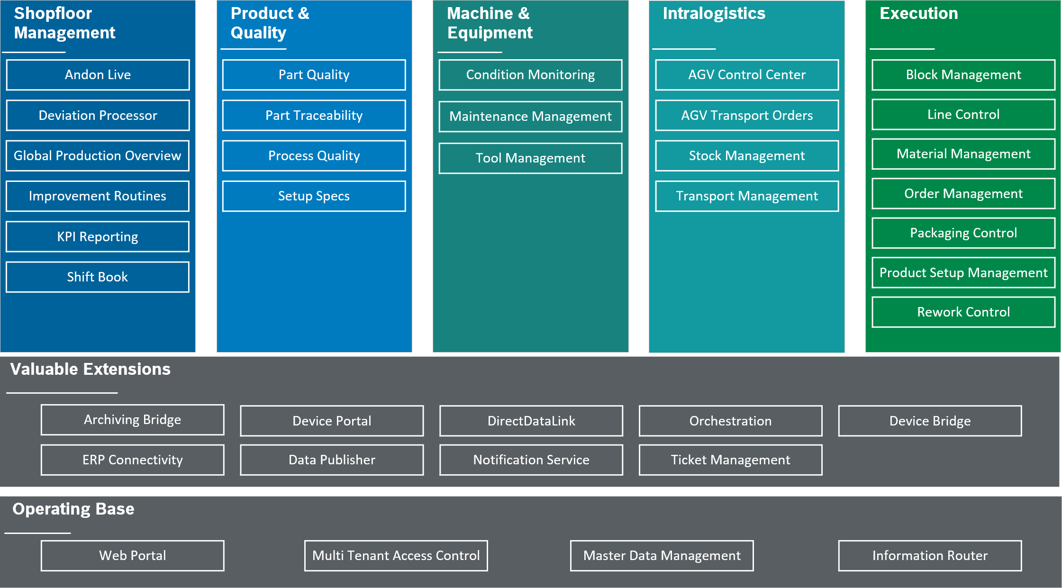
Portfolio Overview. Target picture
Block Management System Brief

Slide 7
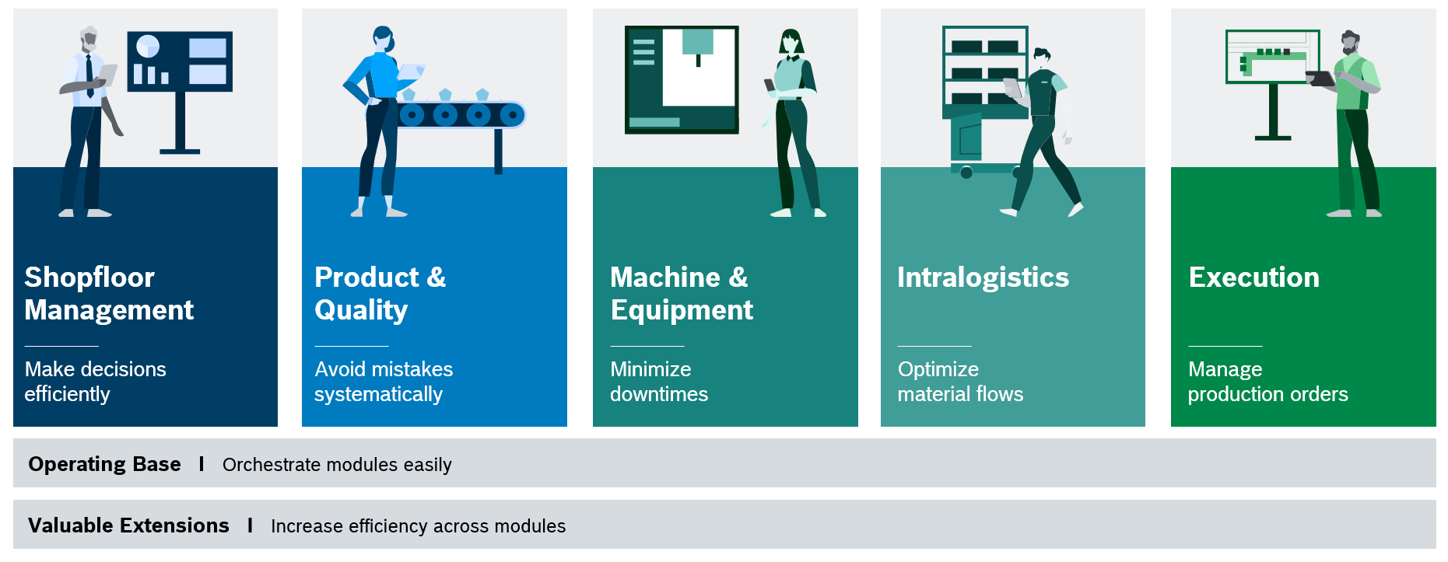
Portfolio Overview. Target picture
Block Management System Brief

Slide 8
Timeline
Block Management System Brief
Kick off in MES, 2021-5
PO role change, 2022-6
Release with IAS 2023.01 in March

