Slide 1
Understanding human trafficking patterns
A small step towards fighting a big crime using data science

Slide 2

A story…
Notes:
The story of one missing 17-year old girl in California has since become the shining example of data triumphing in the world of human trafficking. Using data science, analysts were able to find multiple online posts advertising the missing girl in question for sex. By analyzing over 50 ads, and nine different women spanning five states, analysts didn’t just find the girl—they saw the larger ring and were able to link the pimp to other crimes and victims.

Slide 3
Agenda
Problem Statement
Data Acquisition & Cleaning
Exploratory Data Analysis
Predictive Modeling & Results
Key Takeaways & Next Steps

Slide 4

Problem Statement

Slide 5
Problem statement
Between 27 and 45.8 million individuals worldwide are trapped in some form of modern-day slavery
Analytics could help law enforcement combat human trafficking and identify victims. This is where data science comes into play
Objective: Based on demographic data of trafficked victims, model and predict trafficking behavior:
Exploitation location
Type of exploitation (e.g. sexual/labor/both)
Types of labor/sexual exploitation
Means of control
Notes:
Between 27 and 45.8 million individuals worldwide are trapped in some form of modern-day slavery. It has sadly become a hugely profitable industry, generating an estimated US$150 billion annually in illegal profits per year.
Analytics could help law enforcement combat human trafficking. Traffickers often leave a data trail as they move the "supply" (human victim) through a network to meet "demand (for cheap, vulnerable and illegal labor), despite their efforts to operate off the grid and in the shadows. With such data, there is an opportunity to use bits and pieces of information gathered to get on the distribution of victims, traffickers and exploiters, and to disrupt the supply chain wherever and however possible.

Slide 6

Data acquisition
& Cleaning

Slide 7

Data Acquisition
Counter-Trafficking Data Collaborative (The Global Dataset)
Central repository for critical information about human trafficking
Contributors: IOM, Polaris, and Liberty Asia
2002 to 2017
About 47,000 data points across 62 variables that could be grouped as follows:
Demographics
Exploitation Geo
Types of Exploitation
Means of Control
Types of Labor
Types of Sexual Exploitation
Is Abduction?
Recruiter Relations
Source: https://www.ctdatacollaborative.org/
Notes:
The dataset for this project is acquired from Counter-Trafficking Data Collaborative, who serves as a central repository for critical information about human trafficking.
It publishes standard and harmonized data from various organizations using a unified schema in its Global Dataset, which includes data from 2002 to 2017.
Data contributors include the International Organization for Migration, Polaris, and Liberty Asia.
Major issue: Missing data partially due to the difficulty in data collection, and that it’s a relatively newer collaborative effort between organizations.

Slide 8
Data cleaning
47,000 → 18,000
Remove rows that have too many unknown values
Consolidate all columns related to Majority Status
Modify age range category into a number by using the mean
Impute missing ages with averages by majority status (one average for Adult, one average for Minor)
Unify unknown geo values: change from -99 to ZZ
For each groups of variables, if all columns of a dependent variable group are zeros, either remove the rows or set the “Not Specified” category to 1, and replace all remaining -99's with zeros.
Drop columns that are redundant with other columns or are totally not reliable (e.g. isAbduction)
For geo data, bucket the countries into wider regions
Notes:
Since much of these data are collected from hotline statistics, it's likely that if there's indication of at least one column being 1, it's a reasonable assumption to say the other columns are 0s. If all columns are 0, then the "Not Specified" column for that group of variables is set as 1.
There are some inconsistencies in the data as well: e.g. at least one type of Sexual Exploitation is indicated as 1, but the isSexualExploit column is still 0. In those cases, I corrected those specific isSexualExploit=0 to 1.

Slide 9
Exploratory data analysis

Slide 10
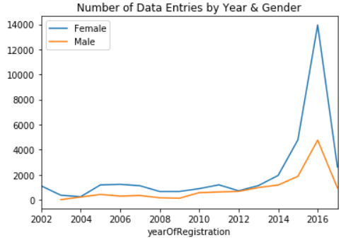
Data Timeline
Huge spikes in data availability from 2014 to 2016
Potential sampling bias
Exclude yearOfRegistration when building models

Slide 11
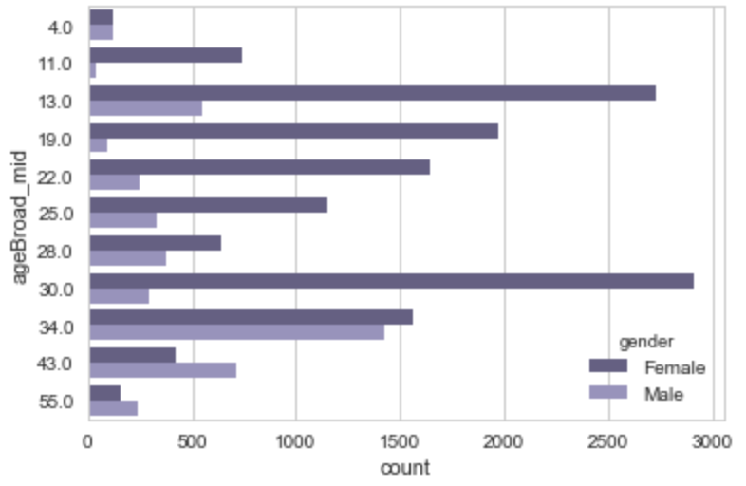
Age & Gender
Generally more female than male victims
Age of female spiking at around 13yo and 30yo
Age of male spiking at around 34yo
4yo group: most likely babies given birth by trafficked victims

Slide 12
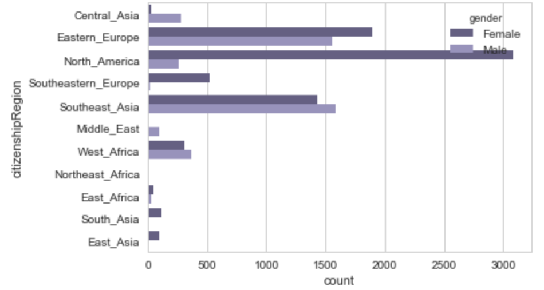
Citizenship & Gender
Majority of female in Eastern Europe, North America, and Southeast Asia
Majority of male in Eastern Europe and Southeast Asia
Vast contrast between female and male in North America

Slide 13
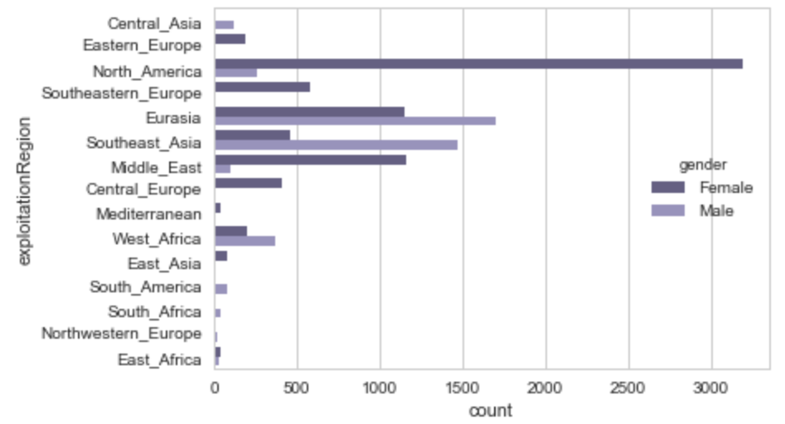
Exploitation Geo & Gender
Some shifts between citizenship vs exploitation
For example:
Eastern Europe → Central Europe and Eurasia
Southeast Asia → Middle East

Slide 14
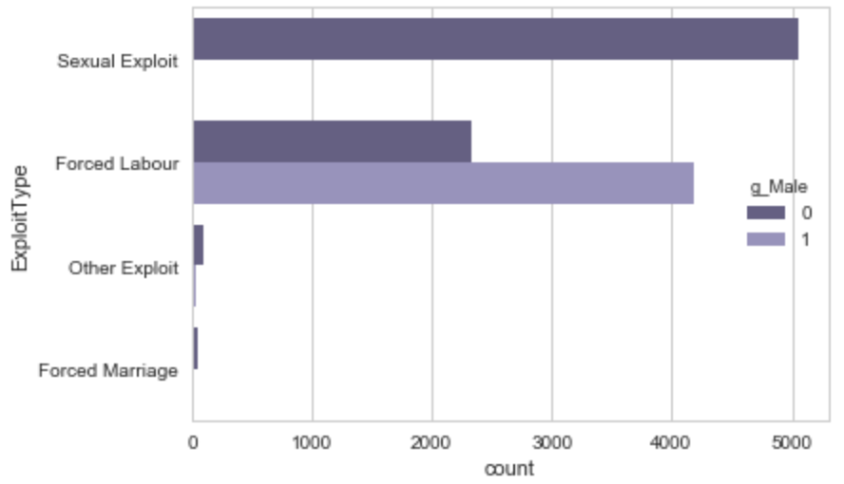
Exploitation Type & Gender
Some shifts between citizenship vs exploitation
For example:
Eastern Europe → Central Europe and Eurasia
Southeast Asia → Middle East

Slide 15
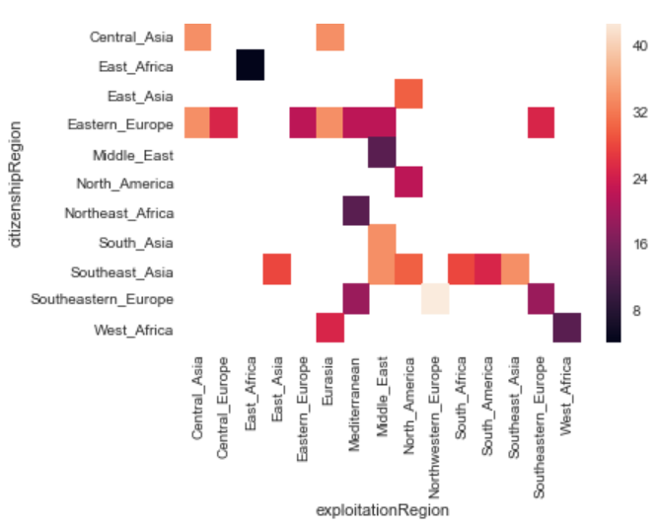
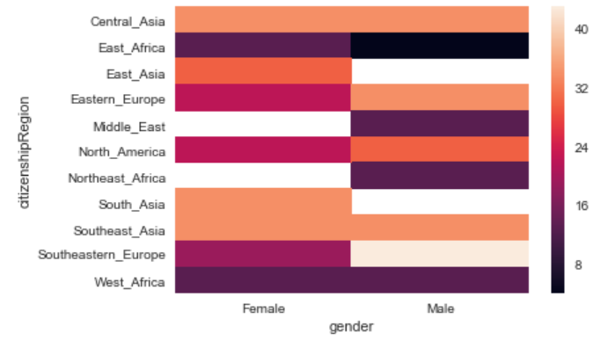
Geo, AGE & GEnder
Younger victims:
Africa
(heatmaps reflect average ages)
Older victims:
Asia
Notes:
some Northeast Africa children are trafficked to Mediterranean

Slide 16
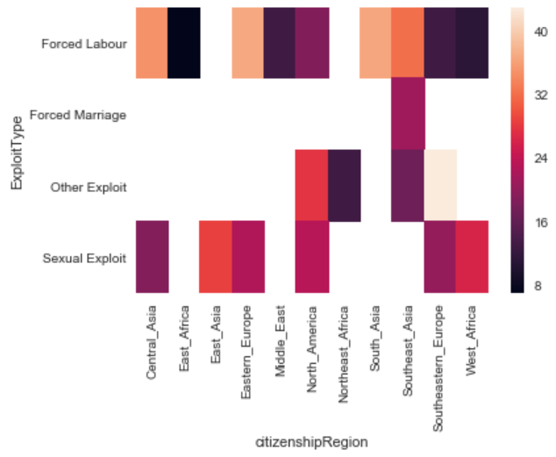
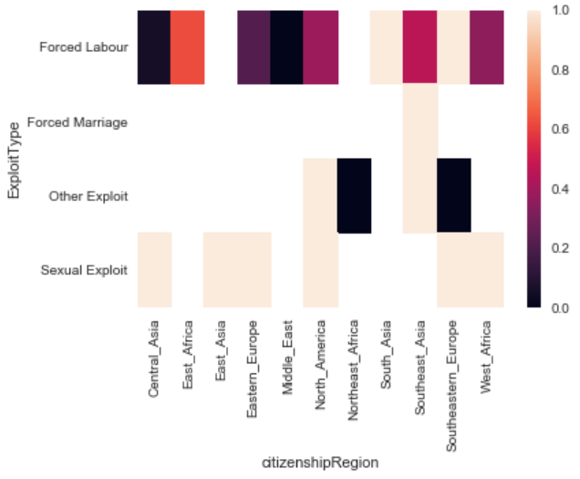
Exploitation type vs GEO
Forced Labor:
older male
Age
Gender (1 = Female)
Sexual Exploit:
Younger female
Notes:
Forced Labor – older victims / Male
Sexual Exploit – younger / Female

Slide 17
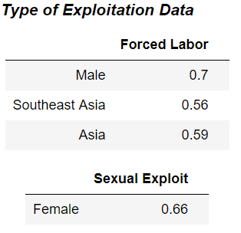
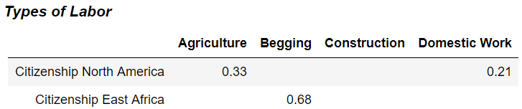
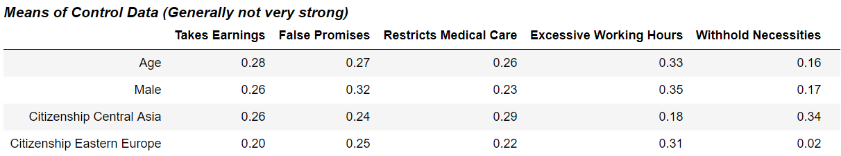
correlation

Slide 18
Predictive modeling
& Results

Slide 19
Objective:
Input Variables:
Demographic
Age
Gender
Citizenship
Recruiter Relationship
Friend
Family
Intimate Partner
Other
Output Variables:
Exploitation Geo
Exploitation Type
Means of Control
Type of Labor
Type of Sex Exploitation
algorithms
Multinomial Logistic Regression
Random Forest Classifier
(One-vs-All Classifier)

Slide 20
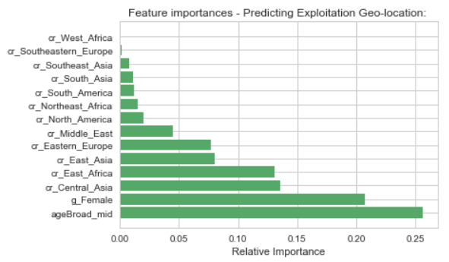
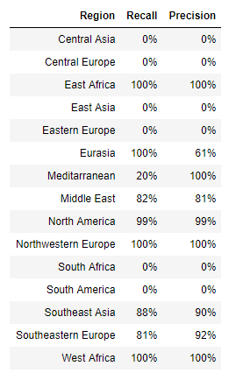
1) Predicting: Exploitation region
Multinomial Logistic Regression
Accuracy = 0.874
Using the confusion matrix:
Compute Recall & Precision
Random Forest Classifier
Accuracy = 0.887
Probabilities:
P(North America|Female) = 0.64
P(North America | Adult) = 0.44
P(North America | Minor) = 0.76
P(SE Asia | SE Asia) = 0.64
Notes:
Best: Northwestern Europe, North America, West Africa, East Africa
Moderate: Eurasia, Middle East, Southeast Asia, Southeastern Europe
Worst: Central Asia, Central Europe, East Asia, Eastern Europe, South Africa, South America

Slide 21
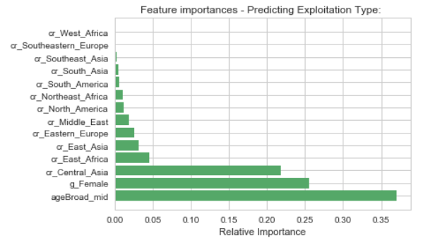
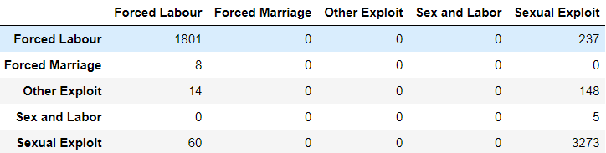
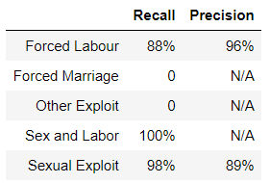
2) Predicting: Type of Exploitation
Multinomial Logistic Regression
Accuracy = 0.915
Using the confusion matrix:
Compute Recall & Precision
Random Forest Classifier
Accuracy = 0.937
P(Forced Labor | age=43) = 0.90
P(Sexual Exploit | age = 11) = 0.88
P(Forced Labor | Male) = 0.97
P(Sexual Exploit | Female) = 0.78
Notes:
Type of Exploitation: Purpose for which the victim was being trafficked
Feature importance – when compared to the previous slide, geo importances drastically decreased – which makes sense

Slide 22
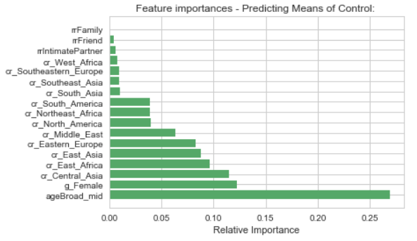
3) Predicting: Means of Control
One-Vs-Rest Classifier
Accuracy = 0.64
Random Forest
Accuracy = 0.63
Notes:
Means of Control: how does the trafficker manipulate the victim so as to exert authority over them
Data is not great. Scores are significantly lower than the other output predictions.

Slide 23
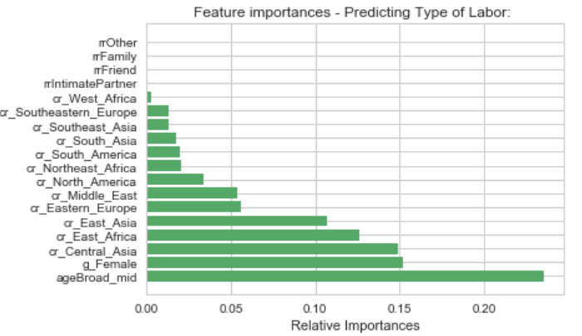
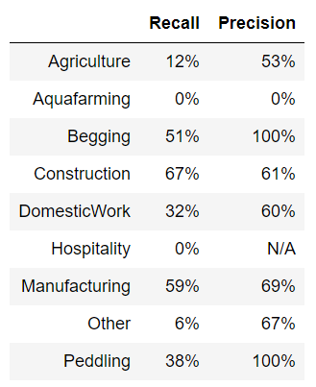
4) Predicting: Type of Labor
Multinomial Logistic Regression
Accuracy = 0.749
Using the confusion matrix:
Compute Recall & Precision
Random Forest Classifier
Accuracy = 0.832
P(Construction| age=55) = 0.313
P(Agriculture| age=30) = 0.35
P(Begging| age=11) = 0.41
P(Domestic Work| South Asia) = 0.75
P(Construction | Eastern Europe) = 0.45

Slide 24
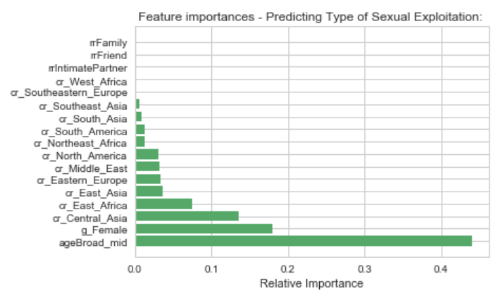
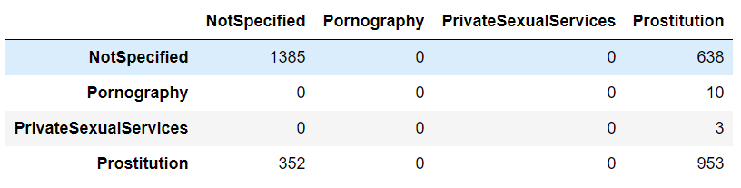
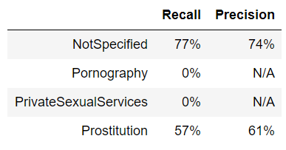
Predicting: Type of sex exploitation
Multinomial Logistic Regression
Accuracy = 0.687
Using the confusion matrix:
Compute Recall & Precision
Random Forest Classifier
Accuracy = 0.707
Issue:
Missing data!!!
P(Prostitution | Female) = 0.38
P(Prostitution | Male) = 0.36
Highest probability of Prostitution is at age 9-17 range (0.56)

Slide 25

Key takeaways
& Next steps…

Slide 26
Key takeaways & Next Steps
Data quality is an issue – need more granular data for building a predictive and reliable model, where data integrity is preserved
Continue to monitor the CTDC website on any data updates they are releasing
Explore using other models (e.g. Naïve-Bayes) on the same set of data
The models imply a heavier issue on child trafficking than I imagined.
Besides active fighting against this crime…
we also need to have preventive measures!

Slide 27
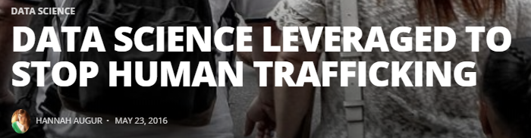
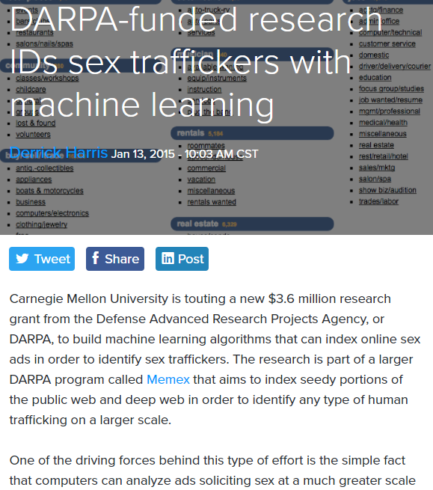
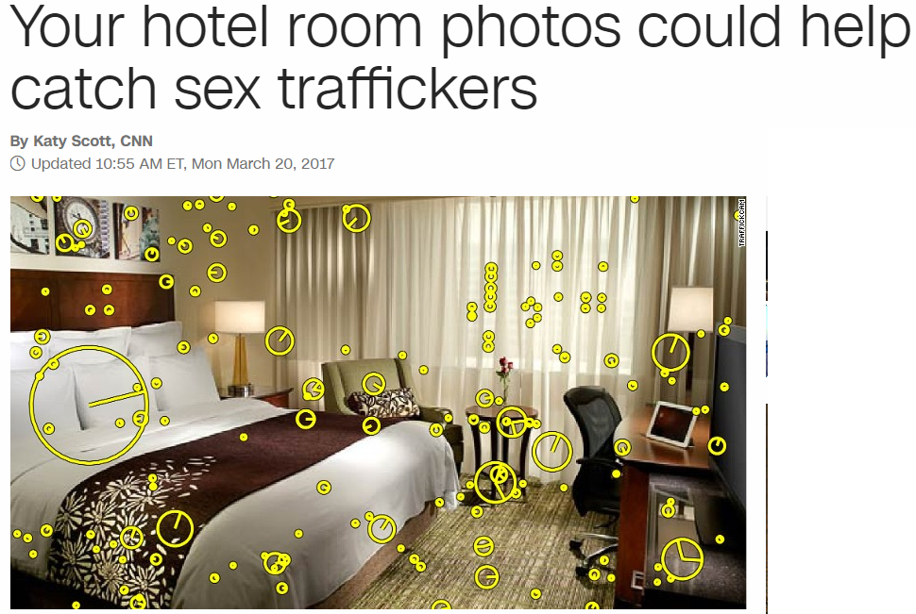
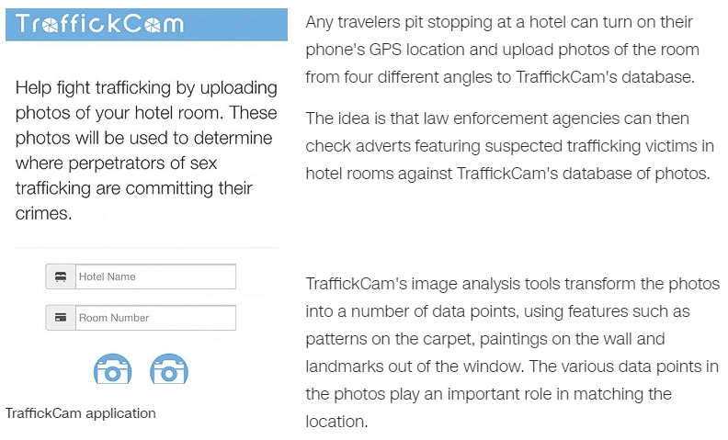
globally…

Slide 28
Resources
http://restorenyc.org/
https://www.ctdatacollaborative.org/
http://dataaspirant.com/2017/05/15/implement-multinomial-logistic-regression-python/
http://scikit-learn.org/stable/modules/multiclass.html
http://scikit-learn.org/stable/modules/generated/sklearn.linear_model.LogisticRegression.html
https://stackoverflow.com/questions/36523558/multi-class-logistic-regression-in-scikit-learn?noredirect=1&lq=1
https://datascienceplus.com/building-a-logistic-regression-in-python-step-by-step/
http://dataconomy.com/2016/05/data-science-leveraged-stop-human-trafficking/
http://www.cnn.com/2017/02/09/tech/traffickcam-sex-trafficking/index.html
https://gigaom.com/2015/01/13/darpa-funded-research-ids-sex-traffickers-with-machine-learning/
https://www.scientificamerican.com/article/data-science-can-help-us-fight-human-trafficking/
https://www.boozallen.com/s/insight/thought-leadership/combating-human-trafficking-using-data-science-.html
https://mapr.com/blog/how-big-data-fights-human-trafficking/
https://www.usnews.com/news/articles/2015/01/14/how-big-data-is-being-used-in-the-fight-against-human-trafficking
https://www.wpi.edu/news/in-the-news/data-science-can-help-us-fight-human-trafficking
Kudos to Jonathan and Nico!

