Slide 1

Statistics 133 Final Project: Financial Exploration through Statistical Computation
Extra Credit Presentation
Christian Alarcio
Sociology
2016
Ellen Chan
Statistics
2017
Anais Sidhu
Economics
2016
Ruomeng (Michelle) Yang
EECS
2018

Slide 2
RESEARCH PROBLEM
Technology industries show higher growth and higher beta, and therefore lower PE ratios.
Questions We Answered:
PE ratio: market value per share / earnings per share
Trailing PE: derived from previous four quarters
Forward PE: calculated using estimated earnings for the next four quarters
Market capitalization: total dollar value of a company’s outstanding shares
Unlevered beta: metric indicating the risk of a company to that of the market
Financial Terminology:
1
What is the relationship between beta and the payout percentage?
2
What is the relationship between beta and the expected growth rate?
Research Problem
Data & Preprocessing
Methods & Analysis
Key Findings

Slide 3
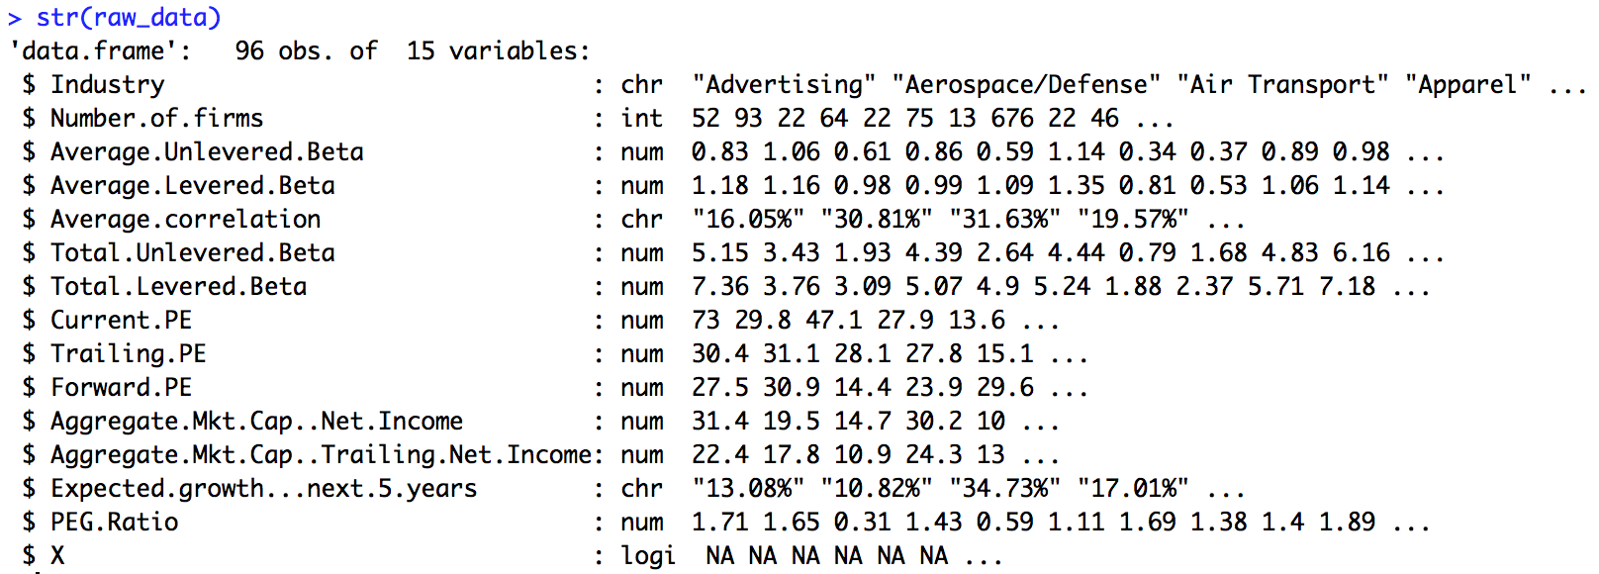
DATA & PREPROCESSING
Raw Dataset from NYU Stern School of Business’s Data Archives
beta
pe
raw_data
Preprocessing Raw Data into Clean Data
Steps:
Inspect elements within raw_data
Make a copy of raw_data called “clean_data”
Rename columns
Convert character columns to numeric vectors
Remove extraneous rows with missing values
Inspect clean_data
Write a CSV file of the processed data
raw_data
clean_data
Research Problem
Data & Preprocessing
Methods & Analysis
Key Findings

Slide 4
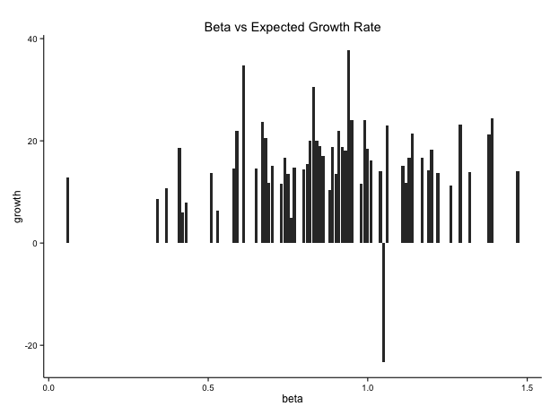
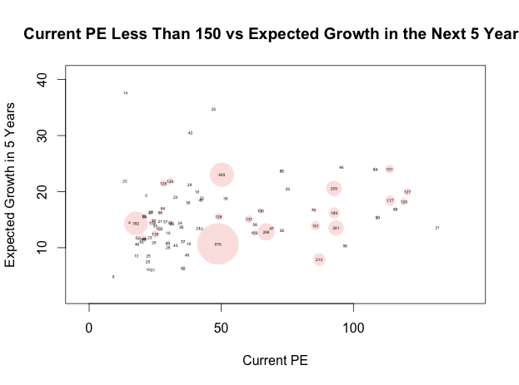
METHODS & ANALYSIS
Histograms
Used to graphically display the distribution of a variable and its corresponding value to another variable
Looked at:
Current PE, Forward PE, Total Levered Beta, Growth
PE Ratio to Average Unlevered Beta
Average Unlevered Beta to Expected Growth Rate
Current PE to Expected Growth Rate
We found that industries with high beta are growing industries such as online retail, real estate, and software and those with the lowest beta are stable markets such as finance or trucking
Bubble Plots and Scatterplots
Used to graphically display the relationship between two variables and add emphasis to a third
Graphed multiple charts, some of which controlled for outliers
Looked at:
Current PE ratio to Expected Growth in the Next 5 Years, with circles of size corresponding to the size of the specific industry
We found that most industries had PE ratios that were below 150, but a few had extremely high Current PE, which skewed the data. When accounting for these outliers, we find that most larger industries have PE values between 50 and 100
Research Problem
Data & Preprocessing
Methods & Analysis
Key Findings

Slide 5
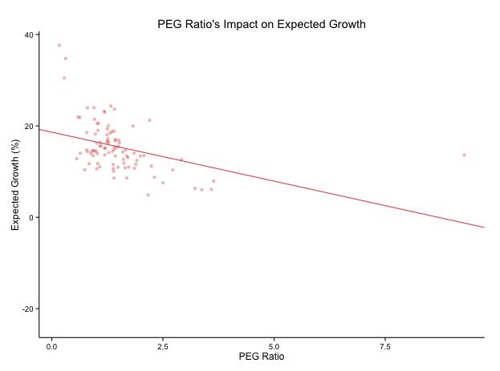
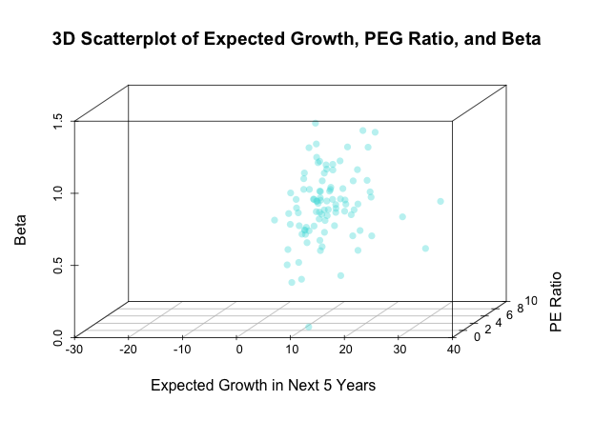
METHODS & ANALYSIS
Linear Regression
Used to illustrate the correlation and relationship between variables
Had multiple scatterplots, some that controlled for outliers or other related variables to maintain accuracy
Looked at the scatterplots and linear regressions of:
Current PE to Expected Growth in the Next 5 Years
Expected Growth to Average Unlevered Beta, Current PE, and PEG Ratio
We found that there was a strong statistical significance of the PEG ratio to growth, as shown in the figure to the right
3D Scatterplots
Used to analyze the relationship between multiple variables
Examined graph from multiple angles
Looked at the 3D plot of:
Expected Growth in the Next 5 Years, PEG Ratio, and Average Unlevered Beta
Expected Growth in the Next 5 Years, Current PE Ratio, and Average Unlevered Beta
We found that higher beta corresponded with expected growth (as predicted), higher beta was correlated with higher PEG ratio, and that lower expected growth equated with higher PEG ratios
Research Problem
Data & Preprocessing
Methods & Analysis
Key Findings

Slide 6
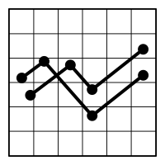

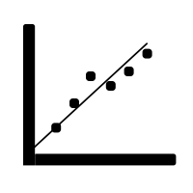
KEY FINDINGS
Beta & Payout Ratio
Payout ratio is directly correlated with PE ratio. Thus, examining the relationship of beta to PE tells us that PE ratio is negatively correlated with beta, and thus payout ratio is negatively correlated with risk.
Beta & Growth Rate
Higher beta corresponds to a higher growth rate, as expected. Industries with higher beta and risk are those that are growing, such as online retail, real estate, and software, while stable markets have lower beta.
Tech Industry
Because the technology industry has a high beta, by our analysis of growth rate versus beta, it also has a high growth rate. Additionally, because beta is negatively correlated with PE ratios, the industry has low PE.
Research Problem
Data & Preprocessing
Methods & Analysis
Key Findings

Slide 7
Q&A

Slide 8
SOURCES
Front-page picture: http://qcfinance.in/wp-content/uploads/2013/10/financial-analysis.jpg
Financial terminology: http://www.investopedia.com/
Icons: The Noun Project

