Slide 1

Statistics 133 Final Project: Financial Exploration through Statistical Computation
Extra Credit Presentation
Christian Alarcio
Economics
2016
Ellen Chan
Statistics
2017
Anais Sidhu
Economics
2017
Ruomeng (Michelle) Yang
EECS
2018

Slide 2
RESEARCH PROBLEM
Technology industries show higher growth and higher beta, and therefore lower PE ratios.
Questions We Answered:
PE ratio: market value per share / earnings per share
Trailing PE: derived from previous four quarters
Forward PE: calculated using estimated earnings for the next four quarters
Market capitalization: total dollar value of a company’s outstanding shares
Unlevered beta: metric indicating the risk of a company to that of the market
Financial Terminology:
1
What is the relationship between beta and the payout percentage?
2
What is the relationship between beta and the expected growth rate?
Research Problem
Data & Preprocessing
Methods & Analysis
Key Findings

Slide 3
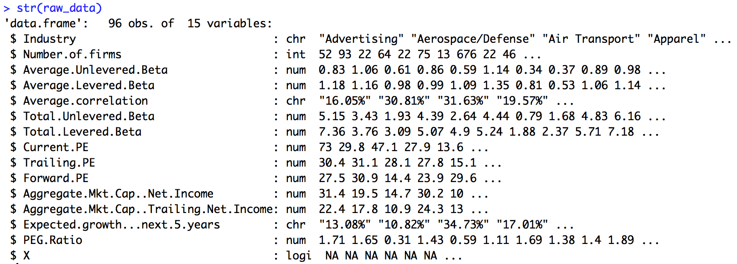
DATA & PREPROCESSING
Raw Dataset from NYU Stern School of Business’s Data Archives
beta
pe
raw_data
Preprocessing Raw Data into Clean Data
Steps:
Inspect elements within raw_data
Make a copy of raw_data called “clean_data”
Rename columns
Convert character columns to numeric vectors
Remove extraneous rows with missing values
Inspect clean_data
Write a CSV file of the processed data
raw_data
clean_data
Research Problem
Data & Preprocessing
Methods & Analysis
Key Findings

Slide 4
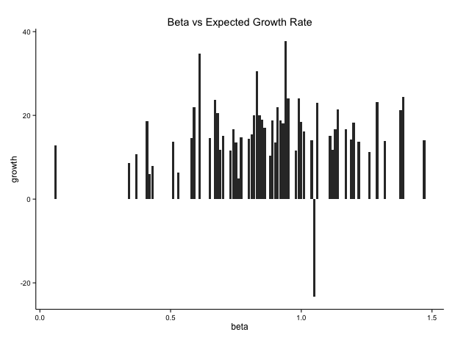
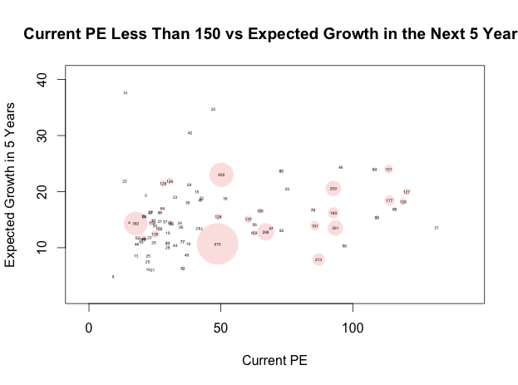
METHODS & ANALYSIS
Bar Plot of Beta vs. Expected Growth Rate in the Next 5 Years
a
Bubble Plot of Current PE and Expected Growth in the Next 5 Years for Different Industries
a
Research Problem
Data & Preprocessing
Methods & Analysis
Key Findings

Slide 5
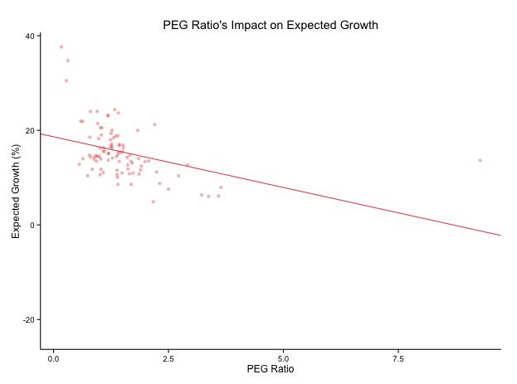
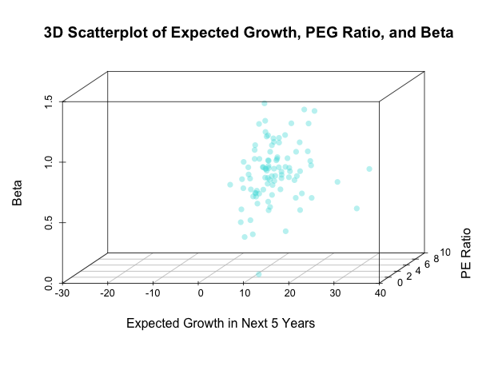
METHODS & ANALYSIS
Bar Plot of Beta vs. Expected Growth Rate in the Next 5 Years
a
Bubble Plot of Current PE and Expected Growth in the Next 5 Years for Different Industries
a
Research Problem
Data & Preprocessing
Methods & Analysis
Key Findings

Slide 6
KEY FINDINGS
Research Problem
Data & Preprocessing
Methods & Analysis
Key Findings

Slide 7
Q&A

Slide 8
SOURCES
Front-page picture: http://qcfinance.in/wp-content/uploads/2013/10/financial-analysis.jpg
Financial terminology: http://www.investopedia.com/

