Slide 1
Mitigating the Leaching of Phosphorus from Soils
Emma Gregory, Caitlin Byrne, Sofia Anker,
Ellen Crombie, Ellie Letts, Dilsa Dag

Slide 2

Background
Clear-cutting effects
Reduces nutrient and water uptake by vegetation
Increases surface run-off
Alters soil chemistry
Eutrophication
Importance of phosphorus
Limiting nutrient
Notes:
After clear cutting, soils are disturbed increasing possibility of phosphorus leaching because retention of soil is changed
This can lead to decrease in tree growth later
Iron ochre is an alkaline iron oxide which can provide a surface for phosphorus to bind on creating strong complexes and preventing leaching
It also increases pH which decreases solubility

Slide 3
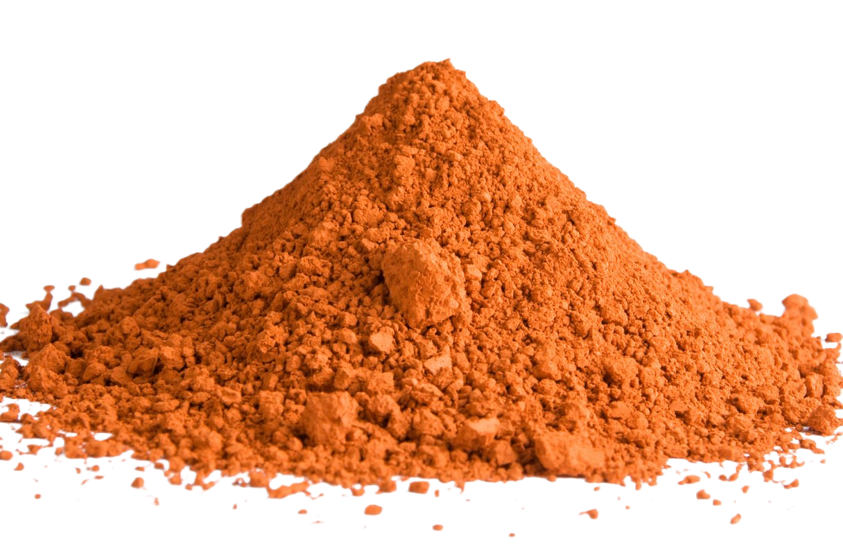
What is Ochre?
-Rich in Iron-oxide
By-product of Acid-Mining
Forms Fe-P complexes
Immobilises Phosphorus

Slide 4
Research Question
Is iron ochre effective at increasing phosphorus retention in clear cut forest sites?
At what level is the treatment most effective?
Up to what concentration of phosphorus can retention
be achieved?

Slide 5
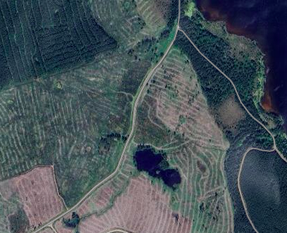
Sampling Plan
Soil samples will be taken from an area of clear-cut forest on the southwest of Loch Morlich
6 random sampling sites
Remove vegetation
Collect three trowels of soil from each site
Take only the top 20cm of soil
Combine and mix in bag

Slide 6
Soil Samples
Phosphorus solution concentration
Iron ochre percentage
Combined Soil
0%
0.5%
1%
3%
5%
3x
3x
3x
3x
3x
0
5
10
0
5
10
0
5
10
0
5
10
0
5
10
20
40
20
40
20
40
20
40
20
40
mg/L
mg/L
mg/L
mg/L
mg/L
Notes:
Blanks
Iron amendment

Slide 7

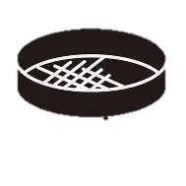

Lab Method Diagram:
Take the mixed soil sample
Wet sieve the soil (2mm)
Background analysis (pH, soil moisture content, leachable P , and more)
105°C
2 hours
Oven dry samples
Divide soil into 100g batches, for each ochre amendment level
100g
100g
100g
100g
100g

Slide 8

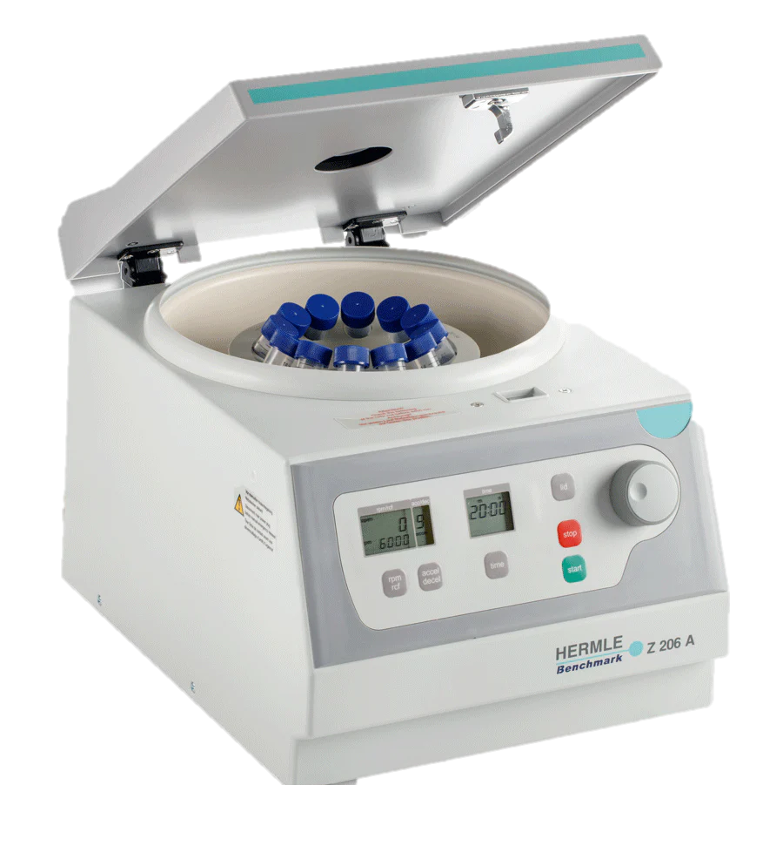

Method Continued:
Add ochre to each soil batches (e.g. 1g of ochre for the 1% ochre level etc.) and mix thoroughly.
2g soil/ochre mixture
20 ml Phosphorous solution
5 concentrations of Phosphorous are investigated
Shake the solution
1 hour on end-over-end shaker
Remove supernatant using syringe and filter
Analyse the filtrate for phosphorous using a colorimetry method
Centrifuge tubes
8000 rpm for 10 minutes

Slide 9
Statistics
General linear mixed model
Explanatory variables: iron ochre percentage (fixed effect), phosphorus solution concentration (fixed effect)
Response variable: phosphorus retention (mg/L)

Slide 10
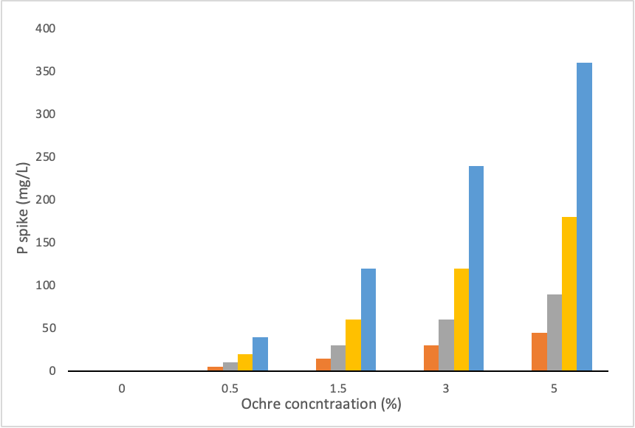
Predicted results
We expect to see higher P retention in soils with higher concentrations of ochre.
Fenton et al. (2011) found the highest amount of P retention in sandy soil with an ochre amendment of 3%.
We are focusing our project on corniferous soil which is more acidic with higher organic matter and thus likely to need higher concentrations of ochre.
Notes:
We expect to see higher p retention in soils with higher Ochre amendments because the iron oxides in the ochre binds to the phosphorus, reducing the potential of leaching.
Fenton et al. (2011) focused their research on sandy soil and had the least amount of Phosphorus loss with an ochre amendment of 3%.
We are focusing our project on coniferous soil which is more acidic with higher organic matter and thus likely to need higher amendments of ochre as seen in our diagram

