Slide 1
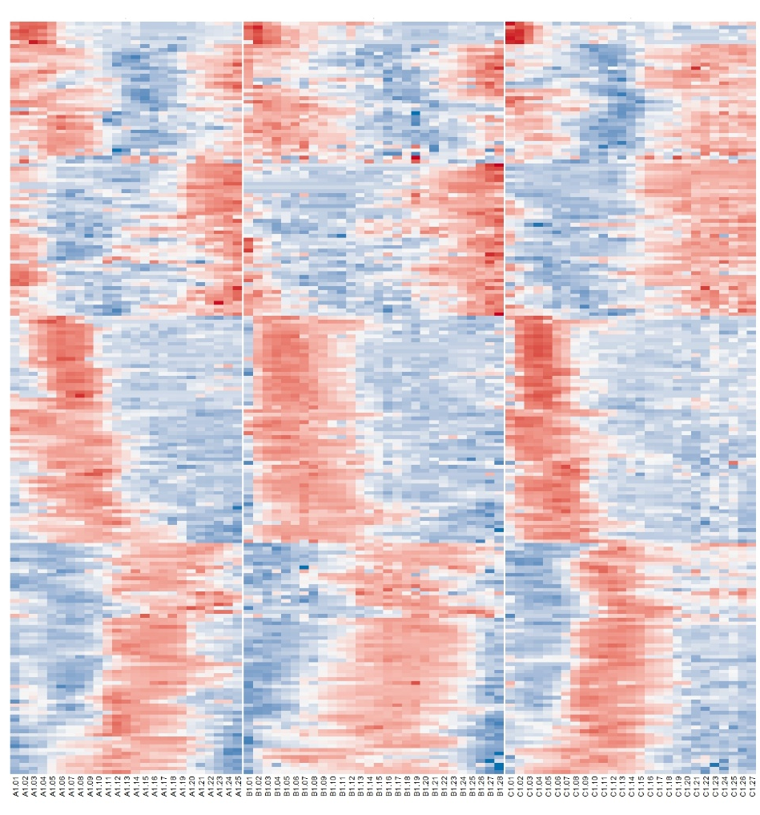
Ultra-conserved clique orthologs: Angiosperm-specific

Slide 2
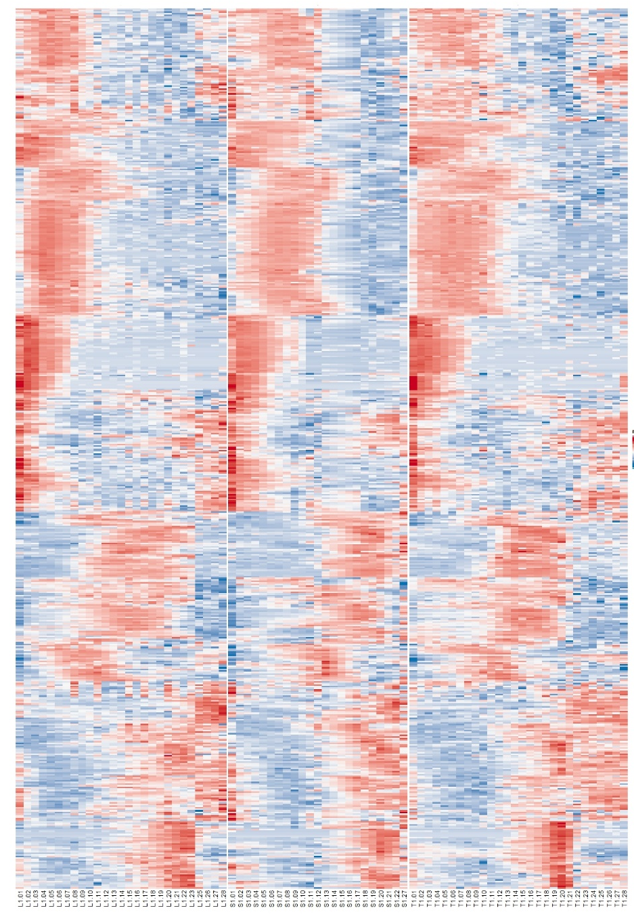
Ultra-conserved clique orthologs: Gymnosperm-specific

