Slide 1
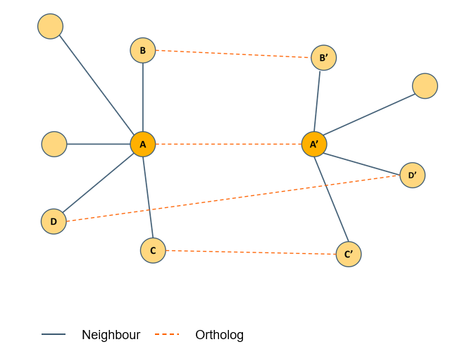
A
B
N - number of genes in the network
n - number of neighbours of gene (5)
k - number of neighbours of gene A’ after mapping them to the network of species 1 (network to the left) (3)
x – the overlap of the two neighbourhoods in species 1 (3)
Repeat for species 2.

