Slide 1
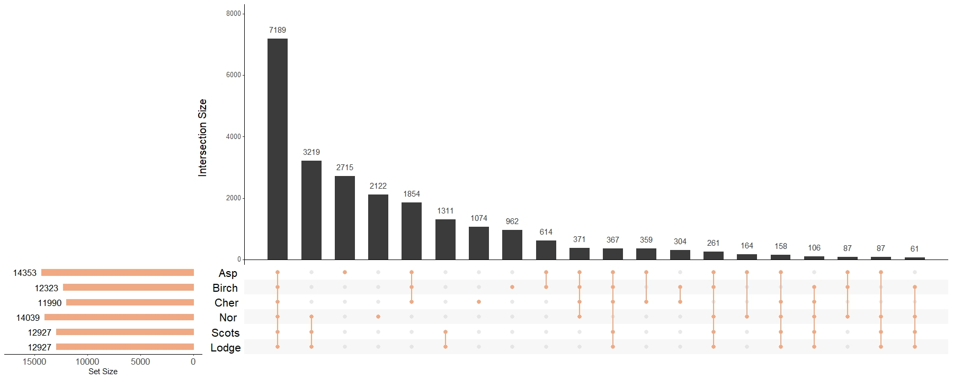
a)
 | Number of conserved genes identified using ComPlEx
Species pair | Expressed genes | Co-expressologs
Aspen - Cherry | 5990 | 2556
Aspen - Birch | 7159 | 2968
Birch - Cherry | 5779 | 2742
Aspen - Norway spruce | 39.431 | 9464
Aspen - Scots Pine | 41,811 | 9464
Lodge Pine - Aspen | 6050 | 1852
Lodge Pine - Birch | 5732 | 2073
Lodge Pine - Cherry | 4852 | 1671
Norway Spruce -Birch | 5468 | 1915
Norway Spruce -Cherry | 4642 | 1623
Scots Pine - Cherry | 4715 | 1764
Scots Pine - Birch | 5607 | 2051
Norway Spruce - Scots Pine | 6972 | 3801
Lodge Pine - Scots Pine | 8655 | 6717
Lodge Pine -Norway Spruce | 7146 | 3604
b)

Slide 2
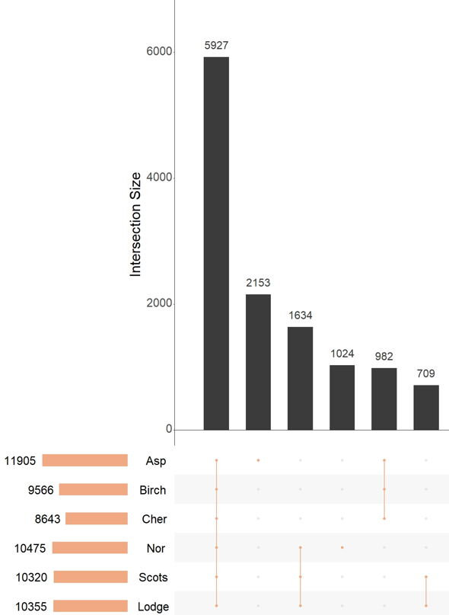
A
B
Species pair | Expressed genes | Co-expressologs
Aspen - Cherry | 39,546 | 13,140 (33,2%)
Aspen - Birch | 44,968 | 14,746 (32,8%)
Birch - Cherry | 26,720 | 9810 (36,7%)
Aspen - Norway spruce | 39,431 | 9986 (25,3%)
Aspen - Scots Pine | 41,811 | 9841 (23,5%)
Lodgepole Pine - Aspen | 42,209 | 9955 (23,6%)
Lodgepole Pine - Birch | 29,342 | 7474 (25,5%)
Lodgepole Pine – Cherry | 24,496 | 6364 (26%)
Norway Spruce -Birch | 27,075 | 7304 (27%)
Norway Spruce –Cherry | 23,026 | 6569 (28,5%)
Scots Pine - Cherry | 24,213 | 6641 (27,4%)
Scots Pine – Birch | 29,077 | 7740 (26,6%)
Norway Spruce - Scots Pine | 46,054 | 13,795 (30%)
Lodgepole Pine - Scots Pine | 57,308 | 21,655 (37,8%)
Lodgepole Pine -Norway Spruce | 45,722 | 13,055 (28,6%)

