Slide 1
Employee Analysis
Ellen Lull
Doing Data Science, DS6306, Section 401
April 18, 2020

Slide 2

Project Goals
Classification Model for Employee Attrition
Prediction Model for Employee Attrition
Identify Top 3 Factors that Influence Attrition
Prediction Model for Employee Salaries
Identify Job Role Specific Trends

Slide 3
Data for Employee Analysis
Employee Data Overview:
870 Employee Data Records
36 Demographic, Salary, Job Role, and Employee Survey Data Columns.
Attrition Data: There is about a 16 percent Attrition Rate.
Care had to be taken when creating Training and Test Datasets to include Yes Responses for Attrition Rate. To create these datasets, random samples were created on subsets of Yes and No data Individually, then merged together
Attrition | Training | Test
YES | 112 | 28
NO | 584 | 146

Slide 4
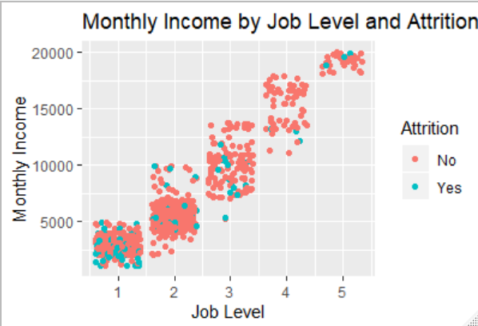
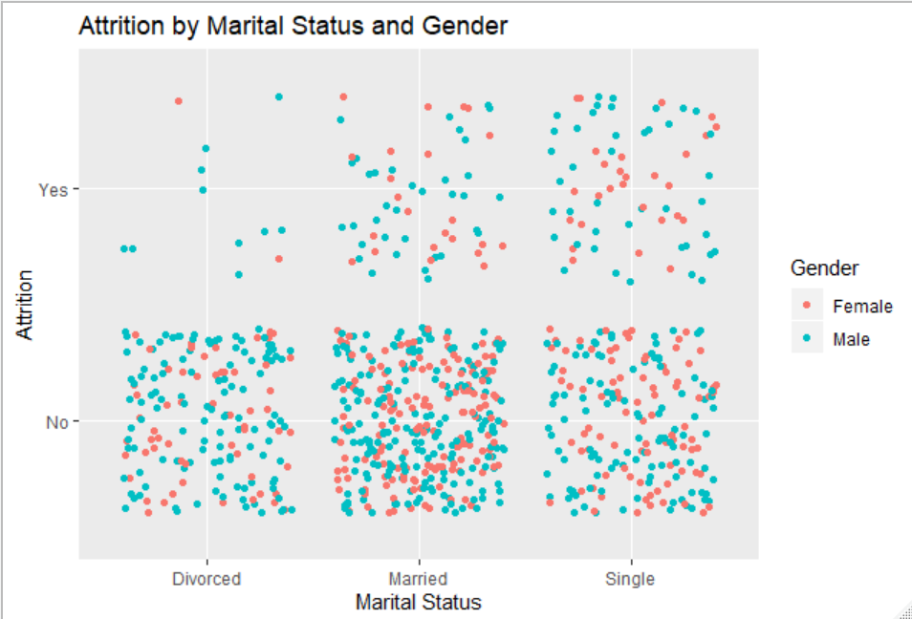
Breweries by State
Employee Data Exploratory Data Analysis
Plot Data Columns to Determine Trends for Attrition
Plot Data Columns to Determine Trends for Salaries
Over 50 Plots are Available: Some Notable Plots are Below:
Job Level has strong linear correlation to Monthly Income
Demographic data points out that there are variables that cannot be controlled by the company

Slide 5
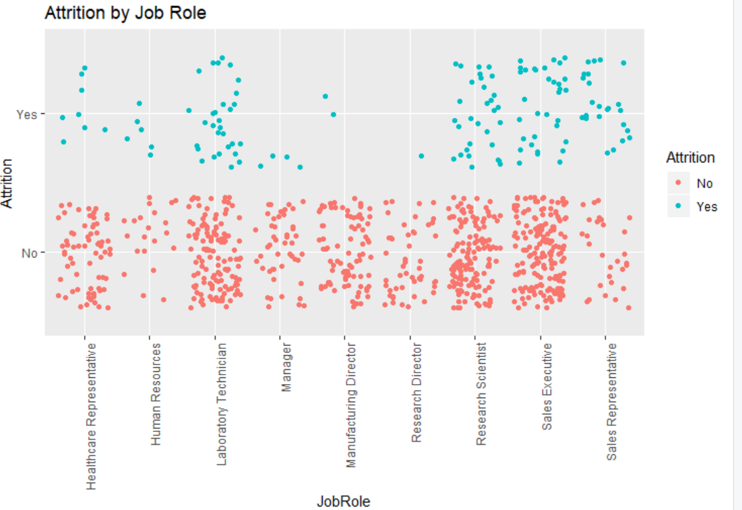
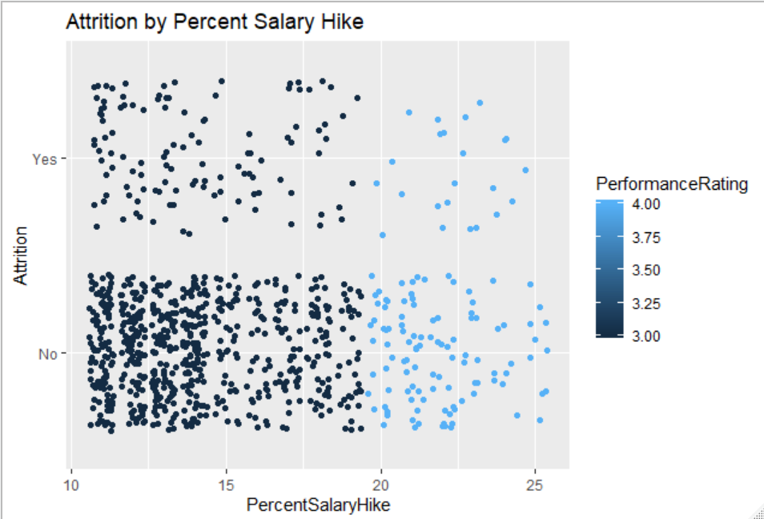
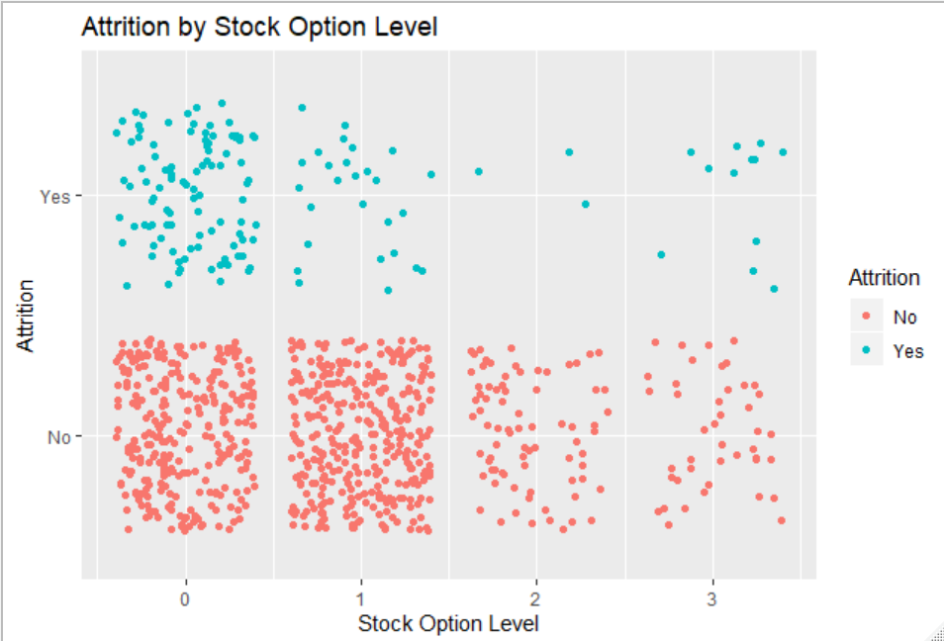
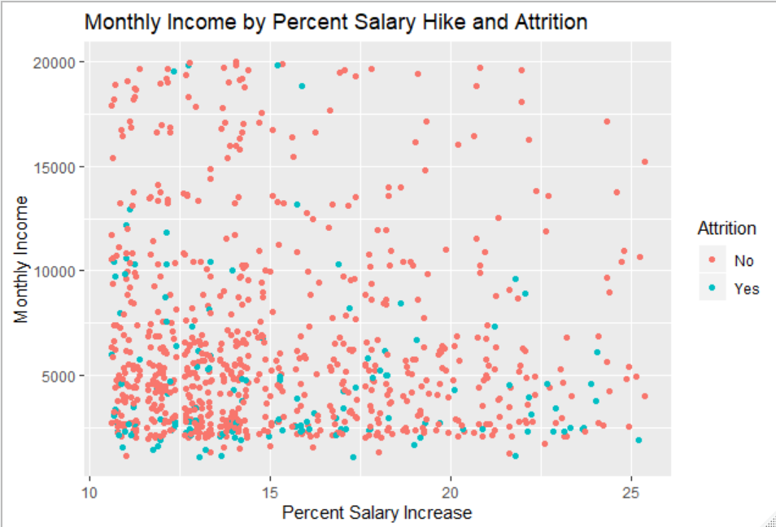
Employee Data Exploratory Data Analysis
Performance and Salary Raises are correlated as expected
Some roles have very low Attrition
Stock option 3 has low Attrition
Monthly Income not as strong of a predictor of Attrition

Slide 6
Employee Data - Classifying Attrition
Comparison of 5 Models for classifying attrition:
KNN1: KNN on Reduced Dataset based on EDA
KNN2: KNN on Same Reduced Dataset after Scaling Variables
LR 1: Logistic Regression after LASSO Feature Selection with modifications based on EDA
LR 2: Logistic Regression after EDA plots without Feature Selection
RF: Random Forest on Reduced dataset based on EDA
Model | Accuracy | Sensitivity | Specificity
KNN1 | .83 | .99 | .05
KNN2 | .85 | 1 | .05
LR1 | .83 | .84 | .75
LR2 | .72 | .75 | .57
RF | .84 | .93 | .36

Slide 7
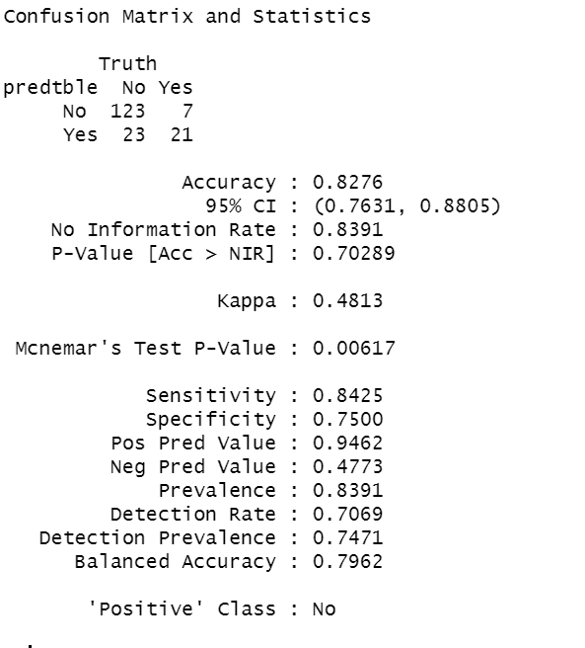
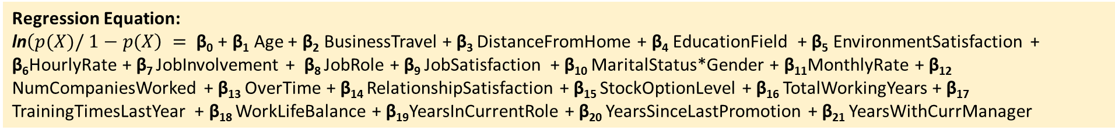
Attrition Prediction
Regression Equation:
ln$\left(p(X)/ 1−p(X\right) =$ β₀ + β₁ Age + β₂ BusinessTravel + β₃ DistanceFromHome + β₄ EducationField + β₅ EnvironmentSatisfaction + β₆HourlyRate + β₇ JobInvolvement + β₈ JobRole + β₉ JobSatisfaction + β₁₀ MaritalStatus*Gender + β₁₁MonthlyRate + β₁₂ NumCompaniesWorked + β₁₃ OverTime + β₁₄ RelationshipSatisfaction + β₁₅ StockOptionLevel + β₁₆ TotalWorkingYears + β₁₇ TrainingTimesLastYear + β₁₈ WorkLifeBalance + β₁₉YearsInCurrentRole + β₂₀ YearsSinceLastPromotion + β₂₁ YearsWithCurrManager
Model was developed starting with LASSO then mapping to EDA Plots to change variables and add interactions
Interaction of Marital Status and Gender was made based on EDA plot

Slide 8
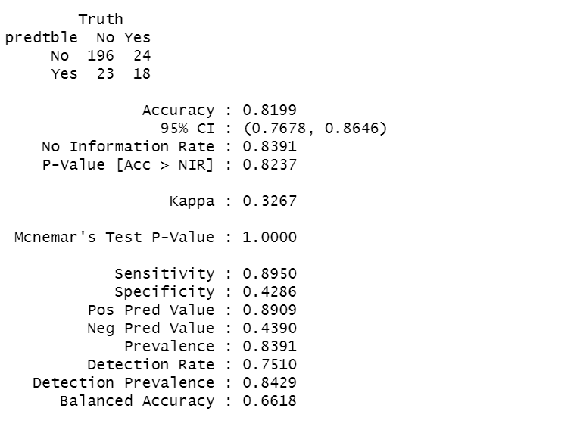
Top 3 Factors for Attrition
Total Working Years
Job Level
Work Life Balance
Logistical Model pared down to these 3 factors, still gave a 81 percent accuracy rate
Naïve Bayes test did not show as well, but Total Working Years had to be Categorized and Attrition was skewed

Slide 9
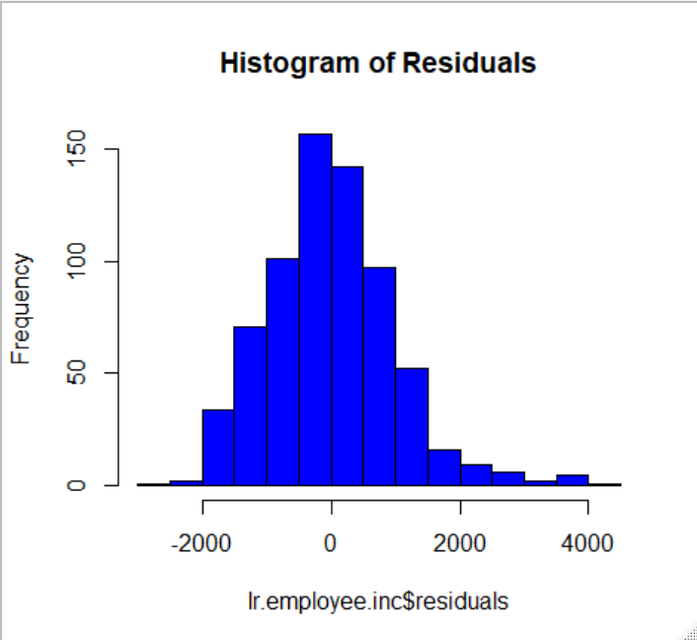
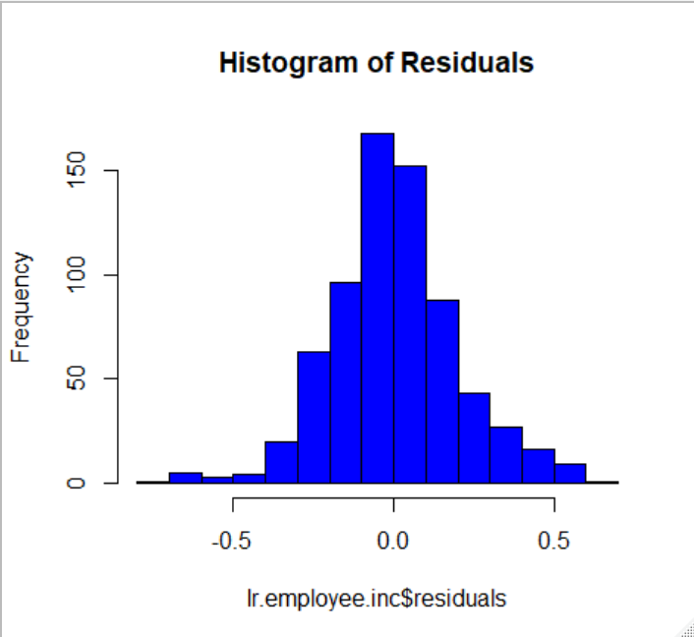
Monthly Income Prediction Model
Multiple Linear Regression Equation:
μLog(MonthlyIncome) = β₀ + β₁ JobLevel* JobRole+ β₂ Department + β₃ BusinessTravel* Gender + β₄ DistanceFromHome + β₅ EducationField *Education + β₆ EnvironmentSatisfaction + β₇HourlyRate* MonthlyRate + β₈ JobInvolvement + β₉ JobSatisfaction + β₁₀ MaritalStatus+ β₁₁ NumCompaniesWorked + β₁₂OverTime + β₁₃ RelationshipSatisfaction + β₁₄ TrainingTimesLastYear + β₁₅ WorkLifeBalance + β₁₆YearsInCurrentRole*YearsWithCurrManager + β₁₇ YearsSinceLastPromotion + β₁₈ YearsWithCurrManager
Regression Equation:
Model was developed starting with LASSO then mapping to EDA Plots to change variables and add interactions
Unlogged Monthly Income: RMSE = 988.333
Logged Monthly Income RMSE: .2

Slide 10
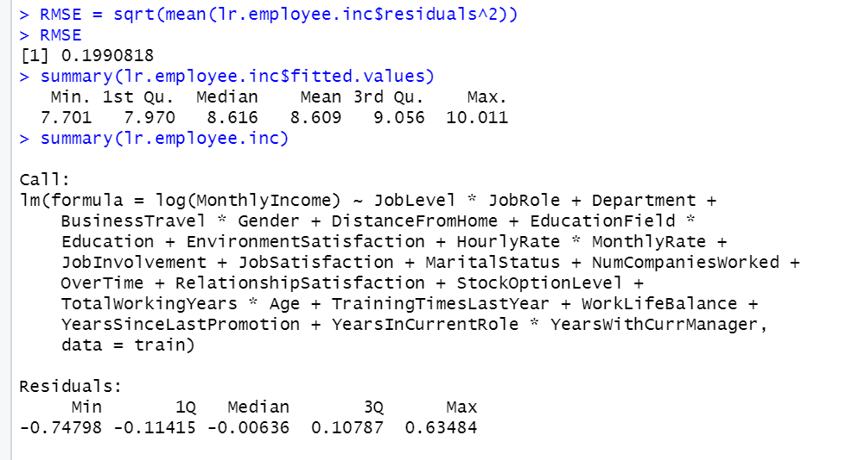
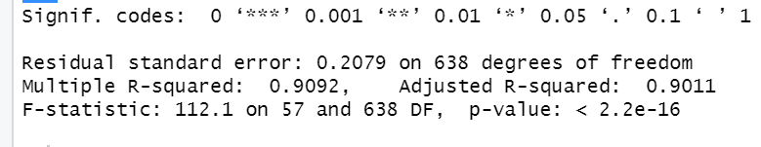
Logged Income Prediction Model
The Details from Prediction Model. Coefficients can be found in R Markdown Report

Slide 11
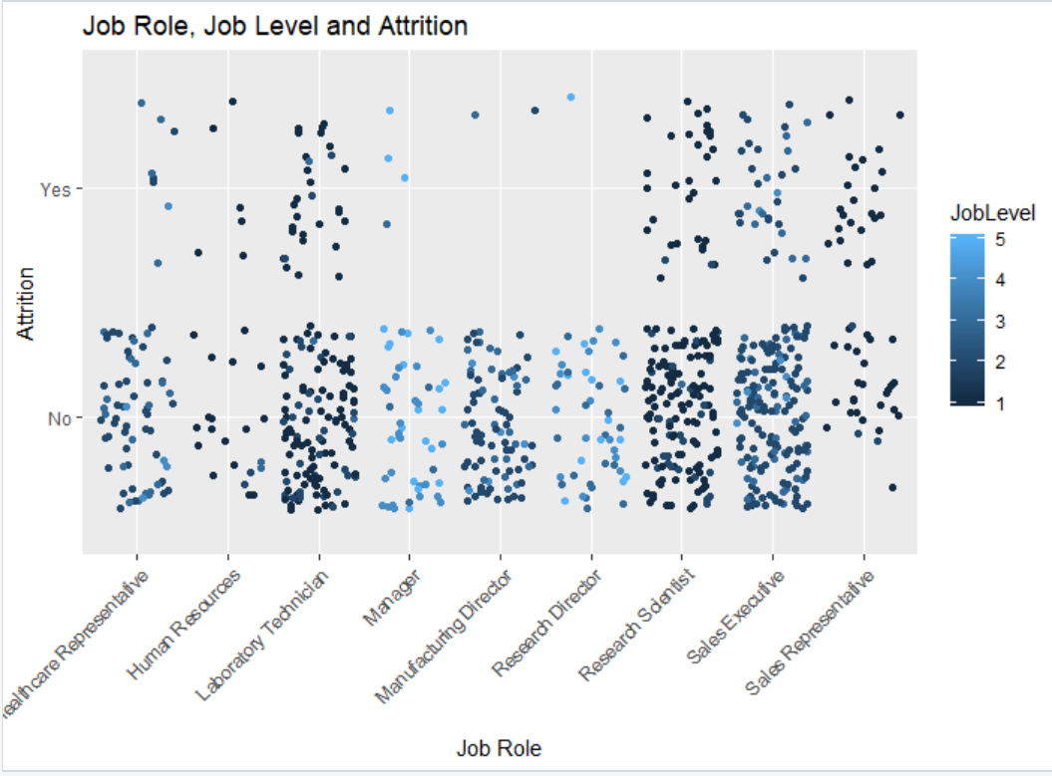
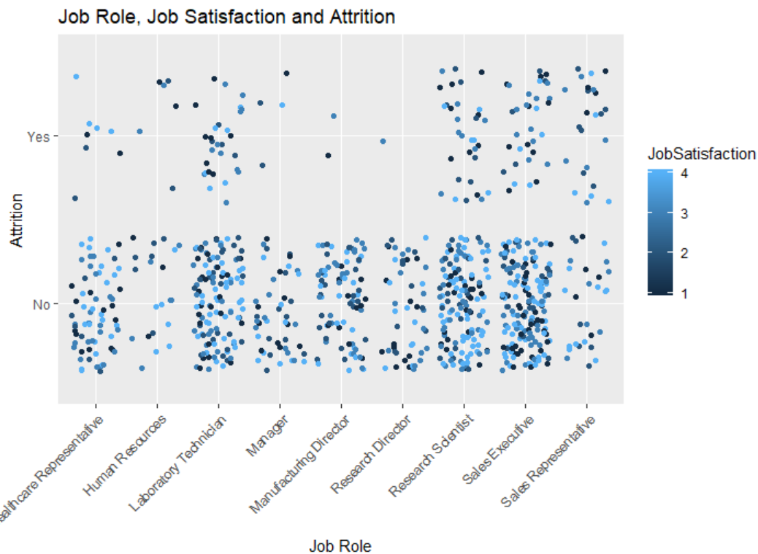
Job Level, Job Role and Job Satisfaction Score Analysis

Slide 12
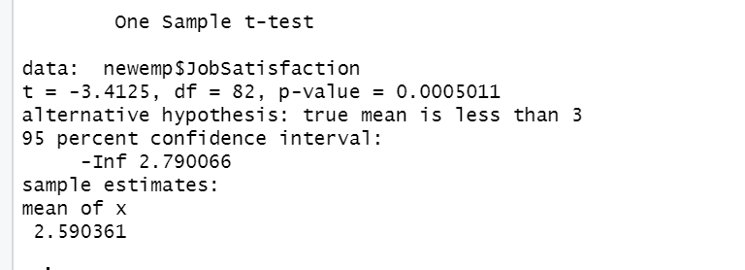
Job Level and Attrition
Test to see that Job Satisfaction Greater than 3 if Job Level > 3 and Job Role is Manager, Manufacturing Director or Research Directory.
Hypothesis:
H0 = Mean Job Satisfaction Score = 3
Ha = Mean Job Satisfaction Score < 3
Conclusion; There is significant evidence to show that the mean Job Satisfaction score is less than 3 for the employees with a Job Level over 3 and Job roles of: Manager, Manufacturing Director or Research Director (p-value .0005).

Slide 13
Thank you
We hope this has given some valuable insights into the employee data.

