Slide 1

SeizureSafe
Ellen Mcintyre
Bachelor of Engineering (Honours) in Software and Electronic Engineering

Slide 2

Why SeizureSafe Matters
In Ireland, up to 40,000 people are affected by epilepsy.
Globally, over 50 million people are affected, and an estimated 2.4 million people are diagnosed with epilepsy each year.
Having the proper knowledge is curial to the care of the person
There was a need for a reliable real time alert system to provide life saving information

Slide 3
What is SeizureSafe
A prototype to be wearable bracelet to detect seizures
Sends real-time audio alert with a step-by-step guild on how to safely help
Keeps a history of the heartrate to show doctors and keep a record
Mobile + Web interface for accessibility

Slide 4
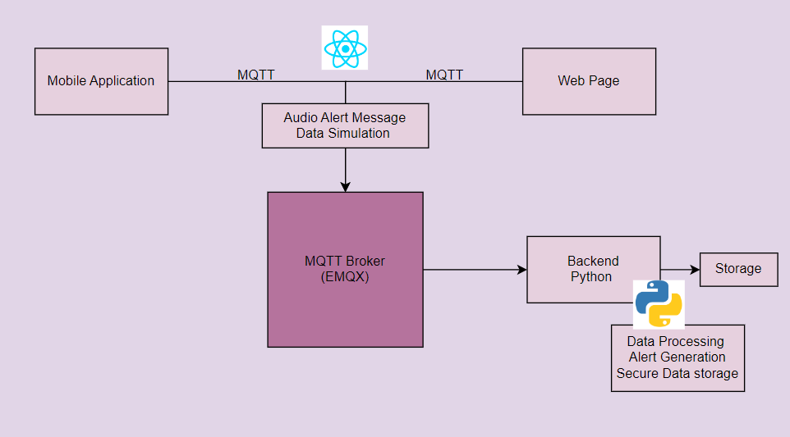
How it Works
Mobile App (React Native/ Expo)
Web (React)
Python Backend (Data processing, Alert generation)
EMQX Broker (MQTT)
Data flow (WebSockets)

Slide 5
The Device in Action
Seizure detected (mocked data in prototype)
Sends event to backend via MQTT
Backend processes data – generates alert
Alert pushed to – mobile app & Web
A smarter way to respond to seizures, in real time.

Slide 6
What Makes It Special
Real-Timer Seizure Alerts
Safety Instructions played instantly
Cross-platform
Historical Data graph
Secure

Slide 7
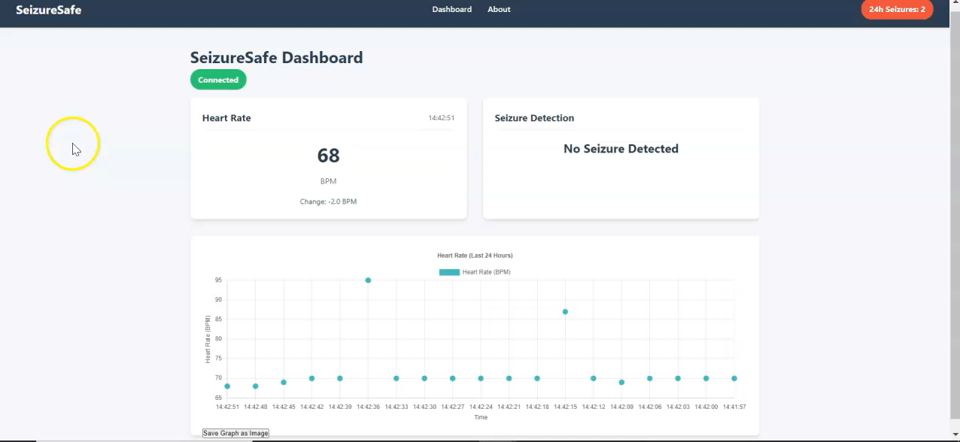
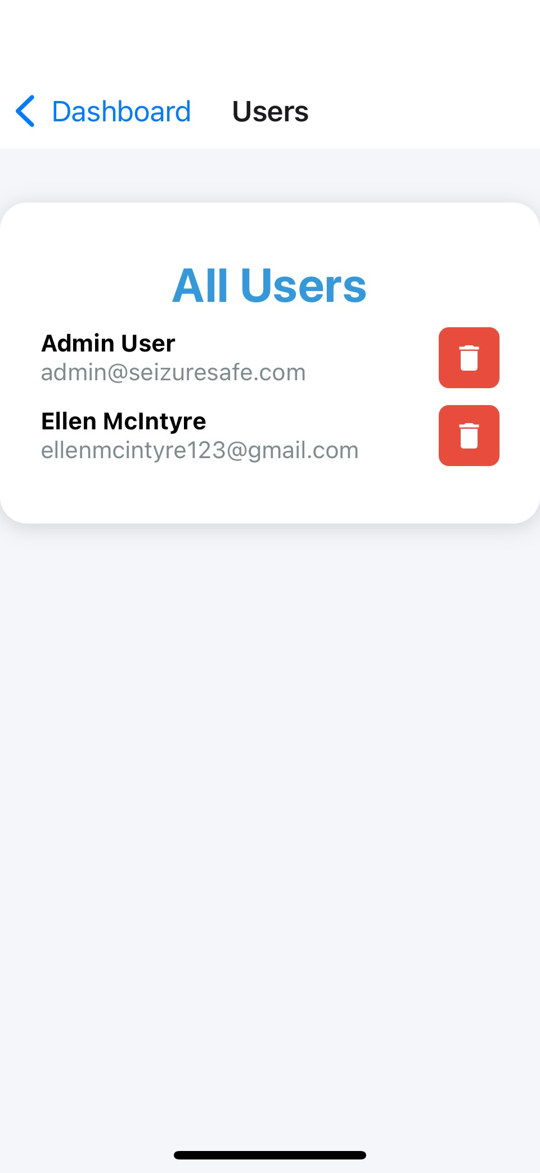
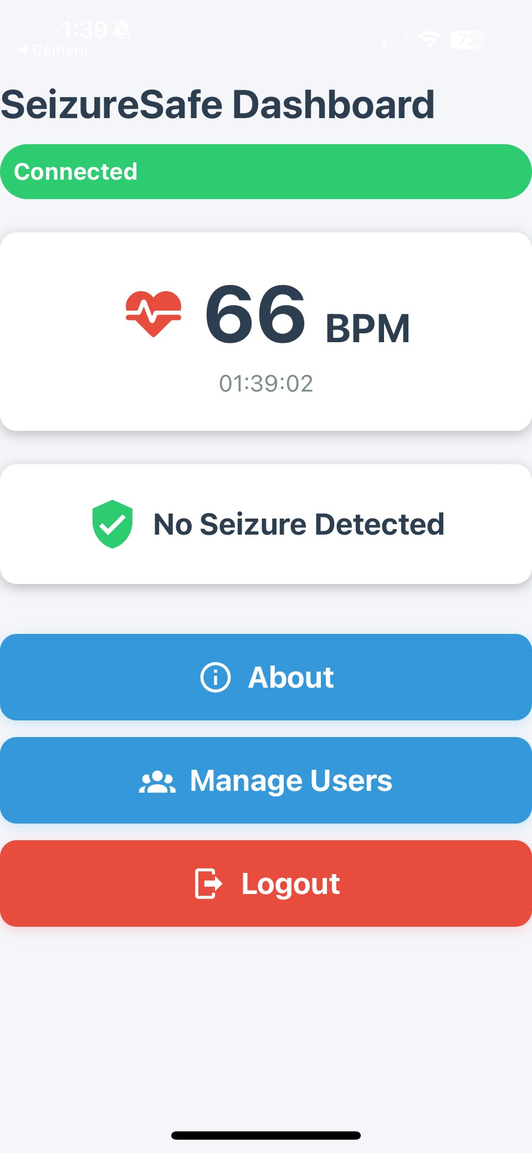
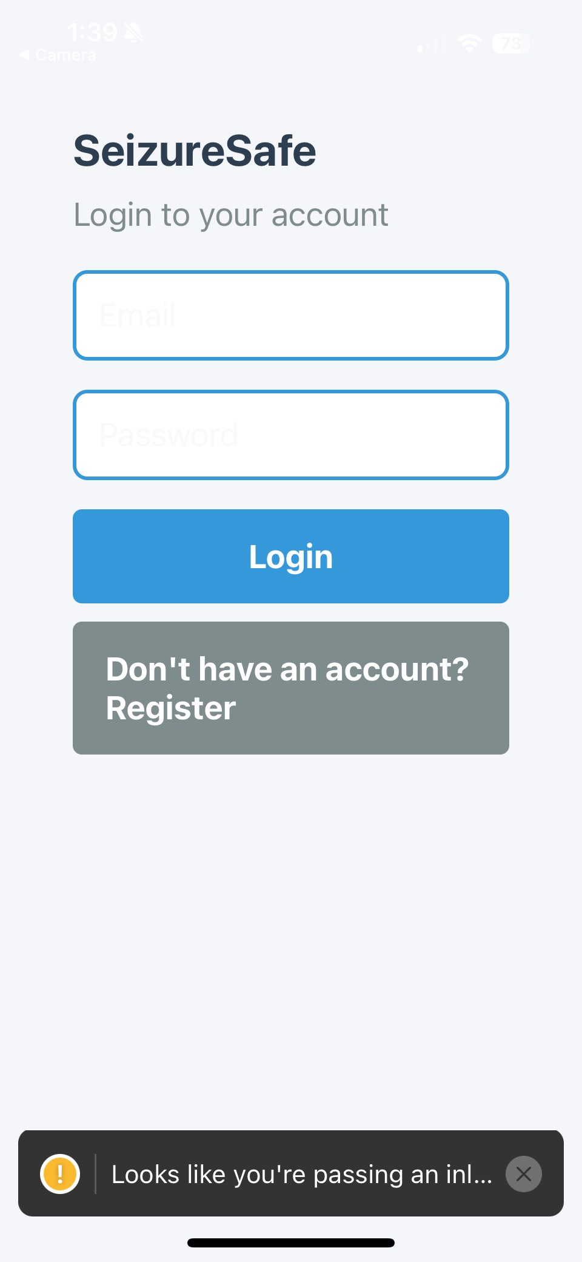
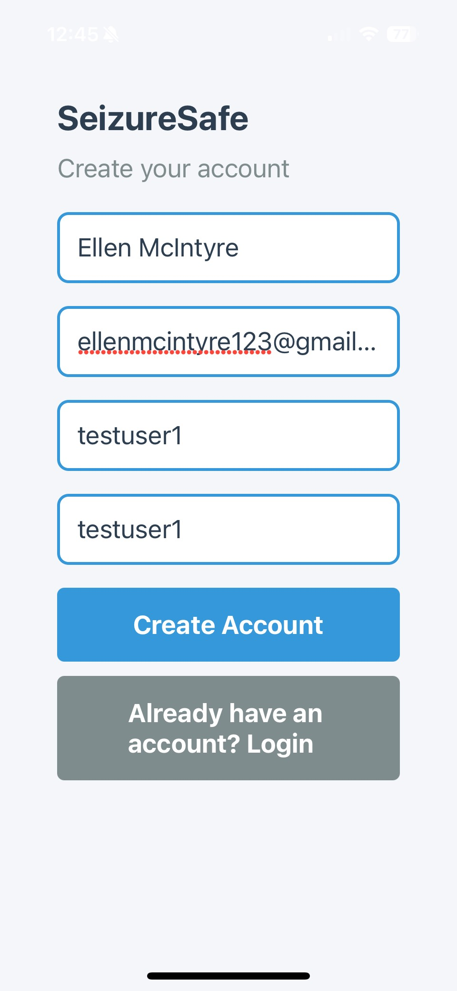
In Action: Demo & Screens

Slide 8

What’s Next
Real hardware integration
Location GPS
Machine Learning to make model smarter
SMS messaging service

Slide 9
Final Thoughts
SeizureSafe solves a real-world problem
Accessible, Real-time, life-saving
Big potential to improve and expand

Slide 10

Questions?
Thank you for listening!

