Slide 1
WEEK 1
INTRO TO SW ENGINEERING
COSC 412
29 May 2018

Slide 2
AGENDA
Introductions
Course & Project Overviews
Syllabus
Intro to SW Engineering
Group Exercise

Slide 3
My Background
Education
Towson University, Bachelor’s Computer Science, 2003
Loyola University, Master’s Software Engineering, 2009
Career
Northrop Grumman - 2001 to 2006
Orbit Logic Inc. – 2007 to 2009
ManTech – 2009 to 2010
CSC – 2010 to 2014
Brave New Markets – Spring 2014 to present
9th semester at Towson – Fall 2014 to present

Slide 4
Syllabus & General Information
Syllabus
Each class we cover a step in the SDLC (Software Development Lifecycle)
General Class Structure each week
Part I
Lecture - Introduce New Topic (Step in SDLC)
In-class Exercise (Usually in groups)
Part II
Group Project Assignment
Apply new SDLC step to project
All or nothing grading (unlimited submissions)
Unless we do not meet as groups, attendance will be taken at this time.

Slide 5
Project General Information
Goals
Experience developing a software product in team environment from start to finish
Exposure to relevant and marketable skills
2 Teams → roughly 3-5 people per team
Currently 8 enrolled
Group selection & Project Assignment – 6/4
Spans duration of semester
High-Level Parts of Project
Multiple Deliverables (aka “classwork”) reflecting steps of SDLC
Generally one per class
Two Presentations (no show means no credit)
Technical Review & Status Report (mid-semester)
Final Product Review & Demonstration (end of semester)
Team mate evaluations
General Topic Area
Web-based

Slide 6
Tips for a Successful Project
Build a well-balanced team
Diligent when selecting team mates
Assess:
Strengths/weaknesses
Reliability
Communicate with me frequently via your POC (Point of Contact)
Address problems as soon as they come up – don’t wait!
You have my cell – text me any time – no reason not to ask questions!
Contribute to project success
Part of final project grade is peer evaluations by your group members
Questions?

Slide 7
Student Intros
Name, Year, Major, Interesting fact
Technical background/experience
School and/or work
Most challenging project? Why?
Technical Background
Programming languages, database, version control (GitHub, Subversion, etc.)
Typical role in teams (in general not necessarily CS-related)
Strengths and weaknesses when working in teams
What you looking to get out of this course?

Slide 8
Let’s Get Started!

Slide 9
Intro to Software Engineering
What is computer software?
Product or actual program
Driven by customer needs for desired output/result
Computer instructions written to produce the desired result
Built & supported by software engineers
Consist of:
Data structures: allow program to manipulate information
Libraries
Related Data
Documentation: (i.e. how to use product)

Slide 10
How is software important to you?
How does it impact your life?

Slide 11
Importance of Software (examples)
Affects most aspects of our lives
Hard to find something not influenced by it
It’s everywhere: commerce, culture & day-to-day activities
Banking, games, ticket sales, communication
Social media → instant access to latest info, news, etc.
Critical Functions
Aircraft control
Medical equipment
Military Ops

Slide 12
Basic Steps for Creating Software
General Steps
Stakeholder(s) expresses a need
Stakeholder: someone “having an interest in the realization of the system”
VERY abstract idea
Engineers
Take need…
Refine into meaningful, manageable & testable parts
Build it
Give it to consumers
Maintain & Evolve it
Consumers use it

Slide 13

What is Software Engineering?
Apply engineering to software development in systematic method.

Slide 14
Applicable Definitions of SE (1 of 3)
“…application of a systematic, disciplined, quantifiable approach to development, operation, and maintenance of software; that is, the application of engineering to software.”
** What is quantifiable? **

Slide 15
Applicable Definitions of SE (2 of 3)
“…establishment and use of sound engineering principles in order to economically obtain software that is reliable and works efficiently on real machines.“
Why do we care about “economically obtained”?

Slide 16
Applicable Definitions of SE (3 of 3)
“…a concerted effort should be made to understand the problem before a software solution is developed.”
Why? Think about this quote as it applies to every day problem solving and not just SE.

Slide 17

How do you know it’s right? (1 of 2)
How does developer know end product is right?
“How do I know I built the software correctly?
*** Produces desired result ***
Meaning – Does it do what the client(s) thinks it is supposed to do?
How it happens?
Work with clients, stakeholders, end users to understand needs
Dream: End users should understand needs and environment
Reality: Customers don’t always understand their own needs
Know what they don’t want OR only know what they want when they see it
So → engineers work with client to refine idea into unambiguous requirements

Slide 18
How do you know it’s right? (2 of 2)
How it happens? (continued)
Developers apply industry standards appropriately
Un-ambiguous requirements
Sound design
Good coding standards
Thorough testing & documentation
Simple deployment
Good support
Put these together → Leads us into processes….

Slide 19
Software Processes
Software Process
What is a process?
Collection of activities, actions & tasks
Activity – achieve broad objective
Action - encompasses set of tasks that produce major work product
Task – small well-defined objective with tangible outcome
Spitting of development project into phases
Intent → Better planning and management
NOT rigid prescription for developing software
Adaptable approach
Enables and helps development team

Slide 20
Software Process Goals (1 of 3)
In the ideal world:
Constant goal
Find repeatable, predictable process that improves productivity and quality
Process should be:
Agile
Adaptable
One process does not fit all projects!

Slide 21
Software Process Goals (2 of 3)
Things to consider when adapting a process
Overall flow of activities, actions or tasks
Dependencies between them
Level of customer involvement
How “technically-savvy” client is
How “involved” client wants to be
How well work products been identified
i.e. Documentation, Diagrams, User guides, etc.
Level of organization in team
Degree to which team is “self-governed”
Is management heavily involved in day-to-day activities or is team empowered to get the job done without constant oversight?
Frequency of demos, deployments, etc.
“Does client want to see something working periodically or do they want to just see the whole thing when it is done?”

Slide 22
Software Process Goals (3 of 3)
Things to consider when adapting a process
SHOULD NOT
Burden or hinder development team
Meant to ease process of development
Facilitate good communication
Within team
Between team & client
Between team & management
Doesn’t always happen
Sometimes companies get lost in process
Forget why it was created in the first place
Give structure
Keep team members on same page with what is happening
Remember the Intent
Deliver quality software in timely manner that meets requirements
Stays within budget → no good if it works but bankrupts company

Slide 23
Essence of software engineering
Understand problem
Communication and analysis
Plan solution
Modeling and software design
Carry out plan
Implement code
Examine result(s) for accuracy
Testing and quality assurance
Delivery/Deployment
Give it to client

Slide 24
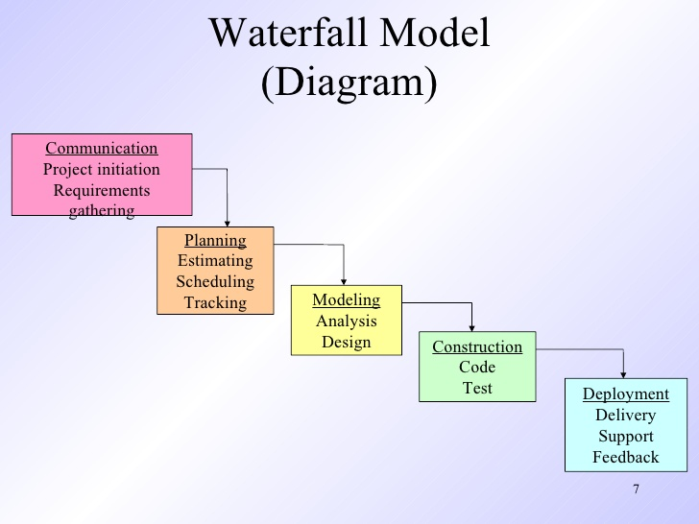
Process Models (1 of 2)
Prescriptive
Well-defined steps and tasks
Intent
Better quality product delivered on time and within budget
More manageable project
Outcome of incorrect use
Objectives NOT achieved
Can increase level of bureaucracy

Slide 25
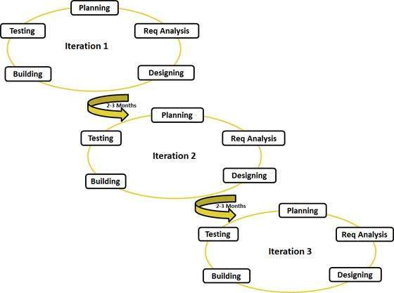
Process Models (2 of 2)
Agile
Focus is maneuverability and adaptability
Informal → emphasize project agility
Use set of principles to create less rigid process
Often iterative

Slide 26
General Process Framework (1 of 3)
Communication
Identify stakeholder objectives
What is my general problem or what does my client need?
Look for any unknowns
What don’t I know how to do?
What do I need to solve the problem?
Gather requirements (desired functionalities)
Become what developers agree to deliver to client
Identify: risks, required resources, work products, schedule, budget

Slide 27
General Process Framework (2 of 3)
Planning
Identify parts of problem you have seen before
Patterns?
Existing code to implement part or all of task?
i.e. An existing library
For example – if your problem requires parsing a csv file then there is tons of code available online for free to handle this need already.
Describe tasks (aka sub-problems) along with solution(s)
** MOST IMPORTANT - Before you start coding ask yourself:
“Do I have a solution planned that will let me implement in an effective matter?
“Are there major holes in my design?”

Slide 28
General Process Framework (3 of 3)
Modelling
Helps to further clarify requirements and design that achieves the requirements
Class diagrams, flow charts, etc.
Construction (implementation)
Build it
Traceable to design model?
Test it
Verify each component is correct
Each component should be testable
*** Validate → “Does it meet the requirements?” ***
Deployment & Post-Deployment
Finished product to customer
Customer feedback based on evaluation
Maintenance and Evolution of product

Slide 29
Software Engineering - Umbrella Activities
Complement framework activities
Span across entire SDLC
Risk management: things that could go wrong and impact delivering product on time
Identify as early as possible
Technical reviews: assess SE work products in effort to find and fix issues before they are propagated to next activity.
Work product:
Software configuration management (SCM): manages effects of change throughout software process.
Document Prep & Production: making hardcopies of all project planning and other activities
Reusability Management: define criteria for work product reuse; establish mechanisms to achieve component reuse

Slide 30
Tips for Successful SE projects (1 of 2)
The Reason It All Exists
Provide value to users
KISS (Keep It Simple, Stupid!)
Keep designs as simple as possible but not simpler
Others need to understand and maintain it
Maintain Vision
Clear vision is essential to success of software project
Always remember your end goal

Slide 31
Guidelines for Successful SE projects (2 of 2)
What You Produce, Others Will Consume
Design software with thought that others need to understand it
Be Open to Future
Don’t design into corner
Design to solve general problem not specific problem
Plan for Reuse
Saves time, effort and money
Don’t re-invent the wheel
Think
Placing clear, complete thought before action almost always produces better results

Slide 32
Software Engineering
Myths - What’s wrong here? Who said it?
“If the project is late then we can add more developers to catch up.”
“Outsourcing saves money and I don’t have to worry about that part of the project.”
“We already have a software procedures/standards guide. Isn't that enough documentation for developers and testers to do their job?”
“A general statement of objectives is sufficient to begin writing programs—we can fill in the details later.”
“Technical staff is interchangeable – if I have to fire one and hire another then no big deal.”
“I can’t test until the product is done.”
“The only deliverable for a successful project is a running program.”

Slide 33
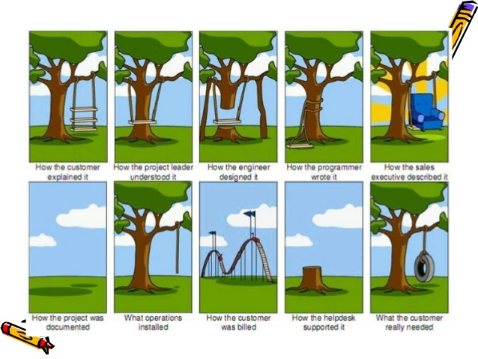
Leading into requirements…

Slide 34
In-Class Exercise: Clarifying the Problem (1 of 3)
Goals
Primary:
Get you thinking about what needs to be asked or clarified when working on a development project to resolve ambiguities, especially at the project start.
Reinforce why it is important to NOT make assumptions about functionality
Secondary:
Allow you to meet with potential project teammates
Part I – Complete individually
Part II - Split into 2 groups (roughly 3-5 per team)

Slide 35
In-Class Exercise: Clarifying the Problem (2 of 3)
Part I: Illustrate importance of resolving ambiguities & managing assumptions
Take the situation below and describe how you think the following will work:
User Registration
User Sign In
User Account Deactivation
Situation: A potential client approaches your company. They need to have a basic user management added to their website. Users should be able to register, sign-in and deactivate their accounts.

Slide 36
In-Class Exercise: Clarifying the Problem (3 of 3)
Part II: Resolving ambiguities
Three situations per team (next slide)
Team 1 → Situations 1, 2, 3
Team 2 → Situations 4, 5, 6
Evaluate & share:
Determine what you need clarified to start designing a solution
What questions should you ask the client?
Address risks
Try to identify areas where there could be problems

Slide 37
Group | Scenario
1 | Your boss says the finance department needs help creating an automated report generator for their proprietary system.
2 | A local doctor’s office contacts your development company about modernizing their website to provide a complete online experience for their patients.
3 | Your new client buys and sells small appliances; they have both a physical location and online presence. Their website is modern albeit very simple, and they currently handle actual purchases only in their physical location. They have approached your team about adding an online store to their website.
4 | The largest client of your company wants to allow potential customers to view inventory for the closest location as well as map directions to the location.
5 | A client has asked you how complicated it would be to add a contact page to their website that will send their sales staff an email when a potential customer submits a request for information.
6 | A local charity contacts your company. They have no online presence and want to help “getting their charity online”.

Slide 38
Sources
https://en.wikipedia.org/wiki/Computer_program
https://www.ics.uci.edu/~ziv/ooad/intro_to_se/tsld006.htm
http://www.businessdictionary.com/definition/work-product.html
https://en.wikipedia.org/wiki/Software_engineering
http://www.rspa.com/spi/glossary.html
https://en.wikipedia.org/wiki/Software_development_process
https://www.quora.com/Why-are-Umbrella-activities-called-as-such-in-Software-Process-Framework
http://highered.mheducation.com/sites/0072853182/student_view0/chapter2/chapter_summary.html
www2.cs.siu.edu/~mengxia/Courses%20PPT/435/Chapter_01.ppt
http://www.tutorialspoint.com/sdlc/sdlc_agile_model.htm
http://www.slideshare.net/zeal123123/pressman-ch3prescriptiveprocessmodels-13798335
http://www.viewpoints-and-perspectives.info/home/stakeholders/
http://www.computerweekly.com/feature/Automate-testing-for-agile-quality
http://www.canstockphoto.com/software-engineering-3433099.html
http://www.slideshare.net/preetimishra14661/requirements-engineering-40421034
Text: Ch 1 & 2

