Slide 1

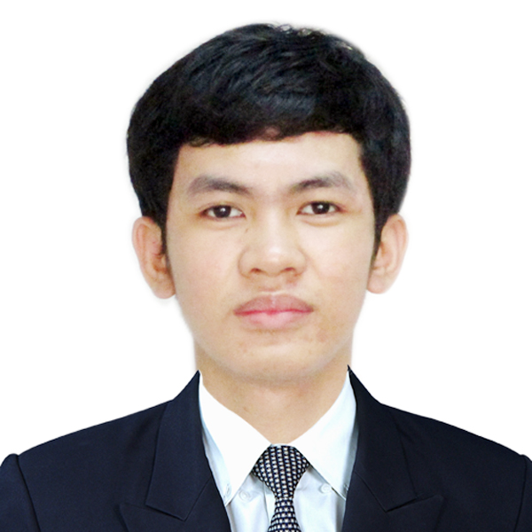
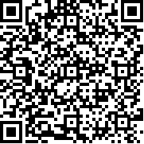
LIBRARY ID CARD
STUDENT ID NO.
202902
Eleazar Romero
COURSE
BS in Information Technology
YEAR
3
VALID UNTIL
09 July 2024

