Slide 1


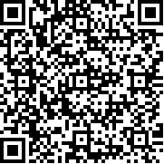
LIBRARY ID CARD
STUDENT ID NO.
21612
Jamesmar Martin
COURSE
YEAR
UNKNOWN
VALID UNTIL
09 July 2024

