Slide 1


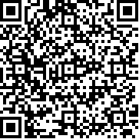
LIBRARY ID CARD
STUDENT ID NO.
21612
Jamesmar Martin
COURSE
Bachelor of Science in Computer Engineering
YEAR
UNKNOWN
VALID UNTIL
08 July 2024

