Slide 1
CV, personal letter and portfolio

Slide 2
Study information about the company
Study information about the job
How does the company want the application?
Who are you going to send the application to?
Network, network, network!

Slide 3
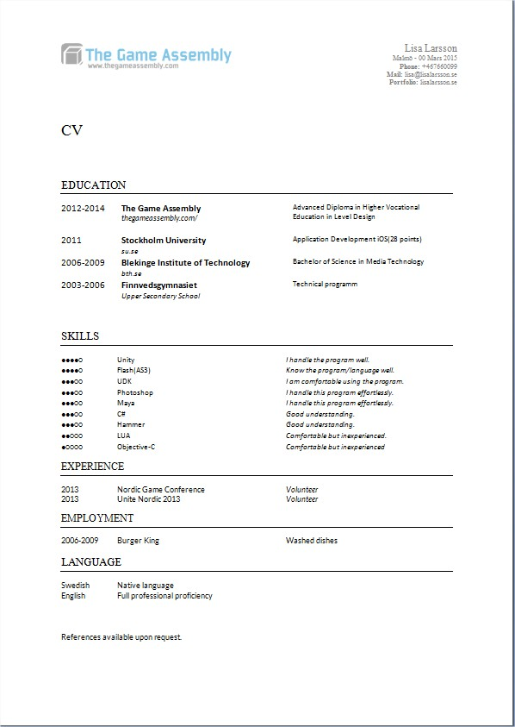
CV:basic
Maximum 1 A4
Simple, structured and easy to read
Use a template
Be relevant
Focus!
Cronological order - latest first
Education/Employment, Knowledge/Experience
Use the correct contact information, no strange mail address

Slide 4
Check the spelling - Get somebody to test read
English – Full professional proficiency
Don’t forget Volonteer at Nordic Game, drivers licence
Use ”action-words” ex responsible for or created props
References?
Artists...as an artist you need to package your CV well. If you don’t care about the lay out it will say that you don’t work all the way through your products
TGA logo
There is no universal template
Use the same text on Linked in

Slide 5
Grading knowledge
For example
5 = Very good – worked with it for 2 years
4 = Good knowledge – have worked with it in 2 game projects
3 = Intermediate knowledge – have worked with it during one game project
2 = Enough knowledge to solve problems
1 = Have tried it

Slide 6


Slide 7
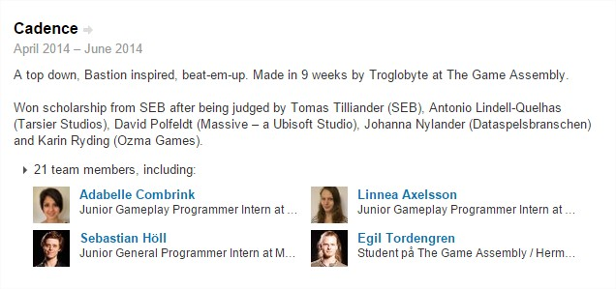
Game projects
8 game projects
Genre
Duration
Halftime
Amount of artists and level designers
Responsibilities
You are each others best reference

Slide 8
CV: extra
SP: Programmering knowledge (grading)
SP: Debugging knowledge?…read our curriculum
SP: Made your own game engine
LD: Posted levels on forums?
SG: Posted pix on forum
Twitter, instagram.....
Study job ads?

Slide 9
Personal letter - basic tips
Match the things you write about with the job/internship you are looking for
½ A4
First sentence should contain your name, what you are looking and the actual dates
The personal letter is not a cv
Why should they choose you?
What could you bring to the company?
Don’t write what you are not good at.
Write something that makes you stand out
Passion for games, creative, thorough, good abillity to cooperate, act on feedback

Slide 10
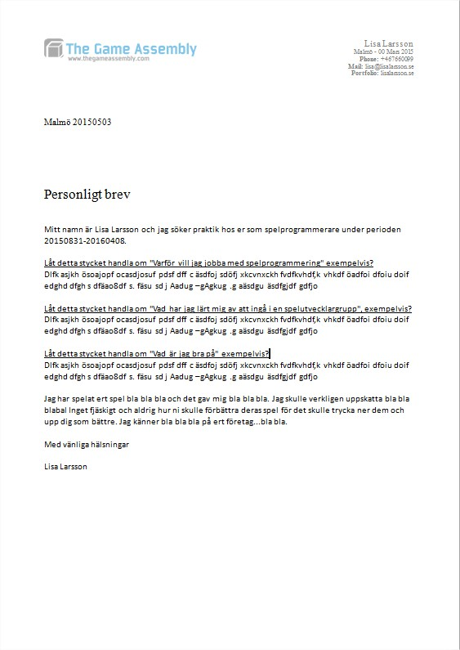
Make it look like the same lay out as the CV
Introduction
3 parts of text – start with setting headlines on each part, it could be a question, but in the end you shiuld be able to take the headline away
End section or in the begonning – write something personal about the company and their games

Slide 11
Job ad/ programmer
Massive ” To suit this position you have a passion for programming. You enjoy working closely with other programmers and consider yourself being a team player but you are not afraid to take initiatives. Also you thrive in being an independent force, enjoy taking on responsibility. You describe yourself as result oriented, creative and dedicated. As we are focusing on games and different kinds of game services, a passion for games is very valuable.”

Slide 12
Job ad/ tech art
King ” The Technical Artist is charged helping the artists to get their content into the game as easily as possible. This person will be the first point of contact for any artist with a problem with content or tools. The TA must dedicate time to understand the casual games production to understand existing problems, and find innovative solutions.

Slide 13
Job ad/ level design ex
Avalanche” As a World Designer at Avalanche Studios you will be focused on crafting the game world, constantly iterating in all of its aspects to comply with quality requirements, design constraints and art direction. You will be involved in a variety of topics and different tasks, including: design, planning and documentation; designing and crafting urban and military settlements; terraforming and creating landmarks; prototyping specific layouts and design ideas; receiving, processing and following up on peers’ and focus tests feedback.”

Slide 14
Portfolio
Game projects; genre, duration, halftime, 5 programmers, 5 artist, 3 leveldesigners, responsibilities,
Cv, pdf / word, linked in
Contact
exemples
http://www.amandaelm.com/
http://www.depuiseau.com/
http://carolinewallberg.se/
http://www.adabelletc.com/
http://www.rasmusjansson.com/
http://iamrobin.se/
http://kevinandersson.se/
http://www.mellergardportfolio.se/
http://www.ellasvahn.com/

Slide 15
Remember…
What are you good at?
Why are you here?
TGA USP? (good relations with the industry, experienced teachers, we make games)
What words do the job ads use? (don’t copy), have you used simelar words? (cooperation, communication, passion, agile and so on)
Programmers...use the words; code standard, no middle ware and so on
Artists…creative process...for example?
If you write you have made 8 games, does the portfolio mirror that?
To mention all 8 games show on progress
The people in your group are your best references

Slide 16
Assignement
From now on we’ll meet in separate groups (see text I sent you and google calender)
Bring your CV template, your template personal letter, and a sketch on your home page.
All of you need to have peer read someone elses CV and personal letter and given feedback on it. Plus given feedback on a portfolio sketch. In the group I’ll pick a few and go through the material. I’m going to ask who have gone through the material and what they said and what you acted on.

Slide 17
Read this please!
http://www.gamasutra.com/blogs/AlanWilson/20100108/4057/Applying_For_A_Job_Please_Do_It_RIGHT.php

