Slide 1
CSED 332 Progress Presentation
Kim Jihyun (20220302)
Choi Jae wan (20220247)
Park JunHyeok (20220312)

Slide 2
Progress Milestones
Check input and output data format
(Research on worker-master communication, sorting within the worker machines, and shuffling)
Implement worker-master communication and test
Implement the worker algorithms
Implement overall sorting and shuffling
Currently working on #3

Slide 3
Review of your weekly progress
Week 1
Set up git repository
Schedule weekly team meeting
Research on problems of distributed sorting
Week 2
Define milestones for progress
Set up project environment
Week 3
Individually research on the project -> explained in later “design” part

Slide 4
Review of your weekly progress
Week 4
Research on shuffle methods
Write pseudocode based on week 2 research results
Week 5
Implement basic algorithms
Sorting inside single disk
Gather data range from workers and decide key range
(goal of) Week 6
Write and test communication part (with basic functions)
(if successful) start implement other parts of sorting

Slide 5
Logistics
Team communication
We have weekly in-person meeting on Wednesday 18:00-20:00.
Also, we communicate through a messenger on Sunday when everyone wrote down a weekly progress on git.
Documentation
Individual team member upload a pdf or markdown files on git after a thorough research on each topics.
Git repo
Branch
Commit message
Role of each team member
Jun Hyeok (chief programmer) : Master-worker communication
Jae Wan (co-pilot) : Sorting
Ji Hyun (toolsmith/tester) : Shuffling

Slide 6
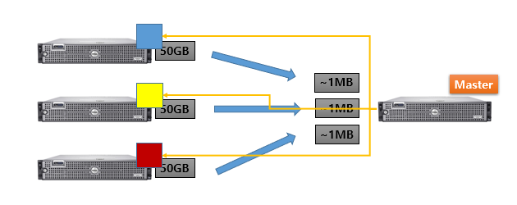
Design & Implementation – communication
1. Initialize master, worker connection
2. workers send partition keys
3. master finalize keys, send to workers, initiate sorting
4. master initiate shuffling, initiate merge
5. finished.
Use Netty framework for sorting.

Slide 7
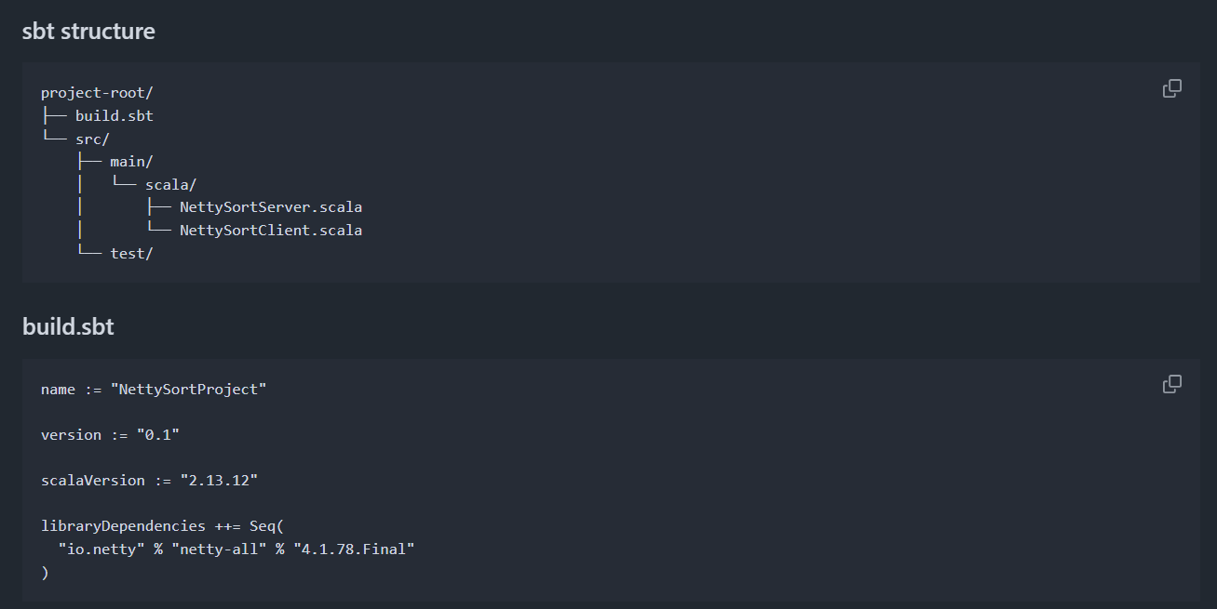
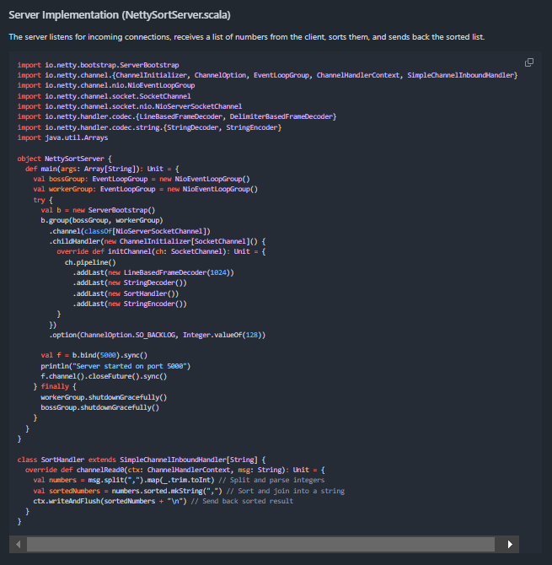
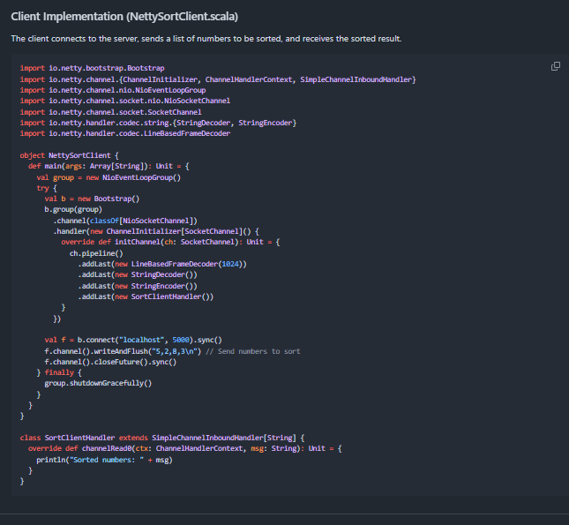
Design & Implementation – communication

Slide 8
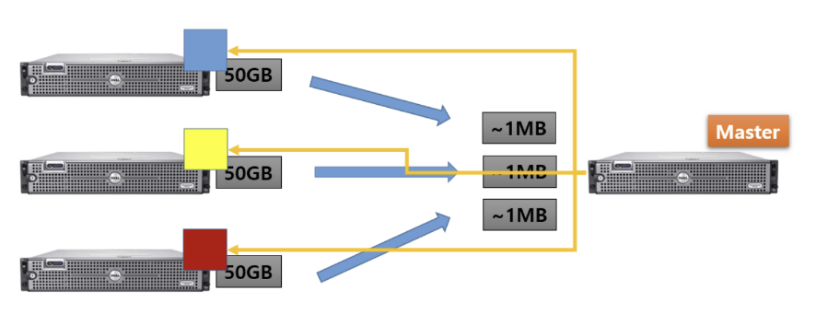
Design & Implementation – sorting
Sort->sampling->partition->shuffle->merge

Slide 9
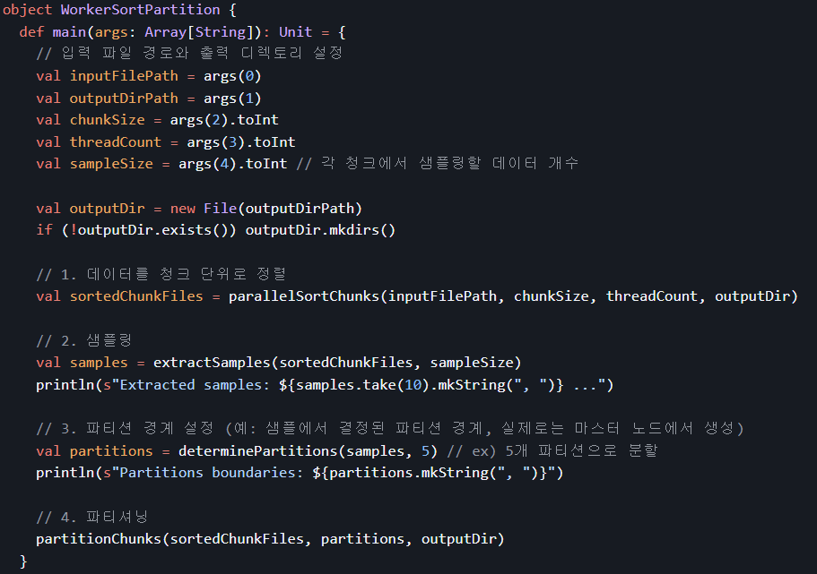
Design & Implementation – sorting

Slide 10
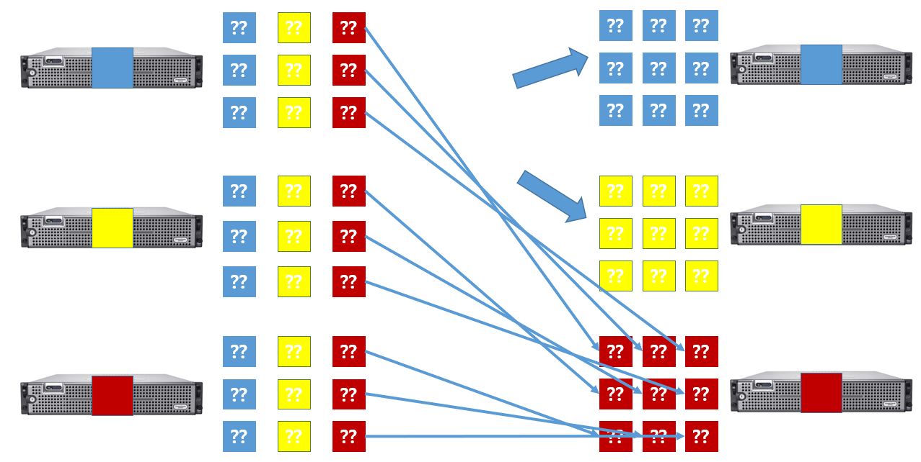
Design & Implementation – shuffle

Slide 11
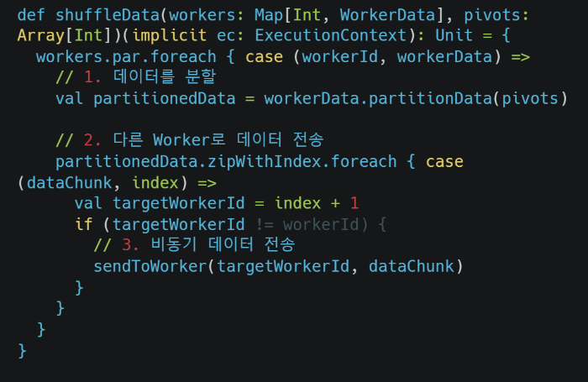
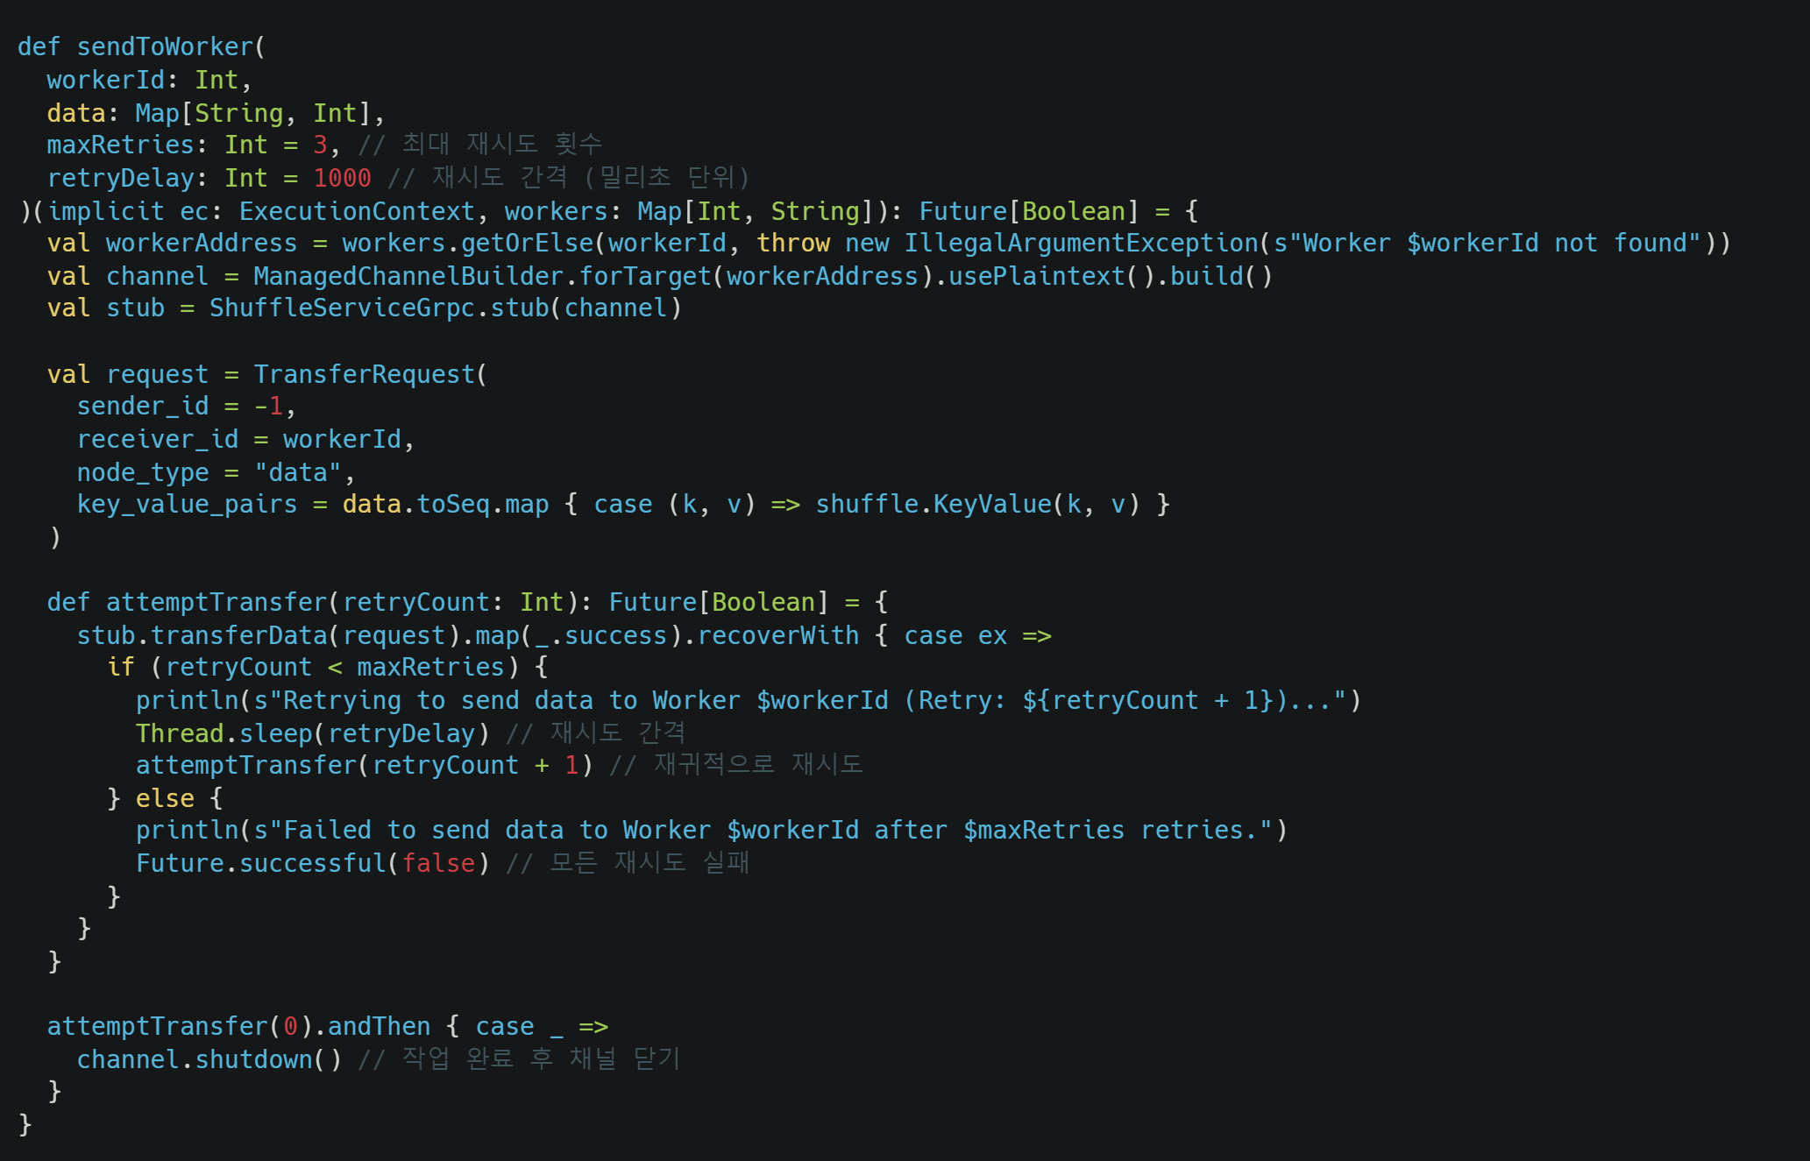
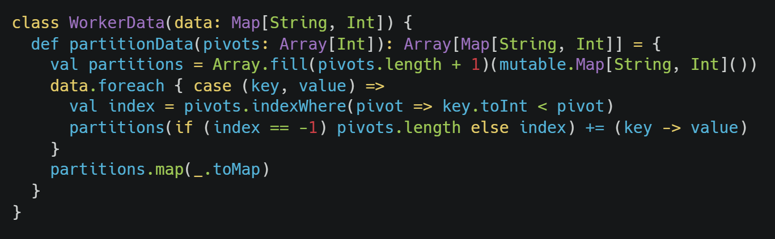
Design & Implementation – shuffle

Slide 12
Testing
master-worker communication test
Gather partition keys, check whether the partitions are uniformly distributed.
Test sending, receiving signals between the master and workers.
Worker sorting test
After each sorting operation, verify whether data is correctly sorted.
After shuffling and merging, verify whether data is correctly sorted.
Other
Check if input data is truncated after any work.

Slide 13
Ｑ＆Ａ

