Slide 1


Level 4 Data Analyst Apprenticeship - APP-Communicating Insights
HOTEL PERFORMANCE REPORT
Presenter: Ellie Crossley-Fells
17th of July 2025
Notes:
Hi everyone, welcome to my presentation, today I'll talk through my hotel performance analytics project
Now you’ll notice I have gone rogue on the theme, firstly, I am not on my work laptop so can’t access the template, but secondly, I got really excited about having a break from green Lloyds branding

Slide 2

Level 4 Data Analyst Apprenticeship - APP-Communicating Insights
CONTENTS
The brief and business questions
Executive summary
The data: data cleaning, tools used
Data analysis and interpretation of results
Conclusions and recommendations
Predictive modelling: Random Forest to predict likelihood of cancellation
Notes:
I will giving an overview of the analysis I have undertaken
1. I'll start with the brief and the proposed business questions
2. next, I will talk through the executive summary
3. following on from that, I'll go through an overview of the dataset, including the data cleaning process, and some of the tools I used.
4. I'll then go through the analysis I undertook and the results
5. and finally some conclusions and recommendations based on the analysis.
6. At the end, I will discuss my predictive model for forecasting the likelihood of booking cancellations. A random forest methodology was used

Slide 3

Level 4 Data Analyst Apprenticeship - APP-Communicating Insights
INTRODUCTION: THE BRIEF
PRIMARY AIM: Produce a predictive model to forecast the likelihood of cancellations.
Further business questions:
Best time of year to book rooms?
Optimal length of stay to get best rates?
Which hotel receives a high number of special requests?
Who is the top agent?
Summary statistics
Business recommendations
Notes:
Jack Jones work for the company Sleep, that operates 2 hotels, and his primary aim is that he wants us to produce something to predict likelihood of cancellation
Then, he has several other business questions:
1. When is the best time of year to book rooms?
2. What is the optimal length of stay to get the best daily rate?
3. Which hotel receives a high number of special requests?
4. info on top agent
5. summary stats
6. recommendations for the
business to implement moving forward. to improve occupancy, which in turn will improve revenue.

Slide 4
Level 4 Data Analyst Apprenticeship - APP-Communicating Insights
EXECUTIVE SUMMARY
Seasonal Booking Trends | Busiest month: August Quietest month: January, closely followed by February and November Winter is best time for easy bookings and better rates. For a summer holiday June offers best rates.
Optimal Stay Duration for Best Rates | Shorter stays are more expensive. 20-25 nights yield best value for nightly rates <£100. 7 nights has the lowest median ADR for stays <10 nights Average stay duration is 3-4 nights
Special Requests | Resort Hotel receives the highest percentage of special requests per booking.
Agent Performance | 86% of bookings are made via Agents. Agent 9 handles the most bookings but have the most cancellations (40%), and Agent 240 has the most repeat customers.
Recommendations | Promote off-peak winter packages Consider packages and deals for certain stay durations Tailored marketing for each hotel Strengthen agent relationships and investigate poorer performing agents

Slide 5

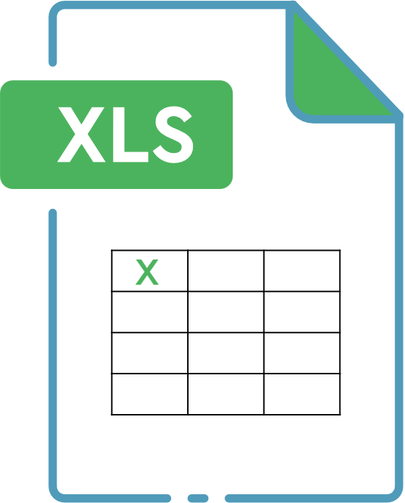



Level 4 Data Analyst Apprenticeship - APP-Communicating Insights
THE DATA
Medium sized, structured
c.119k rows
data from July 2015 to August 2017
Del-HotelBookings.xlsx
32 columns
Tools:
Notes:
Tools I used: I began in Excel, using pivot tables and simple bar charts and line charts, I then moved into Python using JupyterLabs as my IDE, for further analysis and more visualisations such as boxplots.
I like to use a mixture of Excel and Python in tandem with each other. I find data cleaning much easier in Excel, and charts look better use Python libraries.

Slide 6

Level 4 Data Analyst Apprenticeship - APP-Communicating Insights
DATA CLEANING
Handle Null Values | Replaced null values in Agent and Company fields with ”No Agent” and ”No Company”
Converted Data Types | Converted arrival_date_year, month and day from text to values
New & Derived Columns | Created row identifier: booking_id Created an arrival_date column from previously converted arrival_date_year, month and day columns. Created a total_stay_duration column by summing weekday & weekend night stays columns.
Ensure Spelling Consistency | Ensured variables in text columns (e.g. reservation status column) were consistent; addressed spelling variations
Filtered Out Outliers | Some ADRs were 0 and these were filtered out during investigation of optimal length of stay for best average daily rate.
Notes:
I checked every column for blanks to begin with and there were none.
I then checked for NULL values and found some in the agent and company columns. These were replaced with No Agent and No Company respectively, as NULLs can cause problems in analysis.
Numbers were predominantly text in the raw data. I did this in excel and converted numbers to numbers.
A note about booleans: booleans already existed in this dataset which was good, if they hadn't (e.g is_canceled) I would have needed to convert these to use in analysis.
Created new column: booking_id. In my job we always have a row identifier and so this felt intuitive, though I didn't really need to use it, having a unique identifier can be useful, and I did use it to do my counts.
Checked spellings e.g reservation column has 3 distinict tags: Canceled, Check Out, No-Show. All were consistent.
Outliers: for parts of my analysis I filtered out some data, though I did not drop it, sometimes it can be useful to keep or even required.

Slide 7
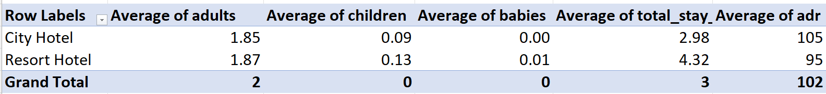
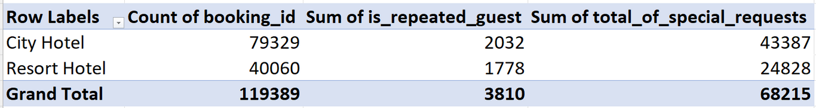
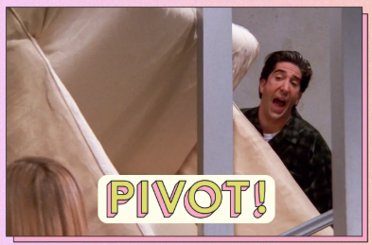
Level 4 Data Analyst Apprenticeship - APP-Communicating Insights
DATA ANALYSIS: EXCEL
Pivot Tables
Notes:
Some of examples of pivot tables: one to look at volume of bookings, number of repeated guests, number of special requests per hotel
One that looks at averages of adults, kids, babies, avg stay duration and average ADR for each hotel.

Slide 8
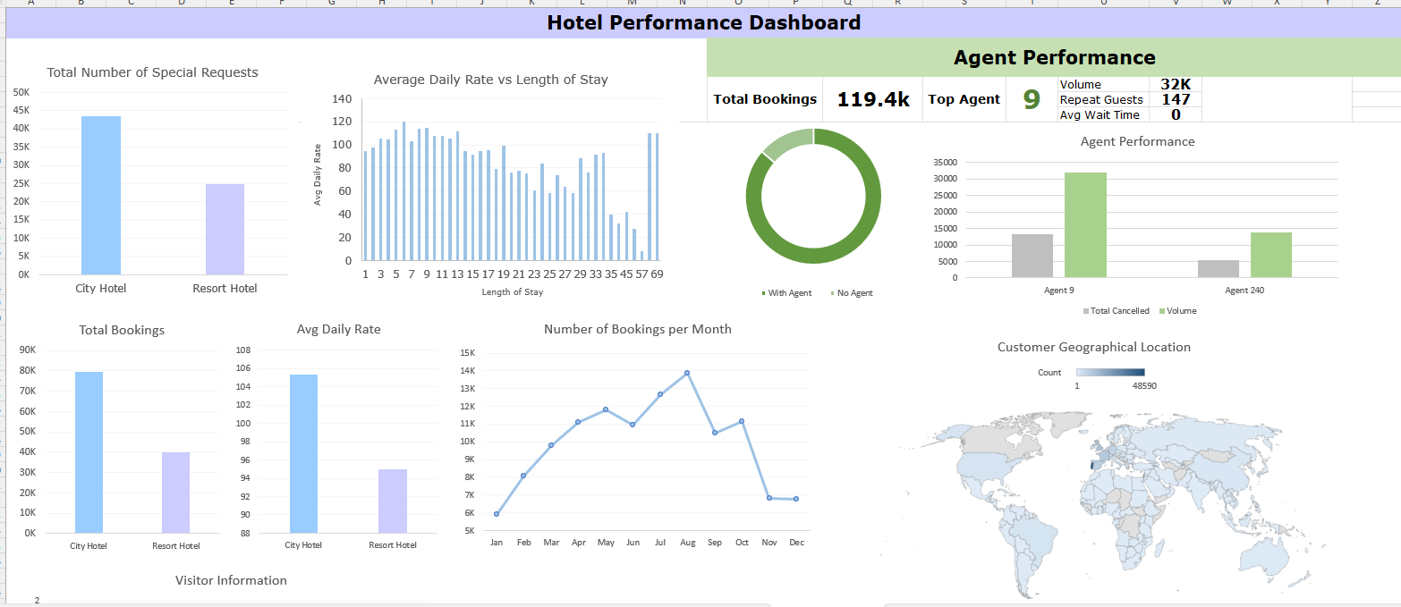
Level 4 Data Analyst Apprenticeship - APP-Communicating Insights
DATA ANALYSIS: DASHBOARD
Notes:
Here is an example of a simple dashboard I made in Excel. It takes the information from pivot tables. This could be used a self-service dashboard for executives, though data would need to be regularly refreshed.

Slide 9
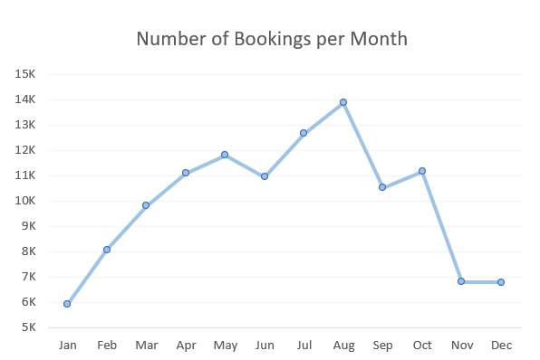
Level 4 Data Analyst Apprenticeship - APP-Communicating Insights
FINDINGS
Booking Trends
Findings
Busiest Month: August (c.13.8k bookings) 
Quietest Month: January (c.5.9k bookings)
Interpretation
Summer school holidays
Decreased spending post-Christmas
Notes:
This is a simple line chart show the number of total bookings per month (all years included).
It shows a clear peak in August, likely due to summer school holidays period, and a trough in Winter, specifically in January, likely caused by reduced number of guests going on
holiday, after increased spending and annual leave taken during the Christmas period

Slide 10
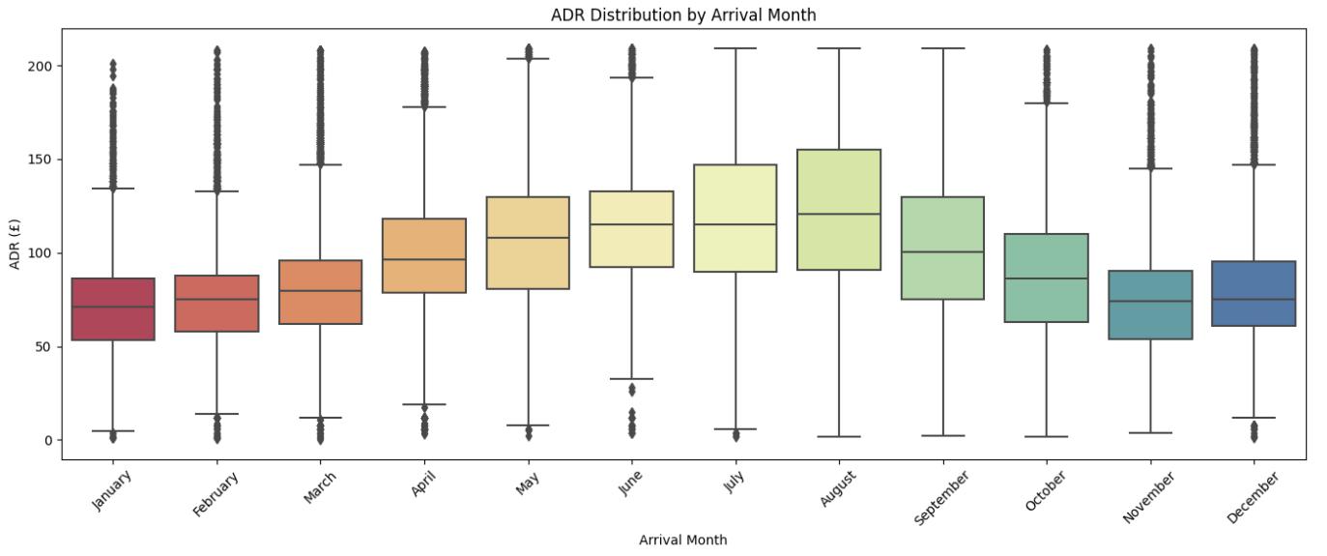
Level 4 Data Analyst Apprenticeship - APP-Communicating Insights
FINDINGS
Seasonality of ADR
Findings
High Season: May-August highest ADRs (median >£100.)
Low Season: Nov-Jan lowest median ADRs (between £60-80)
Transition Periods (Spring & Autumn months): lower ADR variability
Interpretation
Summer school holidays
Decreased spending post-Christmas
Notes:
Low Season
January, February, March, November, and December have the lowest median ADR
(center lines in the boxes), between £60 and £80.
These months also have a narrower interquartile range (IQR, the hight of the boxes),
indicating consistently lower prices and less rate variability.
High Season
May, June, July, and August show the highest median ADRs, with values reaching
well above £100.
The boxes are taller for these months, indicating more rate variability, caused by
higher demand due to school holidays.

Slide 11
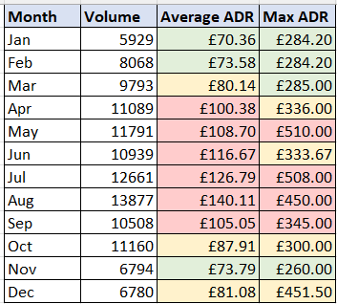
Level 4 Data Analyst Apprenticeship - APP-Communicating Insights
FINDINGS
Seasonality of ADR
Findings
January and February offer the lowest average rates (£70.40 and £73.60 respectively).
June is the cheapest month for summer stays, with a Maximum ADR of £333.
Notes:
done a RAG status on the average ADR and max ADR per month
For Avg ADR
Green is under £80
Amber between £80 and £100
Red over £100
For Max ADR
Green is under £300
Amber between £300-500
Red over £500
Rooms are easiest to book in winter due to lower numbers of bookings; January and February offer the lowest average rates (£70.40 and £73.60 respectively). February has less variation in the ADR compared to Jan and November has the lowest maximum ADR out of all months.  June is the cheapest month for summer stays, with a Maximum ADR of £333 compared to £510 for May, £508 for July, and £450 for August.
worth noting spring and autumn seasons are also good to book. Apr is only slightly over £100 ADR.
The interpretation is the same for the last 2 slides.

Slide 12

Level 4 Data Analyst Apprenticeship - APP-Communicating Insights
We have answered our first business question!
Best time of year to book rooms?
Seasonal demand peaks in August, making winter the best time for easy bookings and better, cheaper rates for guests, or June for a summer holiday.

Slide 13
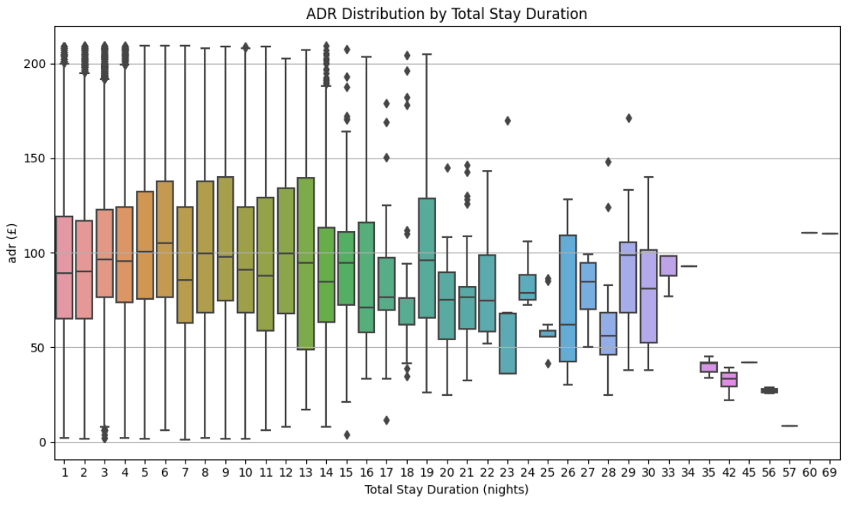
Level 4 Data Analyst Apprenticeship - APP-Communicating Insights
FINDINGS
Optimal Stay Duration and ADR
Findings
Short Stays (1–13 nights): Higher, more variable ADR. 
Long Stays (17–24+ nights): Lower, more stable ADR. 
Stays of 20–25 nights offer the lowest, most consistent nightly rates.
14 to 15 days potentially good choice. 16 days has lowest median.
7 nights has the lowest median for stays <10 nights.
Notes:
Shorter stays are more expensive and ADRs more variable.
Longer stays have lower, less variable ADRs
Based on what data we have, 20-25 optimal
However who has that much annual leave they want to take all in one go? Not me!
So looking at individual nights stay, 14,15,17 and 18 are also good choices, which is still quite long. 7 nights has the lowest median for under 10 nights.

Slide 14
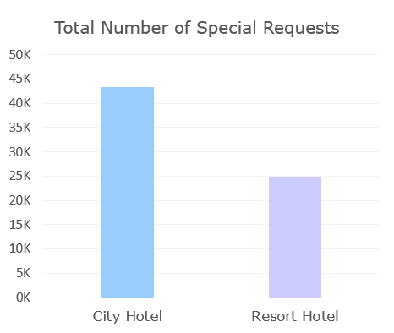
Level 4 Data Analyst Apprenticeship - APP-Communicating Insights
FINDINGS
Special Requests
City Hotel: 43,000 special requests.
Resort Hotel: 25,000 special requests.
City Hotel receives more requests.
HOWEVER, per bookings, 62% have special requests at Resort Hotel, and 54.7% at City Hotel
Resort Hotel has a disproportionately higher number of special requests.
Notes:
city hotel does handle more bookings however,

Slide 15
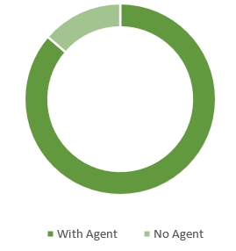
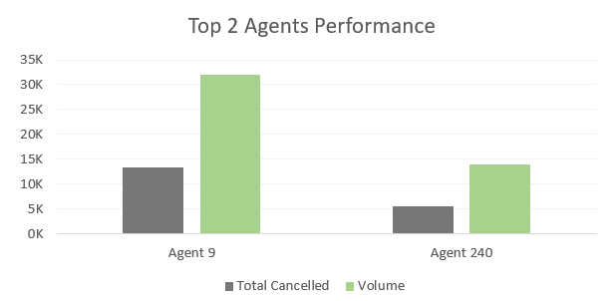
Level 4 Data Analyst Apprenticeship - APP-Communicating Insights
FINDINGS
Agent Performance
Majority of Bookings (86%) are made via agents. 
Top Agent: Agent 9 with 32,000 bookings, 147 repeat guests, zero wait time.
Runner-up: Agent 240 with 13,900 bookings, 255 repeat guests, zero wait time.
Notes:
Pie chart shows proportion of bookings with an Agent, and with no agent.
However I did look into this further yesterday evening and I found that Agent 9 does have a 40% cancellation rate!

Slide 16
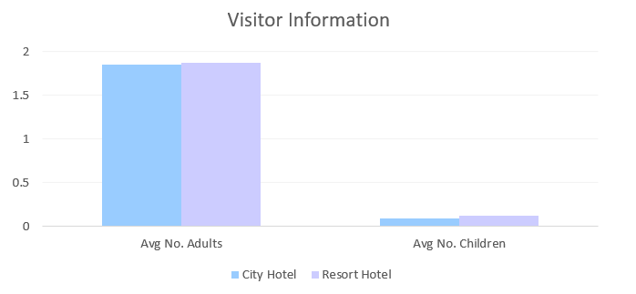
Level 4 Data Analyst Apprenticeship - APP-Communicating Insights
FINDINGS
Summary Statistics - Visitor Demographics
Both hotels average a similar number of adults and children per booking.
City Hotel typically hosts slightly more adults (suggesting a business or solo traveler focus),
Resort Hotel serves more families.

Slide 17
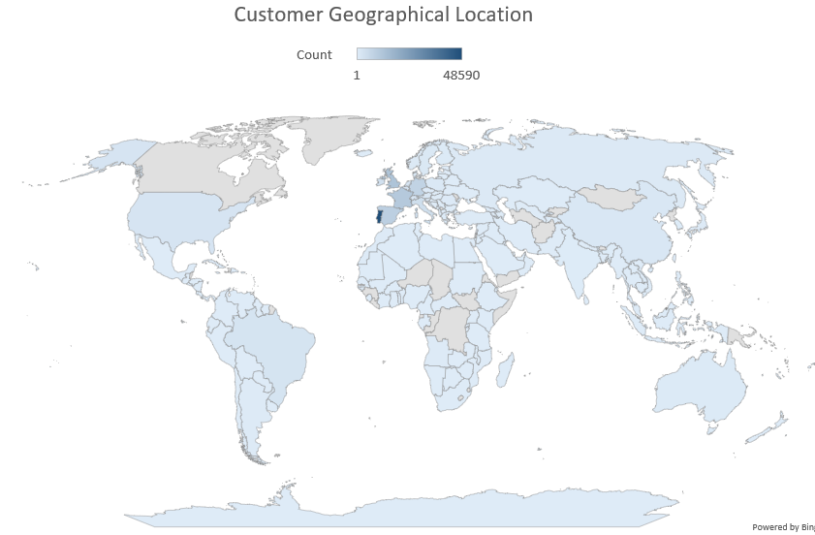
Level 4 Data Analyst Apprenticeship - APP-Communicating Insights
FINDINGS
No visitors from Canada, Greenland, parts of Africa and parts of Eastern Europe and Middle East
Portugal
Great Britain
France
Notes:
No visitors from Canada or Greenland

Slide 18
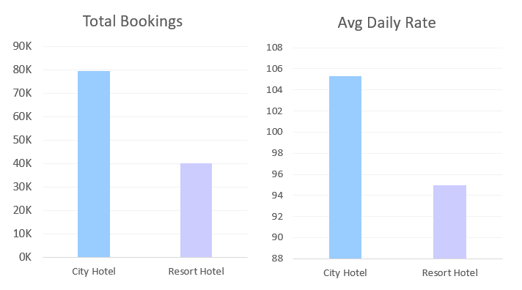
Level 4 Data Analyst Apprenticeship - APP-Communicating Insights
FINDINGS
Notes:
Just a quick over view of total bookings and Average ADR - both are higher for city hotel.

Slide 19
Level 4 Data Analyst Apprenticeship - APP-Communicating Insights
CONCLUSIONS
 Seasonal demand peaks in August (peak bookings, peak median ADR). January has lowest volumes of bookings and lowest median ADR, closely followed by February and November, making winter the best time for easy bookings and better rates. For a summer holiday June has the least ADR variability and lowest max ADR. Also to consider Spring and Autumn.
01
Shorter stays are more expensive.
20-25 nights yield best value for nightly rates. But not everyone has 20+ days to take as annual leave for one holiday!
7 nights is also a good choice; lowest median for stays <10 nights.
Average stay is 3-4 nights.
02
Resort Hotel receives the highest percentage of special requests per booking.
03
86% of bookings are made via Agents. Agent 9 handles the most bookings, and Agent 240 has the most repeat customers.
04

Slide 20
Level 4 Data Analyst Apprenticeship - APP-Communicating Insights
RECOMMENDATIONS
 Promote Off-Peak Winter Bookings: Offer targeted packages and deals for winter months to boost bookings.
01
02
Stay duration deals: Offer special packages and deals for: 3-4, 7 and perhaps 20-25 days stay
Tailored Marketing: Focus City Hotel campaigns and deals on solo/business travelers, and families for the Resort Hotel. Consider partnerships with businesses who have employees travelling for work.
03
 Strengthen Agent Relationships: As agents make up the majority of bookings, recognize and reward top-performing agents and investigate poorer performing agents to see what can be done
04
Notes:
Just a quick over view of total bookings and Average ADR - both are higher for city hotel.

Slide 21

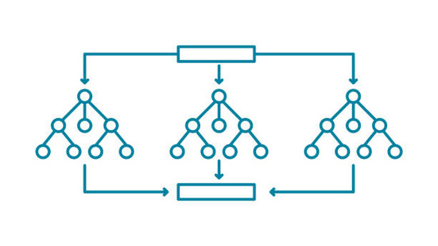
Level 4 Data Analyst Apprenticeship - APP-Communicating Insights
PREDICTIVE MODEL: RANDOM FOREST
Analysis showed 37% of bookings are cancelled.
A random forest is a machine learning method that builds and combines many individual decision trees to make a final prediction.
Each decision tree is like a flowchart that asks a series of questions about the data
Every tree looks at slightly different random parts of the data, so each tree is unique
Notes:
why random forest?

Slide 22

Level 4 Data Analyst Apprenticeship - APP-Communicating Insights
PREDICTIVE MODEL: RANDOM FOREST
Why random forest?
Captures complex relationships in the data
Random forests can process datasets with numerous numerical and categorical features without requiring extensive feature selection
Resilient to noise and outliers: ideal for real-world data
Notes:
why random forest?

Slide 23
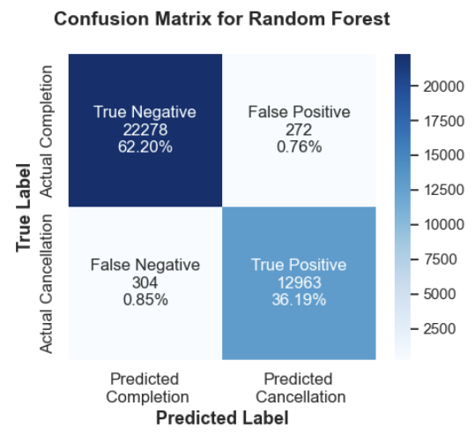
Level 4 Data Analyst Apprenticeship - APP-Communicating Insights
PREDICTIVE MODEL: RANDOM FOREST
Highest factors influencing cancellations:
Deposit type (0.48)
Agent (0.38)
Country (0.35)
Notes:
This is a confusion matrix, used to evaluate the model.
TOP LEFT:
The model correctly predicted 22,278 bookings would be completed when they were. This is the largest portion, suggesting the model is very good at detecting completed bookings.
TOP RIGHT: False Positive (FP): 272 cases, the model wrongly predicted a booking would be canceled, but it actually was completed.
BOTTOM LEFt: False Negative
In 304 instances, the model predicted the booking would be completed, but it was actually canceled.
BOTTOM RIGHT: True Positive 12,963 (36.2%)
The model correctly identified 12,963 bookings that were indeed canceled.

Slide 24


Level 4 Data Analyst Apprenticeship - APP-Communicating Insights
PREDICTIVE MODEL: RANDOM FOREST
Disclaimer!
 Further development , testing and evaluation of this model is needed.
Computing time was large!
Works suspiciously well.
However, the concept exists, provides insight into how a fully devloped model would work.
Notes:
I have a few things to say about this model including some disclaimers!
I ran out of time to fully test and evaluate this model.
I don't usually have time in my role to practice skills outside normal duties, so wanted to use this as opportunity to try something new, uninterrupted by emails.
Computing time for hyperparamters was LARGE and took a very long time. (I have analyzed high energy photon collisions from the Large Hadron Collider that took less computing power!)
It needs investigating as I think it is working slightly too well. Comparing it similar models online using similar datasets, false positives and false negatives should be slightly lower, around 4%.
However, this gives a good insight into what a random forest does and how it works. I'd like to work on this a bit more when I have time.

Slide 25

THANK YOU!
QUESTIONS?

