Slide 1
Epigastra only

Slide 2
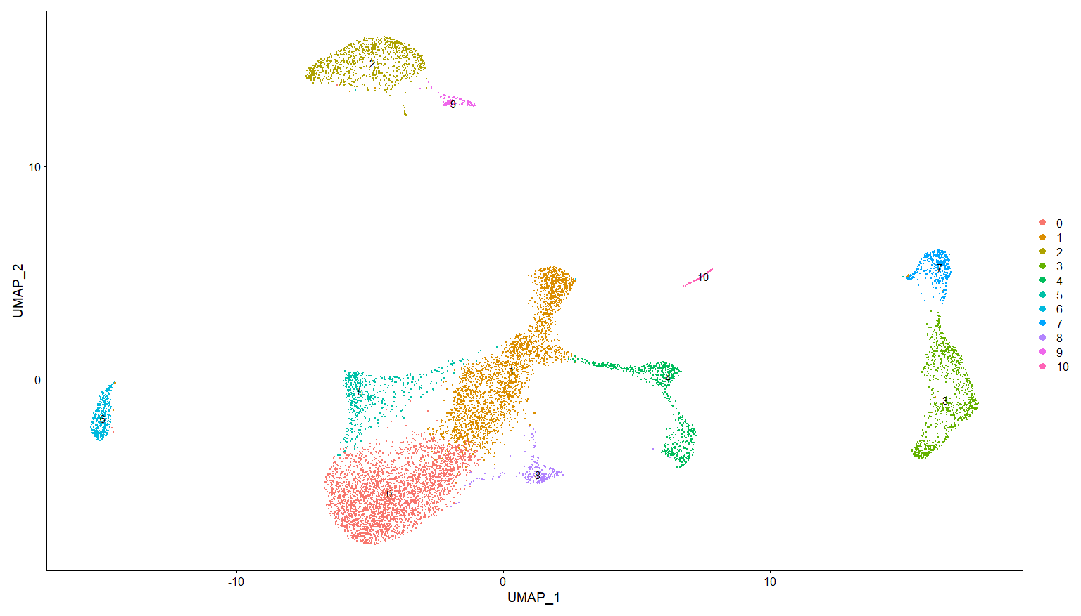
Reintegration – including calc markers, showing labels generated per sample
npc13

Slide 3
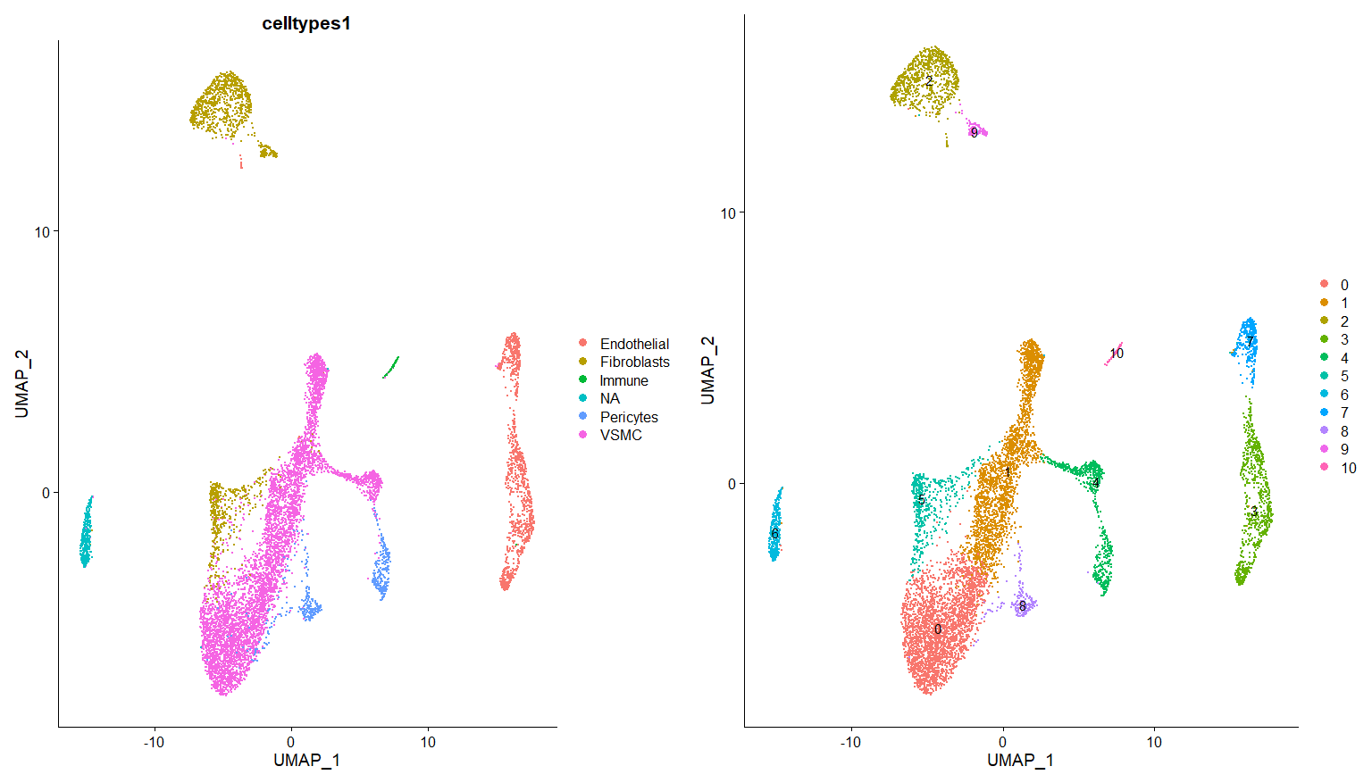
0-VSMC
1-VSMC
2-Fibroblasts
3-Endothelial
4-Pericytes
5-Fibroblasts
6-NA
7-Endothelial
8-Pericytes
9-Fibroblasts
10-Immune

Slide 4
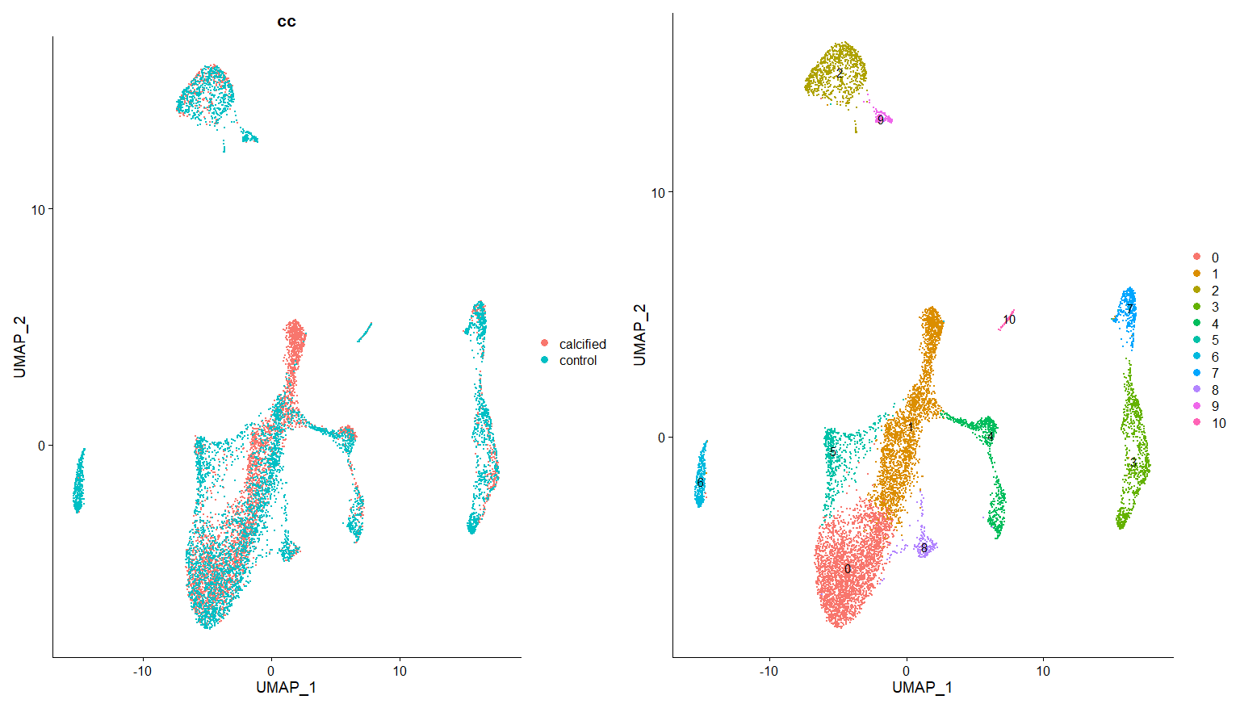

Slide 5
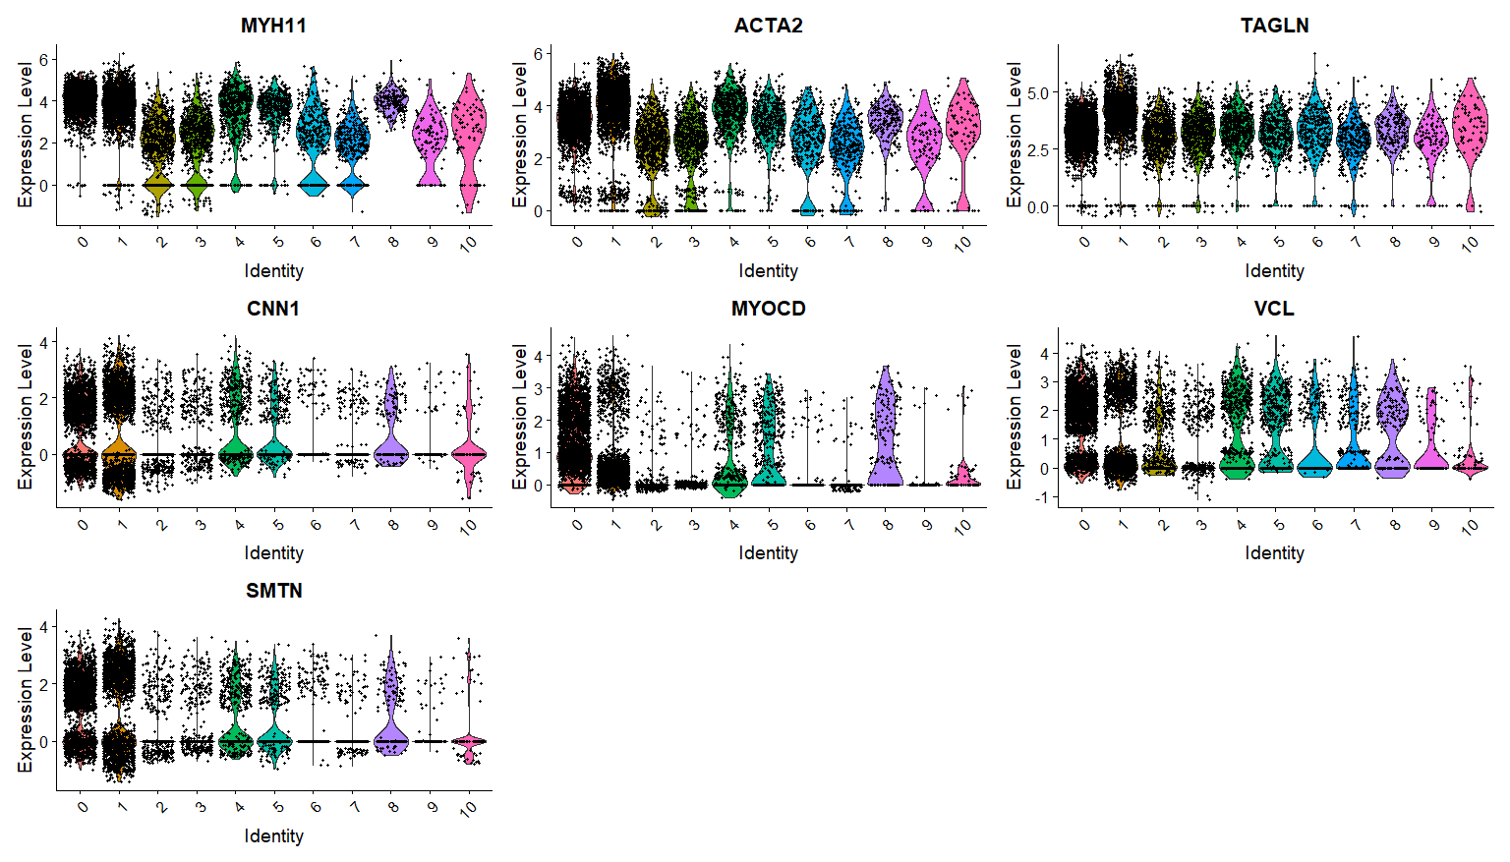
VSMC – 0,1

Slide 6
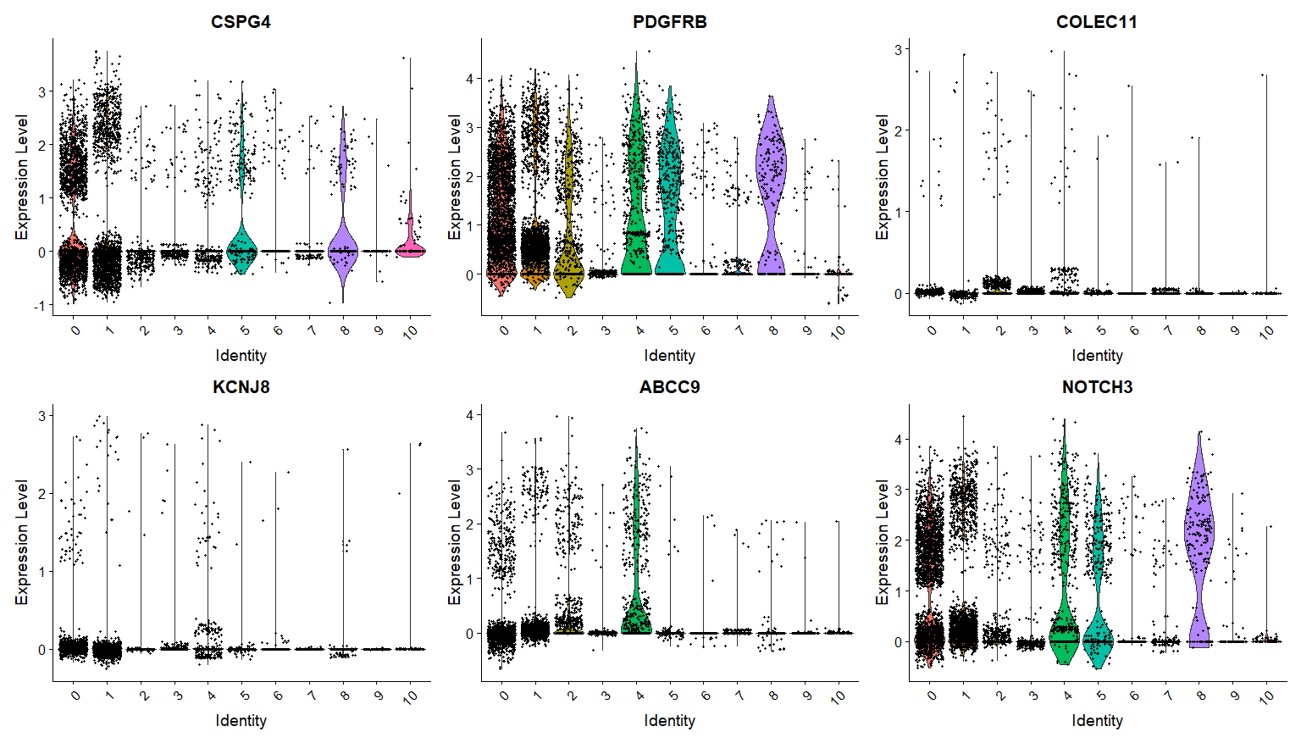
Pericytes – 4,8

Slide 7
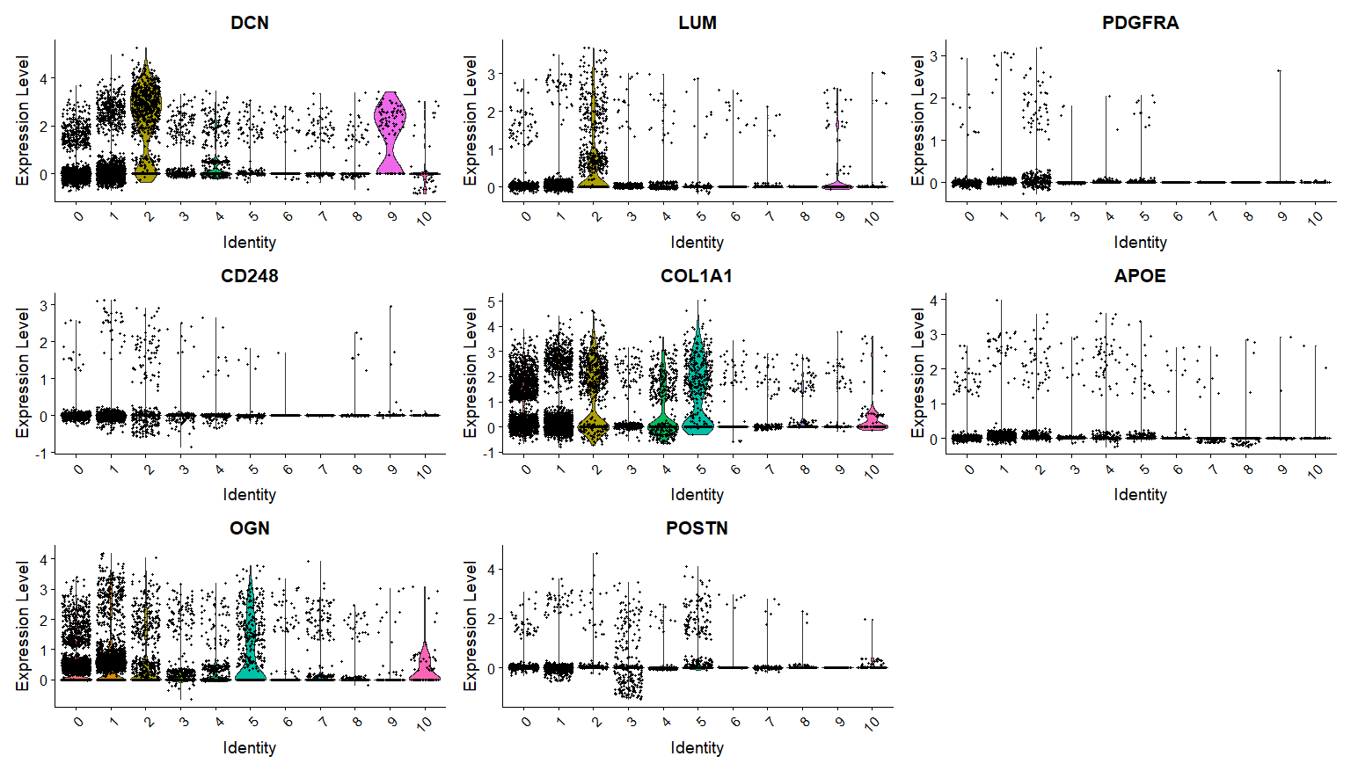
Fibroblasts – 2,5,9

Slide 8
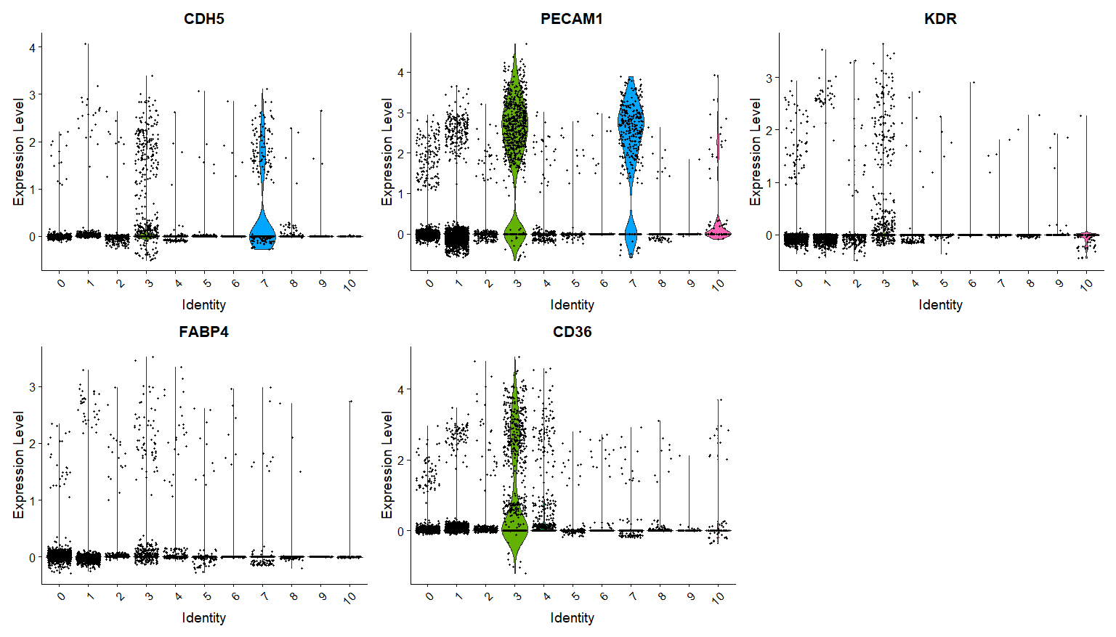
Endothelial – 3,7

Slide 9
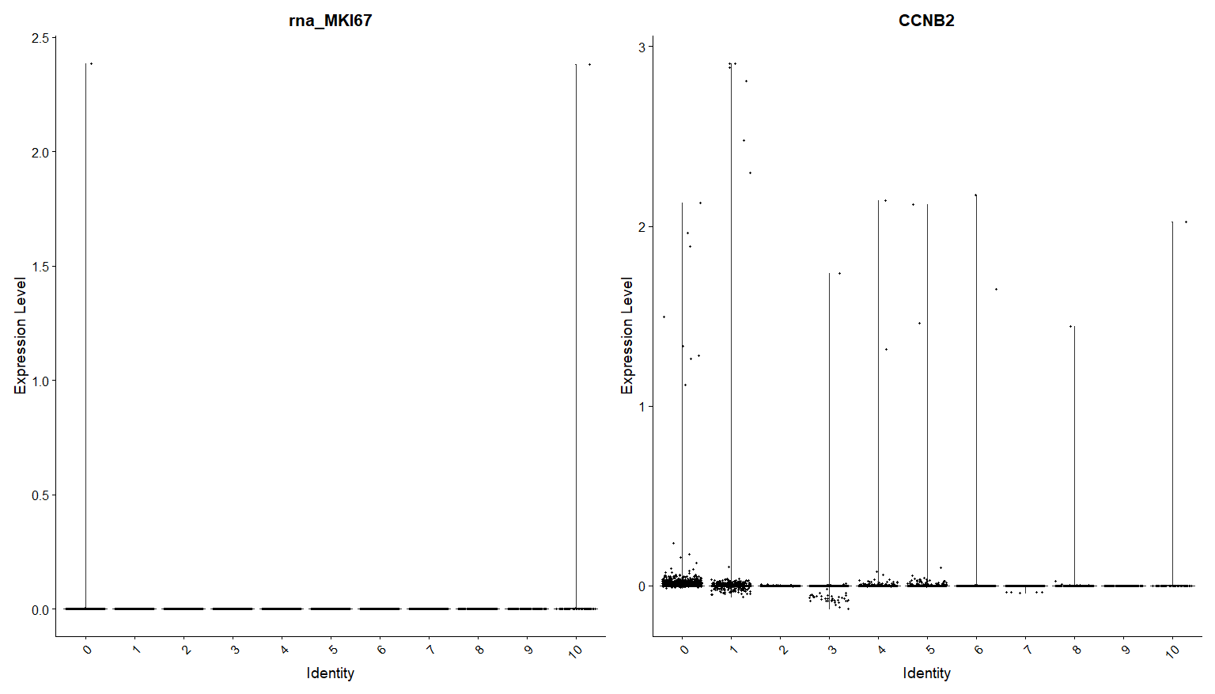
Cellcycle –

Slide 10
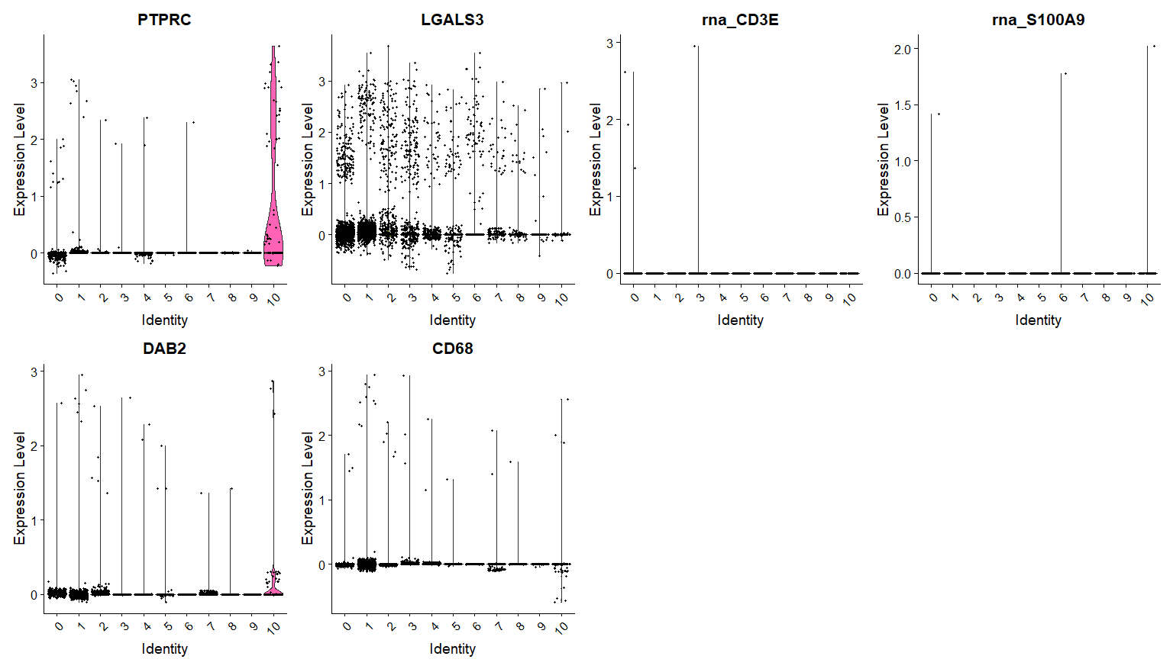
Immune – 10

Slide 11
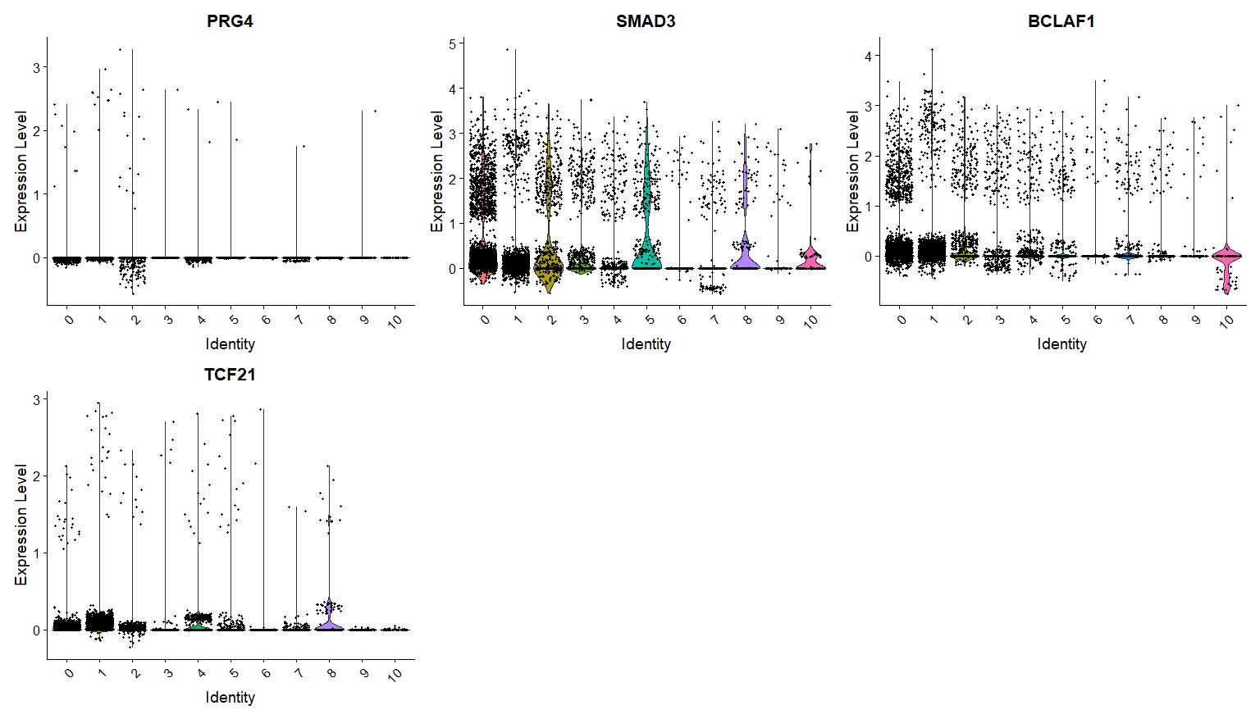
Calc markers – 0,2,5,8

Slide 12
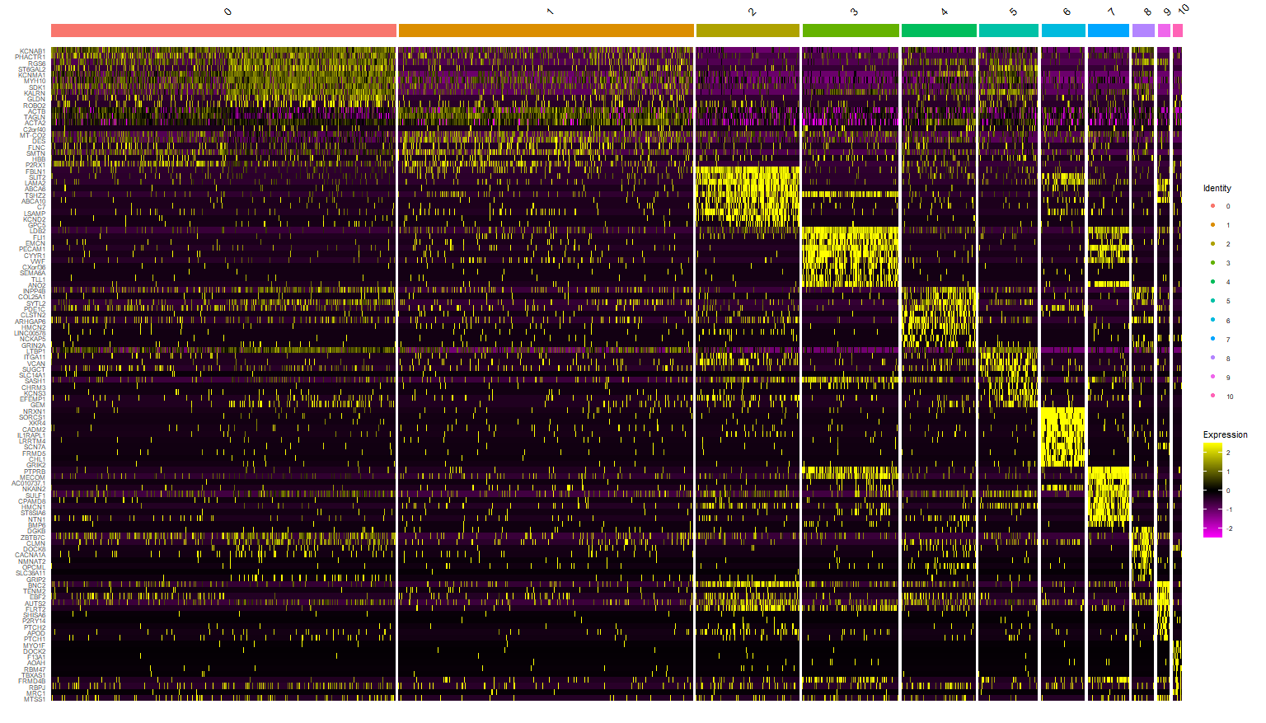

Slide 13
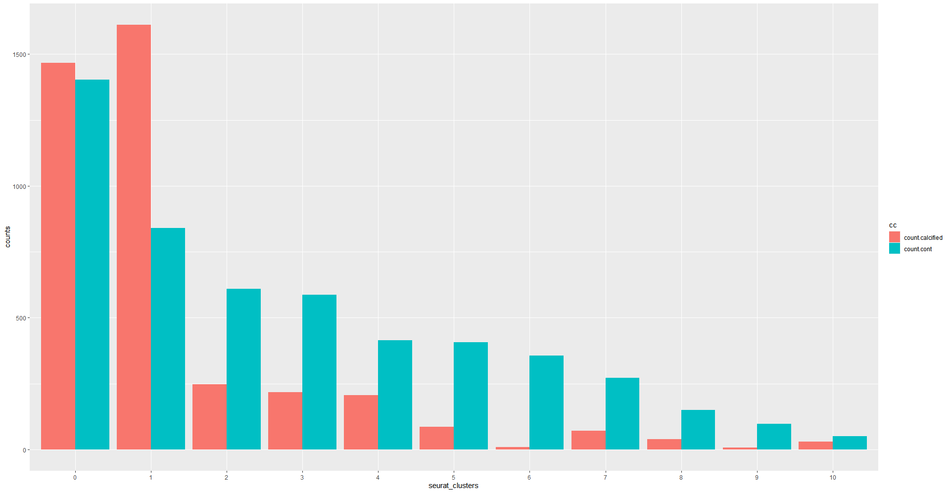

Slide 14
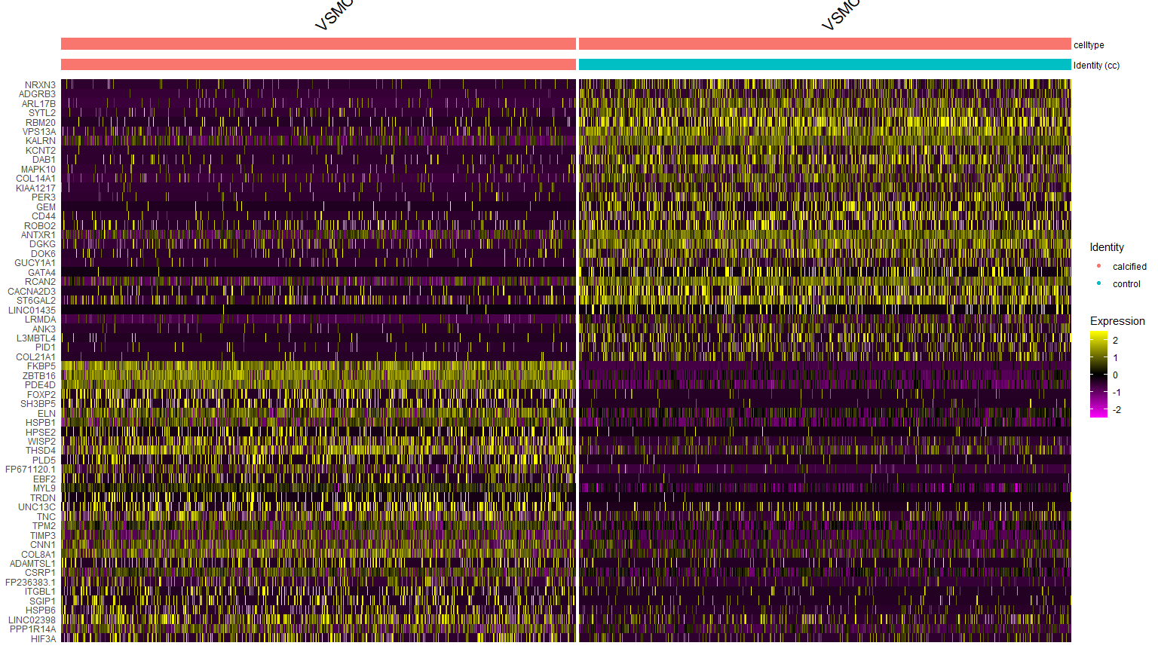
Cluster 0 - VSMC

Slide 15
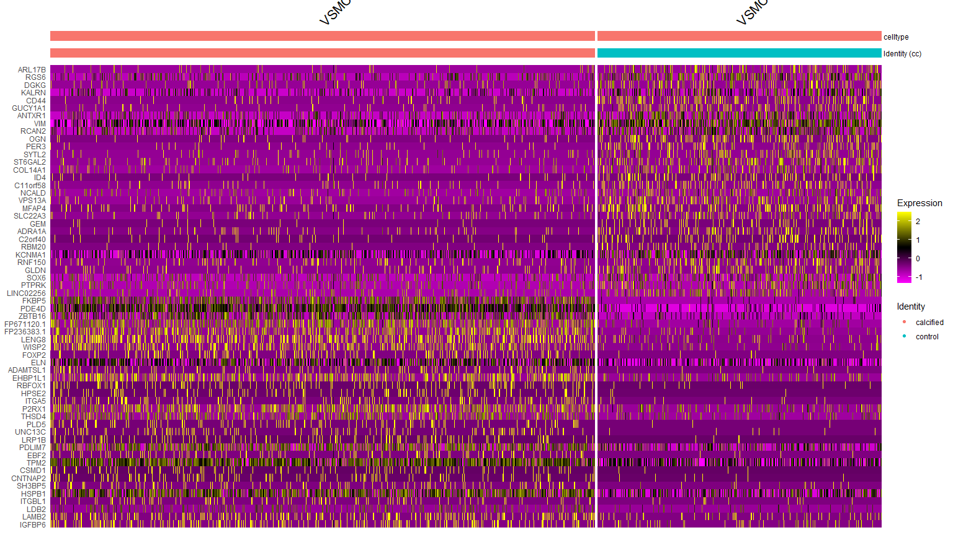
Cluster 1 - VSMC

Slide 16
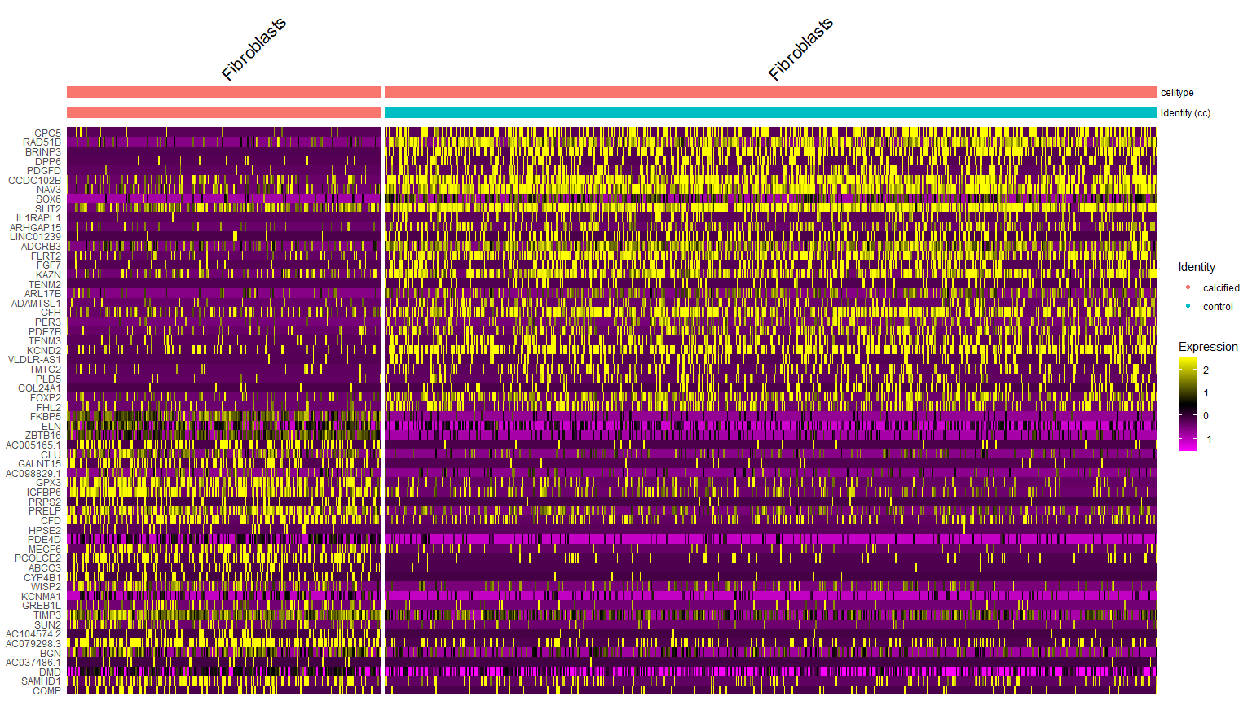
Cluster 2 - Fibroblasts

Slide 17
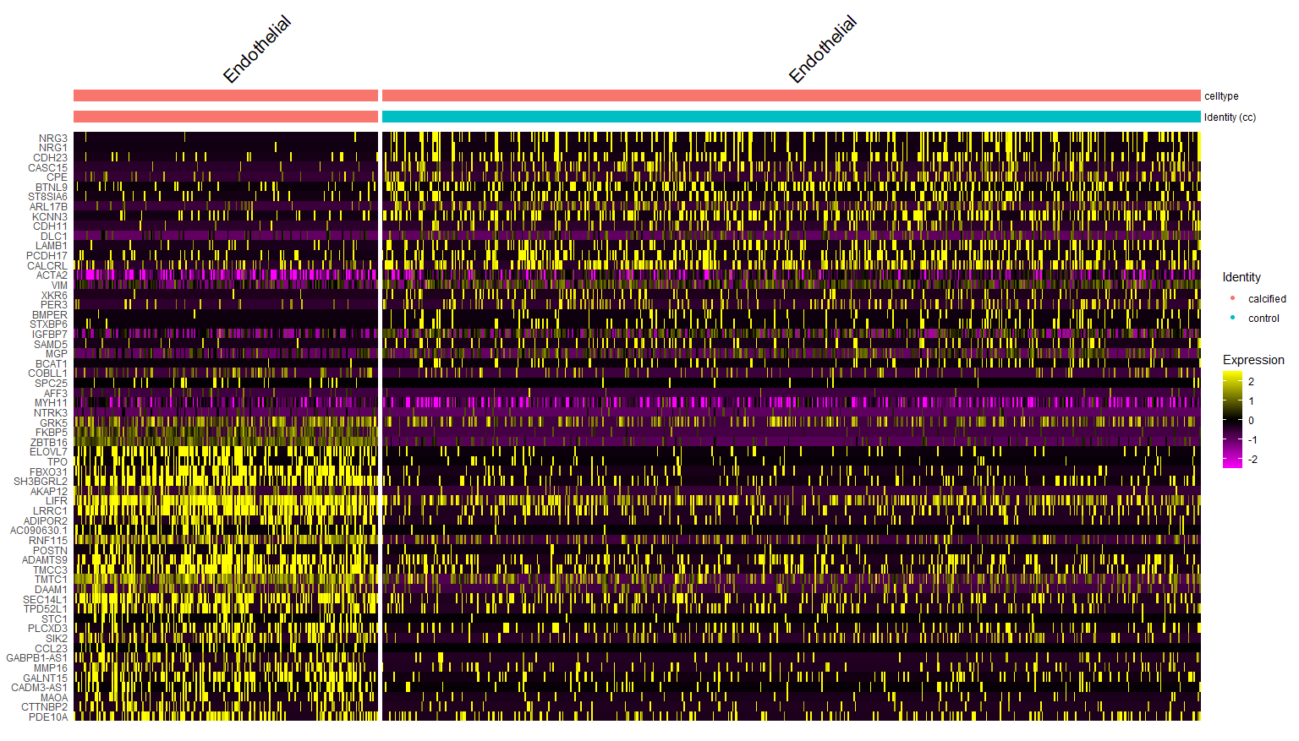
Cluster 3 - Endothelial

Slide 18
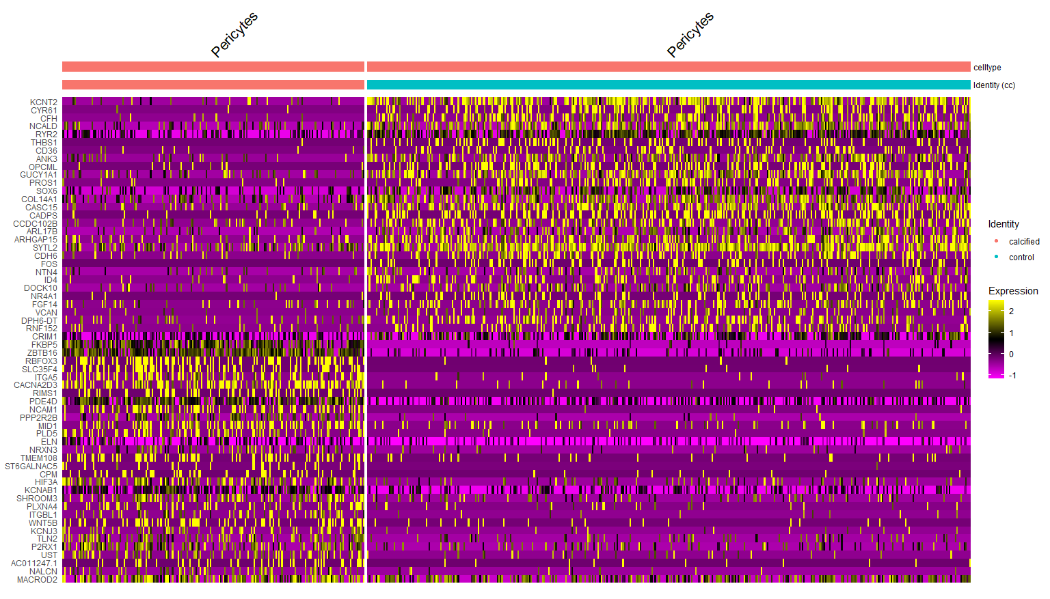
Cluster 4 - Pericytes

Slide 19
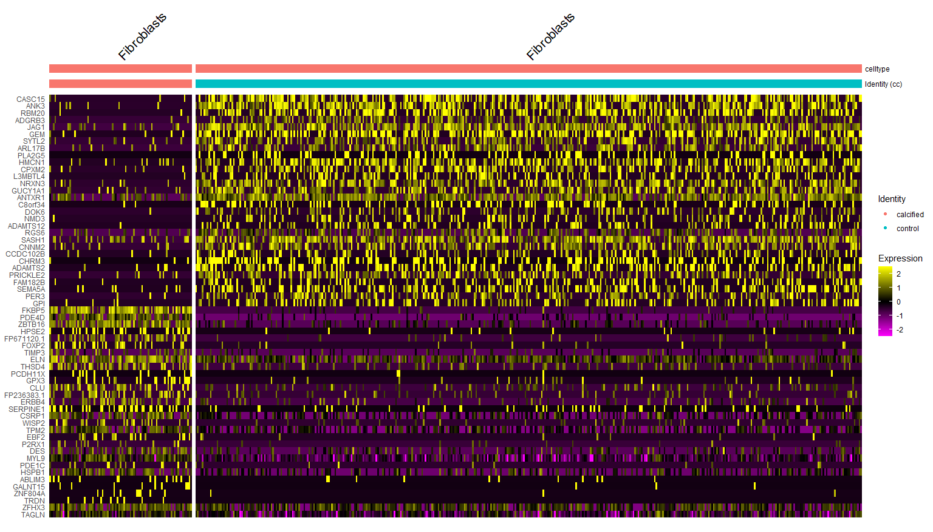
Cluster 5 - Fibroblasts

Slide 20
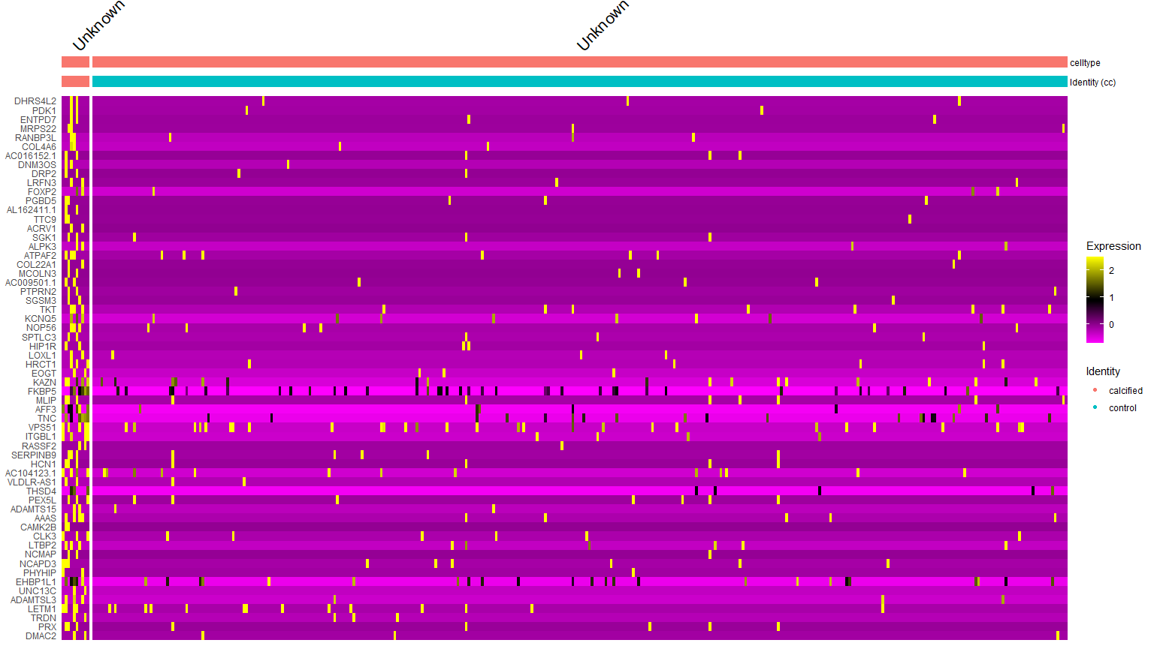
Cluster 6 - Unknown

Slide 21
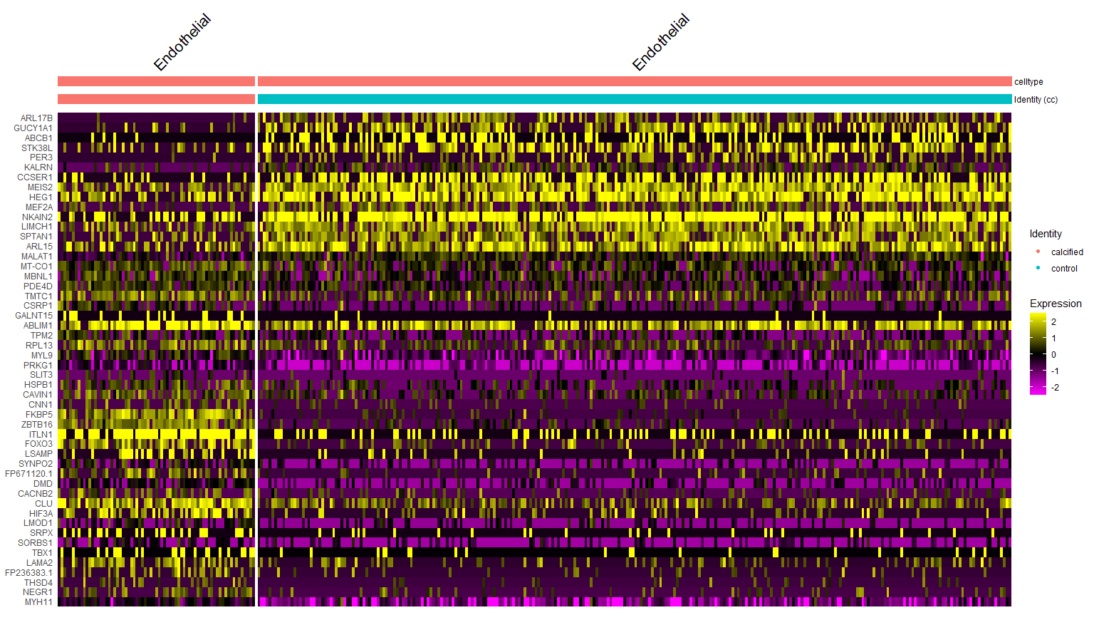
Cluster 7 - Endothelial

Slide 22
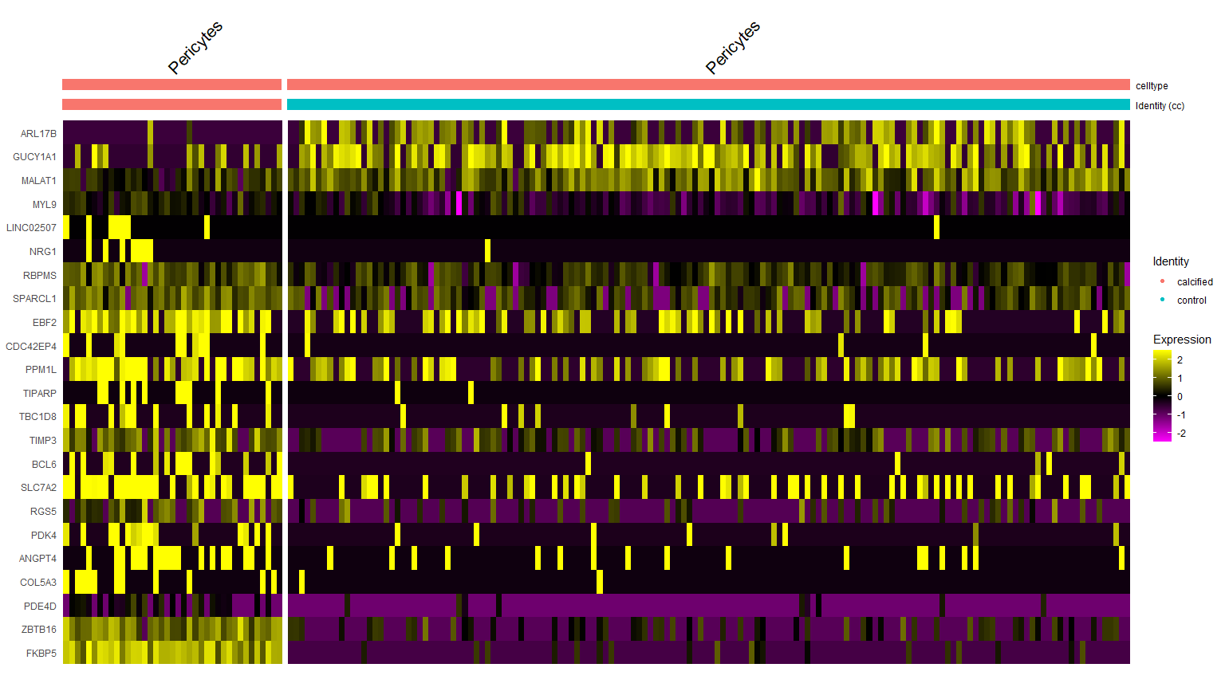
Cluster 8 - Pericytes

Slide 23
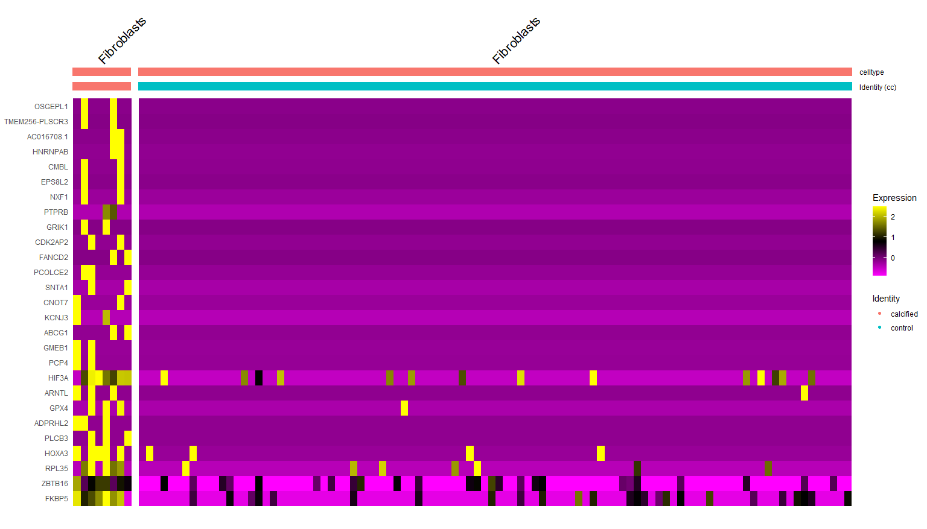
Cluster 9 - Fibroblasts

Slide 24
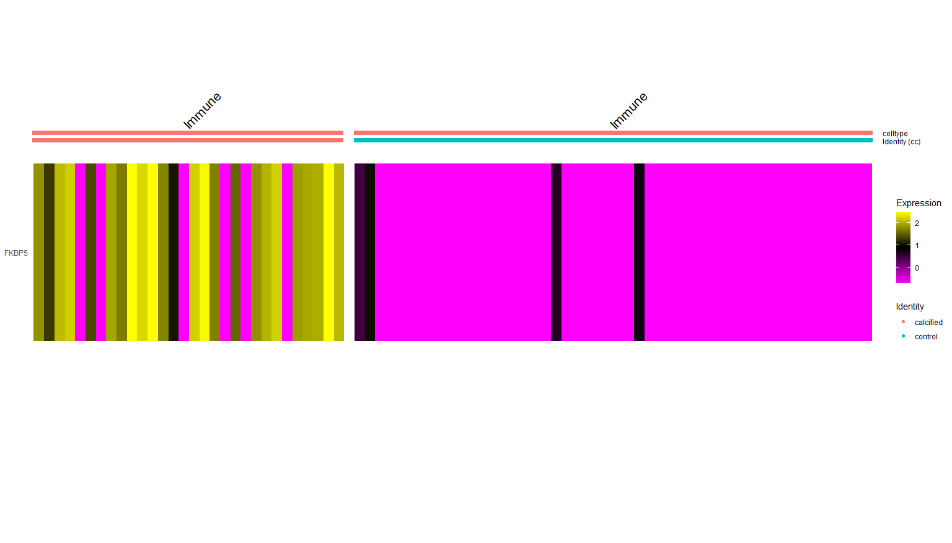
Cluster 10 - Immune

Slide 25
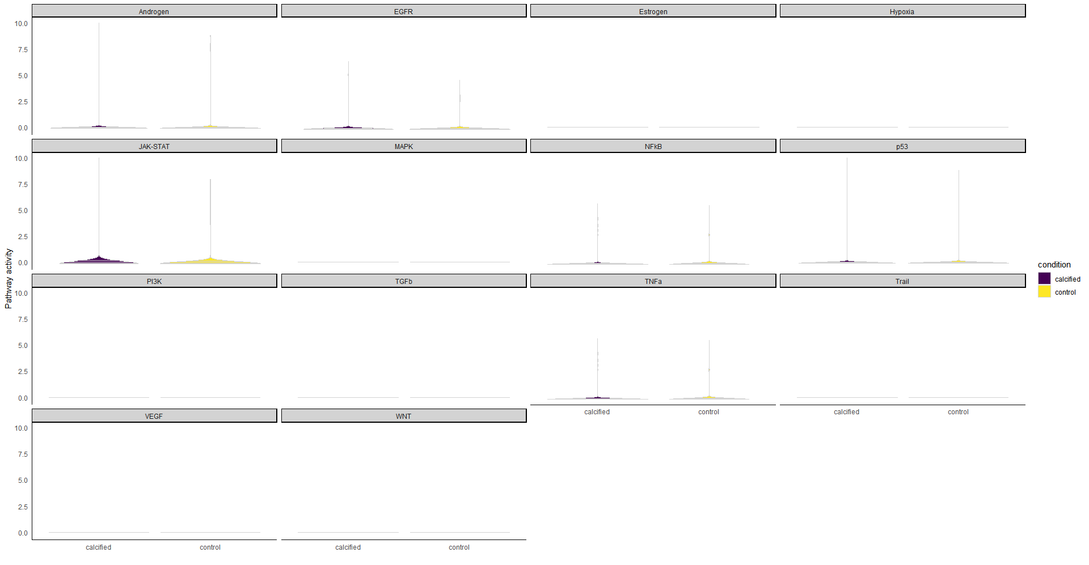
VSMC-0

Slide 26
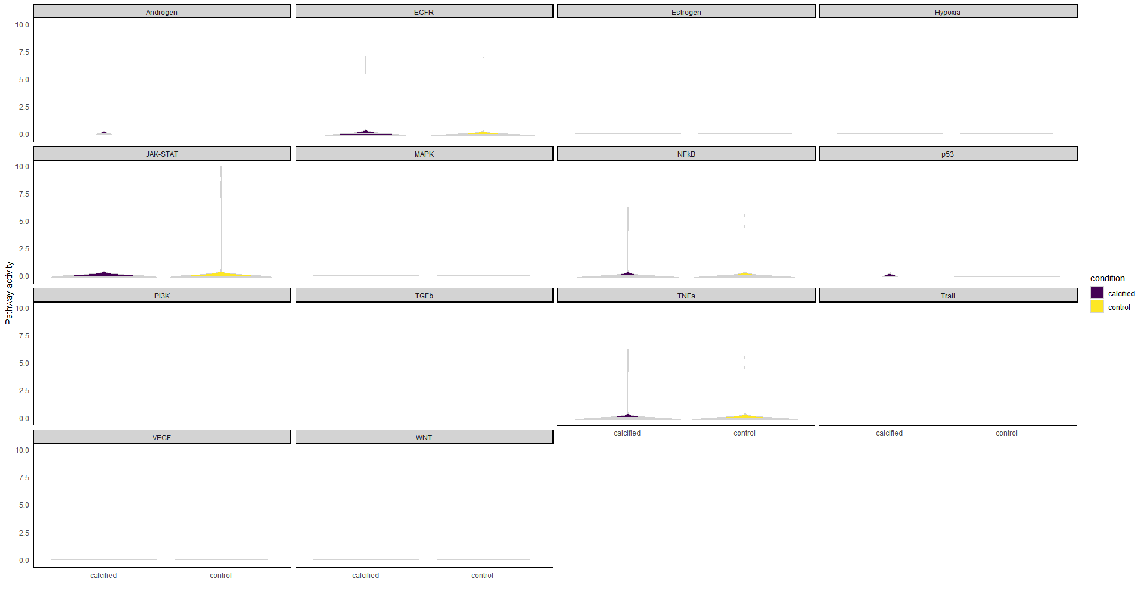
VSMC-1

Slide 27
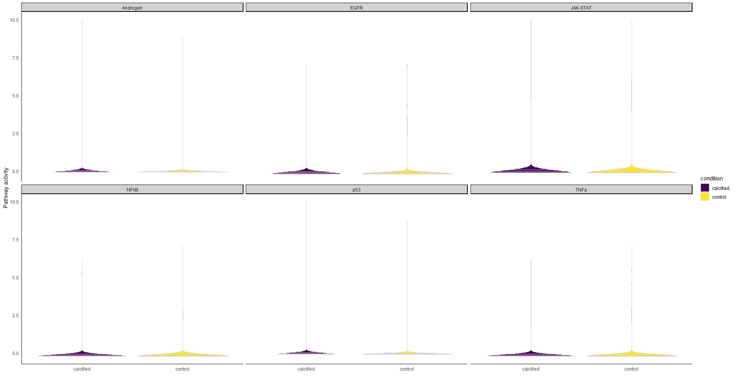
VSMC

