Slide 1
Oasia Portfolio Report — March 30, 2026
As of 2026-03-30 · Oasia MBS Analytics
MV: $3736682220.0M OAS: 44 bps OAD: 4.25 yr Yield: 5.44%

Slide 2
Dashboard

Slide 3
Dashboard — Portfolio KPIs
Market Value
Book Value
Positions
OAS
$3736682220.0M
$3708131109.0M
13
44.0 bps
OAD
Book Yield
Unrealized P&L
EVE +200bp
4.25 yr
5.44%
$28551115K
-8.5%
⚠ EVE BREACH — rebalancing required

Slide 4
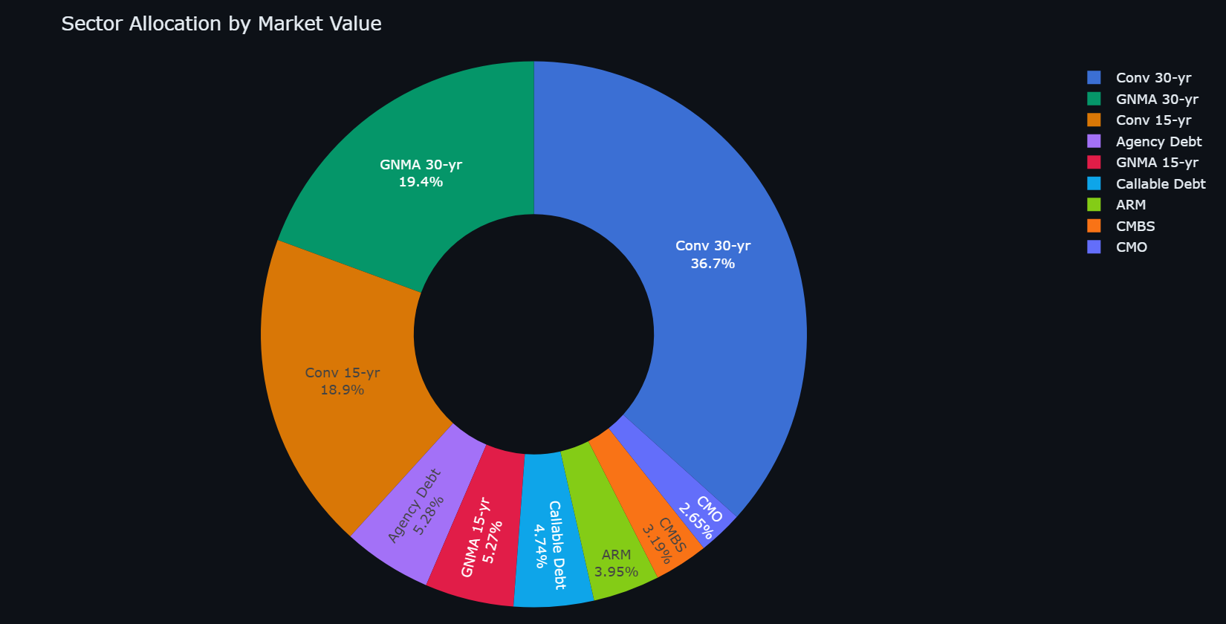
Dashboard — Sector Allocation

Slide 5
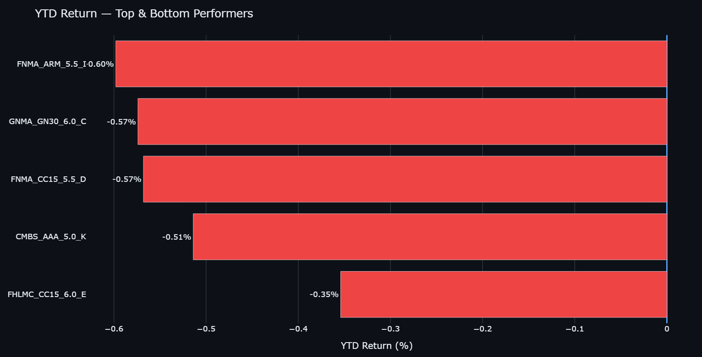
Dashboard — YTD Performance

Slide 6
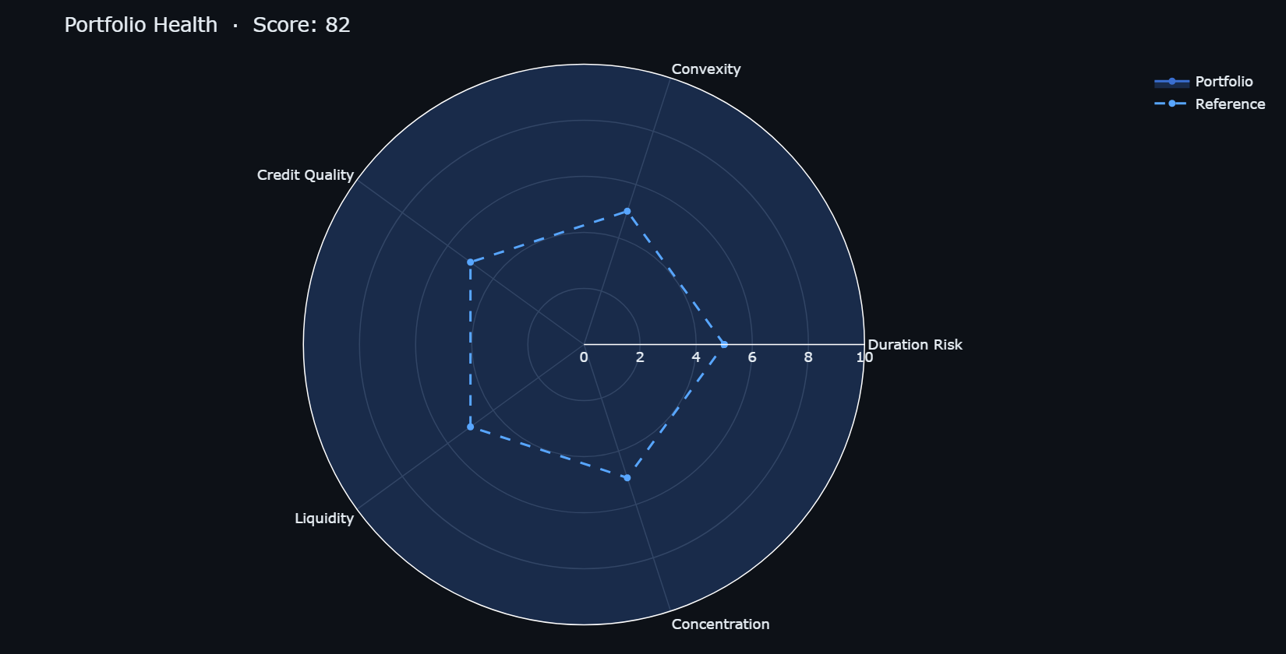
Dashboard — Portfolio Health
Dimension | Score | Note
Duration Risk | 94.0/10 | OAD 4.25 yr vs benchmark 4.2 yr
Convexity | 73.0/10 | Avg convexity -0.77
Credit Quality | 100.0/10 | Agency / GSE only
Liquidity | 80.0/10 | TBA-eligible 80%
Concentration | 61.0/10 | Top issuer 39%

Slide 7
Portfolio Analytics

Slide 8
Portfolio Analytics — Summary
Metric | Value
Total Market Value | $3736682220.00M
Total Book Value | $3708131109.00M
Unrealized P&L | $28551115K
# Positions | 13
Weighted OAS | 44.0 bps
Weighted OAD | 4.25 yr
Weighted Convexity | -0.800
Book Yield | 5.44%
Annual Income | $200342868K
EVE Δ +200bp | -8.5%
EVE Limit | -5.0%
Pool | Type | MV | OAS | OAD
FNMA_CC30_6.0_A | CC30 | $599433948.0M | 53 | 4.84
FHLMC_CC30_5.5_B | CC30 | $538494728.0M | 49 | 4.79
GNMA_GN30_6.0_C | GN30 | $461644690.0M | 38 | 4.52
FNMA_CC15_5.5_D | CC15 | $396701141.0M | 39 | 3.32
FHLMC_CC15_6.0_E | CC15 | $308813595.0M | 43 | 3.20
GNMA_GN30_5.5_F | GN30 | $262662139.0M | 34 | 4.59

Slide 9
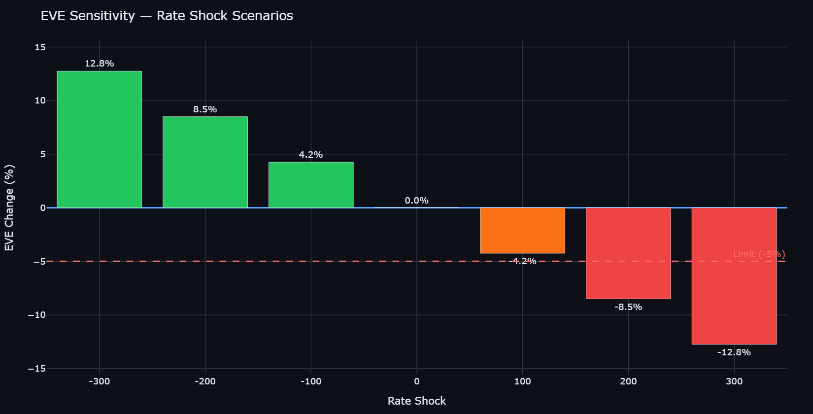
Portfolio Analytics — EVE Stress Test
Shock | EVE Δ% | Status
-300 | +12.8% | OK
-200 | +8.5% | OK
-100 | +4.2% | OK
0 | +0.0% | OK
100 | -4.2% | OK
200 | -8.5% | ⚠ BREACH
300 | -12.8% | ⚠ BREACH

Slide 10
Portfolio Analytics — Full Holdings
Pool ID | Type | Coupon | Par | MV | OAS | OAD | P&L%
FNMA_CC30_6.0_A | CC30 | 6.00% | $600000000.0M | $599433948.0M | 53 | 4.84 | +0.90%
FHLMC_CC30_5.5_B | CC30 | 5.50% | $550000000.0M | $538494728.0M | 49 | 4.79 | +0.75%
GNMA_GN30_6.0_C | GN30 | 6.00% | $460000000.0M | $461644690.0M | 38 | 4.52 | +0.90%
FNMA_CC15_5.5_D | CC15 | 5.50% | $400000000.0M | $396701141.0M | 39 | 3.32 | +0.68%
FHLMC_CC15_6.0_E | CC15 | 6.00% | $310000000.0M | $308813595.0M | 43 | 3.20 | +0.65%
GNMA_GN30_5.5_F | GN30 | 5.50% | $270000000.0M | $262662139.0M | 34 | 4.59 | +0.59%
FNMA_CC30_6.5_G | CC30 | 6.50% | $230000000.0M | $231981139.0M | 57 | 4.89 | +1.14%
GNMA_GN15_5.5_H | GN15 | 5.50% | $200000000.0M | $196797967.0M | 31 | 3.12 | +0.43%
FNMA_ARM_5.5_I | ARM | 5.50% | $150000000.0M | $147691495.0M | 79 | 2.53 | +0.53%
UST_TSY_4.5_J | TSY | 4.50% | $200000000.0M | $197169575.0M | 6 | 4.97 | +0.88%
CMBS_AAA_5.0_K | CMBS | 5.00% | $120000000.0M | $119246596.0M | 109 | 5.59 | +1.05%
FNMA_CMO_5.5_L | CMO | 5.50% | $100000000.0M | $99012174.0M | 66 | 4.11 | +0.69%
FHLB_CDBT_4.0_M | CDBT | 4.00% | $180000000.0M | $177033033.0M | 5 | 3.50 | +0.56%

Slide 11
Security Analytics

Slide 12
Security Analytics — Universe Overview
Product | Count | Balance | Avg Cpn | Avg OAS | Avg OAD | Avg CPR | Avg FICO
CC30 | 400 | 440.77B | 5.93% | 56 | 3.05 | 18.0% | 745
CC15 | 250 | 104.72B | 5.69% | 48 | 1.83 | 17.6% | 745
GN30 | 200 | 51.42B | 5.73% | 39 | 3.21 | 17.0% | 709
GN15 | 150 | 23.27B | 5.41% | 32 | 1.87 | 16.9% | 709
Total: 1000 pools · Balance: 620.19B

Slide 13
Security Analytics — FNMA_CC30_6.0_A
Characteristic | Value
Pool ID | FNMA_CC30_6.0_A
Product
Coupon | N/A
WAC | N/A
WALA | N/A
WAM | N/A
FICO | N/A
LTV | N/A
Orig Balance | N/A
Shock (bps) | OAS | OAD | Convexity | Yield | CPR
Base | 130 | 3.20 | 19.759 | N/A | N/A
Up 100 | 27 | 3.29 | 20.849 | N/A | N/A
Up 200 | -76 | 3.38 | 22.003 | N/A | N/A
Up 300 | -181 | 3.48 | 23.222 | N/A | N/A
Down 100 | 232 | 3.12 | 18.733 | N/A | N/A
Down 200 | 334 | 3.04 | 17.771 | N/A | N/A
Down 300 | 435 | 2.96 | 16.873 | N/A | N/A
Flattener | 127 | 3.25 | 20.266 | N/A | N/A
Steepener | 133 | 3.15 | 19.246 | N/A | N/A

Slide 14
Attribution Analysis

Slide 15
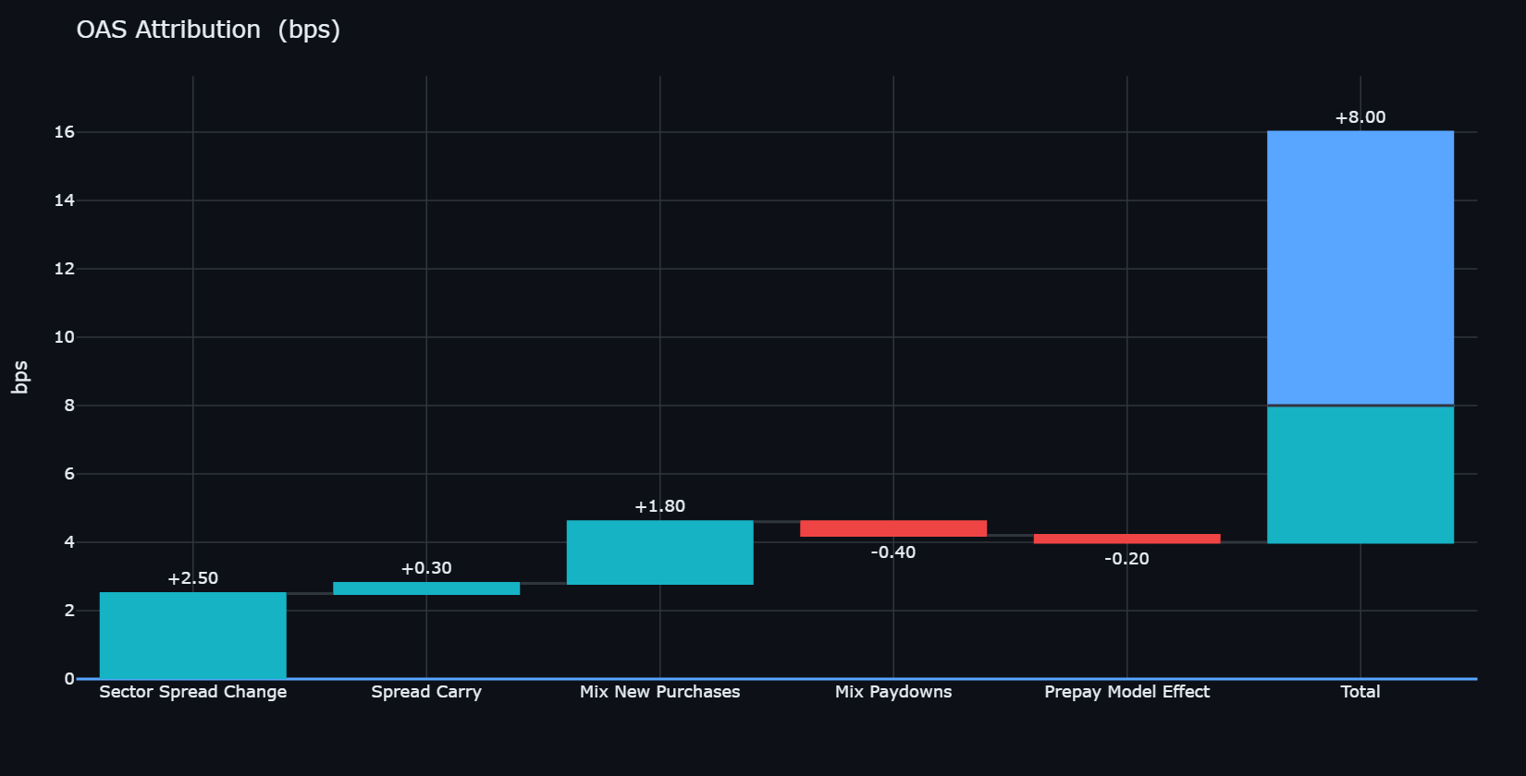
Attribution — OAS Attribution
Driver | Value
Sector Spread Change | +2.50 bps
Spread Carry | +0.30 bps
Mix New Purchases | +1.80 bps
Mix Paydowns | -0.40 bps
Prepay Model Effect | -0.20 bps
Total | +4.00 bps
Total | +8.00 bps

Slide 16
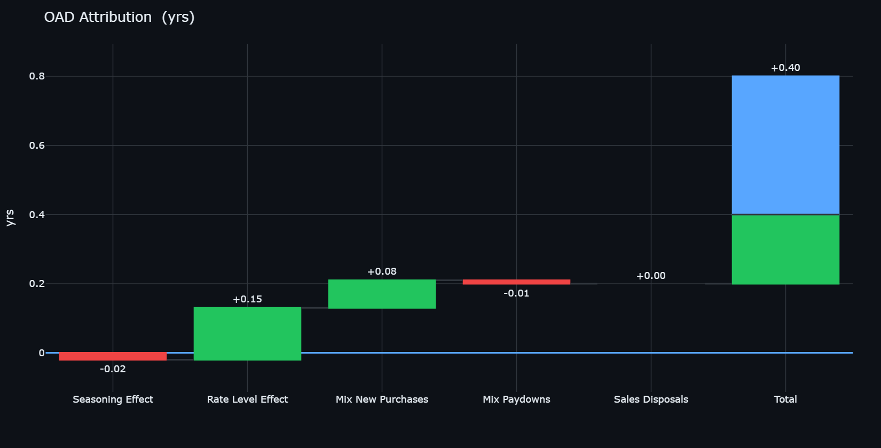
Attribution — OAD Attribution
Driver | Value
Seasoning Effect | -0.02 yrs
Rate Level Effect | +0.15 yrs
Mix New Purchases | +0.08 yrs
Mix Paydowns | -0.01 yrs
Sales Disposals | +0.00 yrs
Total | +0.20 yrs
Total | +0.40 yrs

Slide 17
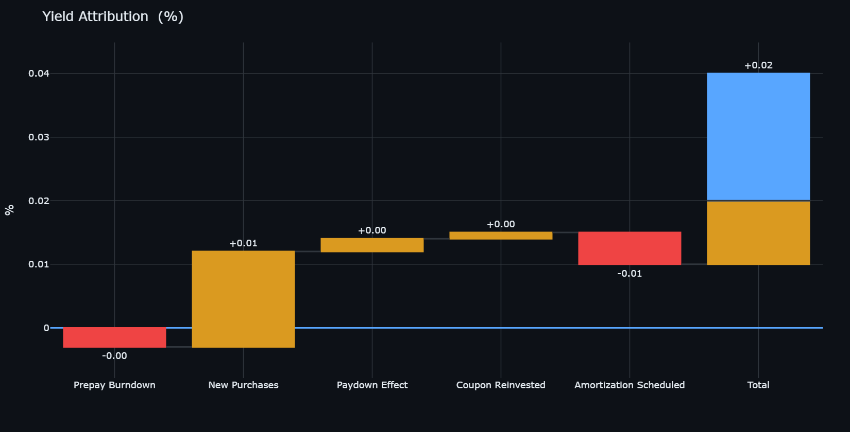
Attribution — Yield Attribution
Driver | Value
Prepay Burndown | -0.00 %
New Purchases | +0.01 %
Paydown Effect | +0.00 %
Coupon Reinvested | +0.00 %
Amortization Scheduled | -0.01 %
Total | +0.01 %
Total | +0.02 %

Slide 18
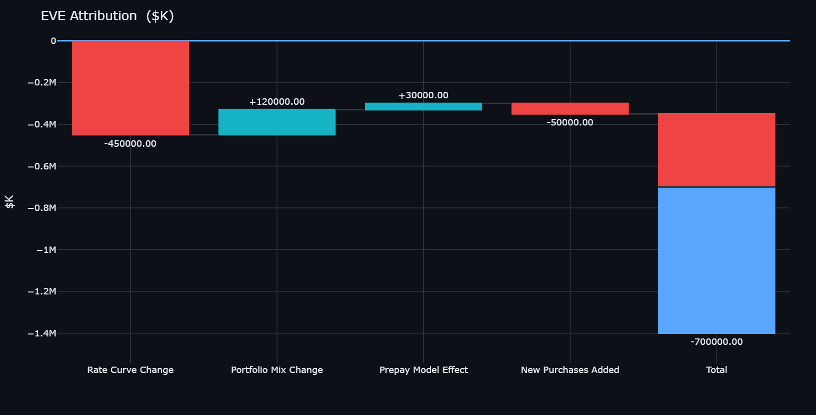
Attribution — EVE Attribution
Driver | Value
Rate Curve Change | -450000.00 $K
Portfolio Mix Change | +120000.00 $K
Prepay Model Effect | +30000.00 $K
New Purchases Added | -50000.00 $K
Total | -350000.00 $K
Total | -700000.00 $K

