Slide 1
Intro to Python (https://github.com/elliewix/Fall2017-StatsClub-IntroToPython)
Fall 2017 Stats Club Workshop
Elizabeth Wickes, wickes1
Lecturer, School of Information Sciences

Slide 2
What is the iSchool?
2 degrees:
MS Library and Information Science
MS Information Management
Classes on information organization, text/data mining, programming for data, information retrieval, data curation, etc.

Slide 3
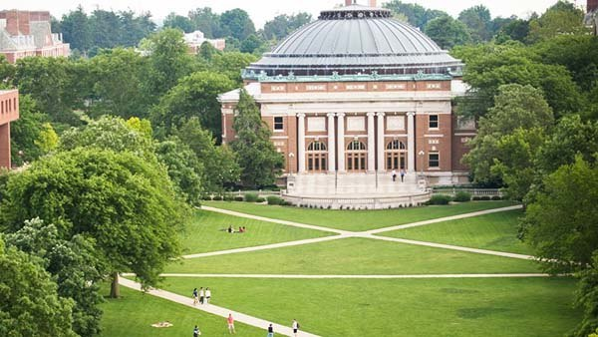
MS in Information Management
Prepares students for information-intensive professional roles in a broad range of sectors
Focuses on understanding the interplay of people, information, and technology and reflects a professional commitment to advancing the well-being of society through the use of information
40-hour degree program, on-campus or online
Four professional pathways:
Data Science & Analytics
Knowledge Management/Info Consulting
Digital Privacy, Security, & Ethics
Information Architecture & Design
Learn more at http://ischool.illinois.edu/academics/degrees/msim

Slide 4
Intro to Python (Stats Club)
What we’ll cover:
What is Python and a bit of the history
The python ecosystem and how to install things
Stepping through a data processing task

Slide 5
What is Python?
General purpose programming language
Has a package repository: PyPI
The word general here is important
R is math-first, Python is programming-first
This is fine, and you can do most of what you want in Python
But you’ll usually have to import some extra things
Which is fine, you’ll survive.

Slide 6
Scientific Python
Think of this like Python + analytics packages
This includes pandas, which is why you might be here
pip is the tool that you use to install these packages
(demo time)
Anaconda will also come with all these things

Slide 7
Installing things with pip
This is a terminal application and not something that you run inside Python
There is also the conda package handler, which is also fine. But pip is the more standard one.
Anaconda will also help you make specific environments if you need different versions, but that’s another day

Slide 8
Importing packages
You might be used to doing library(ggplot2) but python works in a very different way
You have to import packages using the import keyword
(demo)

