Slide 1
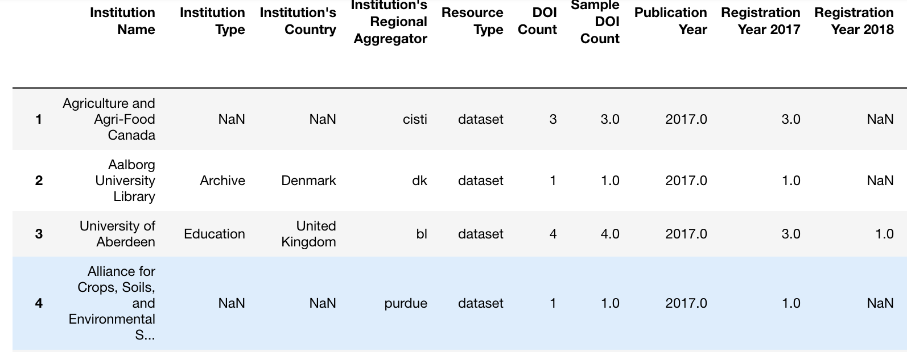
Institution DOI Dataset By Alex Wieker
Investigating how current reproducibility efforts may be measured (DOI production)
What institutions around the world produce more Datasets
Process:
Research Question
Investigation
Finding Data
Accessing Data
Processing & Converting Json
Aggregation
Cleaning
Joining the Data Files
Cleaning
Early Findings:
Institutions of type Education & Other produce more DOI’s
US & UK institutions lead in DOI production

