Slide 1
Intermediate Python for Automation and Data Processing
Elizabeth wickes
Rails, 2018-04-12 – 2018-04-13

Slide 2
(While we’re talking…)
This is the time to download all the things while we’re talking.

Slide 3
Intros
Who am I?
Who are you?
Name, library, and one sentence on why you’re here
We’ll be talking about your projects in more detail throughout!

Slide 4
Free writing
Take a blank sheet of paper or document on your laptop and free write for 5 minutes about what you’re hoping to learn, and projects you want to work on.
Don’t worry about structure or form, just write without stopping for 5 minutes.

Slide 5
How today will work
This isn’t just code – because no one can handle that
This is a mix of code and the skills needed to get code done for these kinds of projects. We’ll be going back and forth between live coding and hands on non-coding activities.
What is live coding?
Writing code live in front of you, walking you through it
No slides! I will have lecture notes I’m working from that are available to you during and after the workshop.

Slide 6
How will the coding be presented?
I aim to present the coding in a way that gives you hands on practice, but also conserves your energy over the course of this workshop.
I’ll be guiding you through it, we’ll be having discussions, questions, small challenges, as well.
I have way more coding content than we have time for, so I should be able to adapt to the levels in the room and give you a taste for some more advanced things.

Slide 7
Broader learning goals
A day and a half can’t make you an expert, but it can give you important exposure to:
Jog your memory for future projects
Allow you to assess the viability of a project and a specific tool
Promote confidence and clear up misconceptions about Python
Some of the things we’ll do are deeper dives into how to solve a problem, others will be interactive tours of how things are done with specific modules.

Slide 8
Installation

Slide 9
Directions
Roughly…
Download anaconda and install
Download pycharm and install
Link them
Throw up a sticky to let me know who has a problem.

Slide 10
What is Anaconda?
This brings you your Python
For windows because you might not have it at all
For macs, because you don’t want to be messing with your system Python

Slide 11
What is PyCharm?
This program let’s you interact with Python.
There are many in the world…

Slide 12
Who’s used what?

Slide 13
Python Syntax

Slide 14
Syntax review and reminders
https://github.com/elliewix/IS-452-Spring2018/blob/master/IS452-CheatSheet.md

Slide 15
What is automation?

Slide 16
Getting started with github

Slide 17
Lunch

Slide 18
Data Management Protips

Slide 19
Consistent File and Folder Naming
For quickly finding and sorting files and folders, the names should be consistent but unique. Avoid special characters.
project name/acronym
experiment/instrument type
site location information (if applicable)
researcher initials
date (consistently formatted, i.e. YYYYMMDD)
version number (w/ leading zeros)
General theme: Scale ruins all informality – Think ahead.

Slide 20
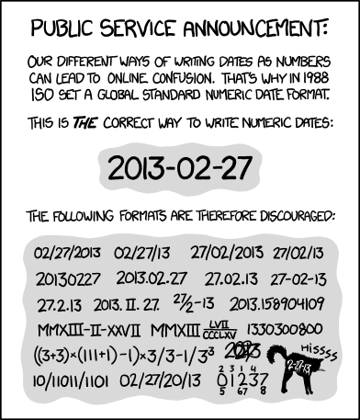
Date Tip
BAM Co-Exp Run 01 20140904.txt
BAM Co-Exp Run 02 20140904.txt
BAM Co-Exp Run 03 20140904.txt
vs.
Run 1 B anth meth Sept 4 .txt
BAM Rxn 2 2014_09_04.txt
20140904_meth_3.txt

Slide 21
Controlled Vocabulary
Take the guess work out of choosing between:
a preferred spelling
behavior vs behaviour
a scientific or popular term
pig vs porcine vs Sus scrofa domesticus
determining which synonym to use
record vs entry
determining which abbreviation to use (if you have to)
USA vs US
Notes:
click through to see the animation

Slide 22
Some examples
Putting this all together, we can look at an example project.

Slide 23
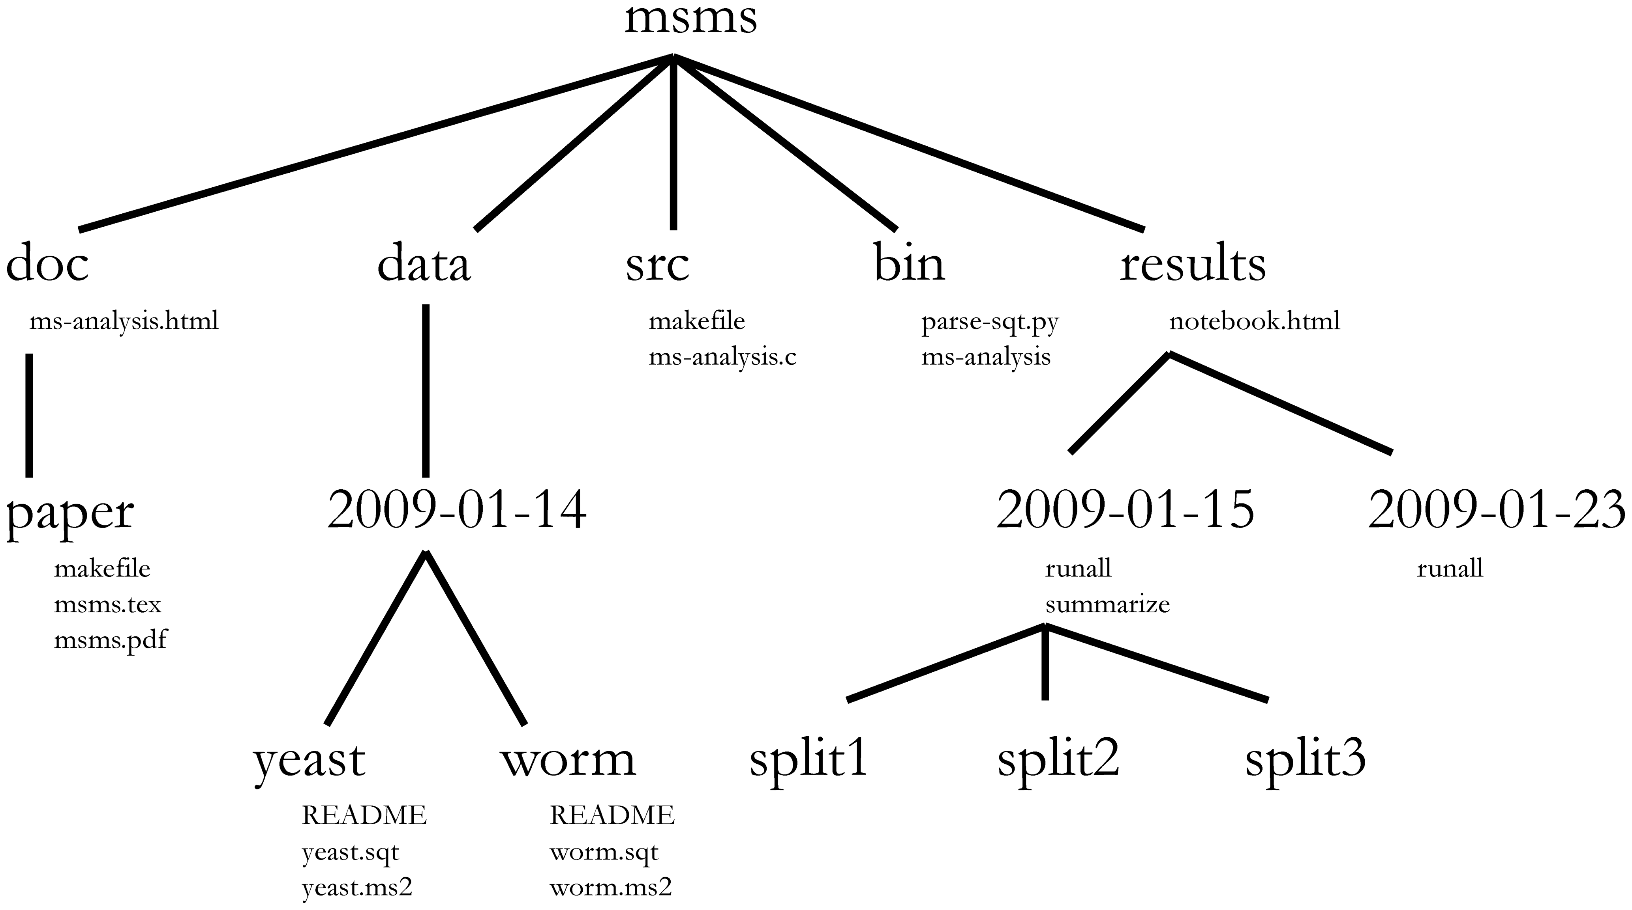
Noble (2009)’s Bioinformatics project structure
Noble WS (2009) A Quick Guide to Organizing Computational Biology Projects. PLoS Comput Biol 5(7): e1000424. doi:10.1371/journal.pcbi.1000424

Slide 24
An example data project
Make folders as large amounts of similar files are created, but not always required.
Jeopardy
HTMLPlayers/
Player-1.html Player-2.html Player-3.html etc…
playerDataFiles/
Player-1.csv Player-2.csv Player-3.csv
playerdata.csv jeopardy_scrape.ipynb jeopardy_dataprep.ipynb jeopardy_analysis.rmd jeopardy_analysis.html readme.txt
bystate.png byregion.png kenjennings.png etc…
visualizations/
Separate folders mean I don’t have to filter from a giant list of files.
Separate scripts by purpose to keep code from being cluttered.
Storing one distinct entity type per file. The semantic link between the contents of these files is encoded in the file extensions, which are the unique entity IDs. Document the meaning of these ID numbers.
Code to produce these graphs is stored & documented in the rmd file.

Slide 25
Basic Documentation
Types of Documentation:
Descriptive (e.g., creator, title, keywords)
Structural (e.g., relation to other files)
Administrative (e.g., software & hardware requirements, rights information)
If you know the data will be deposited in a repository, understand the documentation requirements early in the process

Slide 26
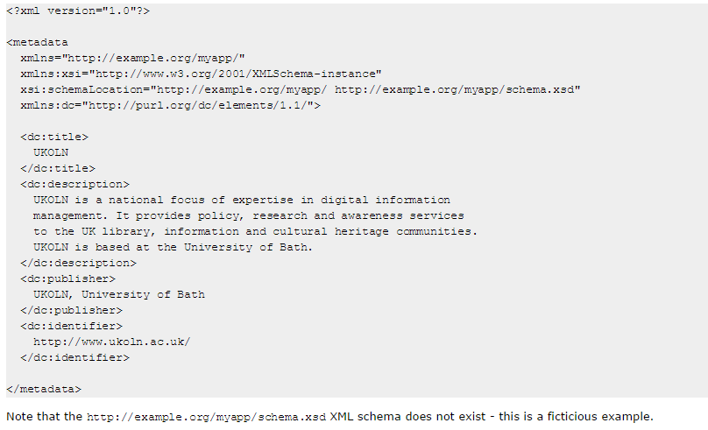
Data Documentation Continuum
Informal ReadMe
Formal Schema
Low-Barrier
Low-Quality
High-Quality
High-Barrier
Fast
Easy
Irregular
Incomplete
Standardized
Rich
Slow
Skilled

Slide 27
File naming activity!

Slide 28
Reading & Writing files

Slide 29
Break!

Slide 30
APIs and URL endpoints

Slide 31
Project discussion

Slide 32
Data workflow mapping

Slide 33
Day 2

Slide 34
More Project Discussion

Slide 35
Did you think of anything new?
Any new ideas sparked overnight?
Any questions or hopes of things that I’ll get into?

Slide 36
Common data formats: JSON, XML, CSV, Regex

Slide 37
Personal Learning Plans

Slide 38
Activity 1: Free writing
You’re going to free write for 7 minutes. Rules:
No stopping to edit or format
Don’t worry about language syntax or structure
You must keep writing until the timer goes off
Not sure what to write? Just keep going!
I’ll keep time. Don’t start until I say.

Slide 39
Activity 2: organize - identify
Take a few colors of markers or pencils.
Go back through what you wrote and mark up the subjects that you mentioned.
Color code as desired
How many do we all have?

Slide 40
Activity 2: organize - categories
Take our your stack of big sticky notes and transcribe your items onto them. One item per note.
Play with physically arranging them on the table into 2-3 categories. These can be any that you want.
Groups to consider:
Tools, methods, skills, projects, things you were directed to do, things you want to do, etc.
This is mostly for you to better understand your own needs, so doesn't need to be scientific.

Slide 41
Activity 2: organize - discuss
Discuss
Report out all the categories that you decided on.
Review and add any color codes to the sticky notes if that makes sense.
Write down the categories you select on your paper.
Move into smaller topical groups if that makes sense.

Slide 42
Activity 2: organize - rename/clean up
Now that you have groups:
Consider the names you have chosen.
Anything you want to…
Combine?
Rename?
Split apart?
On names…next slide, Elizabeth

Slide 43
Activity 2: organize - monoliths
They need to be actionable
No: “learn R” / “be better at stats”
Yes: “learn ggplot2 in R” / “learn R data types”
Operationalize them to what specific thing you need.
Tip: ask yourself “what would it look like to have completed this?” if that isn’t clear, you need more.
Think “[activity] in [tool]” or a specific skill
You may not be able to be more specific! That’s ok.
Those are your monoliths. Set those aside.

Slide 44
Activity 3: monoliths
Can you:
Rephrase to be more specific?
Break it up into several tasks?
Identify dependencies to prioritize first?
There are 2 kinds:
Monsters: Areas that you’ve collapsed many things into and are generally just large things to deal with
Vagueoliths: which are broad topics without a clear learning goal at the end. These are things you cannot currently break apart.

Slide 45
Activity 3: monoliths - monsters
Consider these topics and break them apart into 2-3 stages of learning. Just do your best here.
Anyone have some you don’t know enough to tell?
Discuss.
Put your monsters in your handout and make the new stickies for those subitems.

Slide 46
Activity 3: monoliths - Vagueoliths
These are the monoliths that you don’t know enough about the topic or the project to bust apart.
Options:
You can leave them there if you REALLY need to
What do you need to know before you can unpack it?
Take this time to email a buddy who might know, give yourself a todo list, or add an investigation task to you pile of stickies.

Slide 47
Activity 4: design the grid
Get out one big piece of paper each. Make some space for it at the table.
There is a grid in your handout, but that’s for the end.
We’re going to use this grid to organize your notes by:
Time on the vertical
Priority on the horizontal

Slide 48
Activity 4: design the grid - time
Step 1: Figure out your time spans
Right now these are:
Short
Medium
Long
You need to figure out how long those are.
Use either number ranges or named events.
Add these definitions to your handout.

Slide 49
Activity 4: design the grid - priorities
Step 2: Priorities
Right now these are s at:
Need: things you’ll get fired for not doing, basically
Want: things you strongly desire, but nothing will be destroyed if you don’t.
Watch: things that are interesting enough to keep on your radar, but nothing you want to act on right now.
Change these names if you need – just remember how they match up.
Add your choices to the handout

Slide 50
Activity 4: design the grid - a pause for time
Now assemble your board. Draw the appropriate number of cells (or a 3x3 if you didn’t change anything)
Lets stop and think about the time you have available.
How much time do you have per week or month during:
Work time?
Personal time?
Annual events (like conferences)
Which topics can you use work or research time for?
Fill out your worksheet.

Slide 51
Activity 4: design the grid - a pause for time
Consider the meaning of intersections between your time and priorities. Take a moment to ponder what this means to you.
Generally:
The soonest and highest priority items should be the most specific.
The furthest away and lowest priority items can be ambiguous.
This is a living document that you will need to revisit regularly. That cycle depends on your needs.

Slide 52
Activity 4: design the grid - Draw!
Draw your grid out on the big sheet.
Add the number of rows and columns.
Add the labels and clarifications you chose.

Slide 53
Activity 5: arrange the players -Wants
We’re going to do Wants next. Use the same steps.
Pull all of them out into a separate pile.
Arrange any in dependency order.
Do you have any specific deadlines? If so, write them in on the note.
Start placing them in according to time requirements.

Slide 54
Activity 5: arrange the players -Watches
We’re going to do Watches next. Use the same steps.
Pull all of them out into a separate pile.
Arrange any in dependency order.
Do you have any specific deadlines? If so, write them in on the note.
Start placing them in according to time requirements.

Slide 55
Activity 5: arrange the players -discuss
How did that go?
What was the easiest part?
What was the hardest part? Or the hardest choice?
Did you need to change anything?

Slide 56
Activity 5: arrange the players -review
Take a critical look and make any last few changes.
Take a picture of your grid.
Transcribe it onto your handout.

Slide 57
Free lab and question

