Slide 1

MediRep
AI-Powered Medical Report Analyzer & Longitudinal Health Tracker
A privacy-preserving biomedical NLP system
AI Project
Department of Computer Science & Engineering, IIIT Kottayam
Notes:
Introduce MediRep: an AI system that explains medical lab and radiology reports in plain language, tracks health trends over time, and keeps all patient data in memory only. Built as the AI Mini Project at IIIT Kottayam, 2025–26.

Slide 2



Why Reports Confuse Patients
Clinical jargon
AI hallucination
Privacy risk
Reports use physician-level terms, ranges and abbreviations with no plain-language help.
LLMs invent lab ranges and misread negation, such as treating “No pneumonia” as pneumonia.
Sending records to cloud APIs breaks health-privacy rules such as HIPAA.
70%+
of outpatients report acute stress reading results alone, while those who dismiss abnormal values may delay care.
Notes:
Three flaws in current practice: jargon-heavy reports, generative AI that hallucinates numbers and misreads negation, and privacy violations when records go to third-party clouds. Studies cited in the report suggest over 70% of outpatients feel acute stress reviewing results without a physician.

Slide 3






Project Objectives
1. Multi-format ingestion
2. Deterministic lab engine
PDF, scans and photos (up to 10 MB) read in memory with OCR
Range checks only against values printed in the report
3. Biomedical NER
4. Dataset grounding
8-class clinical taxonomy plus assertion classification
6,168 cleaned MTSamples and IU X-Ray reports
5. Longitudinal tracker
6. Zero-retention privacy
Multi-month biomarker curves with healthy baseline bands
No patient data written to disk, databases or third parties
Notes:
Six concrete objectives: ingestion and OCR, a deterministic lab analysis engine, biomedical NER with assertions, grounding in a real clinical dataset, a longitudinal trend tracker, and a strict zero-retention privacy model.

Slide 4
Gaps in Existing Systems
System | Lab range accuracy | Negation handling | Privacy
Commercial LLMs | No: hallucinates | Inconsistent | Cloud upload
BioBERT | No: entities only | Needs fine-tuning | Host-dependent
ScispaCy | No: entities only | Rule add-ons | Local
Hospital portals | Partial | None | Closed system
MediRep | Yes: strict intervals | Yes: 5 assertion states | Yes: 100% in-memory
Only MediRep closes all three gaps: range math, negation, and privacy.
Notes:
Literature: BioBERT (Lee 2020), ScispaCy (Neumann 2019), NegEx (Chapman 2001), the IU X-Ray collection (Demner-Fushman 2016) and the Kaggle annotation framework. Existing tools either lack numeric precision, ignore negation, or expose data. MediRep combines BioBERT-style token classification and NegEx-style assertions with deterministic range logic.

Slide 5
System Architecture
1
Frontend SPA
2
FastAPI server
3
Ingestion & OCR
React 19, TypeScript, Tailwind; drag-and-drop upload and SVG charts
Validates uploads, schedules background tasks, serves REST responses
PyMuPDF for digital PDFs, Tesseract for scanned reports
4
Range engine
5
NER engine
6
Trend tracker
Regex extraction and strict interval checks, no generative math
Tags 8 entity classes and maps them to plain explanations
Stores serial results and draws trajectory curves with deltas
Notes:
A decoupled full-stack design. React 19 with TypeScript and Tailwind v4 on the client; FastAPI with Uvicorn on Python 3.13 on the server. Behind the API: ingestion and OCR, the deterministic range engine, the NER engine, and the longitudinal tracker.

Slide 6
Seven-Stage Analysis Pipeline
1
Ingestion validates type and the 10 MB limit, then PyMuPDF text or OCR
2
Lab engine regex pulls values and flags High, Low or Normal vs printed ranges
3
NER tags 8 entity classes with offsets and confidence scores
4
Glossary plain-language definitions at a 6th–8th grade reading level
5
Safety red-flag terms raise an urgent alert and pause routine tips
6
Guidance diet, exercise and precaution tips plus doctor-visit questions
7
Longitudinal numeric results update the patient’s time-series curves
Notes:
Each report passes seven asynchronous stages. Stage 2 is the key safety choice: numbers are compared to the reference interval printed in the report, so there is no generative guessing. Stage 5 suppresses routine lifestyle advice and shows an urgent banner when emergency terms such as pulmonary embolism appear.

Slide 7
Dataset: 6,168 Real Reports
6,168
Cleaned, deduplicated reports in the combined corpus
2,336
MTSamples transcripts spanning 40 specialties
3,835
Indiana University chest X-ray reports (NLM/NIH)
Notes:
The combined corpus holds 6,168 cleaned reports (IDs MED_00001 to MED_06168): 2,336 MTSamples transcriptions and 3,835 IU chest X-ray reports. Preprocessing removed duplicates and markup and dropped texts under 100 characters. Split 90/5/5: 5,551 train, 308 validation, 309 test.

Slide 8
Clinical Entity Taxonomy
DISEASE
SYMPTOM
Assertion states
Anemia, Pneumonia
Fever, knee pain
PRESENT
MEDICATION
ANATOMY
ABSENT
Ibuprofen, Metformin
Left knee, Lungs
UNCERTAIN
TEST
PROCEDURE
HISTORICAL
Chest X-Ray, MRI
Arthroscopy, Biopsy
NOT_SPECIFIED
PATHOGEN
RADIOLOGICAL_FINDING
“No pneumothorax” is tagged ABSENT
Streptococcus, Influenza
Pleural effusion
Notes:
Eight entity classes follow the Kaggle annotation schema. Each entity also gets an assertion state, based on NegEx ideas, so a negated finding such as “No pneumothorax” in test case TC-03 is correctly marked ABSENT instead of being reported as a disease.

Slide 9
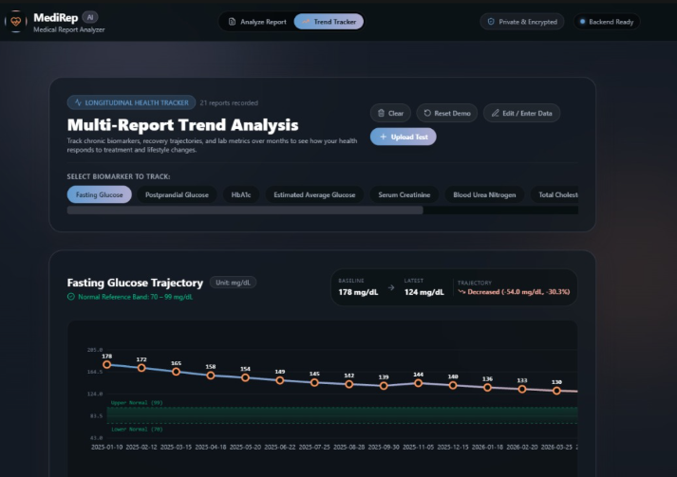
RESULTS AND OUTPUT

Slide 10



Future Scope & Conclusion
Voice in regional languages
Conclusion
Read summaries aloud in Malayalam, Hindi, Tamil, Telugu and Kannada
Deterministic range checks remove numeric hallucination
8-class NER with negation-aware assertions
Grounded in 6,168 clinical reports, zero data retention
Clear, actionable insight for better doctor visits
Chat with your report
On-device RAG assistant bound strictly to the uploaded document
Drug interaction checks
Warn about hazardous drug-drug and food-drug combinations
Notes:
Future work: multilingual voice output, constrained on-device conversational Q&A, and a drug interaction engine. Conclusion: MediRep democratizes report understanding without compromising privacy or precision by combining deterministic interval checks, 8-class NER with assertions, and longitudinal tracking. Limitations: English-only v1, relies on printed reference ranges, and does not replace clinical consultation. Invite questions.

