Slide 1

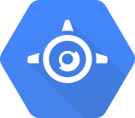
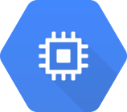

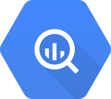


Google App Engine (GAE) Python Course Unit 01: Hello, Google App Engine - Python
Wei-Tsung Su (蘇維宗)
ellington.su@gmail.com
4/5/2015 (Ver. 1.2)

Slide 2
Change Log
Date | Ver. | Authors | Description
6/30/2014 | 1.0 | Wei-Tsung Su | Google App Engine (GAE); GAE for Python; Using Static Files; Google User Service
3/23/2015 | 1.1 | Wei-Tsung Su | Move deployment to the early slides; Add container engine
4/5/2015 | 1.2 | Wei-Tsung Su | Divide the original material into three different units. This is unit 01. This is baseline.

Slide 3
What?
Google Cloud Platform (GCP)
App Engine provides Platform as a Service (PaaS)
Compute Engine provides Infrastrcture as a Servce (IaaS)
Container Engine allows Docker containers running on GCP
Other services
CloudSQL, Cloud Storage, and Cloud Datastore provide storage options
BigQuery and Hadoop provide big data processing capability
Language supported by GAE
Python, Java, PHP, and GO
Different languages may provide different features.

Slide 4
Why?
Easily deploy your web services to public
Seamlessly integrate with other Google services
Free quotas (https://developers.google.com/appengine/docs/quotas)
Code & Static Data Store (1GB free)
Google Cloud Storage (5GB free)
Blobstore Stored Data (5GB free)
API access (which depends on different Google API)
...

Slide 5
How?
Read Support Documentation
https://developers.google.com/appengine/
Try Administration Console
https://appengine.google.com/
https://console.developers.google.com
Download SDK
https://developers.google.com/appengine/downloads
Start Your Engine
3, 2, 1

Slide 6
Setup Development Environment
Install Python 2.7.x
https://www.python.org/download/releases/2.7.8/
Install App Engine SDK for Python
https://developers.google.com/appengine/downloads
Ex. we assume that google_appengine/ is the SDK directory.
Install Git (optional)
http://git-scm.com/downloads

Slide 7
How GAE for Python Works?
A Python web app interacts with the App Engine web server using Web Server Gateway Interface (WSGI) protocol.
WSGI-compatible web application frameworks, such as
webapp2 (by default, simple)
Django
CherryPy
Pylons
web.py
web2py
Notes:
TODO: What’s different of selecting different frameworks?

Slide 8
Project Structure
Configuration
Purpose
Project configuration
Routing requests to modules
Reference
https://developers.google.com/appengine/docs/python/config/appconfig
Filename
app.yaml (pronounce in Chinese: 壓謀!)
Modules
Purpose
Dynamic web page generation
Reference (if using webapp2)
http://webapp-improved.appspot.com/
Filename
xxx.py (ex. helloword.py)

Slide 9
GAE for Python
EX01 – Hello World

Slide 10
EX01_HelloWorld
Description
In this exercise, you will learn the basic programming model of Google App Engine – Python.
Function
Display “Hello, Google App Engine – Python”
Project structure
Configuration
EX01_HelloWorld/app.yaml
Modules
EX01_HelloWorld/helloworld.py

Slide 11
Configuration: app.yaml
1 application: your-app-id 2 version: 1 3 runtime: python27 4 api_version: 1
5 threadsafe: true 6 7 handlers: 8 - url: /.* 9 script: helloworld.app
Description
Line 1: application id is required to deploy apps to Google Cloud Platform
Line 2: application version (Google will keep one copy for each version)
Line 3-4: declare runtime is python2.7 with SDK version 1
Line 5: App Engines sends requests concurrently if true
Line 7-8: mapping URL /.* to helloworld.py

Slide 12
Module: helloworld.py
1 import webapp2 2 3 class MainPage(webapp2.RequestHandler): 4 def get(self): 5 self.response.headers['Content-Type'] = 'text/html' 6 self.response.write('Hello, Google App Engine') 7
8 9 app = webapp2.WSGIApplication([ 10 ('/', MainPage), 11 ], debug=True)
Descriptions
Line 10: mapping / to MainPage
For security issue, you should disable debug which will display a stack trace in the browser when a handler raises an exception.

Slide 13
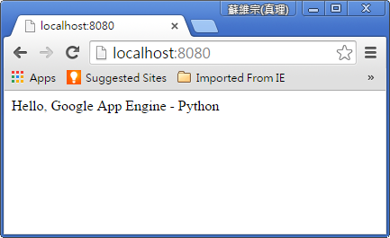
Test Web App in Localhost
Run your project in local machine by
#google_appengine/dev_appserver.py EX01_HelloWorld
Preview your web app by visiting
http://localhost:8080
Admin your web app by visiting
http://localhost:8000

Slide 14
Deploy Web App to GCP
Step 1: Create Project in Developer Console
https://console.developers.google.com
You will get a random project id (Ex. your-app-id).
The public URL of your web app will be
http://your-app-id.appspot.com
Step 2: Check if the application ID in app.yaml matches your-app-id
application: your-app-id
Step 3: Deploy your local project
# google_appengine/appcfg.py update EX01_HelloWorld
Test your web app by visiting the URL: http://your-app-id.appspot.com

Slide 15
Q&A
You can clone all sample codes from
https://github.com/ellingtonsu/GAE_Python_Course

