Slide 1







Google App Engine (GAE) Python Course Unit 02: Using Static Files
Wei-Tsung Su (蘇維宗)
ellington.su@gmail.com
03/27/2015 (Ver. 1.2)

Slide 2
Change Log
Date | Ver. | Authors | Description
6/30/2014 | 1.0 | Wei-Tsung Su | Google App Engine (GAE); GAE for Python; Using Static Files; Google User Service
3/23/2015 | 1.1 | Wei-Tsung Su | Move deployment to the early slides; Add container engine
3/27/2015 | 1.2 | Wei-Tsung Su | Divide the original material into three different units. This is unit 02. This is baseline.

Slide 3
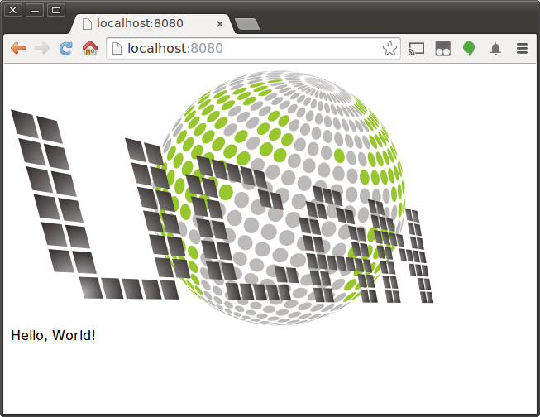
Using Static Files
Sometimes, you may put static files, such images, CSS stylesheets, JavaScript code, and so on, into your web applications.
For example, you may want to show images in your app as
<img src="/images/logo.png"></img>
Unfortunately, you cannot just create a directory and put the static files into the project.

Slide 4
GAE for Python
EX02 – Static Files

Slide 5
EX02_StaticFile
Description
In this exercise, you will learn how to use static files in your web apps.
Function
Using static files (Ex. an image) in your web app
Project structure
Configuration
EX02_StaticFile/app.yaml
Modules
EX02_StaticFile/helloapple.py
Static files
EX02_StaticFile/images/apple.jpg

Slide 6
Configuration: app.yaml
1 application: your-app-id
2 version: 1
3 runtime: python27
4 api_version: 1
5 threadsafe: true
6
7 handlers:
8 - url: /images
9 static_dir: images
10
11 - url: /.*
12 script: helloapple.app
Description
Line 7-8: mapping URL /images to static directory images

Slide 7
Module: helloapple.py
1 import webapp2
2
3 class MainPage(webapp2.RequestHandler):
4 def get(self):
5 self.response.headers['Content-Type'] = 'text/html'
6 self.response.write('Hello, Apple<br>')
7 self.response.write('<img src="/images/apple.jpg">')
8
9 app = webapp2.WSGIApplication([
10 ('/', MainPage),
11 ], debug=True)
Descriptions
Line 7: after routing in app.yaml, you could access the static files in directory images by accessing URL /images

Slide 8
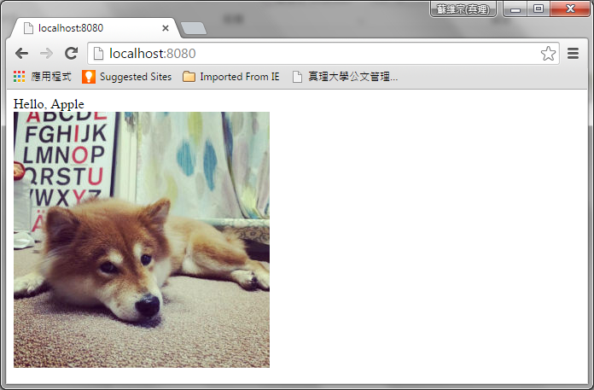
Test Web App in Localhost

Slide 9
Q&A
You can clone all sample codes from
https://github.com/ellingtonsu/GAE_Python_Course

