Slide 1
Field Archer Finder (FAF)
Enterprise Web Development 2017
Assignment 1: Create a SPA using ReactJS
https://github.com/ellingworthl/EDW_Assign1_SPA
Assignment 2: Integrate web API with SPA using Node, Express & Mongoose
Github URL 2

Slide 2
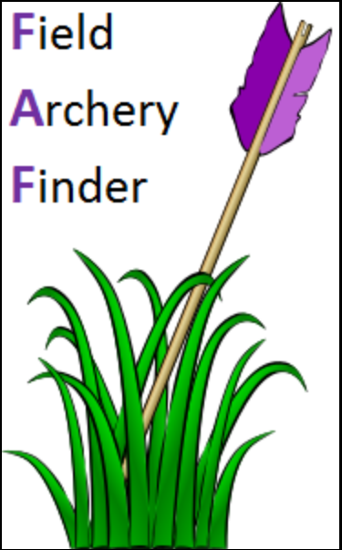
Field Archery Finder (FAF) - Concept
My hobby is field archery. As a newbie I found it difficult to locate shoot venues, particularly those sent in forestry. I couldn't 'just' look-up details about the venue as information wasn’t always persistent online.
Sorted! FAF has a ‘Venues’ page.
There’s a cooperative approach to archery in Ireland, so knowing what’s on, where and who’s hosting it is vital.
Sorted! FAF has an ‘Events’ page.
As a small community we often lament that it would be nice to be able to post 'shoot reviews' and share them with the host club, archers in the same target group and the wider community... if only we had such a facility?
Sorted! FAF has a ‘Reviews’ page.
FAF’s objective is to holistically help existing and new archers find field archery venues (clubs) in their area, look-up, and manage, events being held and be able to submit reviews about a club/an event they attend. Basically, share experiences and grow field archery in Ireland.
Having these facilities on one site makes life terribly handy and will have a broad appeal to anyone interested in the sport.

Slide 3
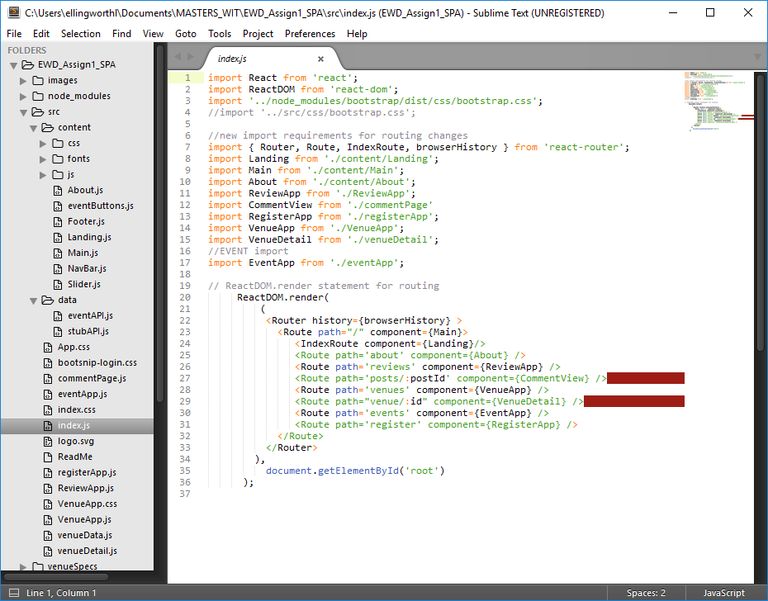
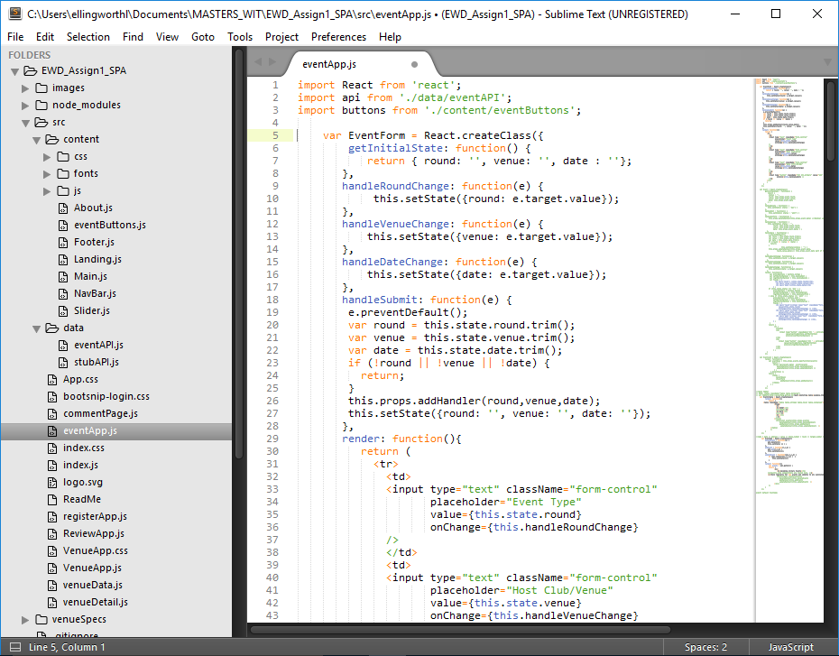
Assignment 1 - ReactJS
FAF is a full React App. Its components are:
\src
commentPage (has state)
eventApp (has state)
Index
registerApp
ReviewApp (has state)
VenueApp (has state)
venueData (has state)
venueDetail
\src\content
About
Footer
Landing
Main
NavBar (has state)
Slider

Slide 4
Assignment 1 - Routing & functionality
The App has 6 main and two child routes:
/root for app (IndexRoute = Landing.js)
/about
NB: email create feature included
/venues
Search (by venue name)
Sort (by name or county)
/venues/:clubID
/events
Add, Edit or Delete events
/reviews
Add new post (Title & Link)
Upvote existing reviews (posts)
/reviews/:postID
Add new comment (Post & Name)
Upvote comment(s) submitted
/register
NB: Login component & CSS completed

Slide 5
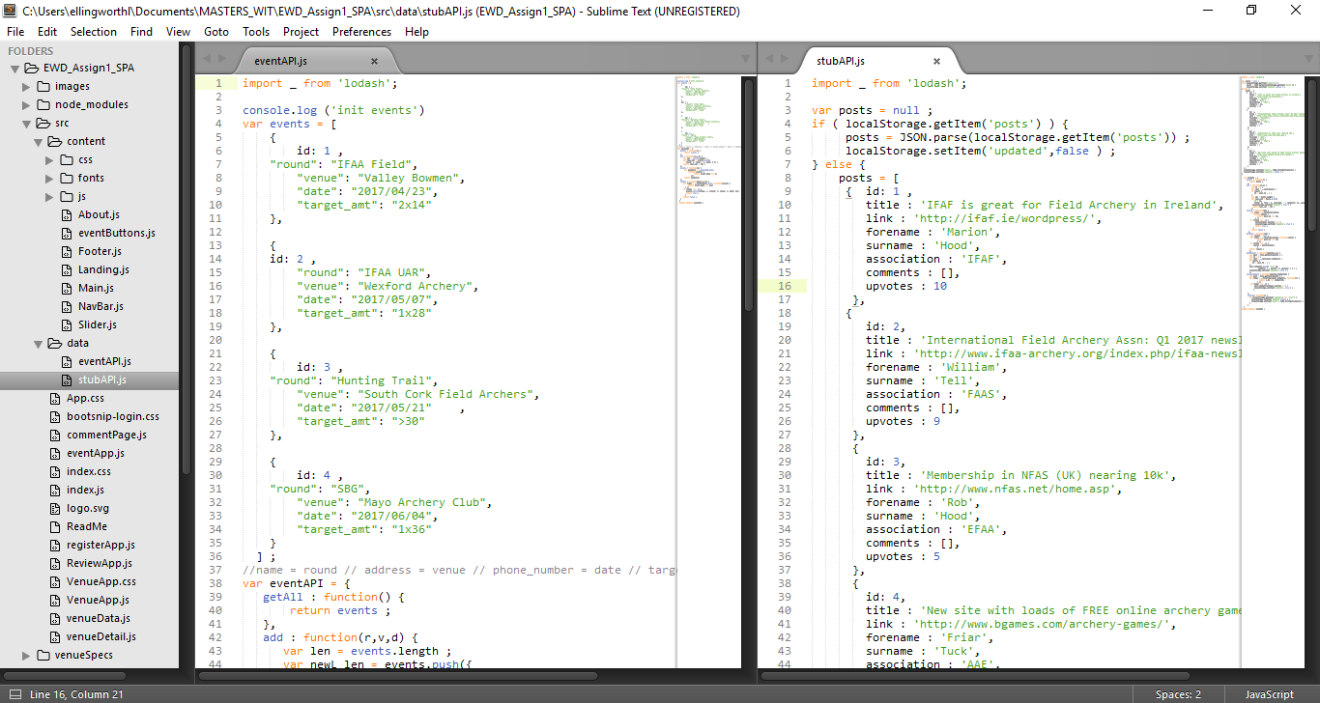
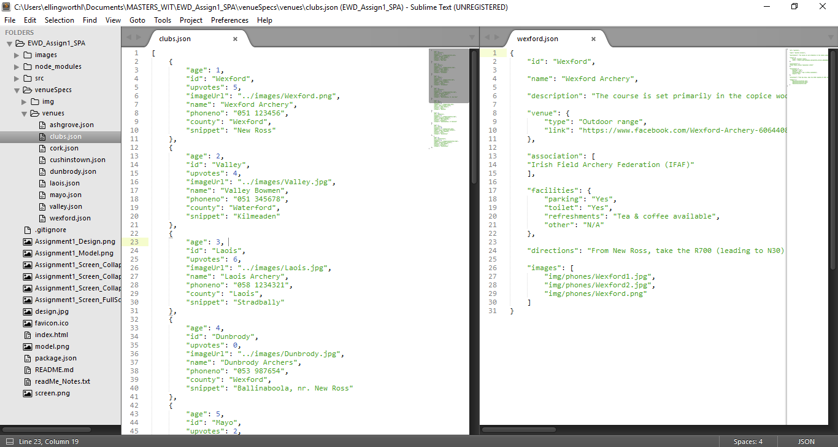
Assignment 1 - content
APIs used on the Events & Review Apps:
Events (eventAPI)
List all
Create new
Edit existing
Delete existing
Reviews (stubAPI)
List all reviews
Create new review
Upvote existing review
Comment on review
Upvote a comment
Both APIs write to local storage.
JSON files
clubs.json delivers data to VenueApp
Individual ‘venue’ json files provide detailed data to venueDetail

Slide 6
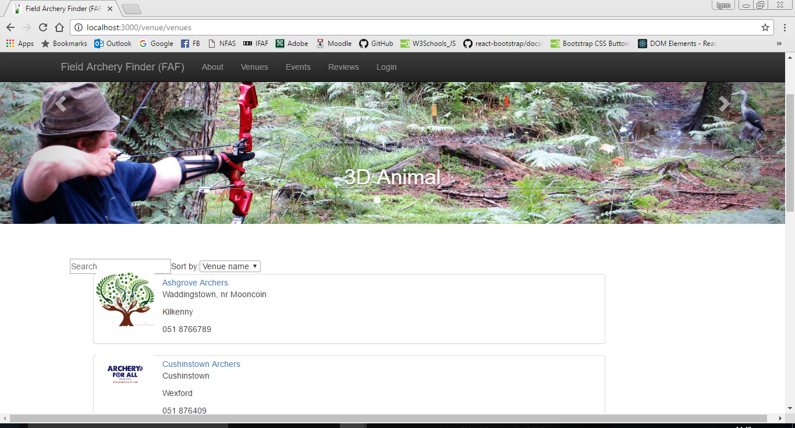
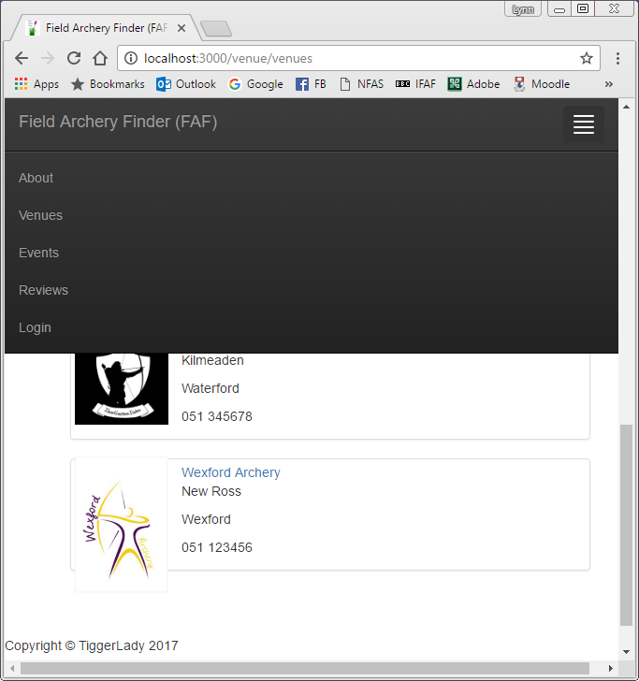
Assignment 1 - App design features
NavBar
Full-screen has navigation menu across the top of the page
Collapsed menu supports navigation across all devices, regardless of screen size
Slider
Code modified to ReactJS
Bootstrap CSS modified for FAF
Scrolling images illustrate the four elements of field archery
Footer
ReactJS component for footer
All ReactJS design elements persist throughout the App

Slide 7
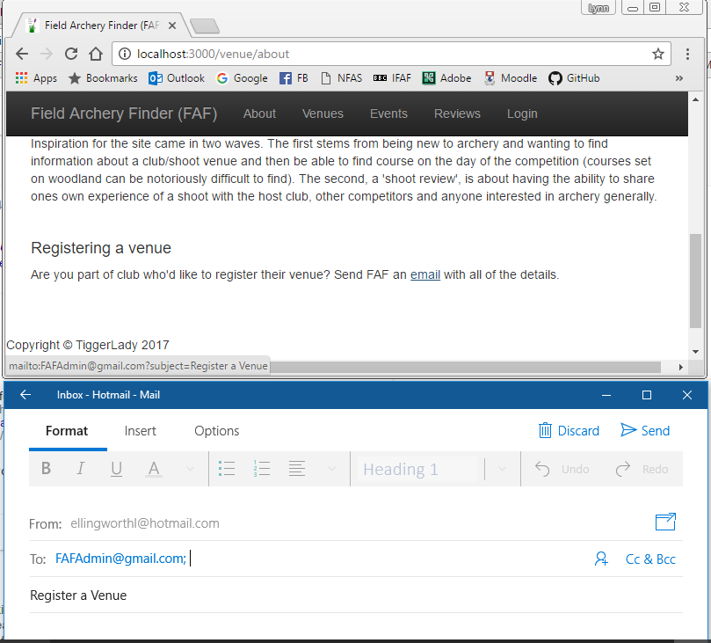
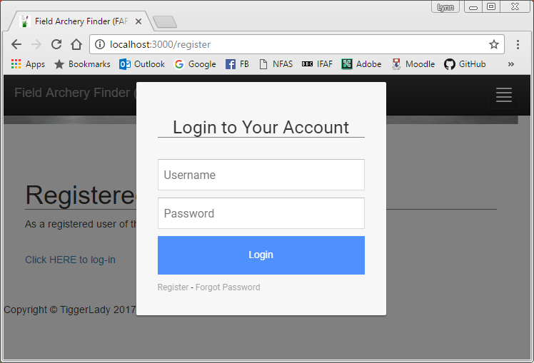

Assignment 1 - App design features cont.
About
Static page content, further information about FAF
Embedded ‘mailto’ feature to trigger email to FAF’s administrator
Register
Static, placeholder page for User authentication (to be built)
HTLM code converted to JS to work in the component
Bootsnipp login CSS applied
Favicon
A new Favicon designed for FAF
Booststap ‘half-slider’ CSS applied throughout the App.

Slide 8
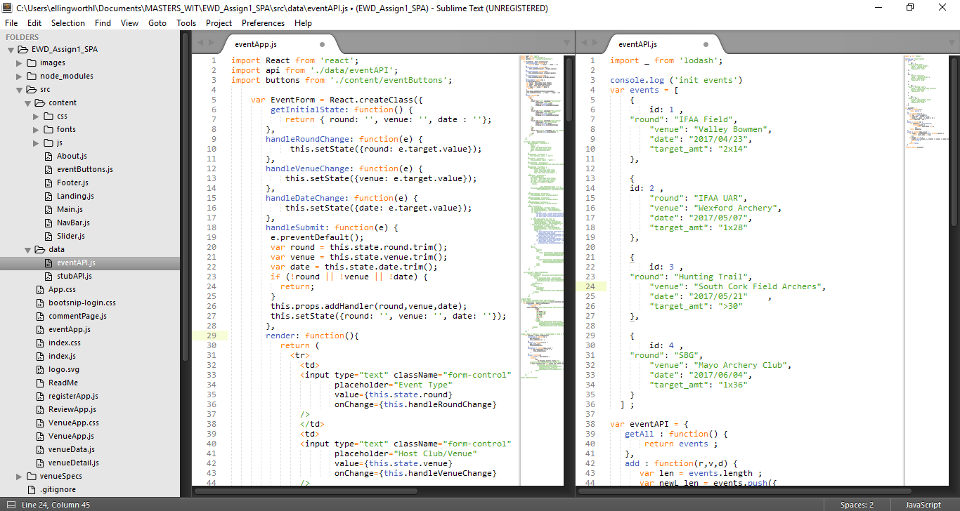
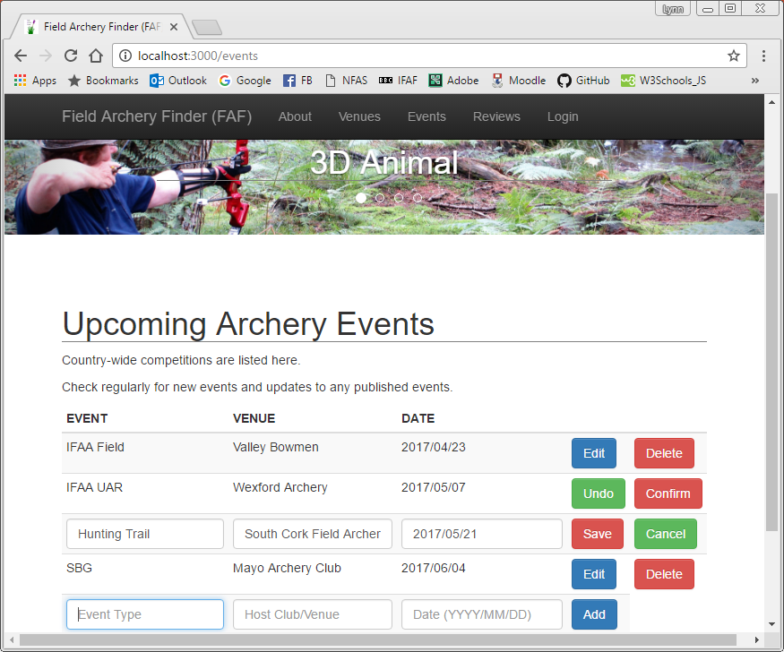
Assignment 1 - Expansion of Lab code #1
EVENTS (based on Contacts)
Functionality: CREATE, UPDATE & DELETE
eventApp
EventForm source code modified
Event source code modified
EventList source code modified
EventsTable source code modified (inc. different table styling)
eventAPI
events source code modified
eventsAPI source code modified

Slide 9
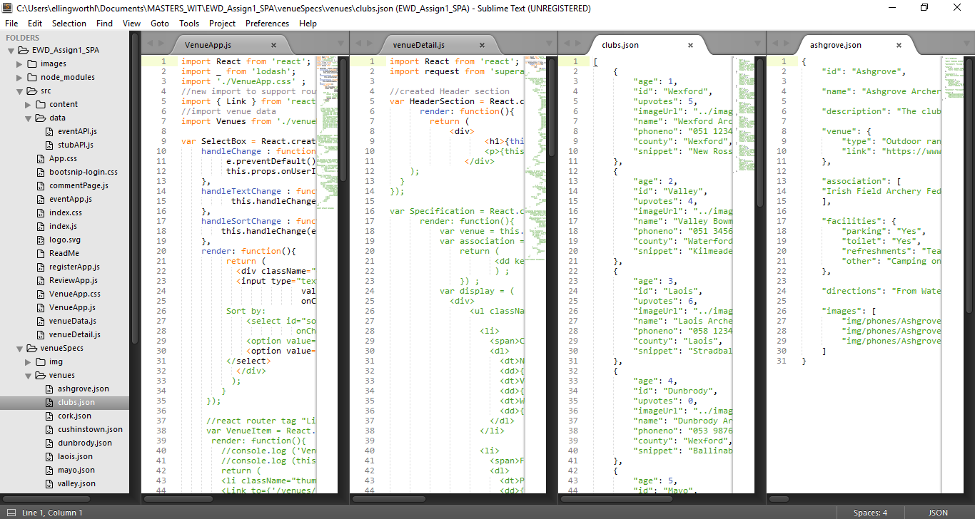
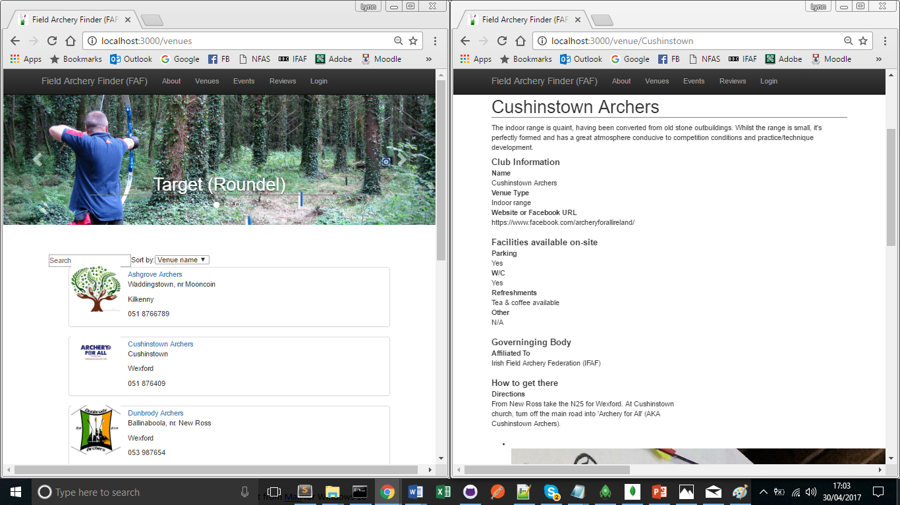
Assignment 1 - Expansion of Lab code #2
VENUES (based on Phone Catalogue)
Functionality: SEARCH (by name (text field)) & SORT (by Name or County (dropdown menu))
VenueApp
Update CCS to support formatting
Event source code modified
Add ‘Link’ import to support routing source code modified
Modify SelectBox to support name & county searches (dropdown) & name (text)
Modify VenueItem to include extra details (town & county) in addition to name and phone number
venueDetail
create HeaderSection
re-order Specification section
modify ImagesSection
re-order VenueDetail & add HeaderSection
clubs.json
expanded data-set for venueApp listing
Venues ( individual .json files)
complete reformat/use new data

Slide 10
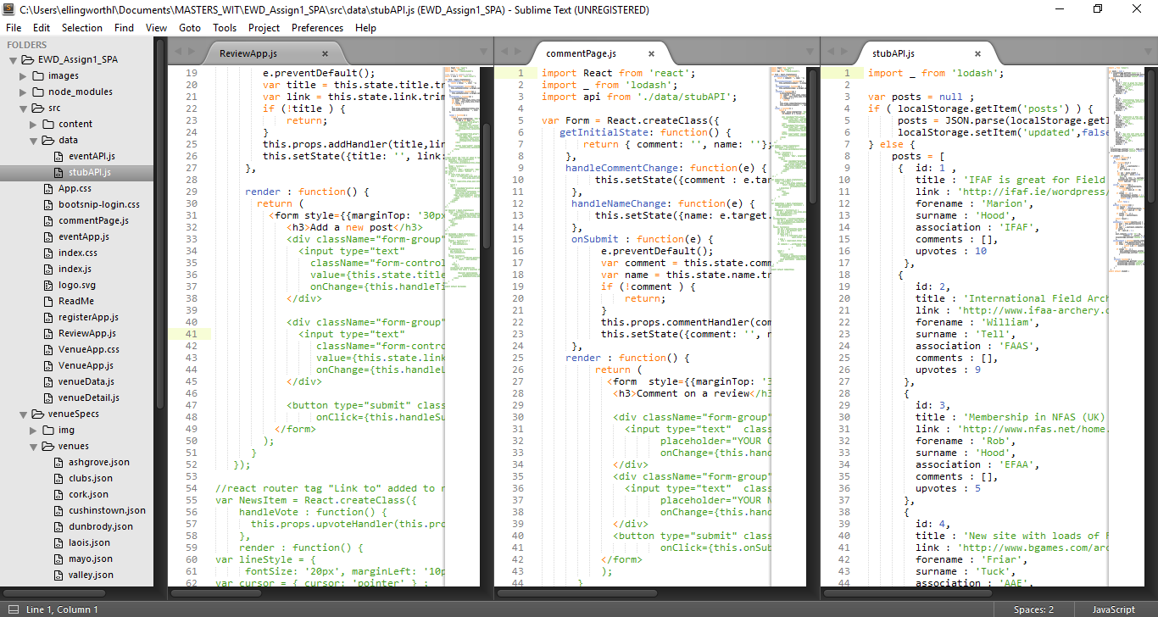
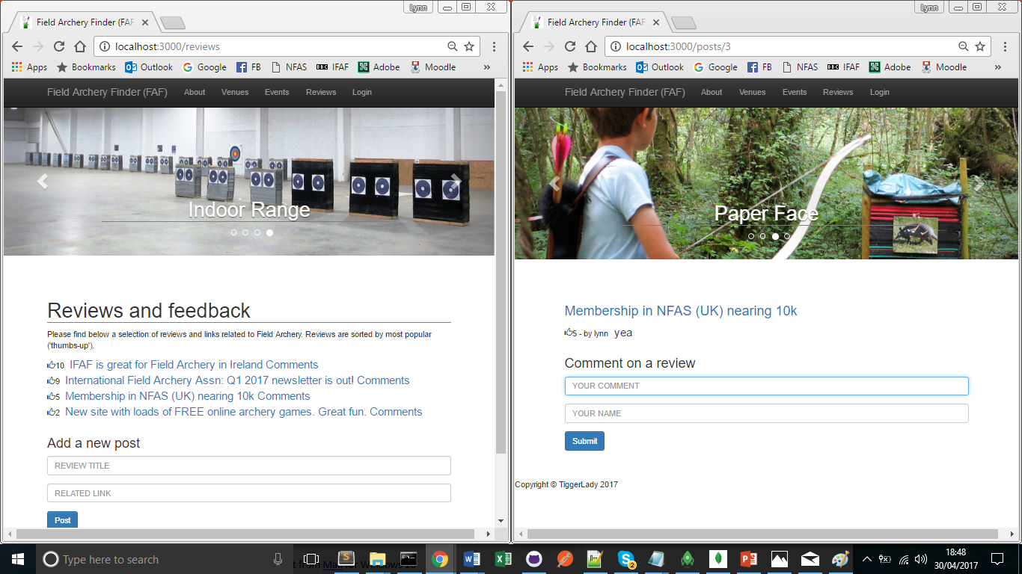
Assignment 1 - Expansion of Lab code #3
REVIEWS (based on Hacker News)
Functionality: CREATE & UPVOTE (create new review & upvote existing reviews and comment on reviews & upvote comments)
ReviewApp
Add ‘Link’ import to support routing source code modified
Form source code modified
ReviewApp source code modified inc. addition of Header & Paragraph to match other page formatting
commentPage
Form, source code modified
commentList limited changes to code
commentView limited changes to code
stubAPI
minimal changes

Slide 11
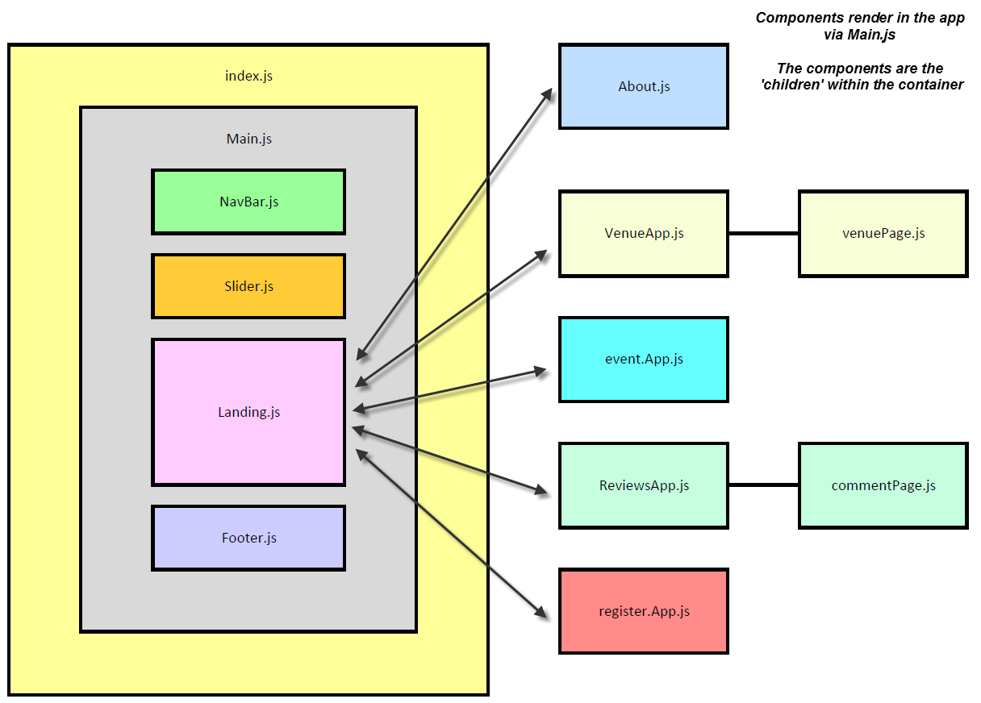
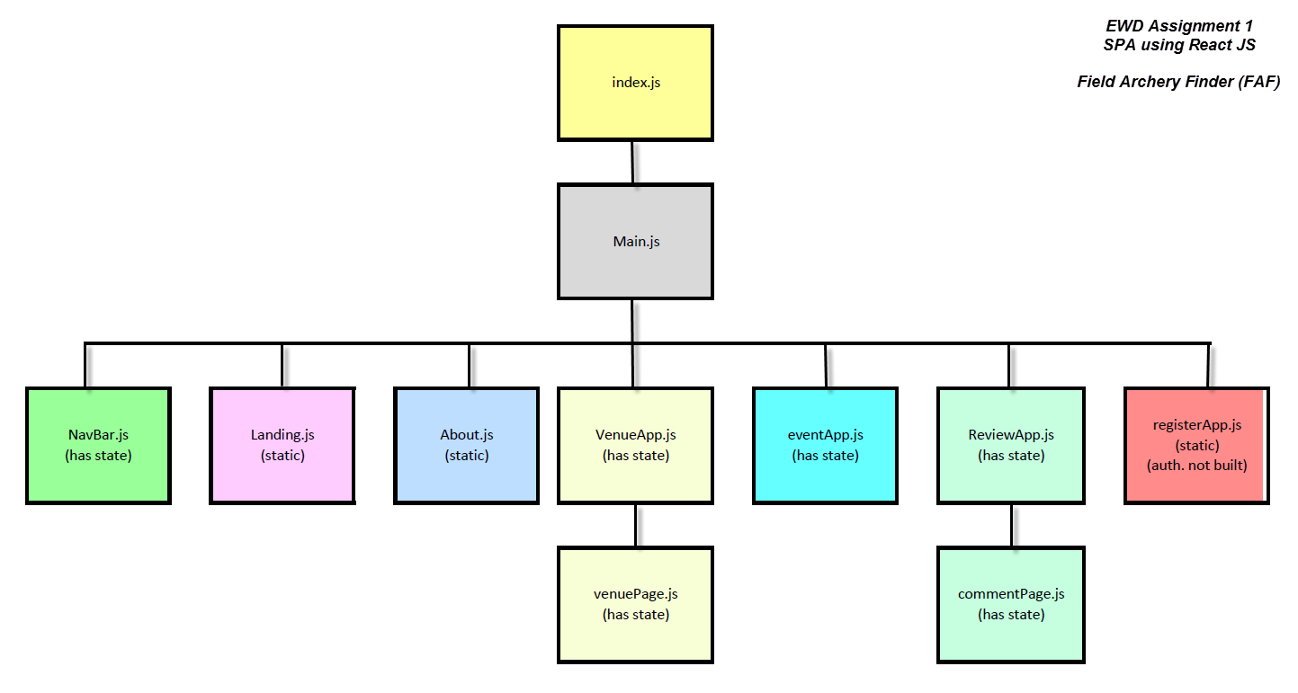
Assignment 1 - Design Model Illustrations

Slide 12
Assignment 1 - Independent Learning
Areas researched and applied in this assignment:
https://github.com/facebookincubator/create-react-app/blob/master/README.md#getting-started (a brilliant react tutorial)
https://www.kirupa.com/react/creating_single_page_app_react_using_react_router.htm (great, simple breakdown of principles of a SPA)
https://www.youtube.com/watch?v=MhkGQAoc7bc&list=PLoYCgNOIyGABj2GQSlDRjgvXtqfDxKm5b
https://github.com/learncodeacademy/react-js-tutorials
https://css-tricks.com/css-modules-part-3-react/
http://stackoverflow.com/questions/41515468/custom-stylesheet-in-react-app (install css loader: npm install --save css-loader )
http://pastebin.com/sLvADsEN (css loaders, do npm install --webpack )
http://magic.reactjs.net/htmltojsx.htm
http://www.tutorialrepublic.com/twitter-bootstrap-tutorial/bootstrap-navbar.php
http://jsonlint.com/
https://startbootstrap.com/template-overviews/half-slider/
http://bootsnipp.com/snippets/featured/clean-modal-login-form
https://github.com/tylermcginnis/react-router-firebase-auth
Areas researched and applied in this assignment (cont):
Installed, but not used: https://www.npmjs.com/package/generator-react-webpack-scaffold
Registered for but not used (intended for Club Detail): https://developers.google.com/maps/documentation/android-api/signup
Additional learning for EWD has been through the following:
Head First: JavaScript
Head First: HTML and CSS
https://www.w3schools.com
https://www.youtube.com/playlist?annotation_id=annotation_270691829&feature=iv&list=PLoYCgNOIyGACDQLaThEEKBAlgs4OIUGif&src_vid=MhkGQAoc7bc
https://www.youtube.com/watch?annotation_id=annotation_3748334139&feature=iv&src_vid=9kJVYpOqcVU&v=pU9Q6oiQNd0
https://www.youtube.com/watch?v=Ybn6Q92m4xg
https://www.lifewire.com/list-of-command-prompt-commands-4092302

