Slide 1
Wave Particles
Tom Read Cutting – tr395@cam.ac.uk

Slide 2

The Basics
Wave Particles [1] are a method to give a convincing (not accurate!) simulation of how water waves form and propagate.
Can’t handle topology-changing water-interactions (splashes, foam, breaking waves etc.)
Represents a solution to the second order wave equation: $\frac{∂^{2}z}{∂x^{2}}+\frac{∂^{2}z}{∂y^{2}}=\frac{1}{v^{2}}\frac{∂^{2}z}{∂t^{2}}$
Objects in water generate particles that represent water disturbances.
The particles have a constant radius and speed, each with an amplitude, dispersion angle and (normalized) velocity.
Can generate complete distortion field by drawing particles to texture as single pixels and convolving with a kernel representing the per-particle distortion function.
Goal is to implement technique in a commercial game-engine (Unity) with extensions!

Slide 3
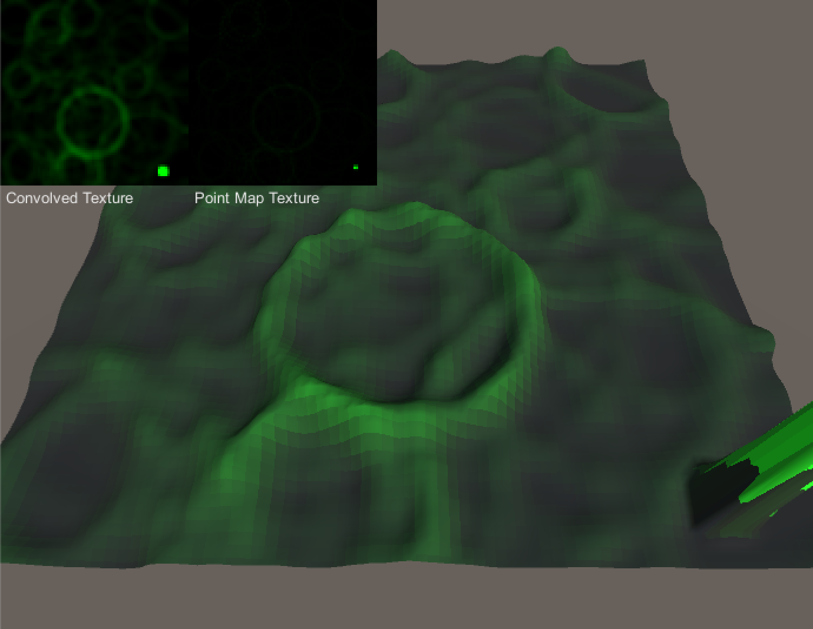
Current Status
Have basic Wave Particles system running on the GPU and CPU
Can select and change implementation details of components at runtime
Implemented everything on CPU
On GPU using:
Compute shader to perform basic Wave Particle iteration
Pixel shader to convolve point map texture
Vertex shader to then apply height-map distortions
100, 000 wave particles at ~70FPS on laptop

Slide 4
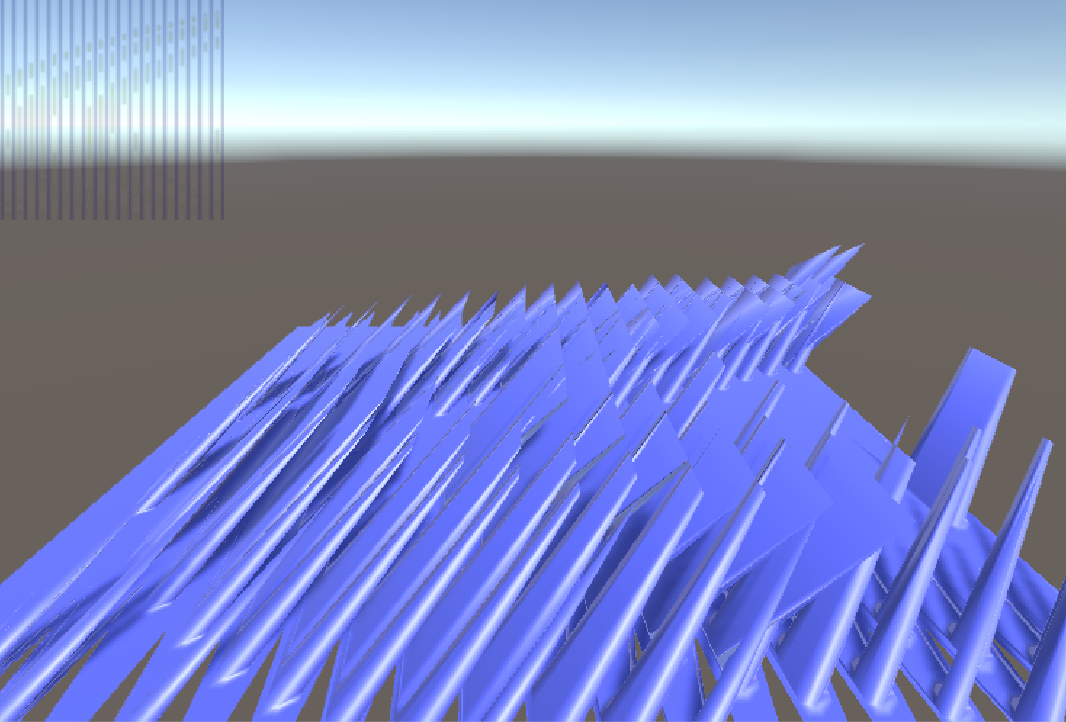
Issues Encountered
GPU different from CPU!
CPU-side code must take GPU limitations into account
Things WILL silently fail (see image)
Object serialization in Unity
Configurable parameters must be in serialized objects
Unity fails to mention this!

Slide 5
Going Forward
Code cleanup
Implement buoyancy
Measure and compare code performance
Optimise code!
Extension ideas
Multiple planes of wave particles, (to overcome limitation of constant radius and speed)
Using above for LOD based on camera position
Combining with some kind of 3D fluid-sim
Handling rain

Slide 6
Special Thanks
Dr. Ian Wassell and Prof. Lawrence Paulson
Dr. Rafal Mantiuk
Huw Bowles from Studio Gobo

Slide 7
References
[1] Cem Yuksel, Donald H. House, and John Keyser. Wave particles. ACM Transactions on Graphics (Proceedings of SIGGRAPH 2007), 26(3), 2007

