Slide 1

Advancements in Visual Perception: Event Camera, Micro Expressions, and SNN
Victor MAYAUD
Elliot BOUCHY

Slide 2
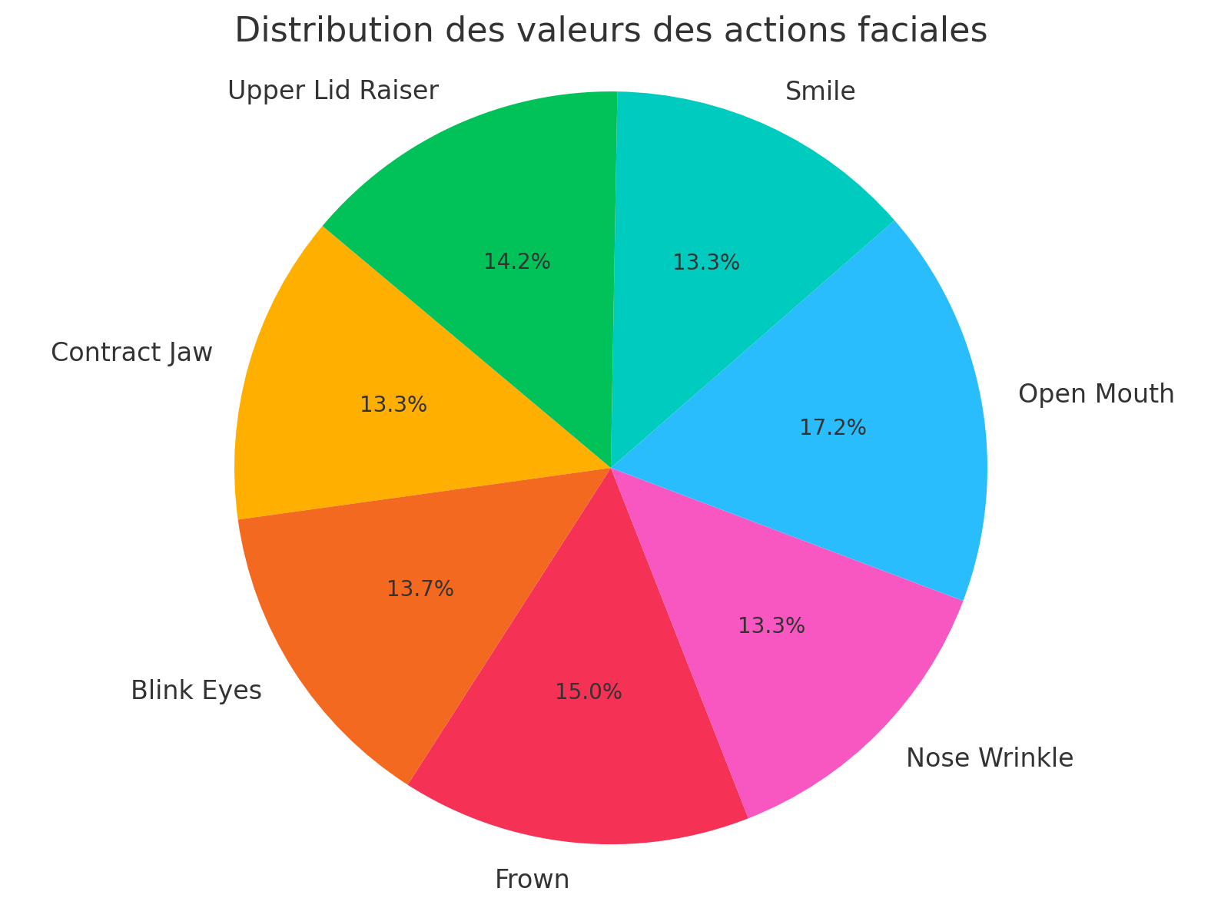
Dataset
-number of videos : 233
-average time per video : 8s
-time : 30min of videos

Slide 3
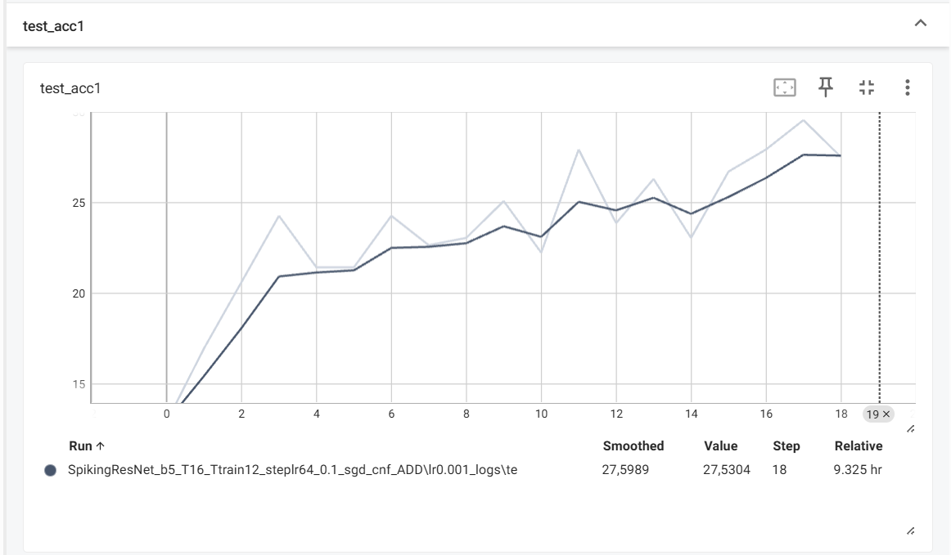
result
Issue : The training takes a lot of times.

Slide 4
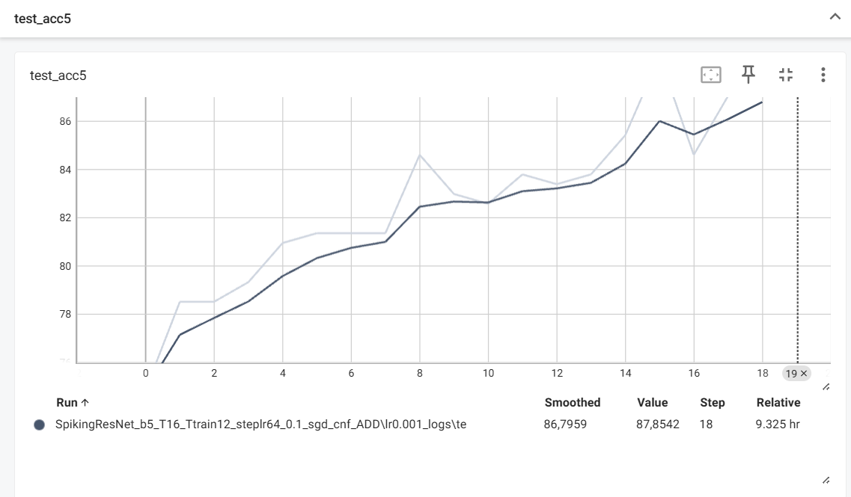
result

Slide 5
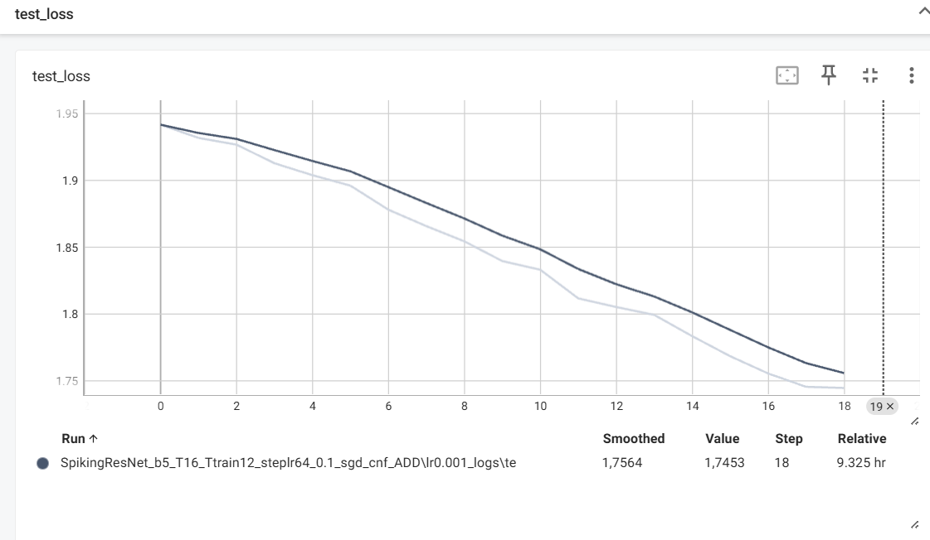
result

