Slide 1

Advancements in Visual Perception: Event Camera, Micro Expressions, and SNN
Victor MAYAUD
Elliot BOUCHY

Slide 2
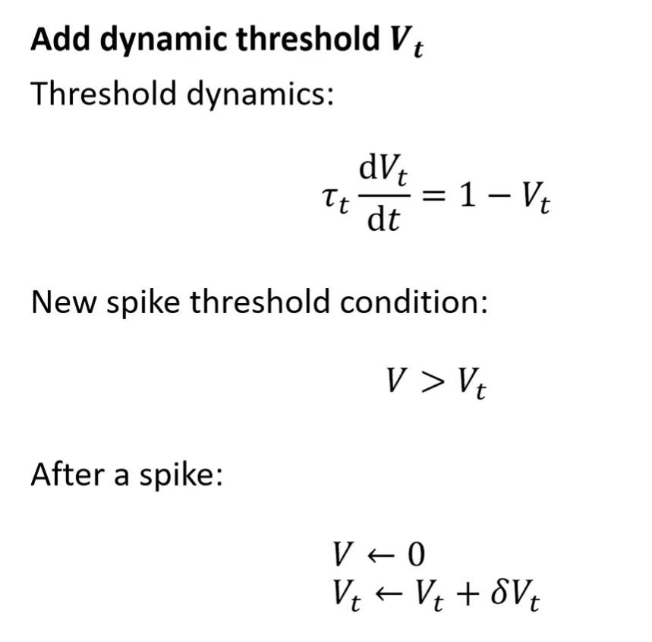
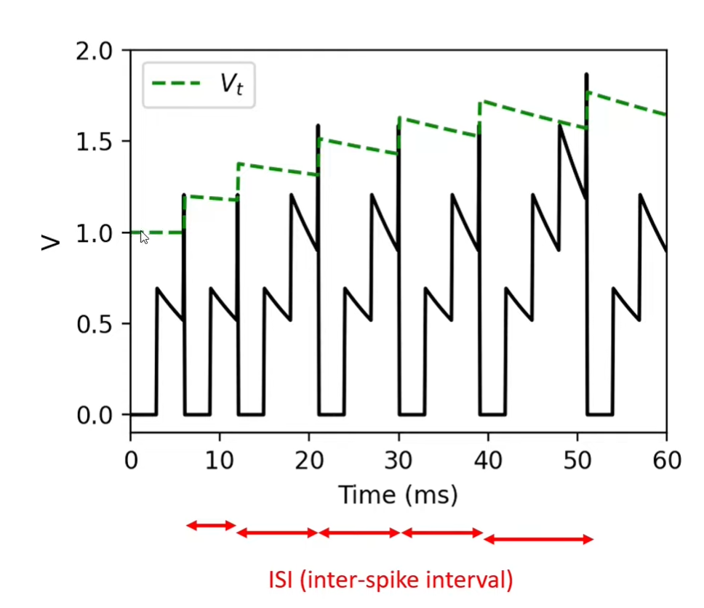
Spiking neural network
2D leaky integrate-and-fire (LIF)

Slide 3
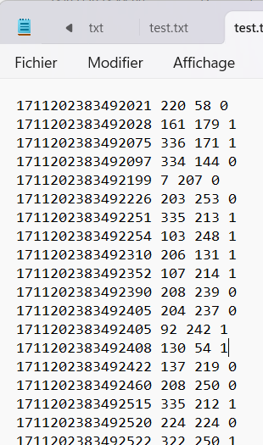
Spiking neural network
Architecture
Sadness
disgust
happiness
surprise
One neuron per pixel
One neuron per emotion
Txt folder about the video taken by the event camera

Slide 4
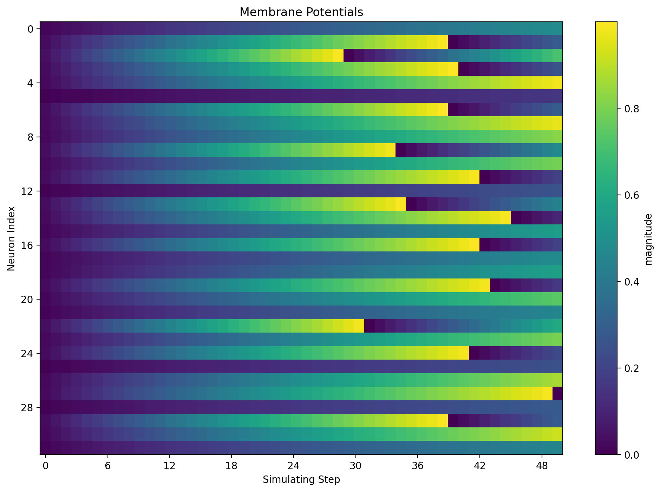
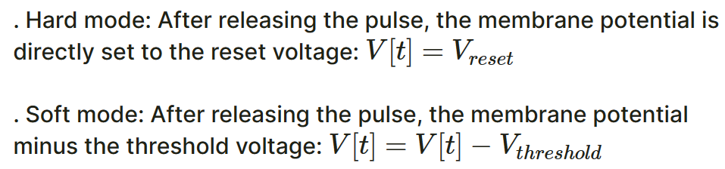
Spiking neural network

Slide 5
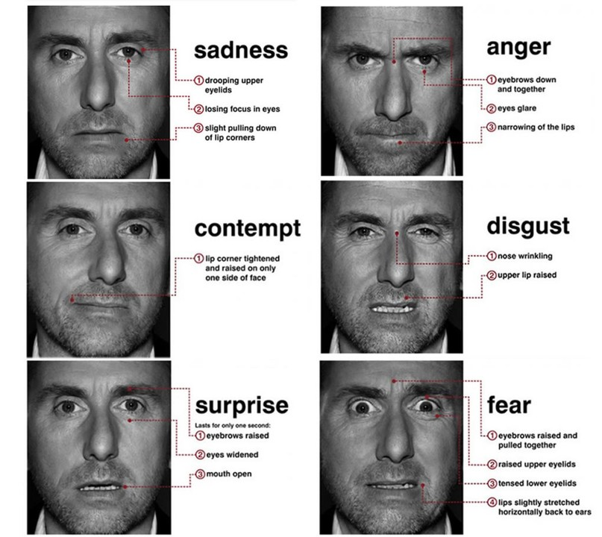
Creation of the dataset
- Problematic : How to record real micro expression ?
- Protocol :
- Find little video which produce several emotions (Disgust, Happiness, Fear, anger, surprise, sadness.)
- Show this video to people and recording them when they are watching the video.
- Classified the videos in categories
- 5 min of videos for each emotions

