Slide 1

Advancements in Visual Perception: Event Camera, Micro Expressions, and SNN
Victor MAYAUD
Elliot BOUCHY

Slide 2
Spiking neural network
Protocol

Slide 3
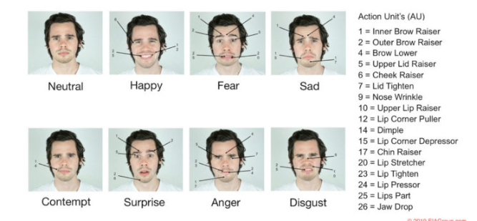
Facial movement
Importante facial movement : frown, raise eyebrows, open mouth, close eyes, contract the lips, separate the lips, open your eyes wide...

Slide 4
Spiking neural network
Dataset
Categories : frown, raise eyebrows, open mouth...
Average 5min (event camera and rgb camera) of videos for each categories.
One video it’s average 10s
30 people

Slide 5
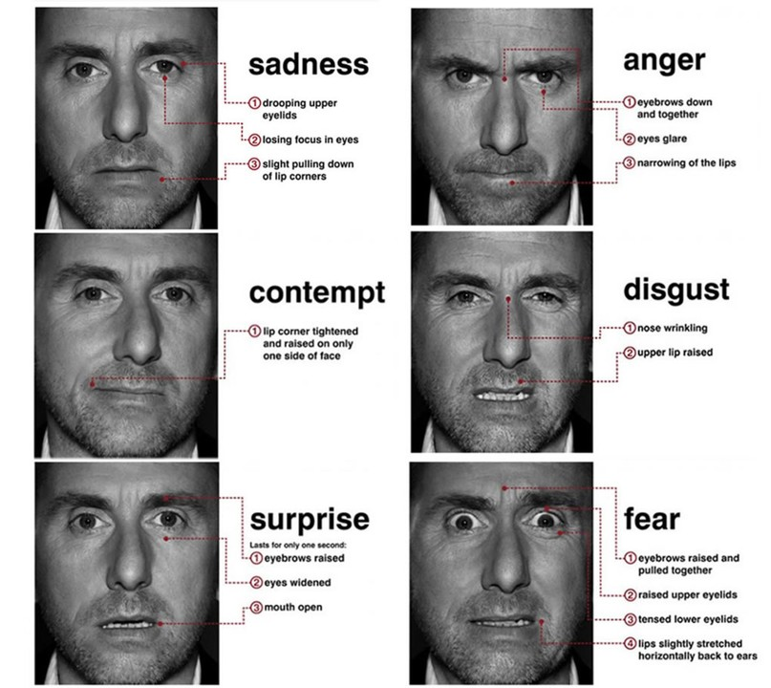
Creation of the dataset
- Problematic : How to record real micro expression ?
- Protocol :
- Find little video which produce several emotions (Disgust, Happiness, Fear, anger, surprise, sadness.)
- Show this video to people and recording them when they are watching the video.
- Classified the videos in categories
- 5 min of videos for each emotions

