Slide 1

Advancements in Visual Perception: Event Camera, Micro Expressions, and SNN
Victor MAYAUD
Elliot BOUCHY

Slide 2
Dataset
dataset progress :
- ~25 persons (someone 2-3 times, with and without glasses, men/women,around 7-8s on 7 facial expressions )
- started to be labelled (~15)

Slide 3
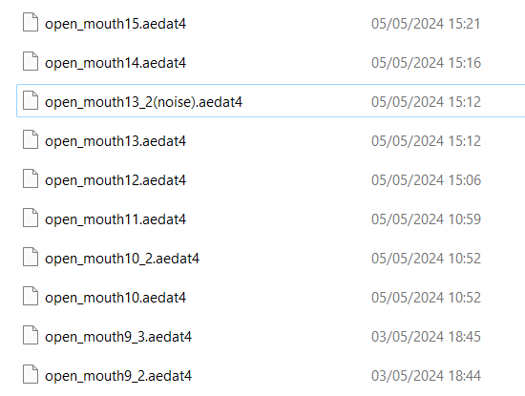
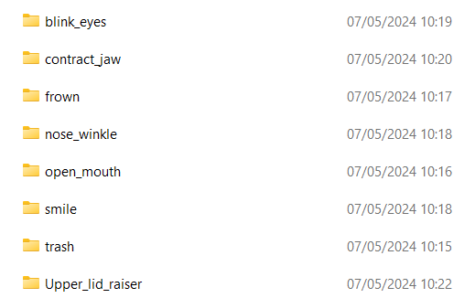
Dataset
- Organisation of the dataset :
repertories
One folder
Format of the name : Facial_movement(id)_number(noise?).aedat4

Slide 4
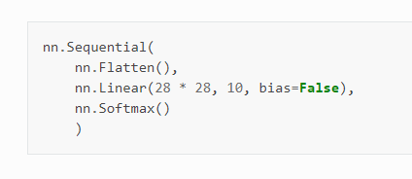
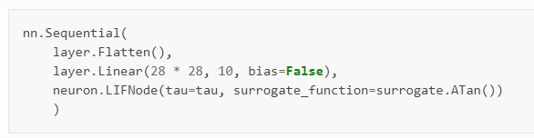
SNN
-We used spikingjelly based on pytorch (https://github.com/fangwei123456/spikingjelly)
-Implementation of the model :
Reference : https://spikingjelly.readthedocs.io/zh-cn/0.0.0.0.14/activation_based_en/lif_fc_mnist.html

Slide 5
Next step
- Complet the dataset. Need more 3-5 peoples
-Try to train our dataset with a snn
- optimize the snn to have the best precision

